Slide 1
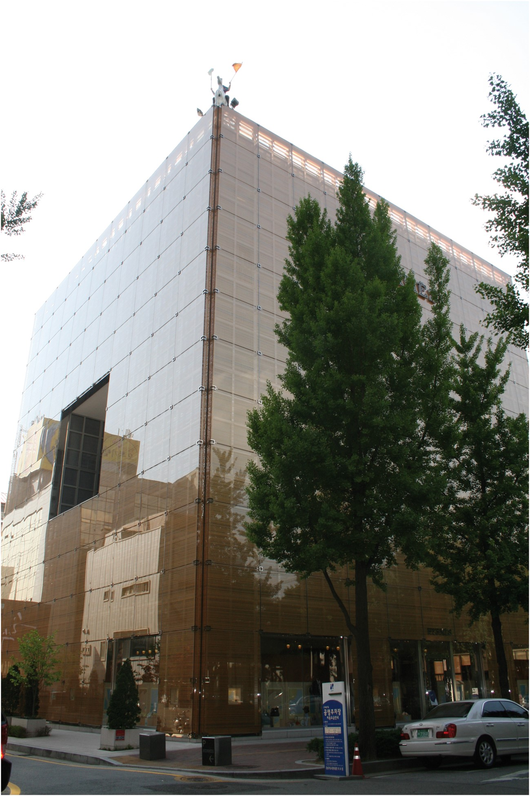
Fig. 1 Façade of Maison Hermès, Dosan Park, Seoul, South Korea. Photo: Chin-tao Wu
Notes:
Fig. 1 Façade of Maison Hermès, Dosan Park, Seoul, South Korea. Photo: Chin-tao Wu
Unless provided in the caption above, the following copyright applies to the content of this slide: © The Author 2016. Published by Oxford University Press; all rights reserved

Slide 2
Fig. 2 Hiroshi Sugimoto, ‘Couleurs de l’ombre’, 2013, Singapore Tyler Print Institute (STPI), wall text with Hermès ...
Notes:
Fig. 2 Hiroshi Sugimoto, ‘Couleurs de l’ombre’, 2013, Singapore Tyler Print Institute (STPI), wall text with Hermès logo. Photo: Chin-tao Wu
Unless provided in the caption above, the following copyright applies to the content of this slide: © The Author 2016. Published by Oxford University Press; all rights reserved

Slide 3
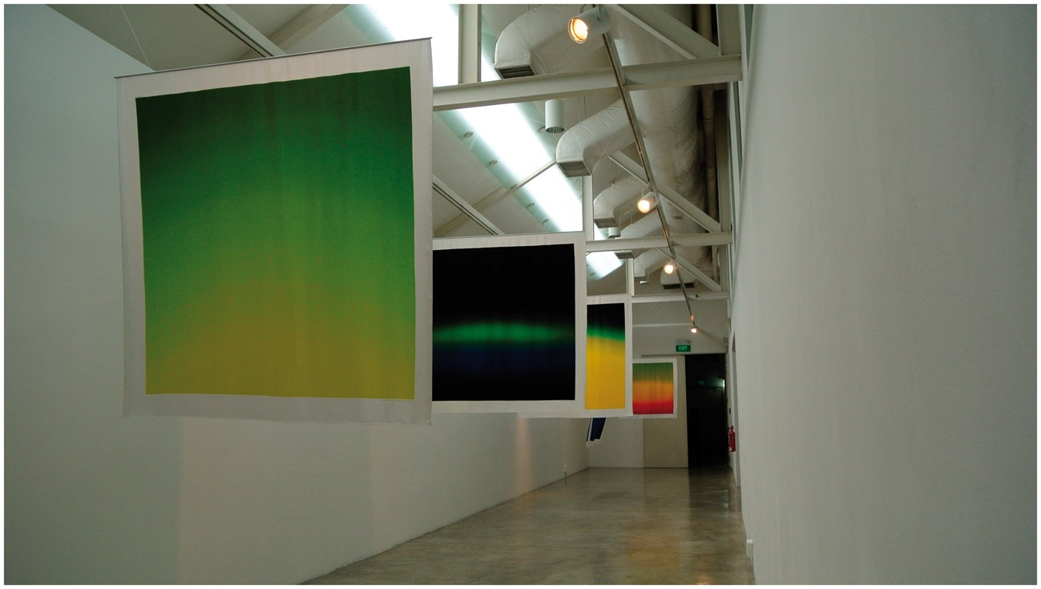
Fig. 3 Hiroshi Sugimoto, ‘Couleurs de l’ombre’, 2013, Singapore Tyler Print Institute (STPI), installation view. ...
Notes:
Fig. 3 Hiroshi Sugimoto, ‘Couleurs de l’ombre’, 2013, Singapore Tyler Print Institute (STPI), installation view. Photo: Chin-tao Wu
Unless provided in the caption above, the following copyright applies to the content of this slide: © The Author 2016. Published by Oxford University Press; all rights reserved

Slide 4
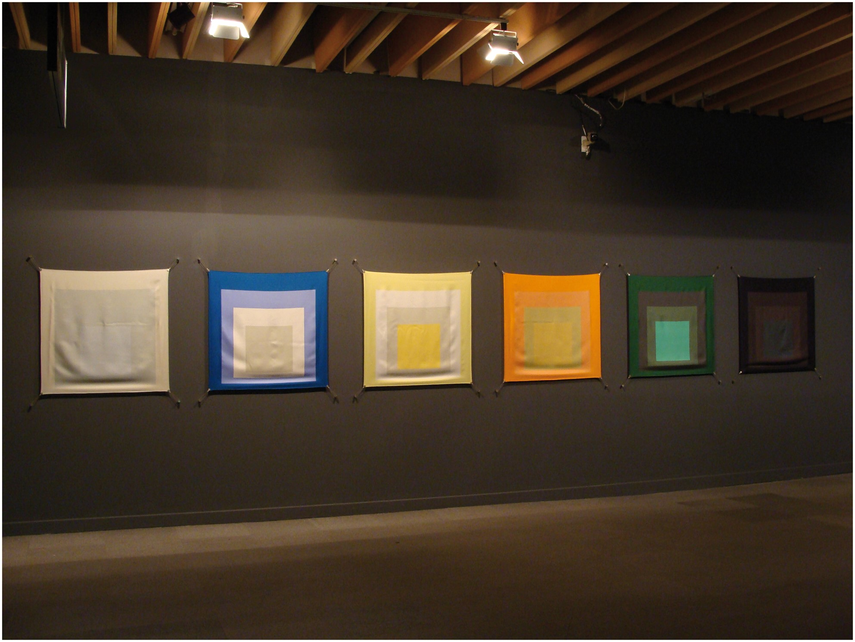
Fig. 4 Hermès gloves presented by the City of Paris to Princess Elizabeth and Princess Margaret in 1938. Promenade ...
Notes:
Fig. 4 Hermès gloves presented by the City of Paris to Princess Elizabeth and Princess Margaret in 1938. Promenade Museum, Maison Hermès, Seoul, South Korea. Photo: Chin-tao Wu
Unless provided in the caption above, the following copyright applies to the content of this slide: © The Author 2016. Published by Oxford University Press; all rights reserved

