Slide 1
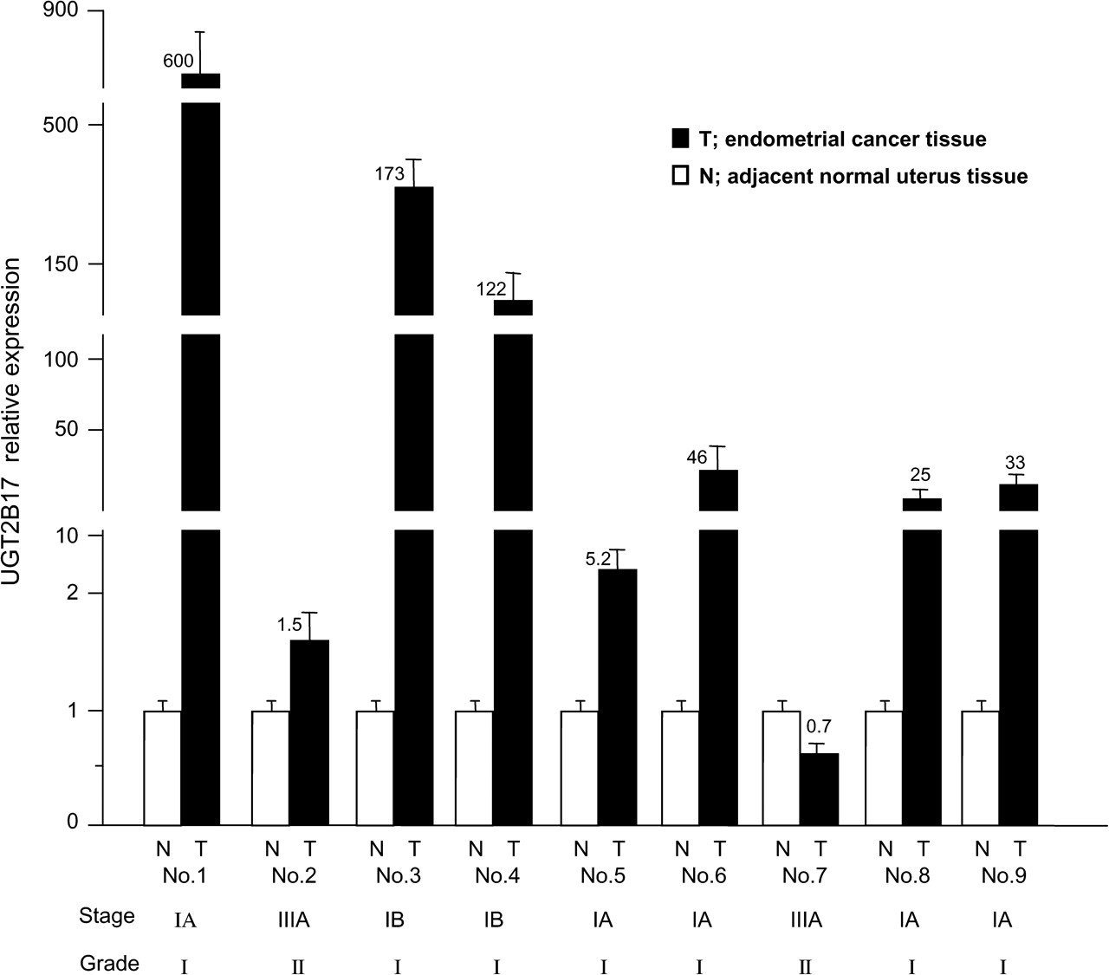
Fig. 1. Expression of UGT2B17 mRNA in EC and adjacent normal uterus tissues. Expression levels of UGT2B17 mRNA in EC ...
Notes:
Fig. 1. Expression of UGT2B17 mRNA in EC and adjacent normal uterus tissues. Expression levels of UGT2B17 mRNA in EC tissues and adjacent normal endometrial tissues (nine paired samples).
Unless provided in the caption above, the following copyright applies to the content of this slide: © The Author 2010. Published by Oxford University Press. All rights reserved. For Permissions, please email: journals.permissions@oxfordjournals.org

Slide 2
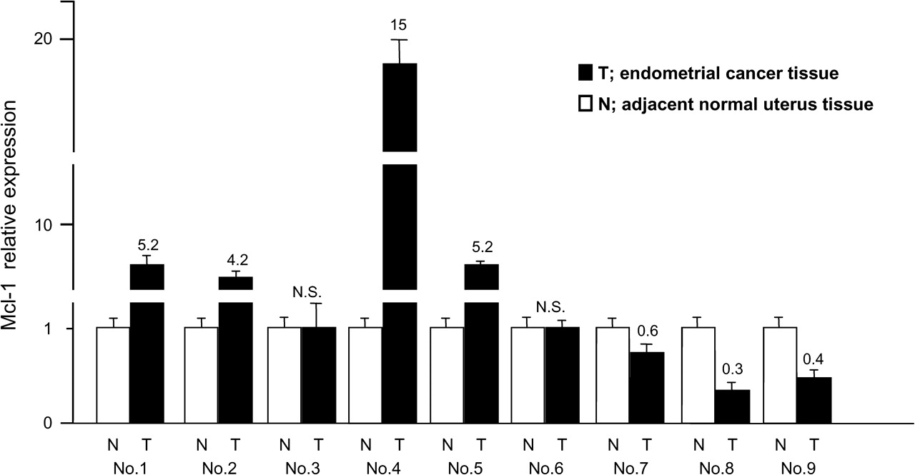
Fig. 2. The mRNA expression level of Mcl-1 in EC and matched adjacent normal uterus tissues. Expression levels of ...
Notes:
Fig. 2. The mRNA expression level of Mcl-1 in EC and matched adjacent normal uterus tissues. Expression levels of Mcl-1 mRNA in EC tissues and adjacent normal endometrial tissues (nine paired samples).
Unless provided in the caption above, the following copyright applies to the content of this slide: © The Author 2010. Published by Oxford University Press. All rights reserved. For Permissions, please email: journals.permissions@oxfordjournals.org

Slide 3
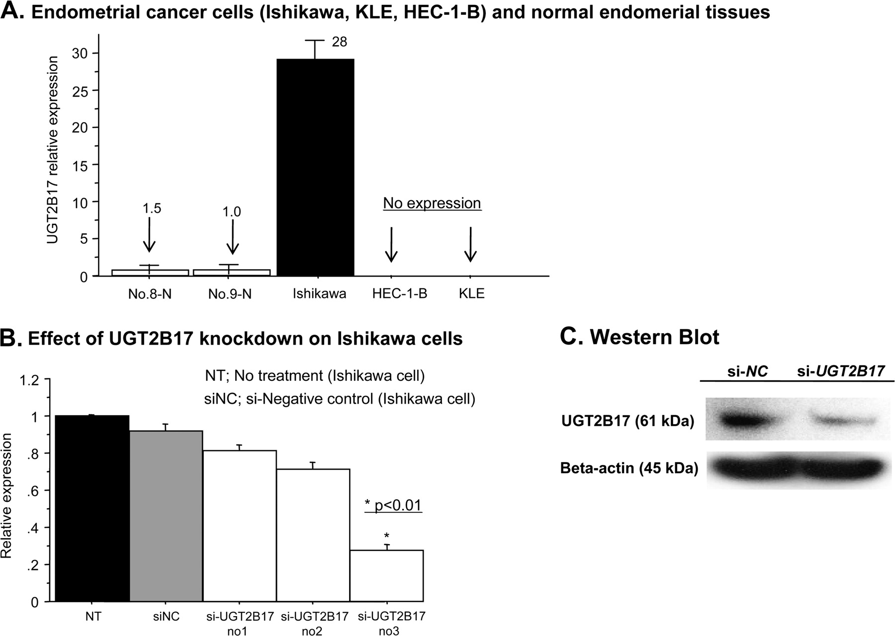
Fig. 3. Expression of UGT2B17 mRNA in EC cells ( A ) and the effect of si- UGT2B17 on Ishikawa cells ( B and C ). ...
Notes:
Fig. 3. Expression of UGT2B17 mRNA in EC cells ( A ) and the effect of si- UGT2B17 on Ishikawa cells ( B and C ). (A) UGT2B17 mRNA expression in three EC cell lines. (B) Effect of si- UGT2B17 (no. 3) on the expression of UGT2B17 mRNA (B) and protein (C) in Ishikawa cells.
Unless provided in the caption above, the following copyright applies to the content of this slide: © The Author 2010. Published by Oxford University Press. All rights reserved. For Permissions, please email: journals.permissions@oxfordjournals.org

Slide 4
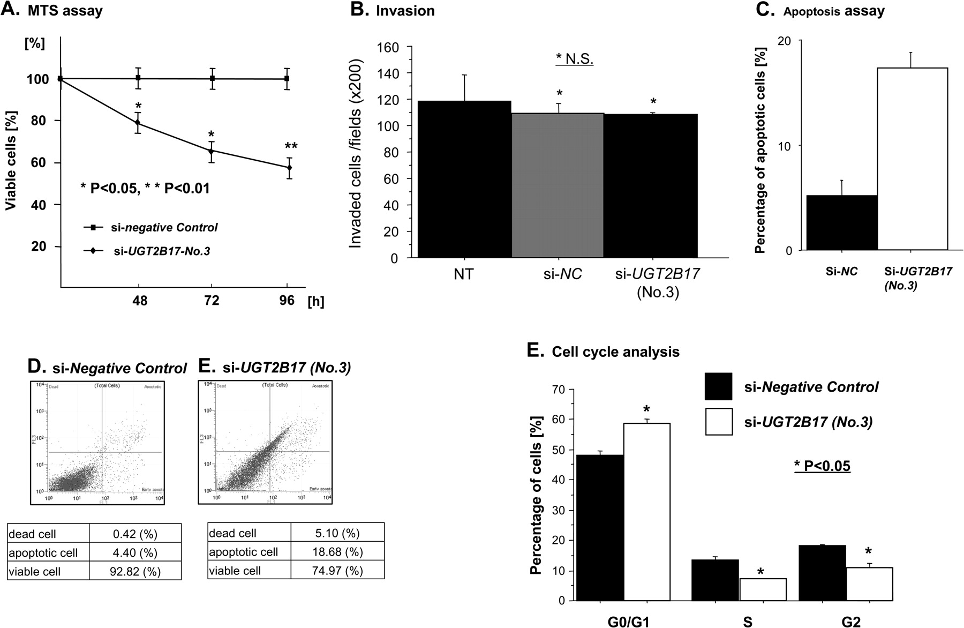
Fig. 4. Effect of si- UGT2B17 on Ishikawa cell growth ( A ), invasion ( B ), apoptosis ( C and D ) and cell cycle ( ...
Notes:
Fig. 4. Effect of si- UGT2B17 on Ishikawa cell growth ( A ), invasion ( B ), apoptosis ( C and D ) and cell cycle ( E ). (A) MTS assay, (B) invasion assay, (C and D) apoptosis assay, Annexin V-FITC and 7-aminoactinomycin D were measured by flow cytometry. Representative results are shown in Figure 3D . Data are the mean ± SD of four independent experiments. (E) Cell cycle analysis. Enumeration of the various phases of the cells was determined using a DNA stain such as 4′,6-diamidino-2-phenylindole. G 0 /G 1 , S and G 2 /M populations were measured using fluorescence and contrasted against cell volume. Data are the mean ± SD of four independent experiments.
Unless provided in the caption above, the following copyright applies to the content of this slide: © The Author 2010. Published by Oxford University Press. All rights reserved. For Permissions, please email: journals.permissions@oxfordjournals.org

Slide 5
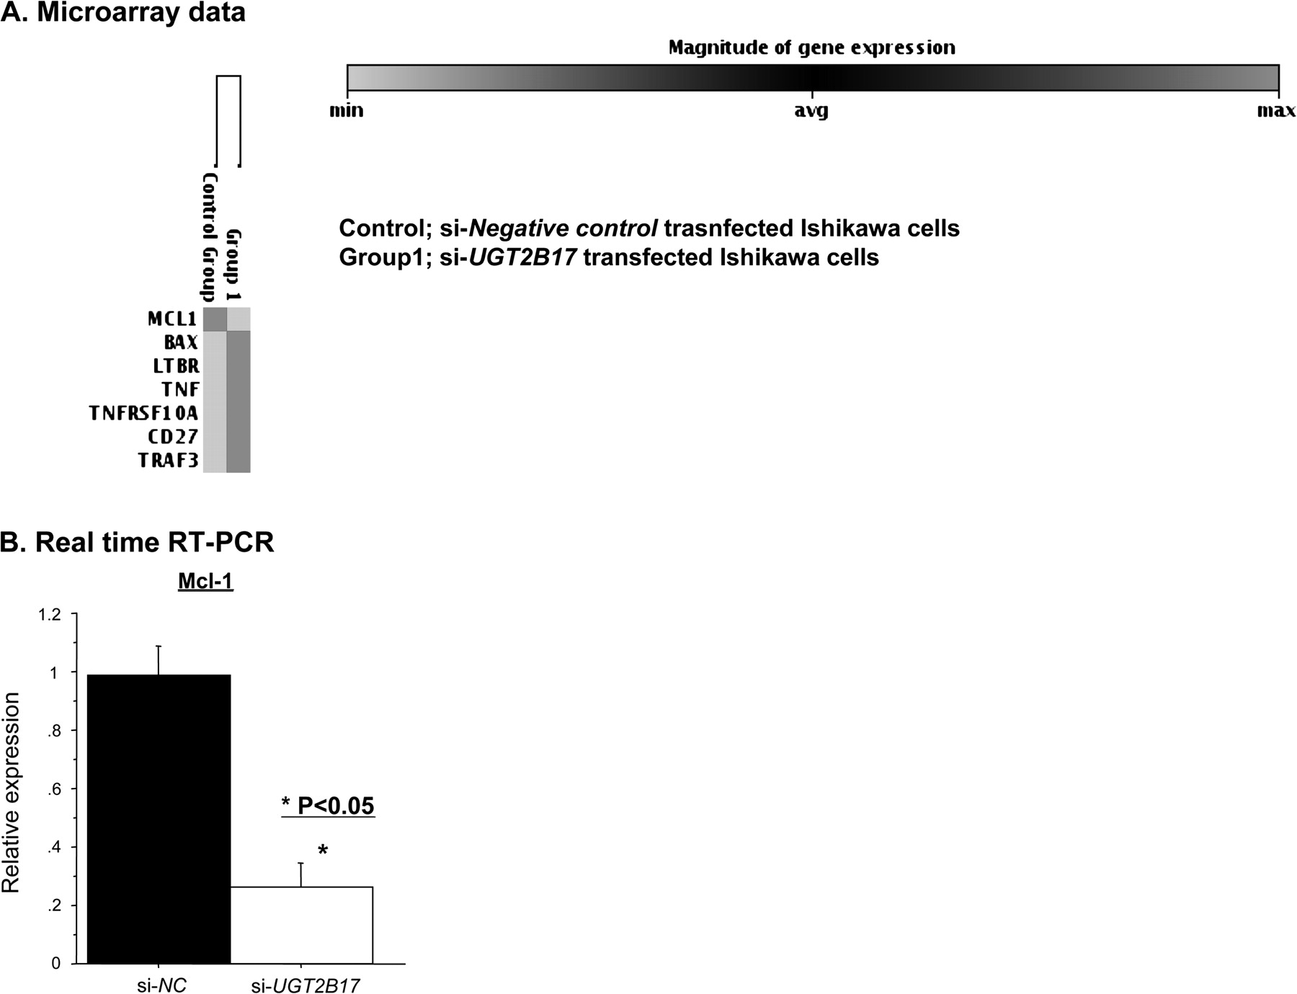
Fig. 5. Human apoptosis microarray clustergram using si- NC -transfected or si- UGT2B17 -transfected Ishikawa cells ...
Notes:
Fig. 5. Human apoptosis microarray clustergram using si- NC -transfected or si- UGT2B17 -transfected Ishikawa cells (threshold 2.5) ( A ) and validation with real-time RT–PCR ( B ). (A) Microarray data are shown. The expression of six genes were altered in si- UGT2B17 -transfected Ishikawa cells compared with si-negative control. (B) Real-time RT–PCR data are shown. Among the six genes, the real-time RT–PCR results were consistent with the microarray data for Mcl-1 only.
Unless provided in the caption above, the following copyright applies to the content of this slide: © The Author 2010. Published by Oxford University Press. All rights reserved. For Permissions, please email: journals.permissions@oxfordjournals.org

Slide 6
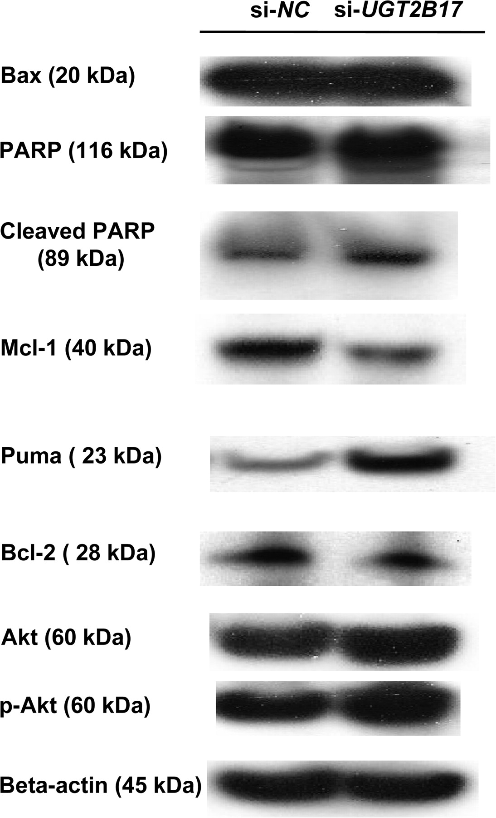
Fig. 6. Protein expression in si- NC -transfected or si- UGT2B17 -transfected Ishikawa cells. The protein expression ...
Notes:
Fig. 6. Protein expression in si- NC -transfected or si- UGT2B17 -transfected Ishikawa cells. The protein expression of Mcl-1 was significantly decreased in si- UGT2B17 -transfected Ishikawa cells, whereas Puma protein expression was increased.
Unless provided in the caption above, the following copyright applies to the content of this slide: © The Author 2010. Published by Oxford University Press. All rights reserved. For Permissions, please email: journals.permissions@oxfordjournals.org

