Slide 1
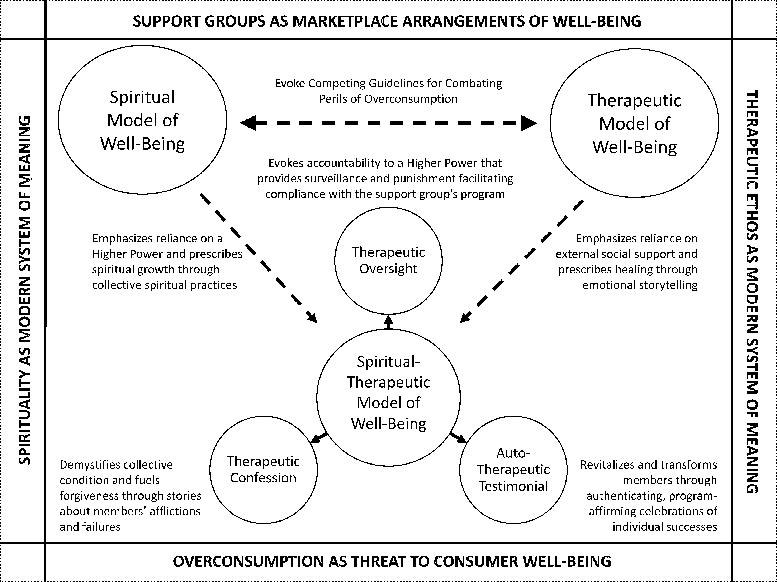
Figure 1 Spiritual-Therapeutic Model of Consumer Well-Being in Support Groups
Notes:
Figure 1 Spiritual-Therapeutic Model of Consumer Well-Being in Support Groups
Unless provided in the caption above, the following copyright applies to the content of this slide: © 2009 by JOURNAL OF CONSUMER RESEARCH, Inc.

