Slide 1
Fig. 1. Half a century of progress in rotation curve (RC) determination of the Milky Way. Top to bottom: 1950s (Kwee ...
Notes:
Fig. 1. Half a century of progress in rotation curve (RC) determination of the Milky Way. Top to bottom: 1950s (Kwee et al. 1954); 1970s—CO and H i (Burton & Gordon 1978; Blitz & Lada 1979); 1980s—composite of CO, H i, and optical (Clemens 1985); 2000s—most accurate trigonometric RC by maser sources with VERA (Honma et al. 2015); and a semi-logarithmic grand RC from the Galactic Center to half-way to M 31 (Sofue 2015).
Unless provided in the caption above, the following copyright applies to the content of this slide: © The Author 2016. Published by Oxford University Press on behalf of the Astronomical Society of Japan. All rights reserved. For Permissions, please email: journals.permissions@oup.com

Slide 2
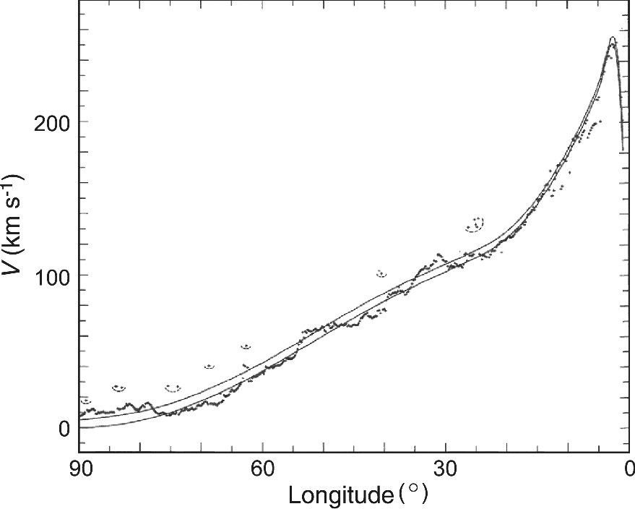
Fig. 2. CO and H i line tangent velocities for the inner rotation curve (Burton & Gordon 1978).
Notes:
Fig. 2. CO and H i line tangent velocities for the inner rotation curve (Burton & Gordon 1978).
Unless provided in the caption above, the following copyright applies to the content of this slide: © The Author 2016. Published by Oxford University Press on behalf of the Astronomical Society of Japan. All rights reserved. For Permissions, please email: journals.permissions@oup.com

Slide 3
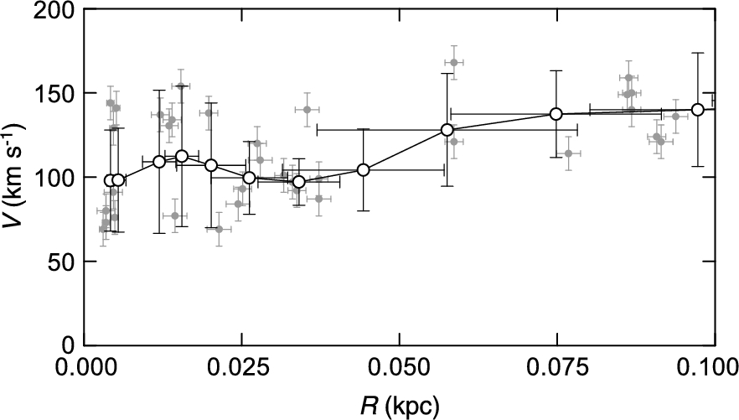
Fig. 3. Rotation velocities in the Galactic Center obtained by terminal-velocity method using position–velocity ...
Notes:
Fig. 3. Rotation velocities in the Galactic Center obtained by terminal-velocity method using position–velocity diagrams (gray dots, measured values; circles, running averaged values) (Sofue 2013b).
Unless provided in the caption above, the following copyright applies to the content of this slide: © The Author 2016. Published by Oxford University Press on behalf of the Astronomical Society of Japan. All rights reserved. For Permissions, please email: journals.permissions@oup.com

Slide 4
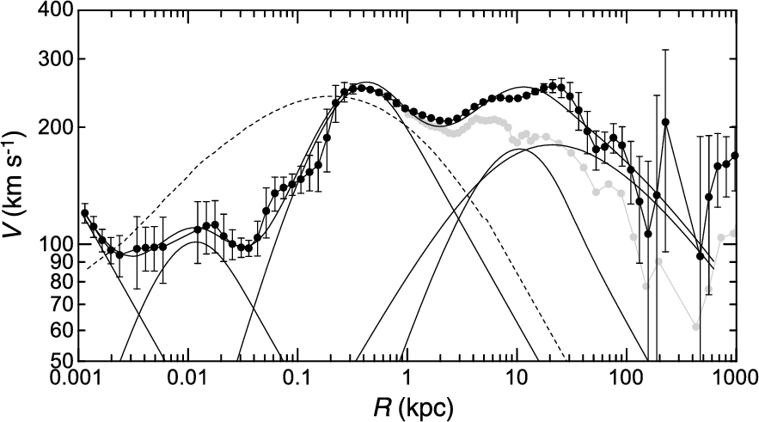
Fig. 4. Logarithmic rotation curve of the Galaxy for V₀ = 238 km s⁻¹ and deconvolution into a ...
Notes:
Fig. 4. Logarithmic rotation curve of the Galaxy for V0 = 238 km s−1 and deconvolution into a central black hole, two exponential-spherical bulges, an exponential flat disk, and a NFW (Navaro–Frenk–White) dark halo by the least-χ2 fitting shown by thin lines. A classical de Vaucouleurs bulge shown by the dashed line is significantly displaced from the observation.
Unless provided in the caption above, the following copyright applies to the content of this slide: © The Author 2016. Published by Oxford University Press on behalf of the Astronomical Society of Japan. All rights reserved. For Permissions, please email: journals.permissions@oup.com

Slide 5
Fig. 5. (a) Accuracy diagrams $\Delta V_{\rm rot}^{v_{\rm r}}(X,Y)$ for δv_{r} = 1 km s⁻¹ and δr/r ...
Notes:
Fig. 5. (a) Accuracy diagrams $\Delta V_{\rm rot}^{v_{\rm r}}(X,Y)$ for δvr = 1 km s−1 and δr/r = 0.02 (2% distance error), (b) $\Delta V_{\rm rot}^\mu (X,Y)$ for δμ = 0.2 mas yr−1, and (c) $\Delta V_{\rm rot}^{\rm vec}(X,Y)$ for δvp/r = 1 km s−1 kpc−1 corresponding to δμ = 0.21 mas yr−1, δvr = 1 km s−1, and δr/r = 0.02 (Sofue 2011).
Unless provided in the caption above, the following copyright applies to the content of this slide: © The Author 2016. Published by Oxford University Press on behalf of the Astronomical Society of Japan. All rights reserved. For Permissions, please email: journals.permissions@oup.com

Slide 6
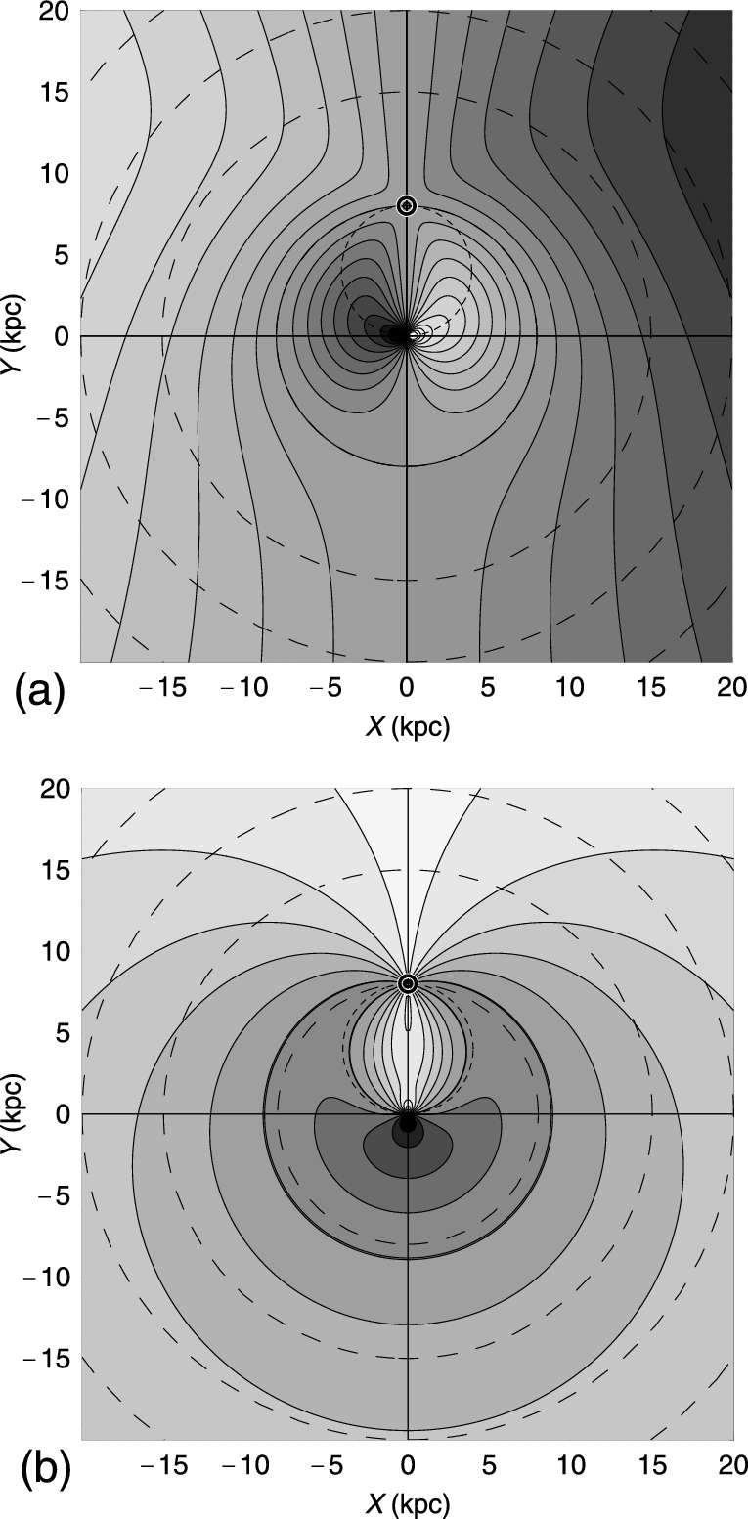
Fig. 6. (a) Radial-velocity field v_{r}(X, Y) with contour increment 20 km s⁻¹, and (b) ...
Notes:
Fig. 6. (a) Radial-velocity field vr(X, Y) with contour increment 20 km s−1, and (b) proper-motion field μ(X, Y) with contour increment 1 mas yr−1. The circle near the solar orbit is for 5 mas yr−1.
Unless provided in the caption above, the following copyright applies to the content of this slide: © The Author 2016. Published by Oxford University Press on behalf of the Astronomical Society of Japan. All rights reserved. For Permissions, please email: journals.permissions@oup.com

Slide 7
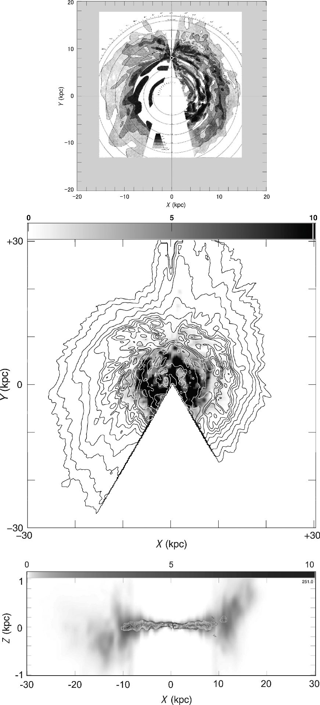
Fig. 7. (Top) 2D H i map of the Galaxy, showing the distribution of volume density of the H i gas in the galactic ...
Notes:
Fig. 7. (Top) 2D H i map of the Galaxy, showing the distribution of volume density of the H i gas in the galactic plane on the assumption of circular rotation of the disk (Oort et al. 1958). (Middle) Surface densities of H i (contours) and H2 (gray-scale) gases obtained by integrating the 3D maps in the Z-direction (Nakanishi & Sofue 2016). (Bottom) H i and H2 cross-section map of the Galaxy in the (X, Z) plane across the Galactic Center. Shown here are the volume densities H i (extended thick disk in gray-scale) and H2 (thin disk by contours) (Sofue & Nakanishi 2016). Note that the Z-axis is enlarged by 4 times.
Unless provided in the caption above, the following copyright applies to the content of this slide: © The Author 2016. Published by Oxford University Press on behalf of the Astronomical Society of Japan. All rights reserved. For Permissions, please email: journals.permissions@oup.com

Slide 8
Fig. 8. Half a century of progress in the rotation curve of M 31. From top to bottom: 1950s—a rotation curve using ...
Notes:
Fig. 8. Half a century of progress in the rotation curve of M 31. From top to bottom: 1950s—a rotation curve using data obtained by M.U. Mayall et al. in the 1940s (Takase 1957); 1960s—rotation curve in the H i 21 cm line (Roberts 1966); a modern position–velocity diagram and a rotation curve in H i, showing flat rotation up to 40 kpc (Chemin et al. 2009); and a grand rotation curve from the center to ∼300 kpc in semi-logarithmic scaling (Sofue 2013b). (Color online)
Unless provided in the caption above, the following copyright applies to the content of this slide: © The Author 2016. Published by Oxford University Press on behalf of the Astronomical Society of Japan. All rights reserved. For Permissions, please email: journals.permissions@oup.com

Slide 9
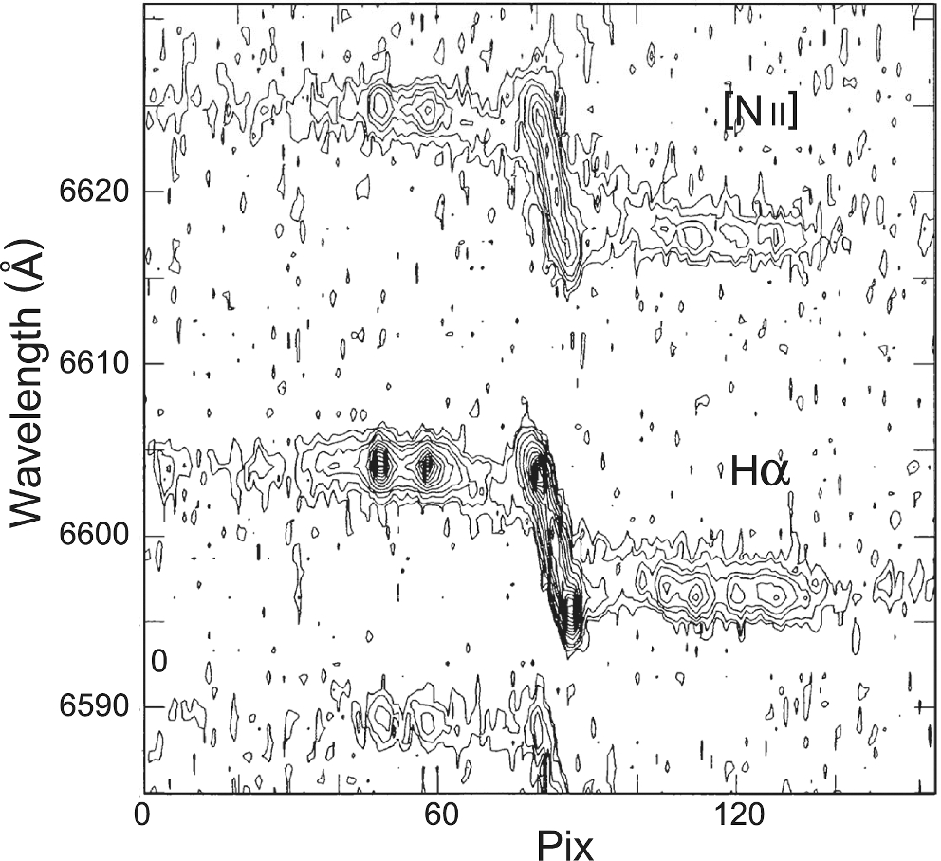
Fig. 9. Slit spectrum of the Hα 6563 Å and [N ii] 6584 Å lines along the major axis of Sb galaxy NGC 4527 (Sofue ...
Notes:
Fig. 9. Slit spectrum of the Hα 6563 Å and [N ii] 6584 Å lines along the major axis of Sb galaxy NGC 4527 (Sofue et al. 1999).
Unless provided in the caption above, the following copyright applies to the content of this slide: © The Author 2016. Published by Oxford University Press on behalf of the Astronomical Society of Japan. All rights reserved. For Permissions, please email: journals.permissions@oup.com

Slide 10
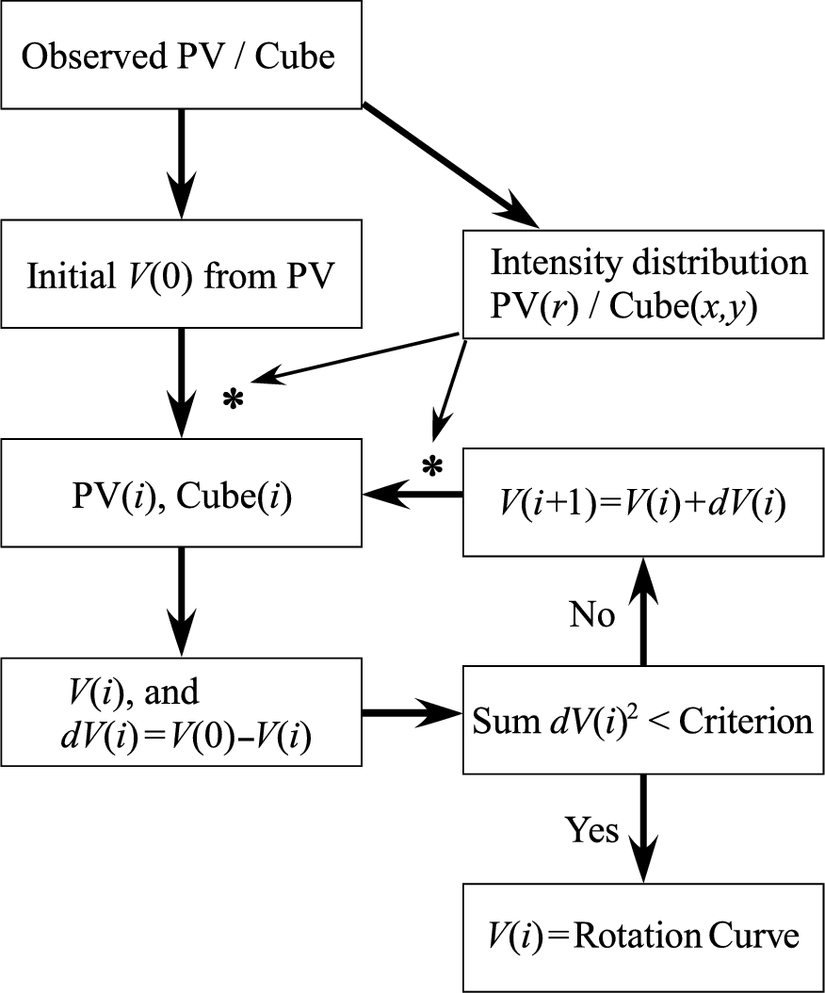
Fig. 10. Iteration method of rotation curve fitting using PV diagrams and/or 3D cube.
Notes:
Fig. 10. Iteration method of rotation curve fitting using PV diagrams and/or 3D cube.
Unless provided in the caption above, the following copyright applies to the content of this slide: © The Author 2016. Published by Oxford University Press on behalf of the Astronomical Society of Japan. All rights reserved. For Permissions, please email: journals.permissions@oup.com

Slide 11
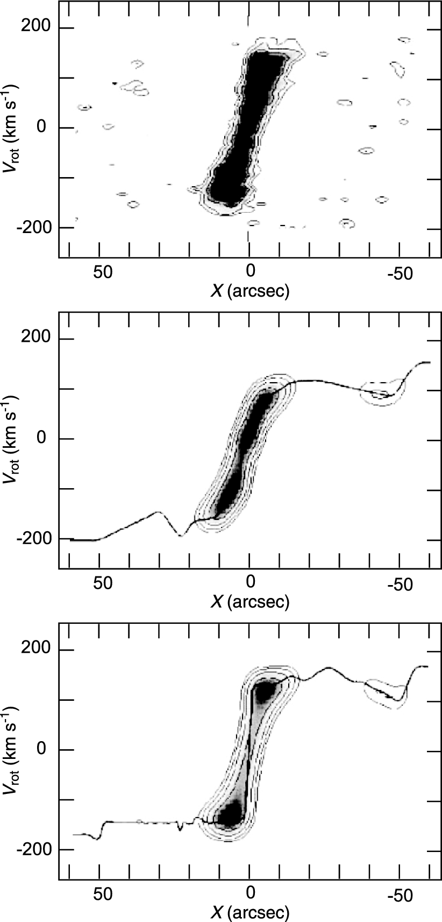
Fig. 11. Iteration method: PV diagram of NGC 4536 in the CO line (top); an approximate rotation curve using the ...
Notes:
Fig. 11. Iteration method: PV diagram of NGC 4536 in the CO line (top); an approximate rotation curve using the peak-intensity method and corresponding PV diagram (middle); the final rotation curve and reproduced PV diagram (bottom).
Unless provided in the caption above, the following copyright applies to the content of this slide: © The Author 2016. Published by Oxford University Press on behalf of the Astronomical Society of Japan. All rights reserved. For Permissions, please email: journals.permissions@oup.com

Slide 12
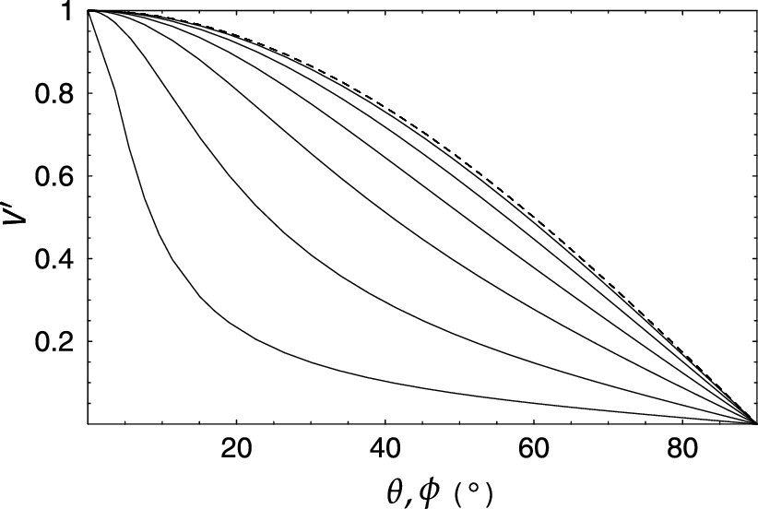
Fig. 13. Variation of V΄ = v_{r}/v_{r, max} along a tilted-ring as a function of position angle ϕ ...
Notes:
Fig. 13. Variation of V΄ = vr/vr, max along a tilted-ring as a function of position angle ϕ (solid line) for different inclinations (from bottom, lines are i = 85°, 75°, 60°, 45°, 30°, and 15°). Variation against azimuthal angle θ is shown by the dashed line.
Unless provided in the caption above, the following copyright applies to the content of this slide: © The Author 2016. Published by Oxford University Press on behalf of the Astronomical Society of Japan. All rights reserved. For Permissions, please email: journals.permissions@oup.com

Slide 13
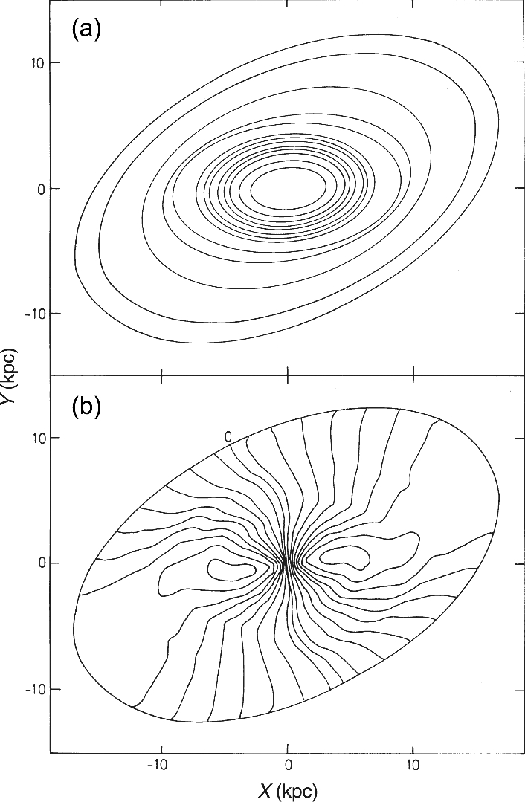
Fig. 12. Tilted rings and velocity field fitted to H i velocity fields of NGC 5055 (Bosma 1981b).
Notes:
Fig. 12. Tilted rings and velocity field fitted to H i velocity fields of NGC 5055 (Bosma 1981b).
Unless provided in the caption above, the following copyright applies to the content of this slide: © The Author 2016. Published by Oxford University Press on behalf of the Astronomical Society of Japan. All rights reserved. For Permissions, please email: journals.permissions@oup.com

Slide 14
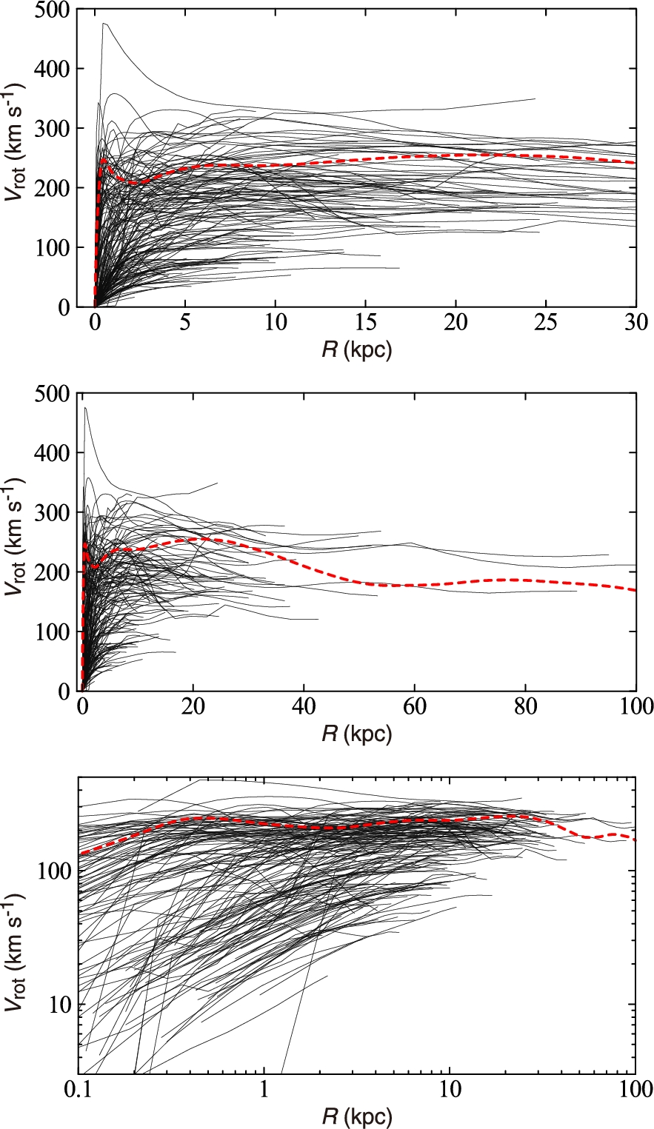
Fig. 14. Rotation curve compilation (Sofue 2016), which includes those from Whitmore, McElroy, and Schweizer (1987), ...
Notes:
Fig. 14. Rotation curve compilation (Sofue 2016), which includes those from Whitmore, McElroy, and Schweizer (1987), Olling (1996), Sofue (1996), Ryder et al. (1998), Sofue et al. (1999, 2003), Márquez et al. (2004), Garrido et al. (2005), Gentile et al. (2007, 2015), Noordermeer et al. (2007), de Blok et al. (2008), Scarano et al. (2008), Swaters et al. (2009), Bershady et al. (2010a, 2010b), Hlavacek-Larrondo et al. (2011a, 2011b), Erroz-Ferrer et al. (2012), Martinsson et al. (2013a), and Richards et al. (2015). (Color online)
Unless provided in the caption above, the following copyright applies to the content of this slide: © The Author 2016. Published by Oxford University Press on behalf of the Astronomical Society of Japan. All rights reserved. For Permissions, please email: journals.permissions@oup.com

Slide 15
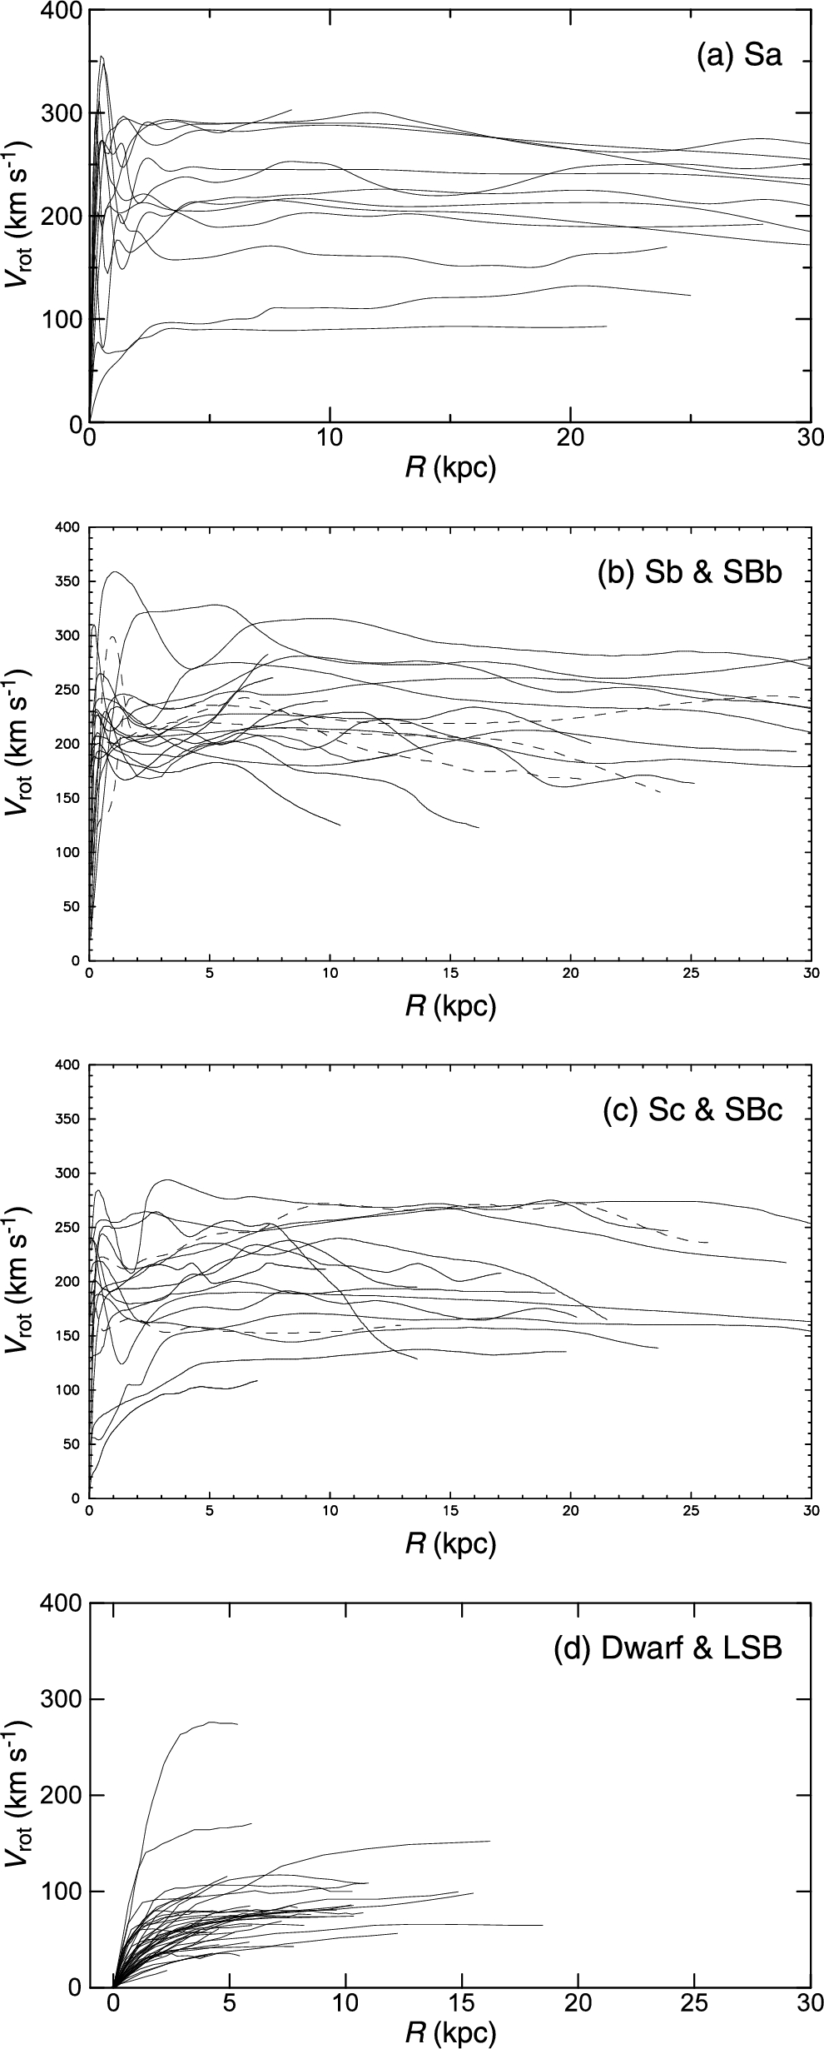
Fig. 15. Rotation curves for Sa-type galaxies (top: Noordermeer et al. 2007), Sb (solid lines) and barred SBb (dashed ...
Notes:
Fig. 15. Rotation curves for Sa-type galaxies (top: Noordermeer et al. 2007), Sb (solid lines) and barred SBb (dashed lines) (second panel), Sc (solid lines) and SBc (dashed lines) (third panel: Sofue et al. 1999), and dwarf and low surface brightness galaxies (bottom: Swaters et al. 2009).
Unless provided in the caption above, the following copyright applies to the content of this slide: © The Author 2016. Published by Oxford University Press on behalf of the Astronomical Society of Japan. All rights reserved. For Permissions, please email: journals.permissions@oup.com

Slide 16
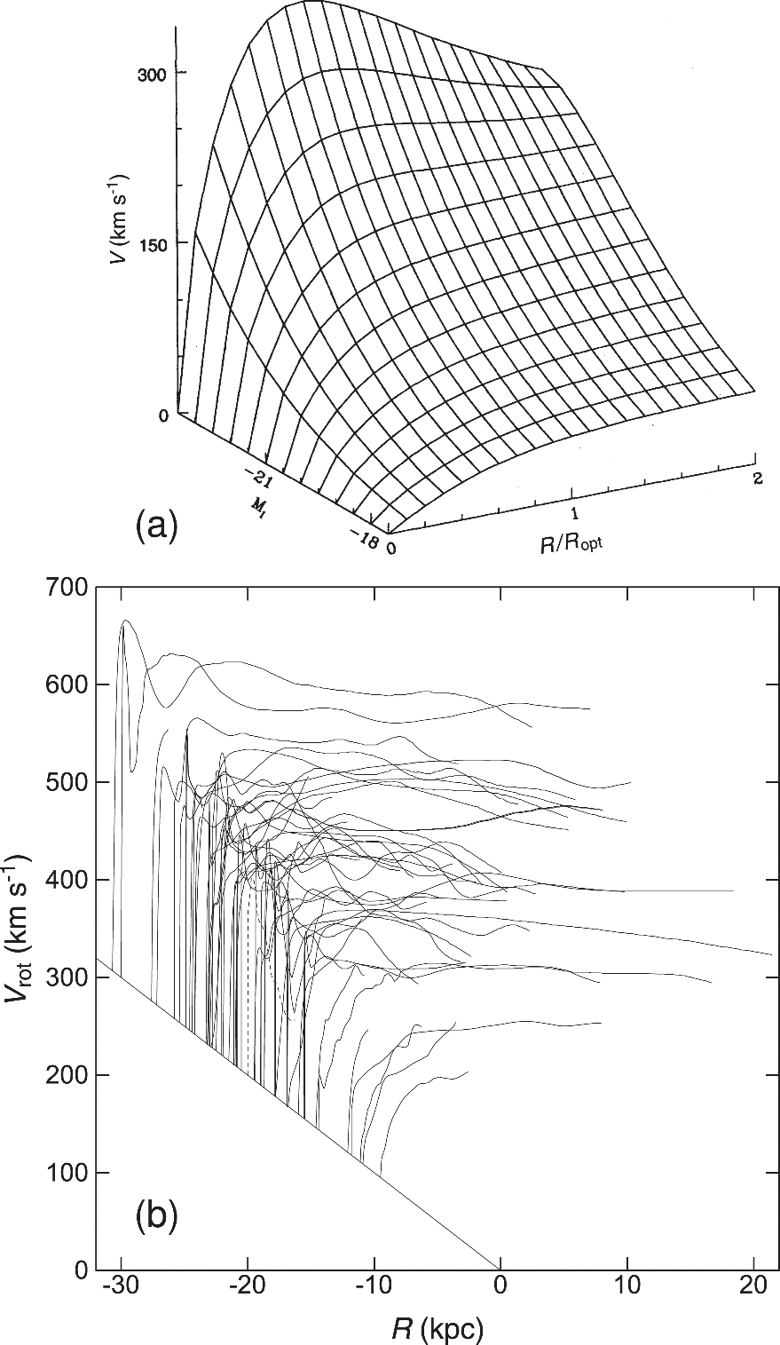
Fig. 16. (a) Universal rotation curves obtained from 967 spiral galaxies (Persic & Salucci 1995). (b) Observed ...
Notes:
Fig. 16. (a) Universal rotation curves obtained from 967 spiral galaxies (Persic & Salucci 1995). (b) Observed rotation curves from figure 14 with the origins shifted according to the disk rotation velocities (averages from R = 1 to 10 kpc), approximately in the order of type, Sa (top-left), Sb, and Sc (bottom-right).
Unless provided in the caption above, the following copyright applies to the content of this slide: © The Author 2016. Published by Oxford University Press on behalf of the Astronomical Society of Japan. All rights reserved. For Permissions, please email: journals.permissions@oup.com

Slide 17
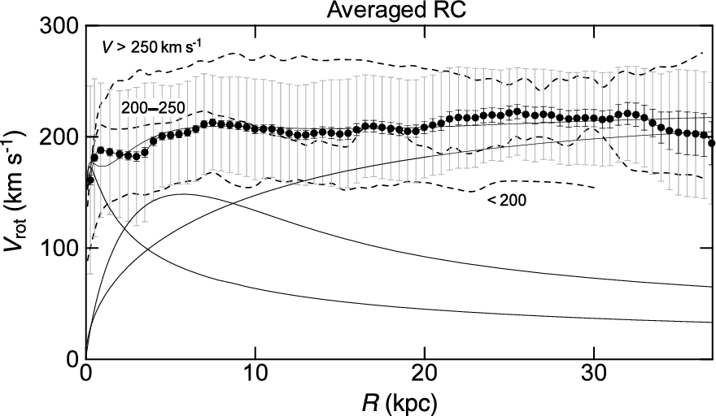
Fig. 17. Black circles show Gaussian-averaged rotation curve from all galaxies listed in Sofue et al. (1999). Long and ...
Notes:
Fig. 17. Black circles show Gaussian-averaged rotation curve from all galaxies listed in Sofue et al. (1999). Long and short bars are standard deviations and standard errors, respectively. Thin lines show the least-χ2 fitting with the de Vaucouleurs bulge (scale radius 0.57 kpc, mass 9.4 × 109 M⊙), exponential disk (2.7 kpc, 3.5 × 1010 M⊙), and NFW dark halo (35 kpc, ρ0 = 3 × 10−3 M⊙ pc−3). The three dashed lines are the averaged rotation curves of galaxies with maximum velocities of, from top to bottom, greater than 250 km s−1, between 200 and 250 km s−1, and below 200 km s−1, respectively.
Unless provided in the caption above, the following copyright applies to the content of this slide: © The Author 2016. Published by Oxford University Press on behalf of the Astronomical Society of Japan. All rights reserved. For Permissions, please email: journals.permissions@oup.com

Slide 18
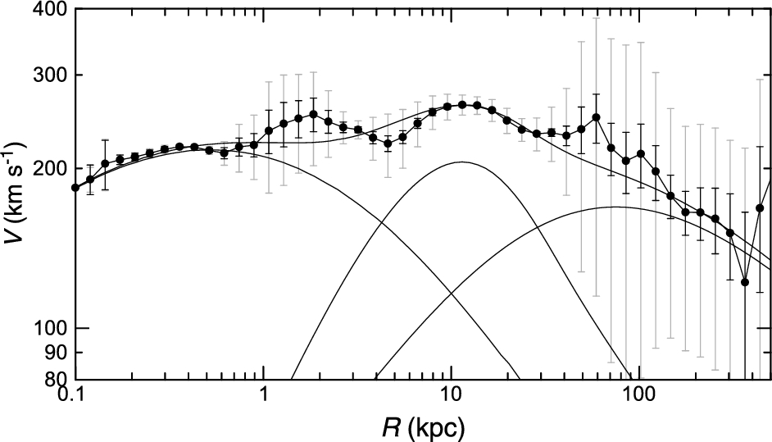
Fig. 18. Logarithmic rotation curve of M 31. Thin lines show the least-χ² fit by the bulge, disk and dark ...
Notes:
Fig. 18. Logarithmic rotation curve of M 31. Thin lines show the least-χ2 fit by the bulge, disk and dark halo components.
Unless provided in the caption above, the following copyright applies to the content of this slide: © The Author 2016. Published by Oxford University Press on behalf of the Astronomical Society of Japan. All rights reserved. For Permissions, please email: journals.permissions@oup.com

Slide 19
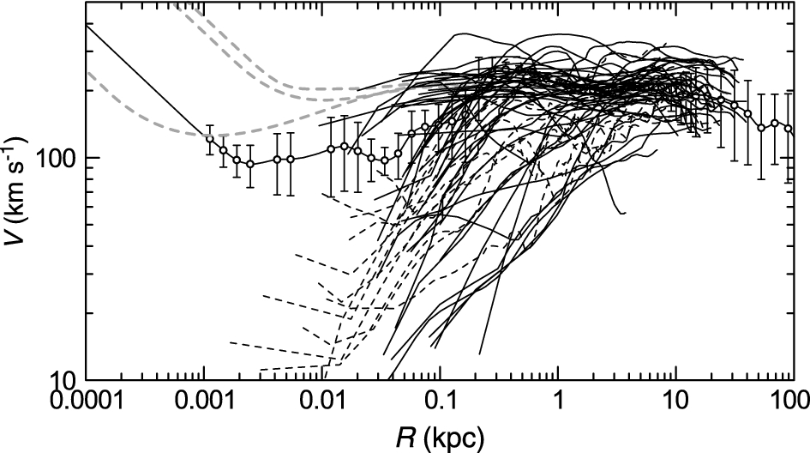
Fig. 19. Logarithmic rotation curves of nearby spiral galaxies with typical resolutions, ∼2″–10″ (thick lines) and ...
Notes:
Fig. 19. Logarithmic rotation curves of nearby spiral galaxies with typical resolutions, ∼2″–10″ (thick lines) and those from Virgo CO survey (∼1″, thick dashed lines), compared with the Milky Way rotation curve (circles with error bars). Three gray dashed lines show NGC 224, NGC 1068, and NGC 4258 as interpolated with their black holes by horizontal straight lines.
Unless provided in the caption above, the following copyright applies to the content of this slide: © The Author 2016. Published by Oxford University Press on behalf of the Astronomical Society of Japan. All rights reserved. For Permissions, please email: journals.permissions@oup.com

Slide 20
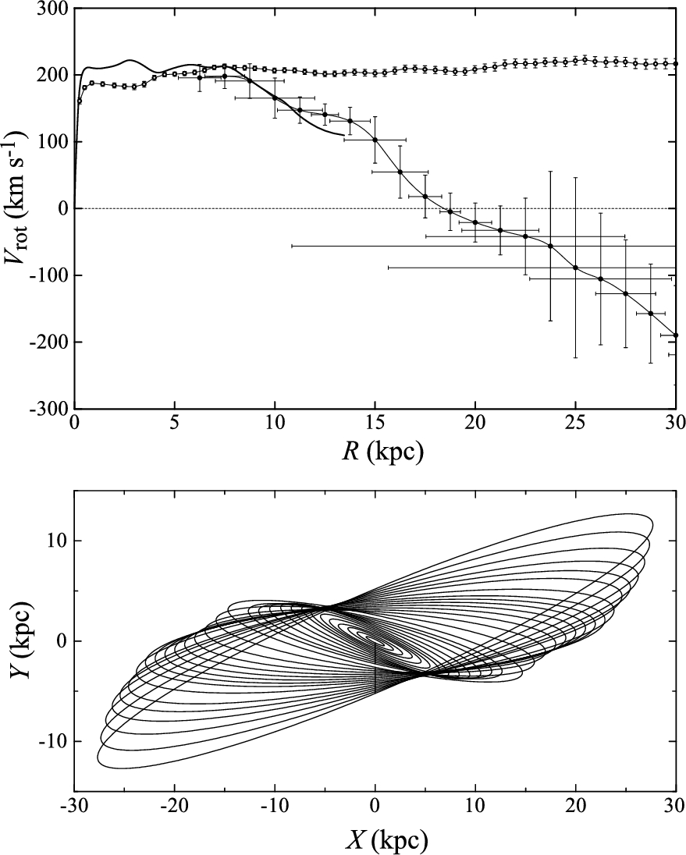
Fig. 20. (Top) Anomalous rotation curve of M 51 showing faster decrease than Keplerian beyond 8 kpc followed by ...
Notes:
Fig. 20. (Top) Anomalous rotation curve of M 51 showing faster decrease than Keplerian beyond 8 kpc followed by apparent counter rotation, compared with an averaged rotation curve of spiral galaxies. (Bottom) Warped disk calculated for rotation curve assuming a universal rotation. The line-of-sight is toward the top. (Oikawa & Sofue 2014).
Unless provided in the caption above, the following copyright applies to the content of this slide: © The Author 2016. Published by Oxford University Press on behalf of the Astronomical Society of Japan. All rights reserved. For Permissions, please email: journals.permissions@oup.com

Slide 21
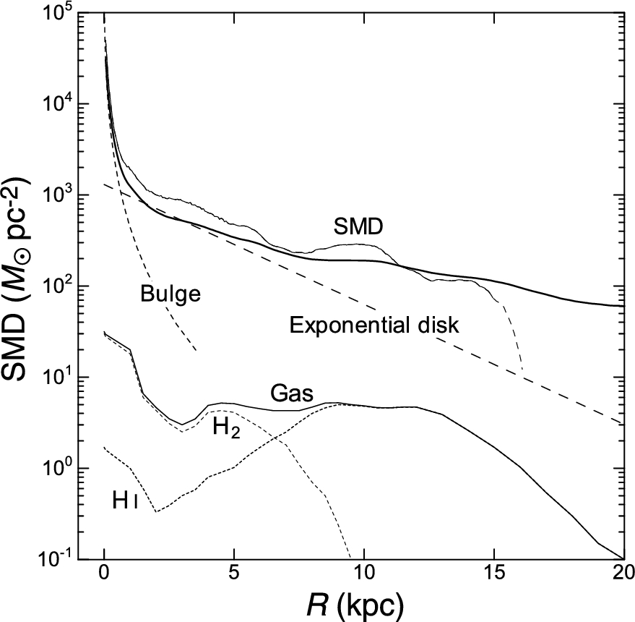
Fig. 21. SMD distribution in the Milky Way. The thick line shows the directly calculated SMD in the thin disk case, ...
Notes:
Fig. 21. SMD distribution in the Milky Way. The thick line shows the directly calculated SMD in the thin disk case, and the thin line shows the result in the sphere case. The long-dashed smooth and dashed lines are the model profiles for de Vaucouleurs bulge and exponential disk. The lower lines show the SMD of interstellar gas made by annulus-averaging of figure 7 (Nakanishi & Sofue 2003, 2006, 2016). H i and H2 gas SMDs are also shown, separately, by dotted lines.
Unless provided in the caption above, the following copyright applies to the content of this slide: © The Author 2016. Published by Oxford University Press on behalf of the Astronomical Society of Japan. All rights reserved. For Permissions, please email: journals.permissions@oup.com

Slide 22
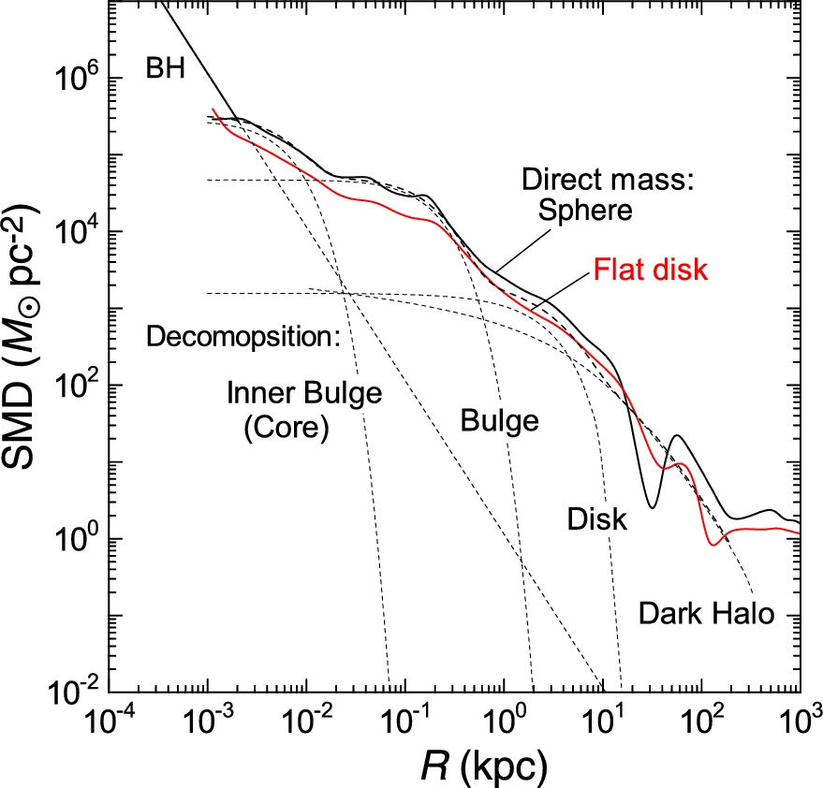
Fig. 22. Directly calculated SMD of the Milky Way under the sphere (thick black line) and flat-disk (thin red line) ...
Notes:
Fig. 22. Directly calculated SMD of the Milky Way under the sphere (thick black line) and flat-disk (thin red line) assumptions on a log–log plot, compared with the result found by the deconvolution method (dashed lines). The straight line represents the black hole with mass 3.6 × 106 M⊙. (Color online)
Unless provided in the caption above, the following copyright applies to the content of this slide: © The Author 2016. Published by Oxford University Press on behalf of the Astronomical Society of Japan. All rights reserved. For Permissions, please email: journals.permissions@oup.com

Slide 23
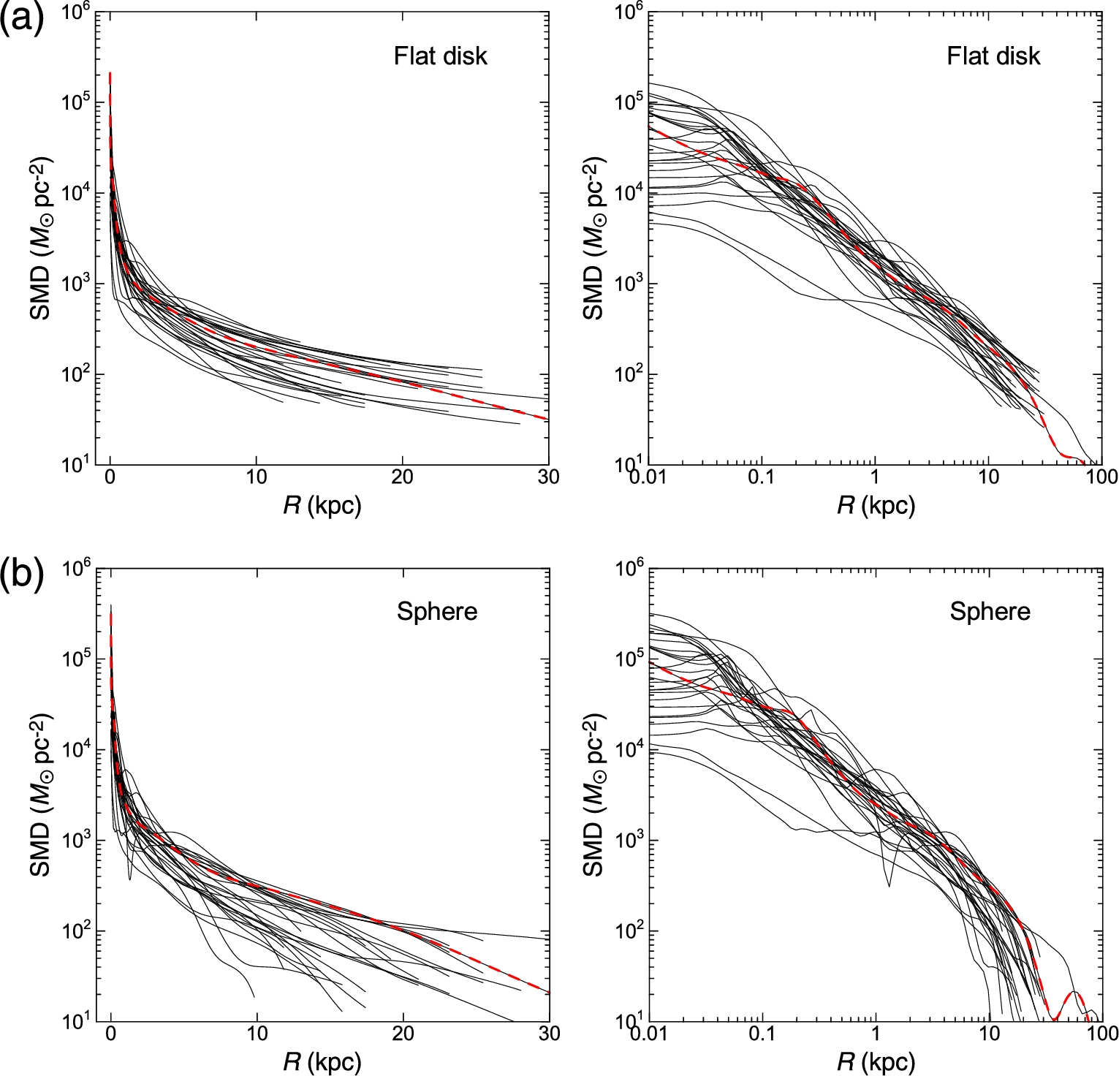
Fig. 23. (a) Direct SMD distributions in spiral galaxies with end radii of RCs greater than 15 kpc (from Sofue 2016) ...
Notes:
Fig. 23. (a) Direct SMD distributions in spiral galaxies with end radii of RCs greater than 15 kpc (from Sofue 2016) calculated under the flat-disk assumption, and the same distributions in logarithmic radius (Sofue 2016). Red dashed lines indicate the Milky Way. (b) Same as (a), but under the sphere assumption. (Color online)
Unless provided in the caption above, the following copyright applies to the content of this slide: © The Author 2016. Published by Oxford University Press on behalf of the Astronomical Society of Japan. All rights reserved. For Permissions, please email: journals.permissions@oup.com

Slide 24
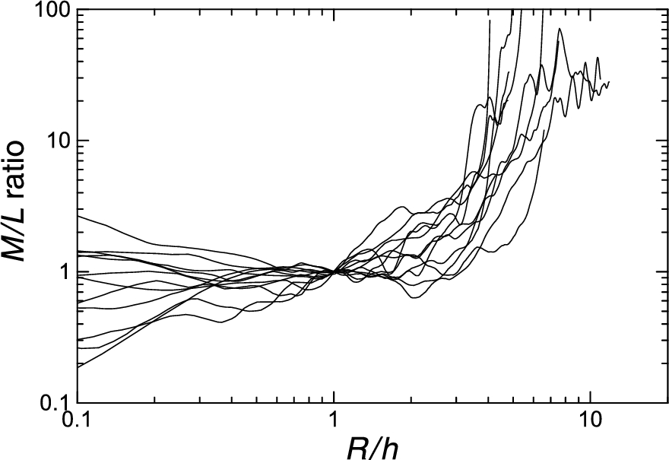
Fig. 24. M/L ratios in spiral galaxies normalized at scale radii using data from Takamiya and Sofue (2000), where L is ...
Notes:
Fig. 24. M/L ratios in spiral galaxies normalized at scale radii using data from Takamiya and Sofue (2000), where L is the optical luminosity.
Unless provided in the caption above, the following copyright applies to the content of this slide: © The Author 2016. Published by Oxford University Press on behalf of the Astronomical Society of Japan. All rights reserved. For Permissions, please email: journals.permissions@oup.com

Slide 25
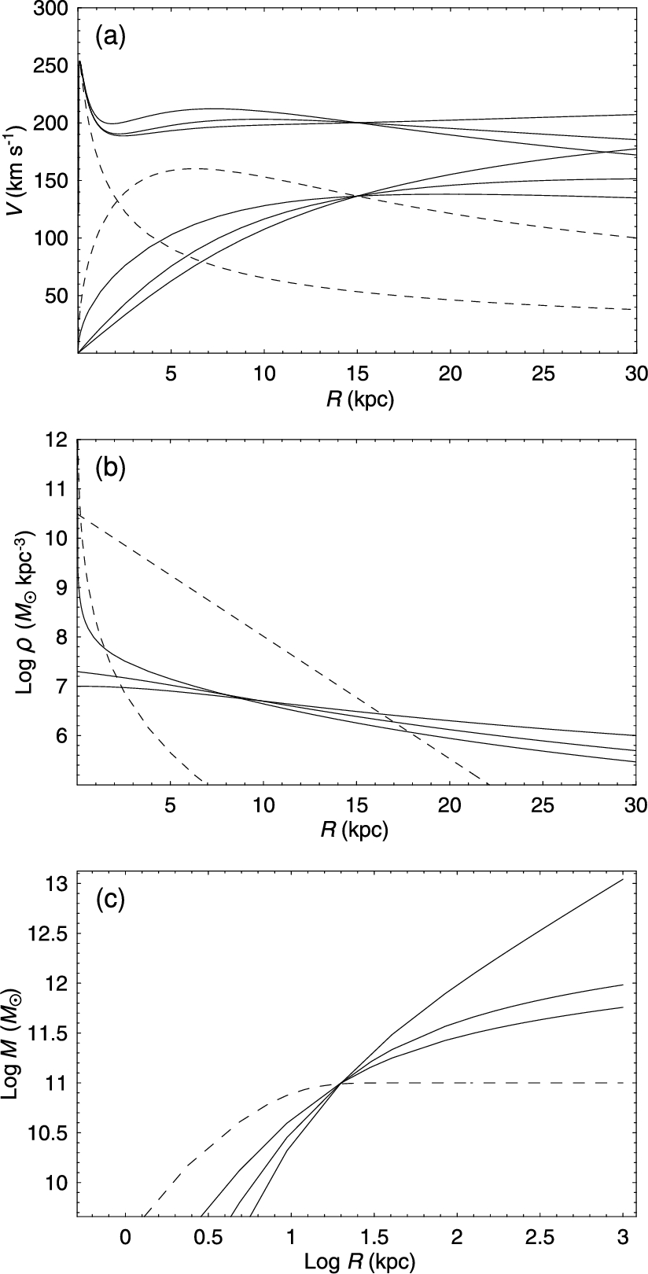
Fig. 25. (a) Analytic rotation curves composed of bulge, disk, and dark halo components represented by isothermal, ...
Notes:
Fig. 25. (a) Analytic rotation curves composed of bulge, disk, and dark halo components represented by isothermal, Burkert (1995), and NFW models (upper solid lines from top to bottom at R = 30 kpc). Dashed lines represent the de Vaucouleurs bulge and exponential disks and three lower solid lines represent the halos as above. (b) Corresponding volume densities. (c) Corresponding enclosed mass within radius r.
Unless provided in the caption above, the following copyright applies to the content of this slide: © The Author 2016. Published by Oxford University Press on behalf of the Astronomical Society of Japan. All rights reserved. For Permissions, please email: journals.permissions@oup.com

Slide 26
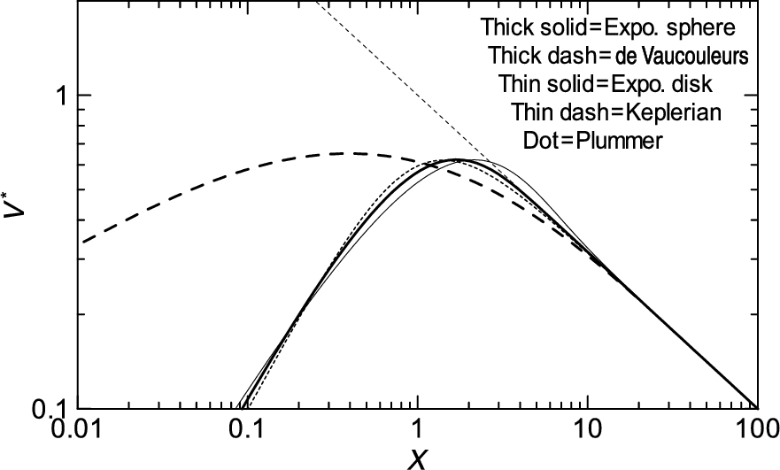
Fig. 26. Comparison of normalized rotation curves for the exponential spheroid, the de Vaucouleurs spheroid, and other ...
Notes:
Fig. 26. Comparison of normalized rotation curves for the exponential spheroid, the de Vaucouleurs spheroid, and other typical models, for a fixed total mass. The exponential spheroid model is almost identical to that for the Plummer law model. The central rise of the de Vaucouleurs curve is proportional to r1/2, while the other models show a central velocity rise ∝ r.
Unless provided in the caption above, the following copyright applies to the content of this slide: © The Author 2016. Published by Oxford University Press on behalf of the Astronomical Society of Japan. All rights reserved. For Permissions, please email: journals.permissions@oup.com

Slide 27
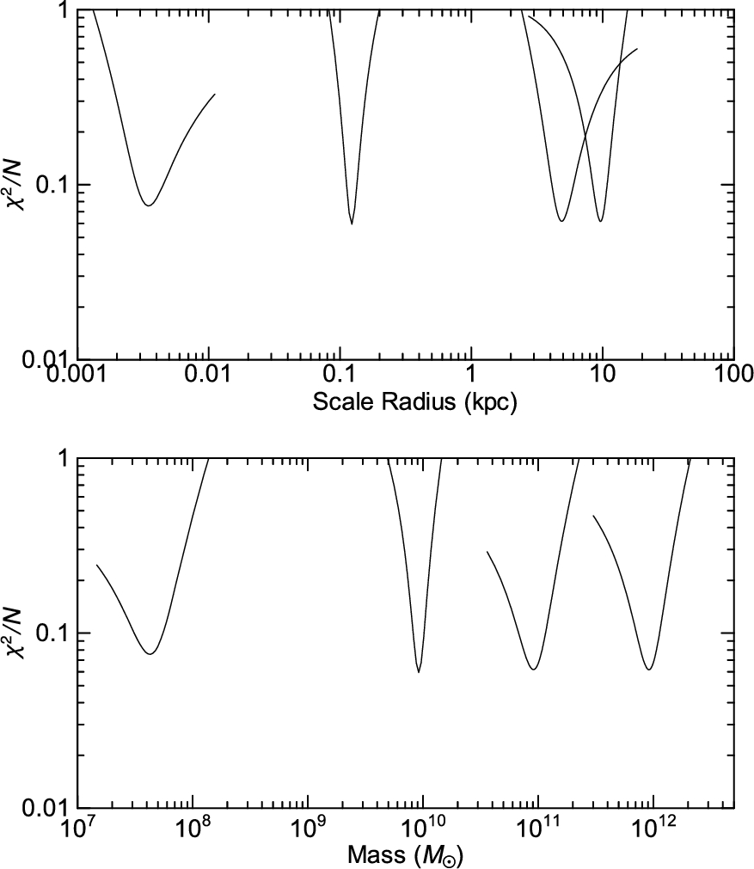
Fig. 27. χ² plots around the best-fitting values of the scale radii of the deconvolution components to ...
Notes:
Fig. 27. χ2 plots around the best-fitting values of the scale radii of the deconvolution components to obtain figure 4.
Unless provided in the caption above, the following copyright applies to the content of this slide: © The Author 2016. Published by Oxford University Press on behalf of the Astronomical Society of Japan. All rights reserved. For Permissions, please email: journals.permissions@oup.com

Slide 28
Fig. 28. Contour presentation of the 2D distribution of the log χ² value around the best-fitting points in ...
Notes:
Fig. 28. Contour presentation of the 2D distribution of the log χ2 value around the best-fitting points in the scale radius–mass space to obtain figure 4.
Unless provided in the caption above, the following copyright applies to the content of this slide: © The Author 2016. Published by Oxford University Press on behalf of the Astronomical Society of Japan. All rights reserved. For Permissions, please email: journals.permissions@oup.com

Slide 29
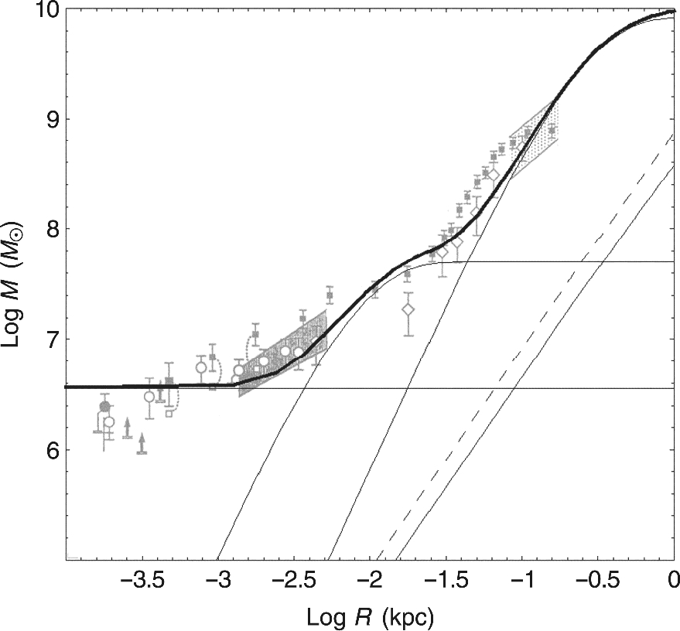
Fig. 29. Enclosed mass calculated for the Galaxy's rotation curve compared to those from Genzel, Hollenbach, and ...
Notes:
Fig. 29. Enclosed mass calculated for the Galaxy's rotation curve compared to those from Genzel, Hollenbach, and Townes (1994). The horizontal line, thin curved lines, dashed line, and lower straight line indicate the black hole, inner bulge, main bulge, disk, and dark matter cusp, respectively.
Unless provided in the caption above, the following copyright applies to the content of this slide: © The Author 2016. Published by Oxford University Press on behalf of the Astronomical Society of Japan. All rights reserved. For Permissions, please email: journals.permissions@oup.com

Slide 30
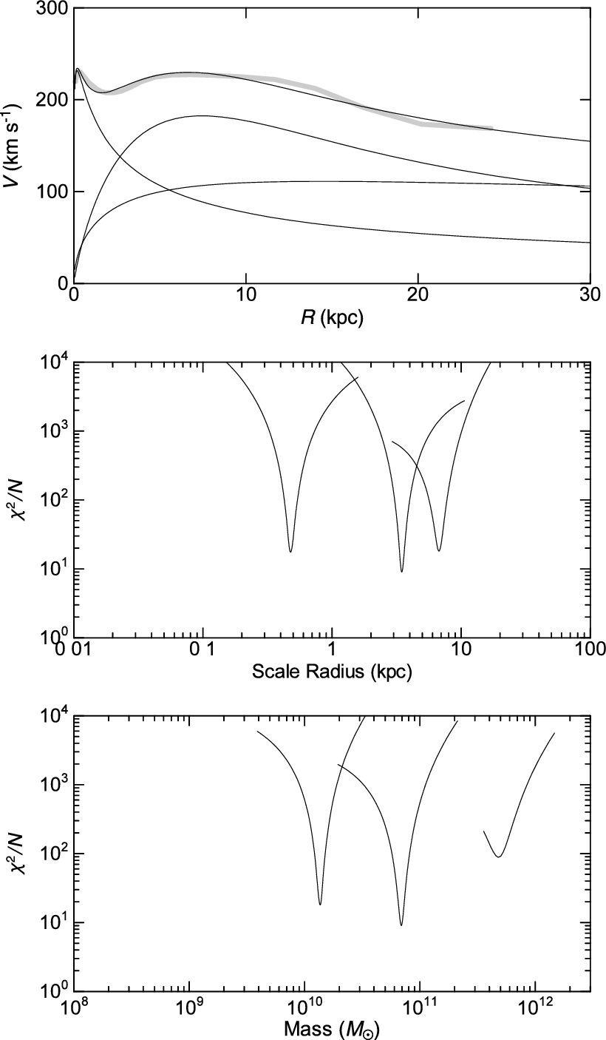
Fig. 30. Rotation curve and χ²-fitting result for NGC 891 (top), the distribution of χ²/N around ...
Notes:
Fig. 30. Rotation curve and χ2-fitting result for NGC 891 (top), the distribution of χ2/N around the best-fitting scale radii (middle), and the masses (bottom) of the three components.
Unless provided in the caption above, the following copyright applies to the content of this slide: © The Author 2016. Published by Oxford University Press on behalf of the Astronomical Society of Japan. All rights reserved. For Permissions, please email: journals.permissions@oup.com

Slide 31
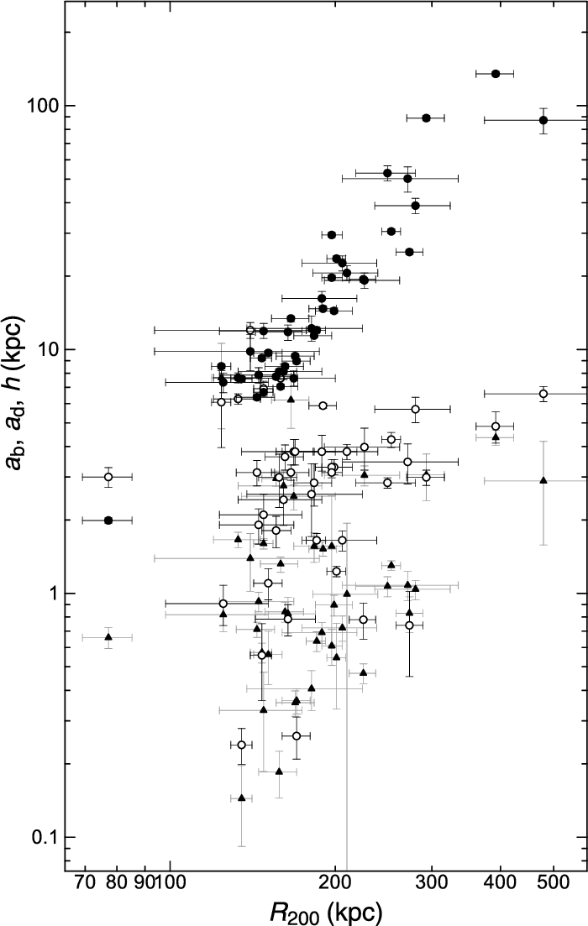
Fig. 31. Size–size relations for dark halo critical radius for (R₂₀₀, a_{b}) (triangles), ...
Notes:
Fig. 31. Size–size relations for dark halo critical radius for (R200, ab) (triangles), (R200, ad) (open circles), and (R200, h) (black dots) (Sofue 2016).
Unless provided in the caption above, the following copyright applies to the content of this slide: © The Author 2016. Published by Oxford University Press on behalf of the Astronomical Society of Japan. All rights reserved. For Permissions, please email: journals.permissions@oup.com

Slide 32
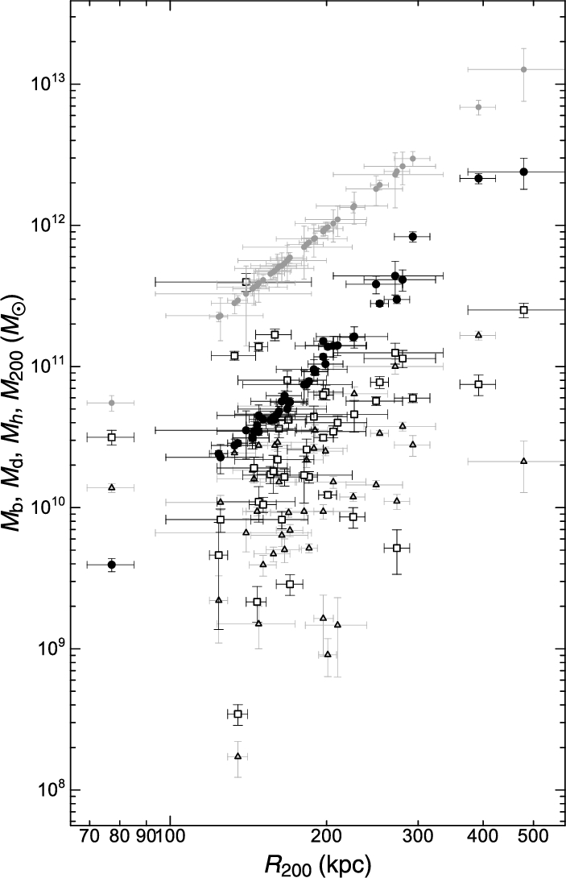
Fig. 32. Size–mass relations for (R₂₀₀, M_{b}) (triangles); (R₂₀₀, M_{d}) ...
Notes:
Fig. 32. Size–mass relations for (R200, Mb) (triangles); (R200, Md) (rectangles); (R200, Mh) (black dots); and (R200, M200) (small gray dots), showing the trivial relation by definition of the critical mass.
Unless provided in the caption above, the following copyright applies to the content of this slide: © The Author 2016. Published by Oxford University Press on behalf of the Astronomical Society of Japan. All rights reserved. For Permissions, please email: journals.permissions@oup.com

Slide 33
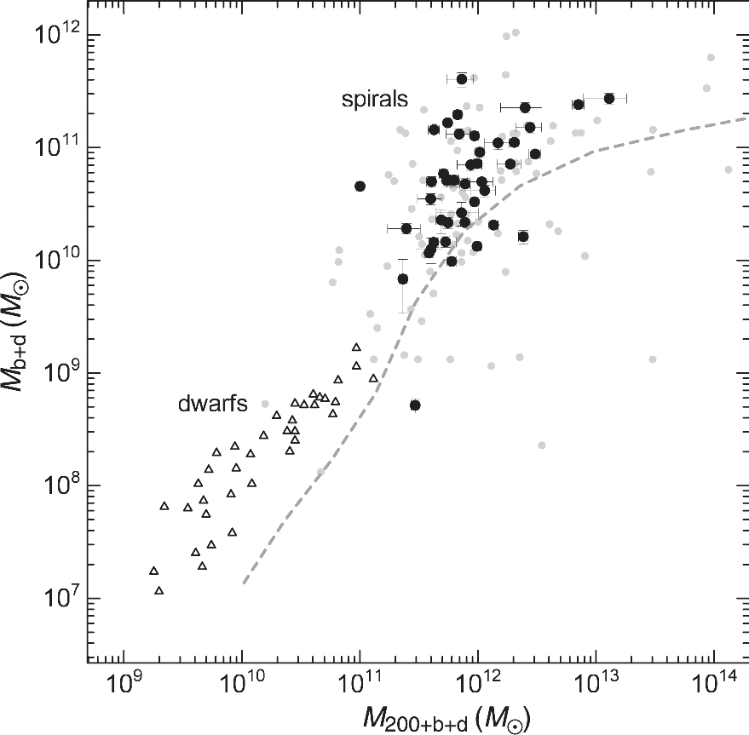
Fig. 33. M _{b + d}–M_{200 + b + d} relation compared with the stellar mass–total mass relation for ...
Notes:
Fig. 33. M b + d–M200 + b + d relation compared with the stellar mass–total mass relation for dwarf galaxies (triangles: Miller et al. 2014) and simulation + photometry (dashed gray line: Behroozi et al. 2013). Black dots are the selected galaxies with reasonable fitting results, while small gray dots as well as black dots show non-weighted results from automatic decomposition of all rotation curves.
Unless provided in the caption above, the following copyright applies to the content of this slide: © The Author 2016. Published by Oxford University Press on behalf of the Astronomical Society of Japan. All rights reserved. For Permissions, please email: journals.permissions@oup.com

