Slide 1
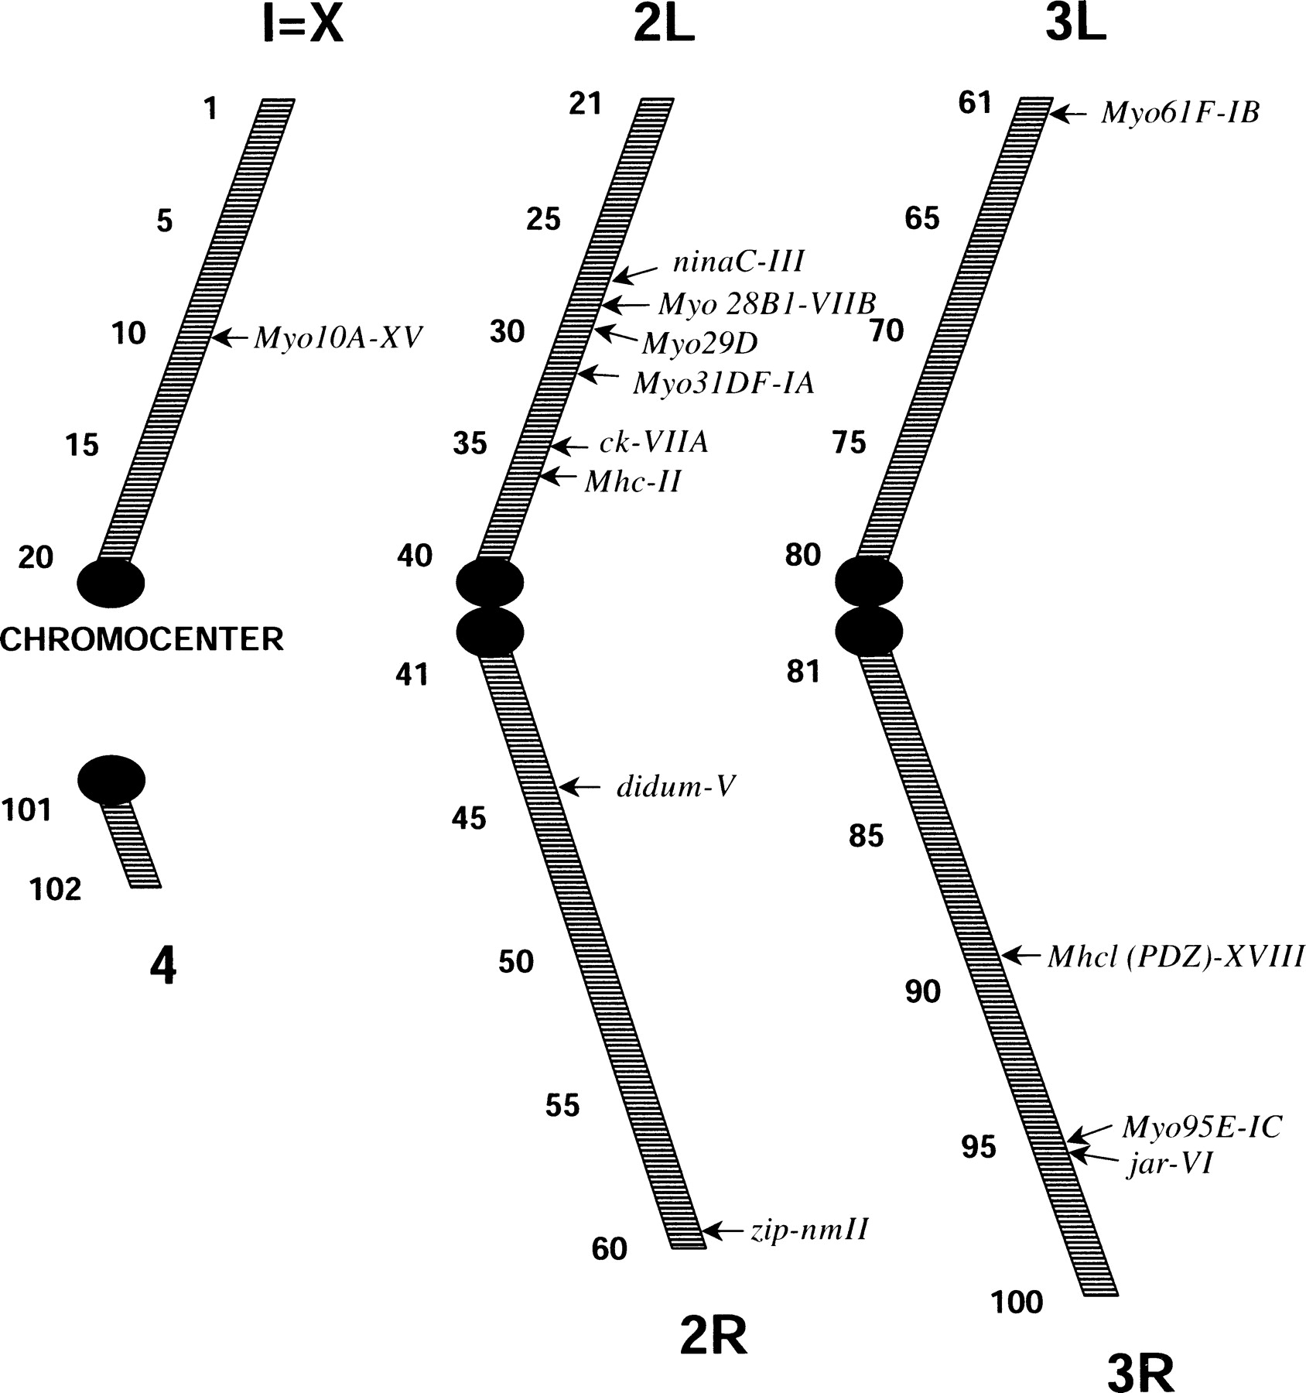
Fig. 2.—Polytene chromosome position of D. melanogaster myosin genes (based on the data provided by the ...
Notes:
Fig. 2.—Polytene chromosome position of D. melanogaster myosin genes (based on the data provided by the Berkeley Drosophila Genome Project). The figure presents all myosin genes, new and previously identified, in relation to their chromosomal locations. So far, no myosin genes have been found on the fourth chromosome
Unless provided in the caption above, the following copyright applies to the content of this slide:

Slide 2
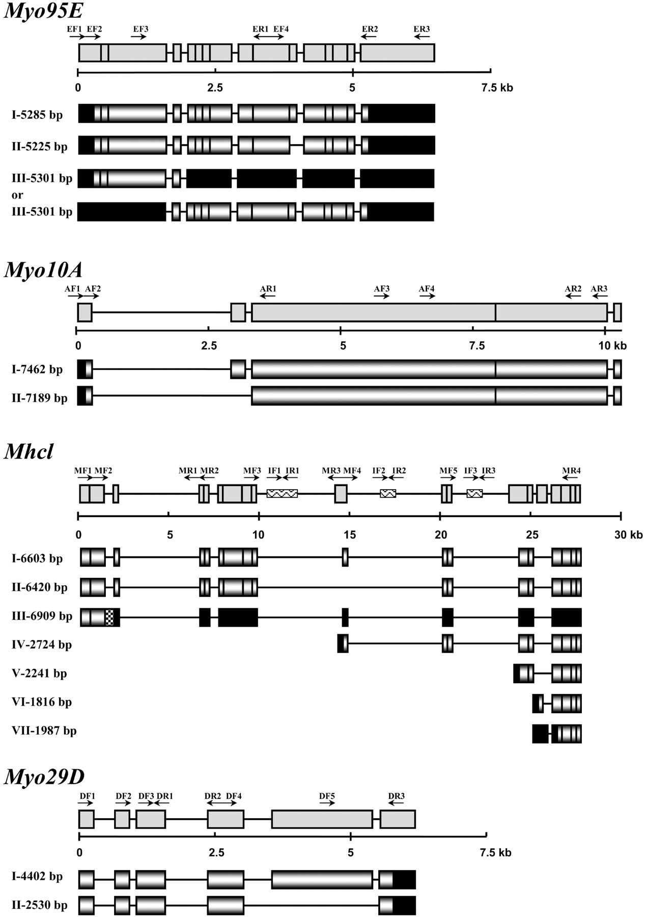
Fig. 3.—Molecular organization of Myo95E, Myo10A, Mhcl, and Myo29D myosin genes. The exon structure of the ...
Notes:
Fig. 3.—Molecular organization of Myo95E, Myo10A, Mhcl, and Myo29D myosin genes. The exon structure of the myosin genes is represented by gray boxes. Arrows indicate the primers used in the RT-PCR analysis of the gene structure. The length of the predicted mRNAs is noted on the left side of the transcript maps. Shaded boxes represent ORFs; solid boxes represent untranslated sequences (5′UTR or 3′UTR); dotted boxes represent the intron sequence in the spliced mRNA; wave pattern boxes represent exons from genes located within the myosin gene. The gene depicted by IF1 and IR1 primers is at least a three-exon gene, but for simplicity it is presented with a single box here (for more information see text)
Unless provided in the caption above, the following copyright applies to the content of this slide:

Slide 3
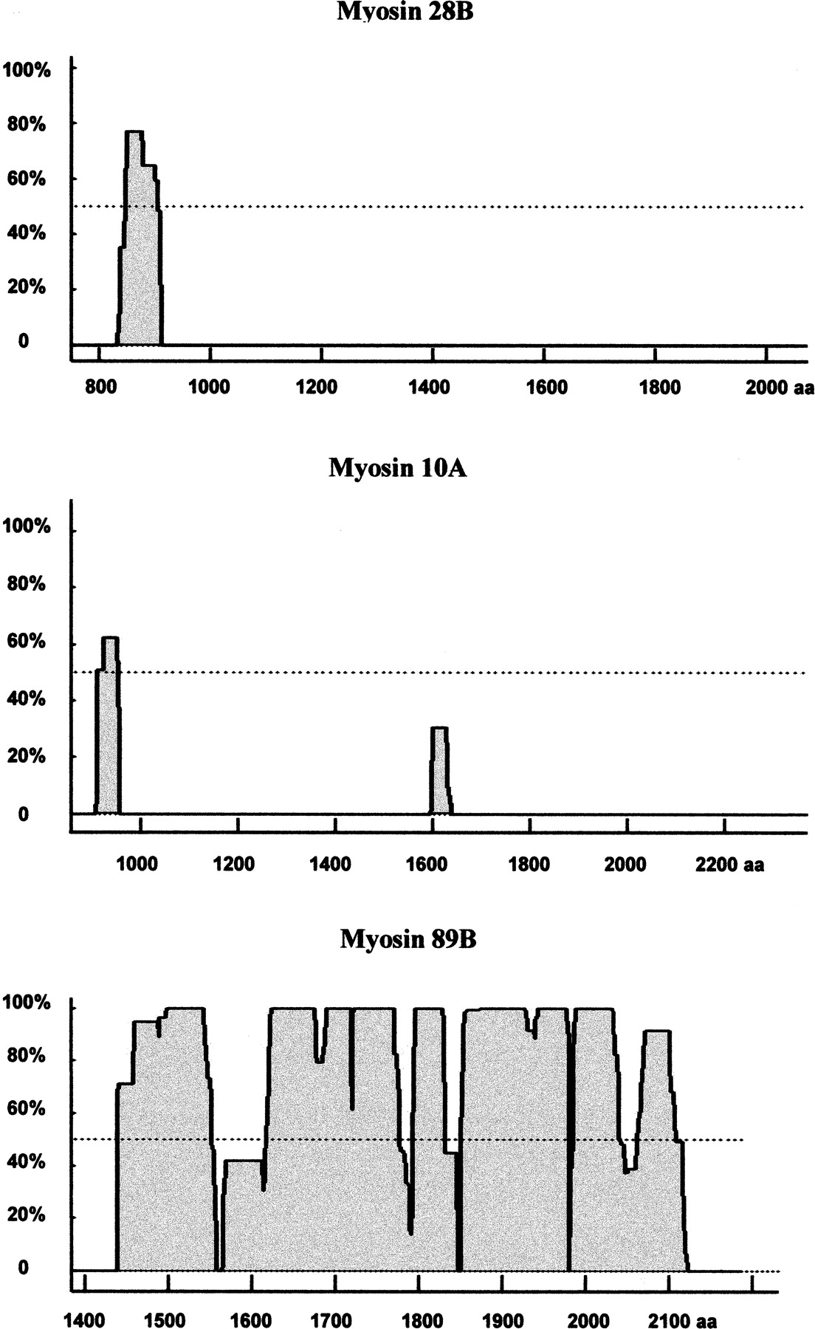
Fig. 8.—Predicted coiled-coil structures in the tails of the newly identified Drosophila myosins. Only three ...
Notes:
Fig. 8.—Predicted coiled-coil structures in the tails of the newly identified Drosophila myosins. Only three of the five myosins are likely to form coiled-coils, these being myosin 28B-VIIB, myosin 10A-XV, and Mhcl-PDZ. Both myosin 28B-VIIB and 10A-XV produced scores close to the lower threshold. Whether they form coiled-coils or not can only be determined experimentally
Unless provided in the caption above, the following copyright applies to the content of this slide:

