Slide 1
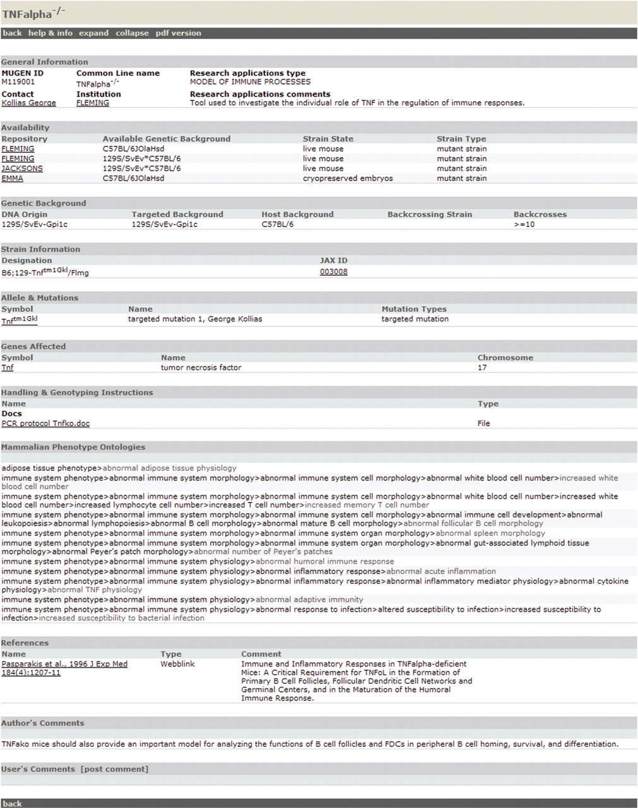
Figure 1. Available information and data categorization on a sample mouse model of MMdb. Representative view of a ...
Notes:
Figure 1. Available information and data categorization on a sample mouse model of MMdb. Representative view of a mutant mouse ‘Tnfalpha −/− ’ from MMdb, demonstrating all the individual data categorizations and information that are recorded in MMdb (general information, availability, genetic background, strain information, allele and mutations, genes affected, handling and genotyping instructions, phenotype(s) references, author's comments and user's comments).
Unless provided in the caption above, the following copyright applies to the content of this slide: © 2007 The Author(s)This is an Open Access article distributed under the terms of the Creative Commons Attribution Non-Commercial License (http://creativecommons.org/licenses/by-nc/2.0/uk/) which permits unrestricted non-commercial use, distribution, and reproduction in any medium, provided the original work is properly cited.

Slide 2
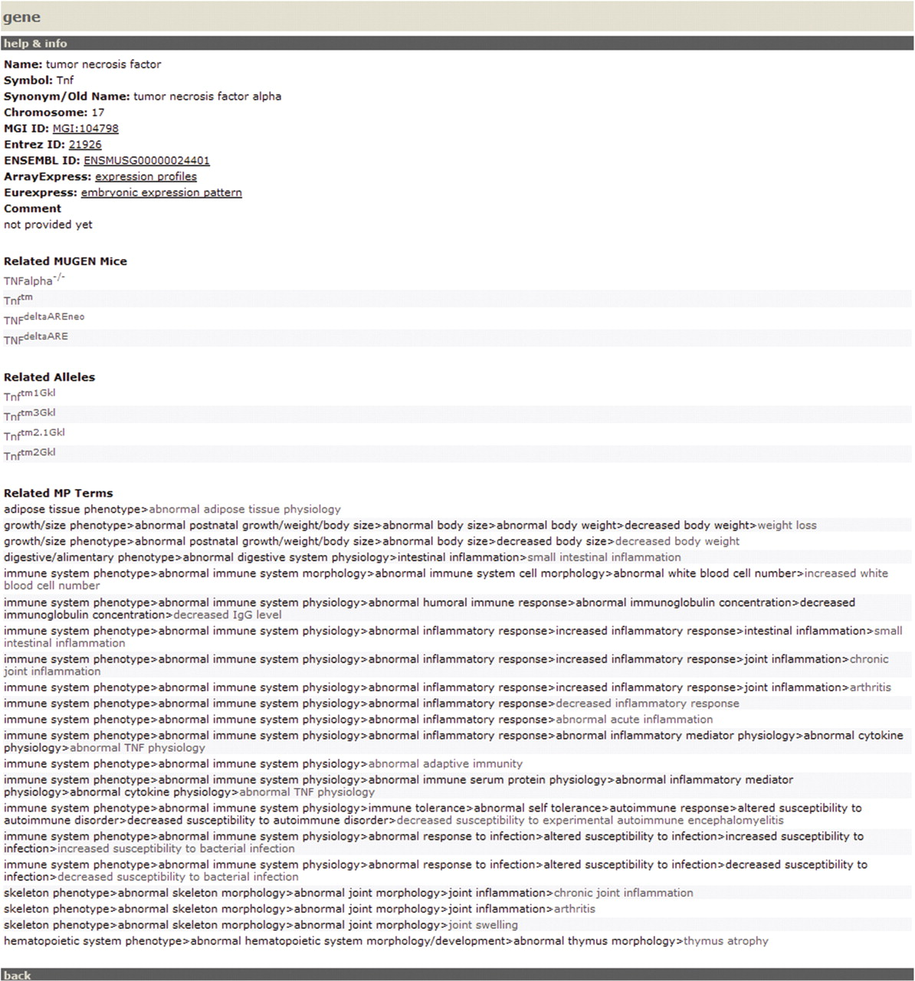
Figure 2. Available information on a sample gene of MMdb. Representative view of a gene ‘tumor necrosis factor’ from ...
Notes:
Figure 2. Available information on a sample gene of MMdb. Representative view of a gene ‘tumor necrosis factor’ from MMdb, demonstrating basic information for the gene/transgene together with a list of Mugen mice, alleles and MP terms available in MMdb, which are relevant to the particular gene. Each gene/transgene index also includes IDs and direct links to Ensembl, ArrayExpress, EURExpress II and NCBI's Entrez Gene database.
Unless provided in the caption above, the following copyright applies to the content of this slide: © 2007 The Author(s)This is an Open Access article distributed under the terms of the Creative Commons Attribution Non-Commercial License (http://creativecommons.org/licenses/by-nc/2.0/uk/) which permits unrestricted non-commercial use, distribution, and reproduction in any medium, provided the original work is properly cited.

Slide 3
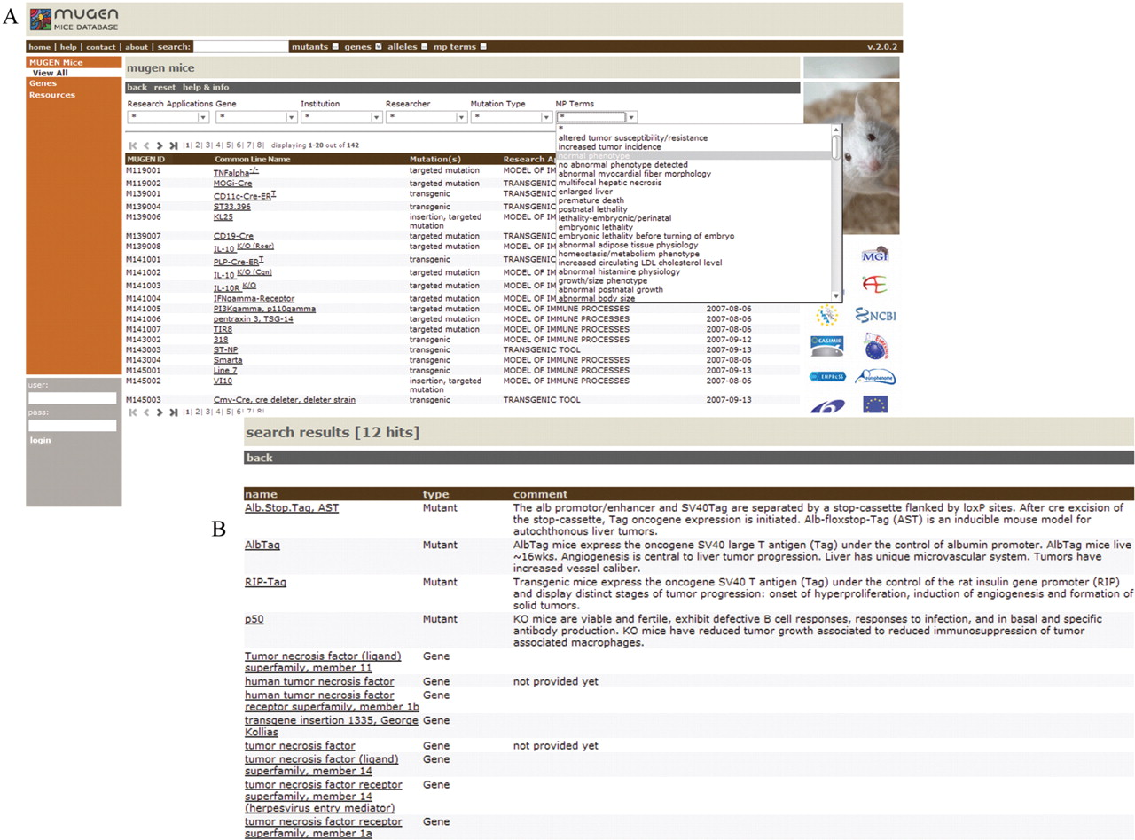
Figure 3. Querying MMdb. ( A ) A screen shot demonstrating how database querying can be restricted via choosing from ...
Notes:
Figure 3. Querying MMdb. ( A ) A screen shot demonstrating how database querying can be restricted via choosing from drop down menus (e.g. research application, gene, institution, researcher, mutation type dissemination level and MP term) and also via the function formulating ad hoc queries. ( B ) Results of an ad hoc query for ‘tnf’. A list with 12 hits of all the available mutant mouse models and related genes is available.
Unless provided in the caption above, the following copyright applies to the content of this slide: © 2007 The Author(s)This is an Open Access article distributed under the terms of the Creative Commons Attribution Non-Commercial License (http://creativecommons.org/licenses/by-nc/2.0/uk/) which permits unrestricted non-commercial use, distribution, and reproduction in any medium, provided the original work is properly cited.

