Slide 1
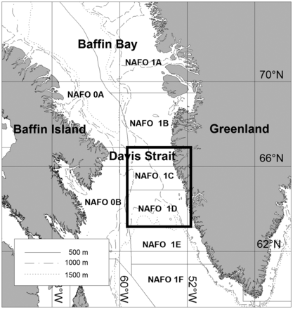
Figure 1. NAFO Subareas 0 and 1 showing divisions. The study area, Division 1CD is highlighted.
Notes:
Figure 1. NAFO Subareas 0 and 1 showing divisions. The study area, Division 1CD is highlighted.
Unless provided in the caption above, the following copyright applies to the content of this slide: © International Council for the Exploration of the Sea 2014. All rights reserved. For Permissions, please email: journals.permissions@oup.com

Slide 2
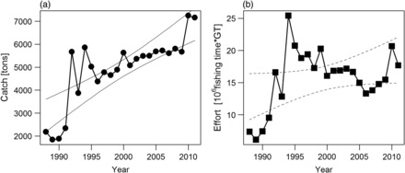
Figure 2. Catch of Greenland halibutin NAFO Divisions 1CD (a) and fishing effort (b) per year with 95% confidence ...
Notes:
Figure 2. Catch of Greenland halibutin NAFO Divisions 1CD (a) and fishing effort (b) per year with 95% confidence interval of the linear regressions (solid lines: alpha < 0.05; dashed lines: 0.05 < alpha < 0.1).
Unless provided in the caption above, the following copyright applies to the content of this slide: © International Council for the Exploration of the Sea 2014. All rights reserved. For Permissions, please email: journals.permissions@oup.com

Slide 3
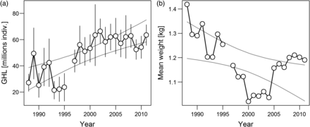
Figure 3. Survey population abundance (a) and individual mean weight (b) of Greenland halibut with 95% confidence ...
Notes:
Figure 3. Survey population abundance (a) and individual mean weight (b) of Greenland halibut with 95% confidence interval of the linear regressions (solid line: alpha < 0.05).
Unless provided in the caption above, the following copyright applies to the content of this slide: © International Council for the Exploration of the Sea 2014. All rights reserved. For Permissions, please email: journals.permissions@oup.com

Slide 4
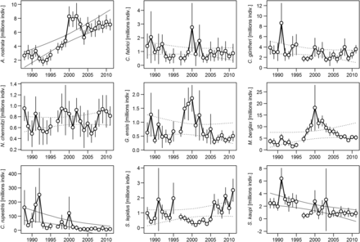
Figure 4. Abundance by species and year in surveys. Each abundance is given with 95% confidence interval.
Notes:
Figure 4. Abundance by species and year in surveys. Each abundance is given with 95% confidence interval.
Unless provided in the caption above, the following copyright applies to the content of this slide: © International Council for the Exploration of the Sea 2014. All rights reserved. For Permissions, please email: journals.permissions@oup.com

Slide 5
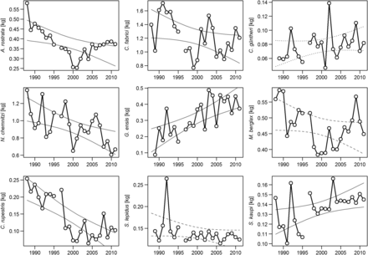
Figure 5. Changes in individual mean weight by species and year. The 95% confidence interval of the linear regression ...
Notes:
Figure 5. Changes in individual mean weight by species and year. The 95% confidence interval of the linear regression is also given (solid line: alpha < 0.05; dashed line: 0.05 < alpha < 0.1; otherwise dotted line).
Unless provided in the caption above, the following copyright applies to the content of this slide: © International Council for the Exploration of the Sea 2014. All rights reserved. For Permissions, please email: journals.permissions@oup.com

Slide 6
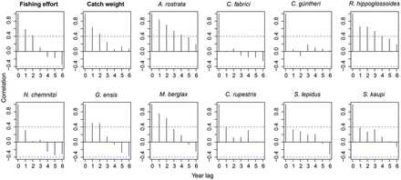
Figure 6. Autocorrelation analyses of the overall fishing effort, catch in tonnes, and abundance time-series by ...
Notes:
Figure 6. Autocorrelation analyses of the overall fishing effort, catch in tonnes, and abundance time-series by species.
Unless provided in the caption above, the following copyright applies to the content of this slide: © International Council for the Exploration of the Sea 2014. All rights reserved. For Permissions, please email: journals.permissions@oup.com

Slide 7
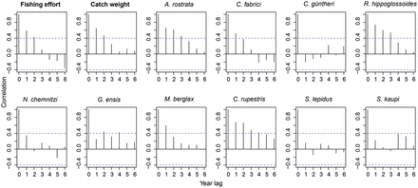
Figure 7. Autocorrelation analyses of the overall fishing effort, catch in tonnes for mean weight time-series by ...
Notes:
Figure 7. Autocorrelation analyses of the overall fishing effort, catch in tonnes for mean weight time-series by species.
Unless provided in the caption above, the following copyright applies to the content of this slide: © International Council for the Exploration of the Sea 2014. All rights reserved. For Permissions, please email: journals.permissions@oup.com

Slide 8
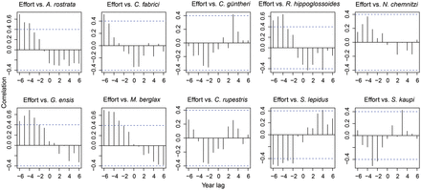
Figure 8. Cross-correlation of commercial effort and abundance of the nine potential bycatch species.
Notes:
Figure 8. Cross-correlation of commercial effort and abundance of the nine potential bycatch species.
Unless provided in the caption above, the following copyright applies to the content of this slide: © International Council for the Exploration of the Sea 2014. All rights reserved. For Permissions, please email: journals.permissions@oup.com

Slide 9
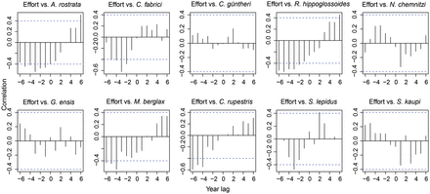
Figure 9. Cross-correlation of commercial effort and mean weight of the nine potential bycatch species.
Notes:
Figure 9. Cross-correlation of commercial effort and mean weight of the nine potential bycatch species.
Unless provided in the caption above, the following copyright applies to the content of this slide: © International Council for the Exploration of the Sea 2014. All rights reserved. For Permissions, please email: journals.permissions@oup.com

