Slide 1
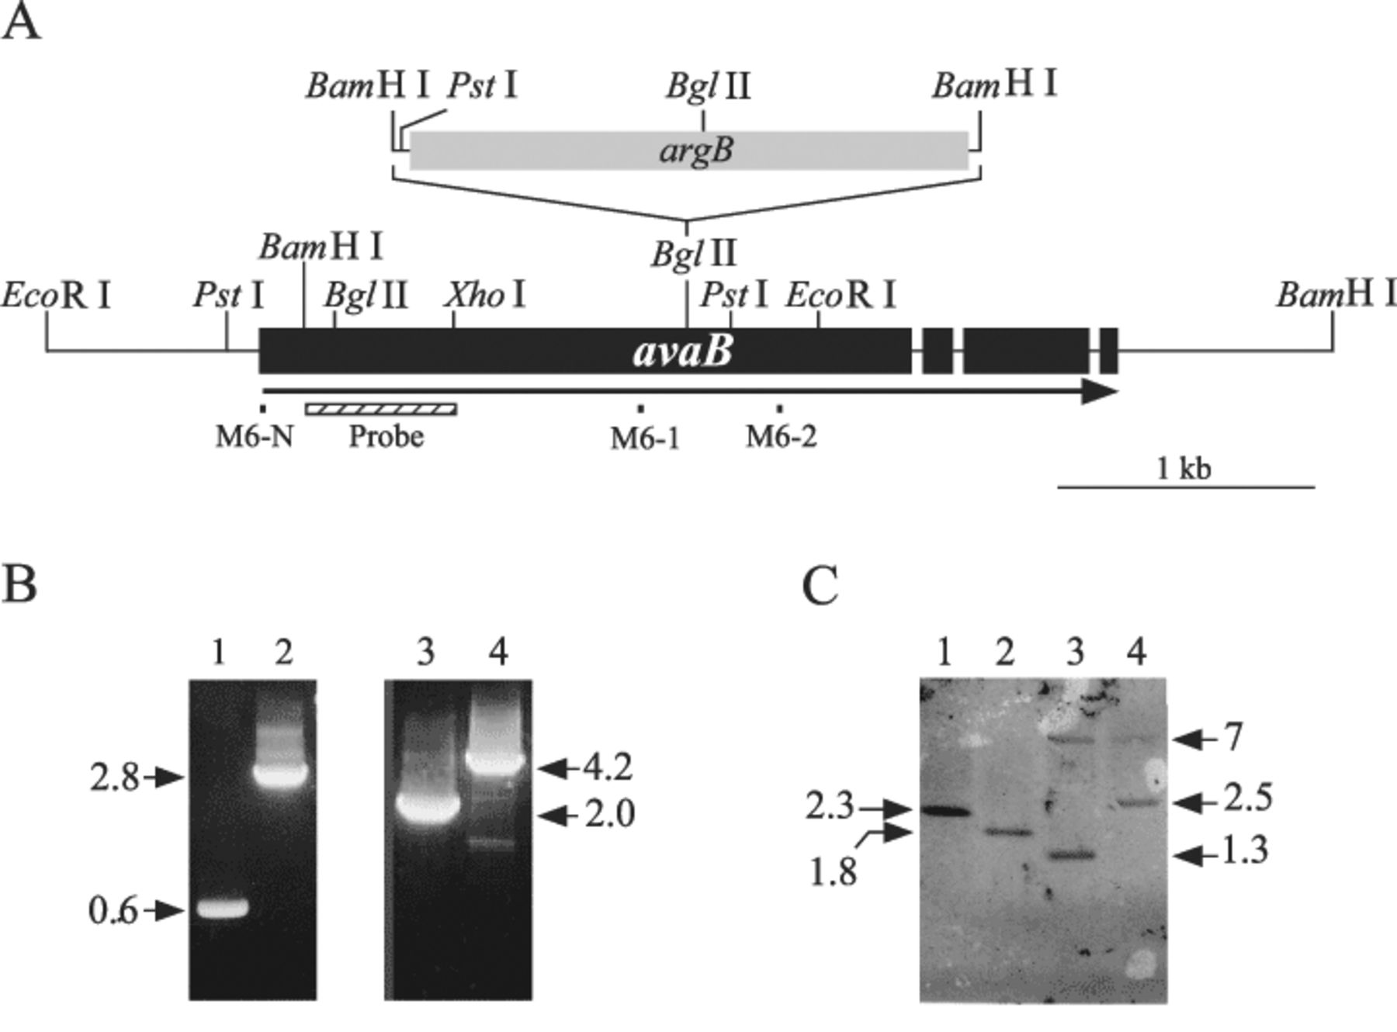
2 Disruption of the avaB gene in A. nidulans. A: A 2.2-kb argB selectable marker was inserted into one of the ...
Notes:
2 Disruption of the avaB gene in A. nidulans. A: A 2.2-kb argB selectable marker was inserted into one of the two BglII sites in the avaB gene in pBB which carries the 4-kb BamHI fragment containing most of the coding region of avaB. The resultant 6.2-kb BamHI fragment carrying argB-inserted avaB was used to transform A. nidulans A89. B: PCR analyses demonstrating the disruption of the avaB gene. The genomic DNAs prepared from the control (A26; lanes 1 and 3) or ΔavaB (D12; lanes 2 and 4) were used as a template for the PCR using primer sets M6-1 and M6-2 (lanes 1 and 2) or M6-N and M6-2 (lanes 3 and 4). The locations of primers are indicated in A, and the expected sizes of products (in kb) are indicated on the left and right margins. C: The genomic DNAs prepared from the control (lanes 1 and 3) and ΔavaB (lanes 2 and 4) strains were digested with PstI (lanes 1 and 2) or BglII (lanes 3 and 4) and served for the Southern blot analysis probed with the 0.4-kb BamHI/XhoI fragment of the avaB gene which is shown in A. The sizes expected for the wild-type and argB-inserted avaB allele are 2.3 and 1.8 kb (for PstI digestion) and 1.3 plus 7.0 kb and 2.5 plus 7.0 kb (for BglII digestion), respectively, which are shown in the figure.
Unless provided in the caption above, the following copyright applies to the content of this slide: © 2004 Federation of European Microbiological Societies

Slide 2
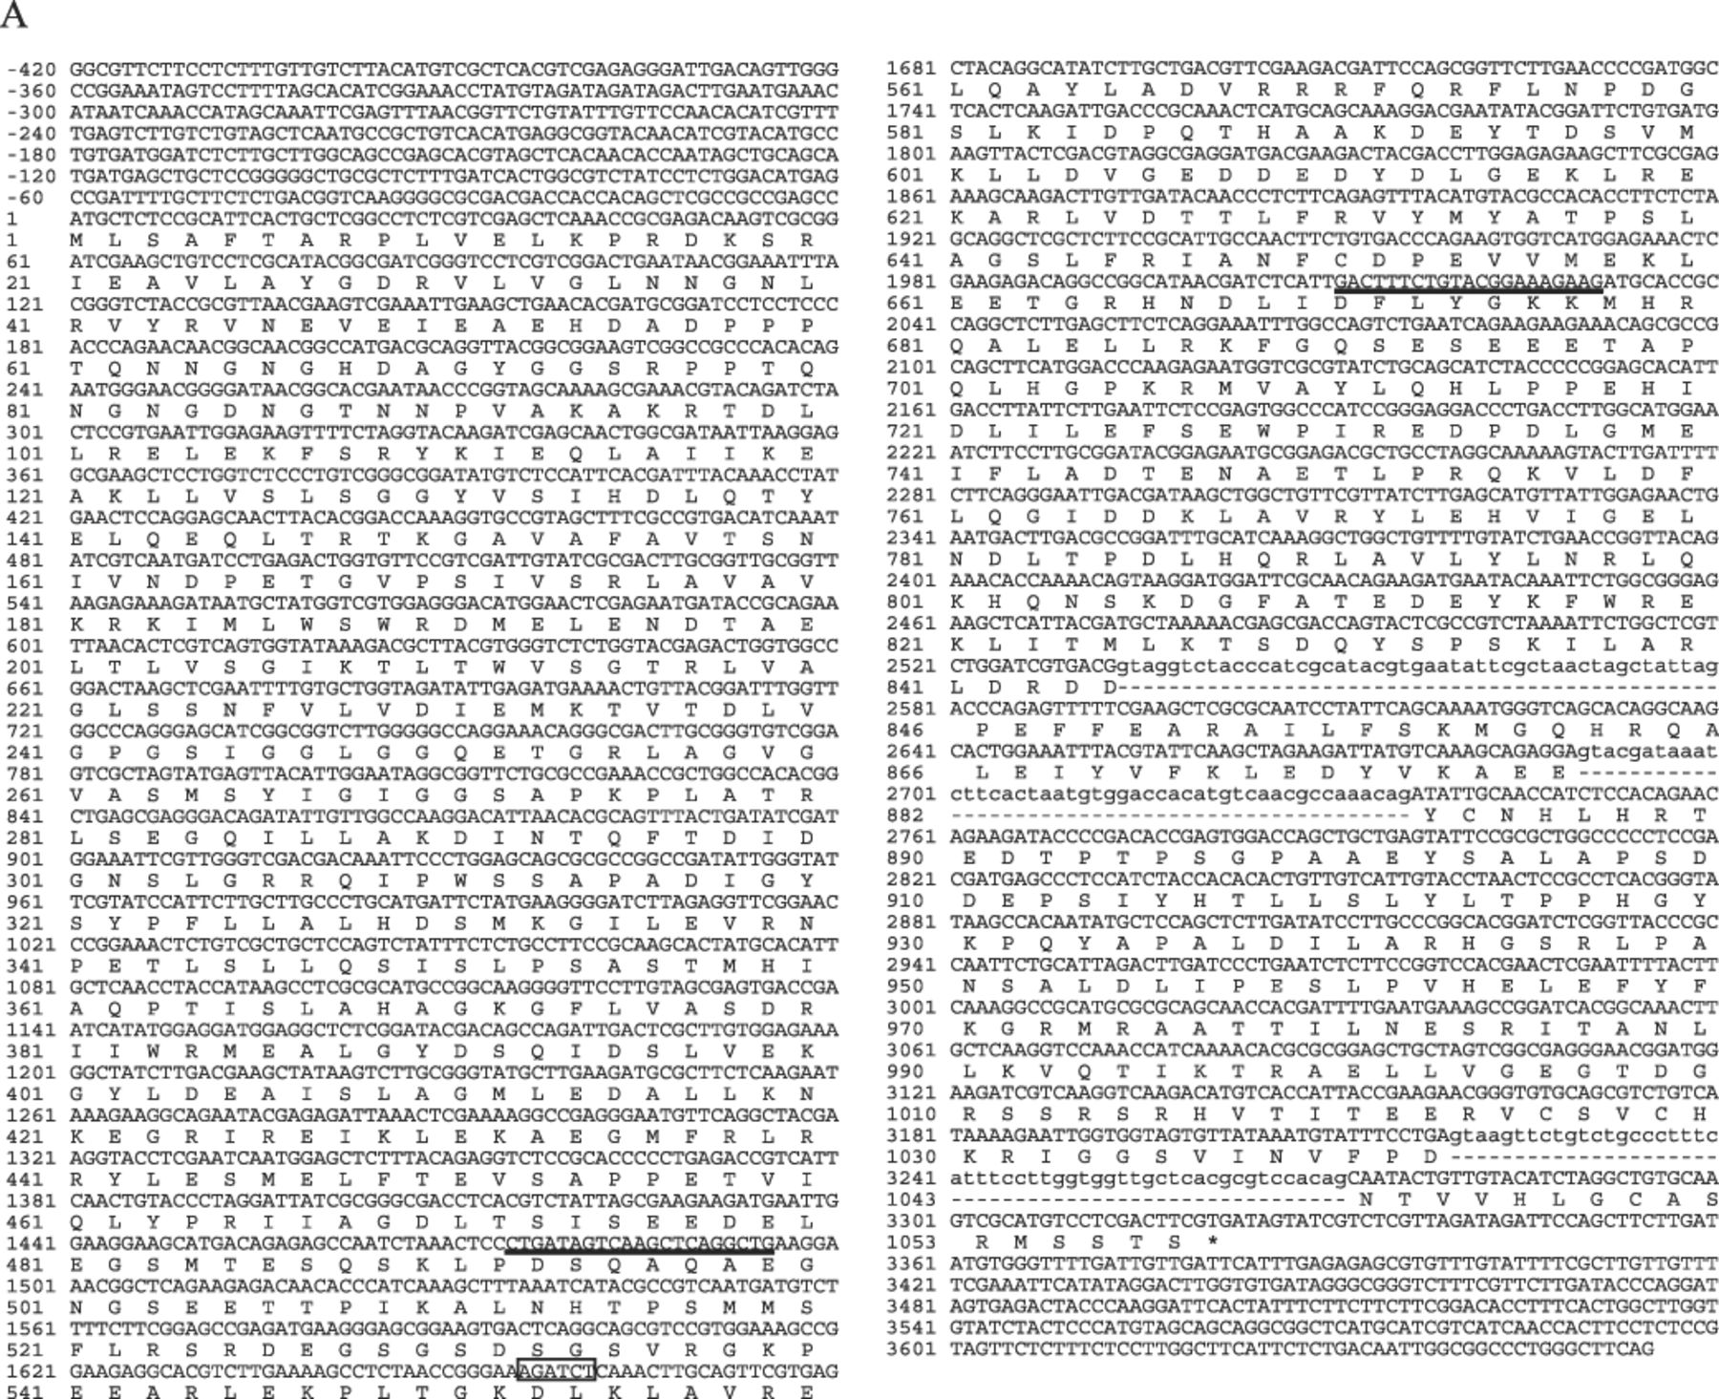
1 A: Nucleotide and deduced amino acid sequences of the A. nidulans avaB gene. Numbers on the left margin ...
Notes:
1 A: Nucleotide and deduced amino acid sequences of the A. nidulans avaB gene. Numbers on the left margin indicate the positions from the first nucleotide and amino acid of the avaB gene and the AvaB protein, respectively. The avaB gene contains three introns, which are indicated by lowercase letters. The BglII site used to insert the argB gene for the gene disruption experiment is boxed. The positions of primers used to screen the genomic library of A. nidulans are underlined. The nucleotide and deduced amino acid sequence data reported here have been deposited in the DDBJ database under the accession number AB090888. B: Proposed domain structure of AvaB and Vam6p/Vps39p family proteins. The total amino acid residue number of each protein is shown at the right. Accession numbers are as follows: Neurospora crassa, CAD21225; S. pombe, CAB11668; S. cerevisiae, BAA11758; Caenorhabditis elegans, CAB04720; Drosophila melanogaster, AAF55525; Arabidopsis thaliana, AAM20730; Homo sapiens, AAK72222.
Unless provided in the caption above, the following copyright applies to the content of this slide: © 2004 Federation of European Microbiological Societies

Slide 3
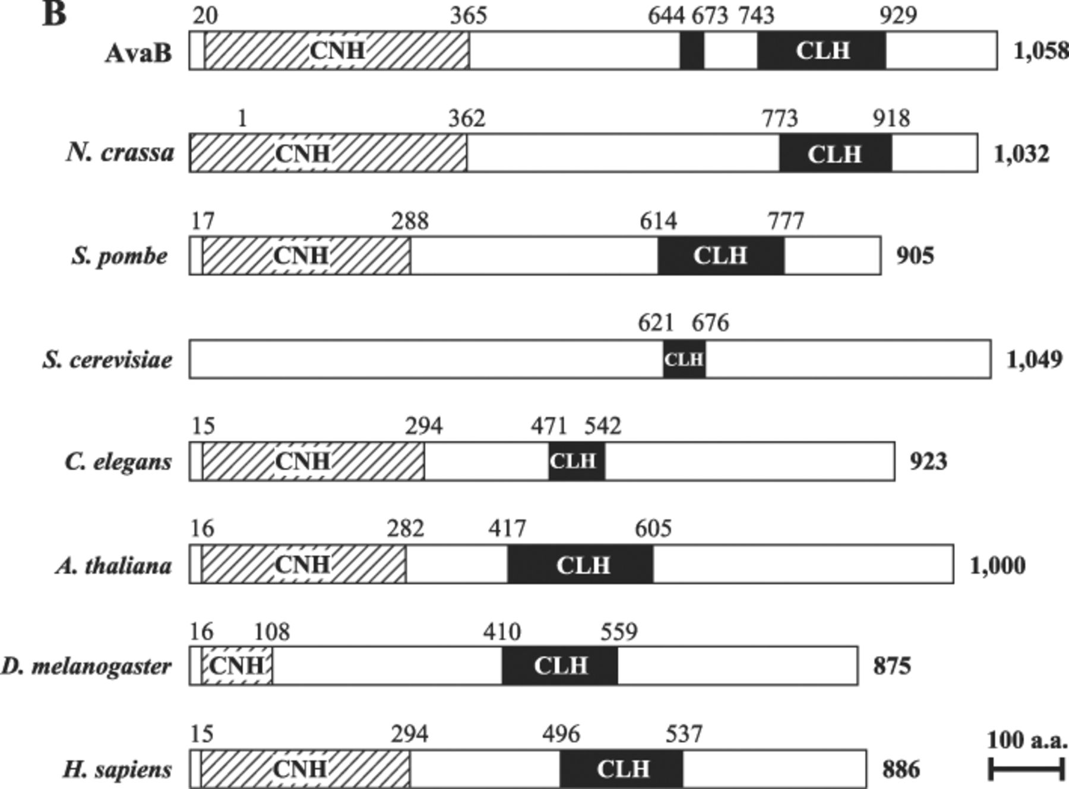
1 A: Nucleotide and deduced amino acid sequences of the A. nidulans avaB gene. Numbers on the left margin ...
Notes:
1 A: Nucleotide and deduced amino acid sequences of the A. nidulans avaB gene. Numbers on the left margin indicate the positions from the first nucleotide and amino acid of the avaB gene and the AvaB protein, respectively. The avaB gene contains three introns, which are indicated by lowercase letters. The BglII site used to insert the argB gene for the gene disruption experiment is boxed. The positions of primers used to screen the genomic library of A. nidulans are underlined. The nucleotide and deduced amino acid sequence data reported here have been deposited in the DDBJ database under the accession number AB090888. B: Proposed domain structure of AvaB and Vam6p/Vps39p family proteins. The total amino acid residue number of each protein is shown at the right. Accession numbers are as follows: Neurospora crassa, CAD21225; S. pombe, CAB11668; S. cerevisiae, BAA11758; Caenorhabditis elegans, CAB04720; Drosophila melanogaster, AAF55525; Arabidopsis thaliana, AAM20730; Homo sapiens, AAK72222.
Unless provided in the caption above, the following copyright applies to the content of this slide: © 2004 Federation of European Microbiological Societies

Slide 4
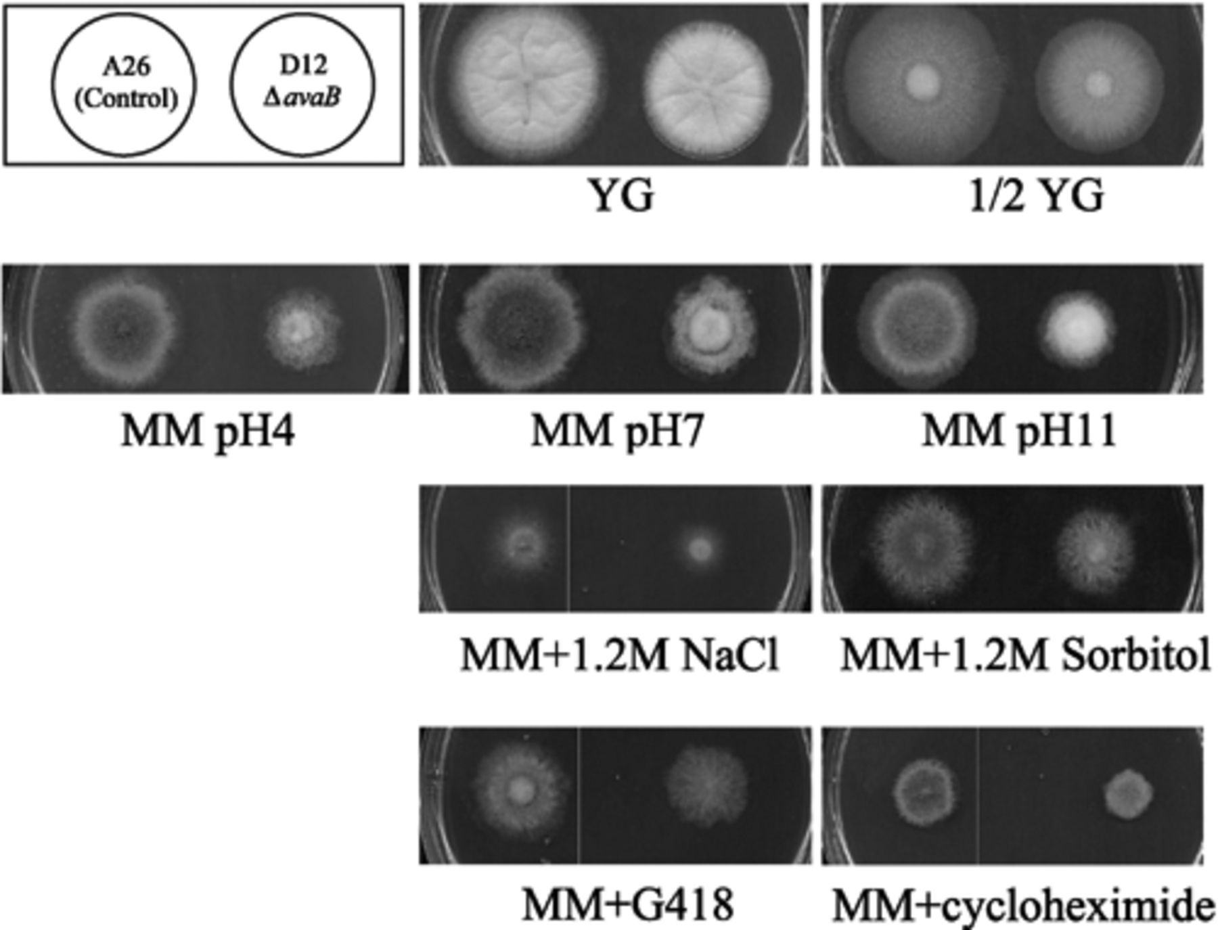
3 Growth of control and avaB disruptant on various media. The control (A26, left) and avaB-disrupted (D12, ...
Notes:
3 Growth of control and avaB disruptant on various media. The control (A26, left) and avaB-disrupted (D12, right) strains of A. nidulans were grown on agar plates under indicated conditions for 3 days at 30°C.
Unless provided in the caption above, the following copyright applies to the content of this slide: © 2004 Federation of European Microbiological Societies

Slide 5
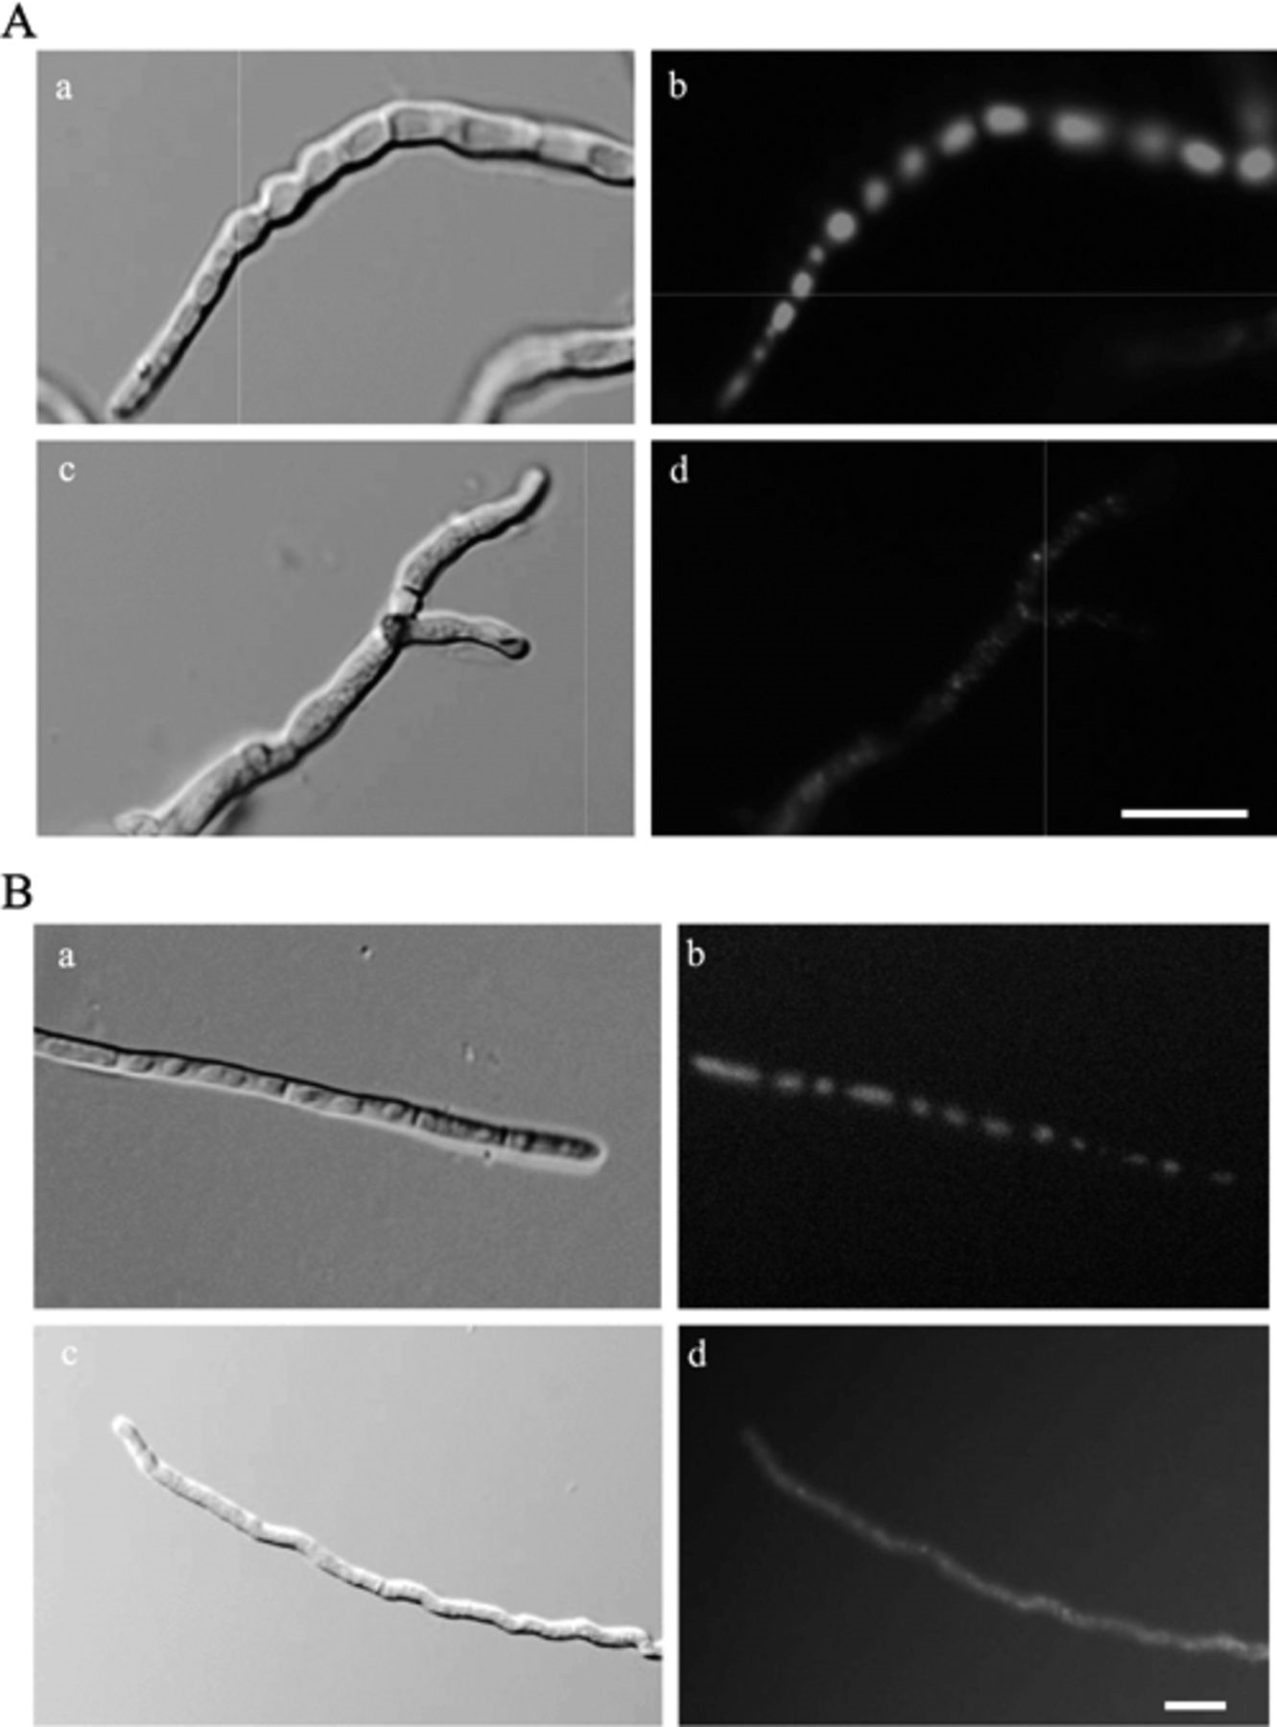
4 Fragmentation of vacuoles in the avaB disruptant of A. nidulans. A: Mycelia from freshly grown control (A26; ...
Notes:
4 Fragmentation of vacuoles in the avaB disruptant of A. nidulans. A: Mycelia from freshly grown control (A26; a and b) and ΔavaB (D12; c and d) strains were stained with CFDA and the cells were observed under Nomarski optics (a and c) or by fluorescence microscopy (b and d). B: A. nidulans strains expressing CpyA-EGFP, CGEBG8 (control; a and b) or CGABD5 (ΔavaB; c and d), were observed under Nomarski optics (a and c) or for the fluorescence of CpyA-EGFP (b and d). Bars, 10 μm.
Unless provided in the caption above, the following copyright applies to the content of this slide: © 2004 Federation of European Microbiological Societies

Slide 6
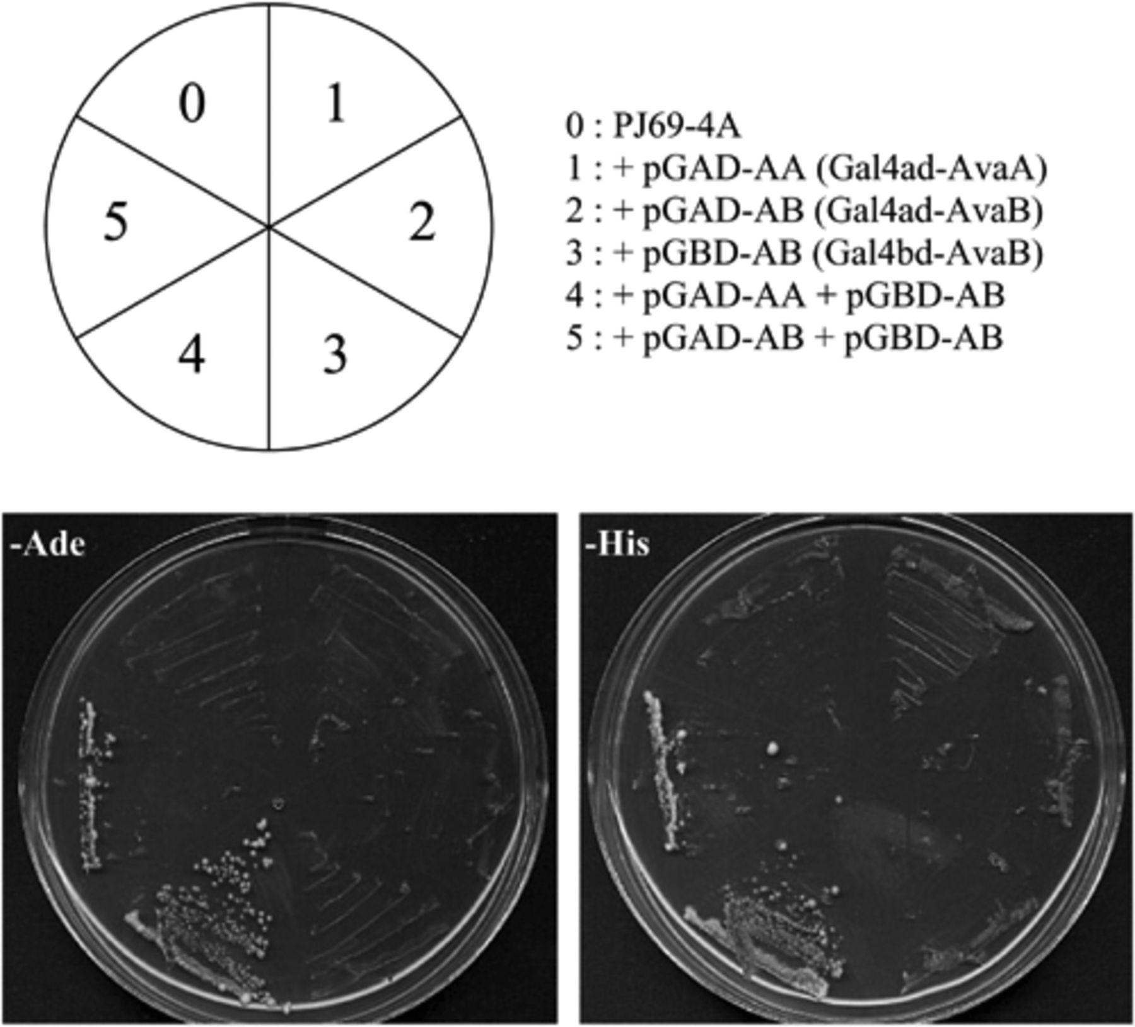
5 Two-hybrid analysis of AvaB hetero- and homooligomerization. S. cerevisiae strain PJ69-4A was transformed ...
Notes:
5 Two-hybrid analysis of AvaB hetero- and homooligomerization. S. cerevisiae strain PJ69-4A was transformed with the fusion constructs expressing Gal4 activation domain (ad)-AvaA (pGAD-AA), Gal4 ad-AvaB (pGAD-AB), or Gal4 DNA binding domain (bd)-AvaB (pGBD-AB), either alone or in combination as indicated in the figure. Transformants were assayed for growth on the adenine-deficient (left) or histidine-deficient (right) media.
Unless provided in the caption above, the following copyright applies to the content of this slide: © 2004 Federation of European Microbiological Societies

