Slide 1
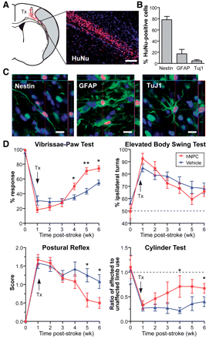
Figure 1 Differentiation fate of transplanted human NPCs and effect on behavioural recovery after stroke. (A) Human ...
Notes:
Figure 1 Differentiation fate of transplanted human NPCs and effect on behavioural recovery after stroke. (A) Human NPCs (human nuclear antigen+ cells; red) exhibit good survival and migration towards the lesion at 5 weeks post-transplantation. Representative photomicrograph of human NPCs in the peri-infarct region. Grey-shaded area indicates the lesion. (B) Differentiation profile of the human NPCs at 5 weeks post-transplant. (C) Confocal images of differentiation markers co-localizing with human nuclear antigen in the peri-infarct area. (D) Human NPC-grafted animals have significantly improved functional recovery compared with vehicle-injected controls in three out of four behaviour tests; *P < 0.05, **P < 0.01. n = 12 per group, except cylinder test n = 6. Scale bars: A = 50 µm, C = 10 µm. GFAP = glial fibrillary acidic protein; HuNu = human nuclear antigen; TuJ1 = neuronal class III β-Tubulin; Tx = transplantation.
Unless provided in the caption above, the following copyright applies to the content of this slide: © The Author(s) 2011. Published by Oxford University Press on behalf of Brain.This is an Open Access article distributed under the terms of the Creative Commons Attribution Non-Commercial License (http://creativecommons.org/licenses/by-nc/2.5), which permits unrestricted non-commercial use, distribution, and reproduction in any medium, provided the original work is properly cited.

Slide 2
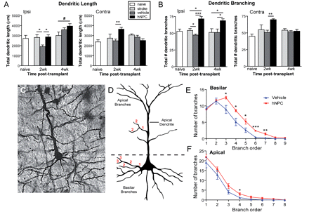
Figure 2 Human NPC transplantation enhances dendritic plasticity after stroke. (A and B) Human NPCs enhance dendritic ...
Notes:
Figure 2 Human NPC transplantation enhances dendritic plasticity after stroke. (A and B) Human NPCs enhance dendritic length (A) and branching (B) at 2 weeks post-transplantation in both the ipsi- and contralesional cortex compared with vehicle-treated animals (n = 4–5 per group). These effects are sustained to 4 weeks post-stroke (n = 5 per group) only in the ipsilesional hemisphere. (C) Representative image of a golgi-stained layer V neuron. (D) Schematic illustrating how branch order is counted for apical and basilar dendrites. (E and F) At 4 weeks post-transplantation human NPCs enhance branching in the middle order branches in ipsilesional layer V neurons. This is more significant in basilar branches (E) compared with apical branches (F). *P < 0.05; **P < 0.01; ***P < 0.001; #P = 0.05.
Unless provided in the caption above, the following copyright applies to the content of this slide: © The Author(s) 2011. Published by Oxford University Press on behalf of Brain.This is an Open Access article distributed under the terms of the Creative Commons Attribution Non-Commercial License (http://creativecommons.org/licenses/by-nc/2.5), which permits unrestricted non-commercial use, distribution, and reproduction in any medium, provided the original work is properly cited.

Slide 3
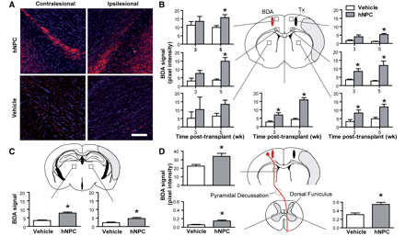
Figure 3 Human NPCs enhance axonal sprouting post-stroke. (A) Representative confocal images of biotinylated dextran ...
Notes:
Figure 3 Human NPCs enhance axonal sprouting post-stroke. (A) Representative confocal images of biotinylated dextran amine (BDA) staining in the contra- and ipsilateral corpus callosum of human NPC- and vehicle-treated animals at 5 weeks post-transplantation. Scale bar = 100 µm. (B) Human NPC-grafted rats have significantly increased BDA-labelled fibre density at 3 weeks (n = 6) and 5 weeks (n = 12) post-transplantation in the cortex, corpus callosum and the ipsilesional striatum. At 5 weeks post-transplantation human NPC-grafted rats also have increased BDA signal in (C) the ipsi- and contralesional thalamus and (D) corticospinal fibres in the contralesional internal capsule and both the contra- and ipsilesional dorsal funiculus in the cervical spinal cord, C5 level. *P < 0.05 human NPC compared with vehicle at same time point. Red oval = BDA injection site; black oval = human NPC transplant site.
Unless provided in the caption above, the following copyright applies to the content of this slide: © The Author(s) 2011. Published by Oxford University Press on behalf of Brain.This is an Open Access article distributed under the terms of the Creative Commons Attribution Non-Commercial License (http://creativecommons.org/licenses/by-nc/2.5), which permits unrestricted non-commercial use, distribution, and reproduction in any medium, provided the original work is properly cited.

Slide 4
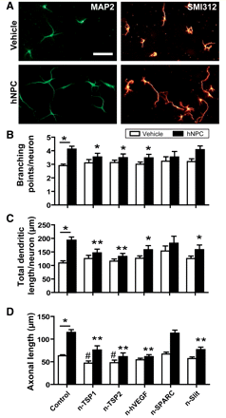
Figure 4 Identification of secreted factors mediating neurite plasticity in vitro. (A) Representative images of ...
Notes:
Figure 4 Identification of secreted factors mediating neurite plasticity in vitro. (A) Representative images of cortical neurons stained for microtubule-associated protein 2 (MAP2, labels dendrites) and SMI312 (labels axons) co-cultured without (vehicle) and with human NPCs. Scale = 50 µm. (B–D) Human NPCs significantly promoted dendritic branching (B), total dendritic length (C) and axonal outgrowth (D) of the cortical neurons; *P < 0.05 ‘control human NPC’ compared with ‘control vehicle’. Neutralization of the secreted factors with antibodies or the soluble slit receptor Roundabout-Fc significantly reduced the effects of human NPCs on these parameters as indicated. *P < 0.05, **P < 0.01 compared with ‘control human NPC’; #P < 0.05 compared with ‘control vehicle’. TSP = thrombospondins.
Unless provided in the caption above, the following copyright applies to the content of this slide: © The Author(s) 2011. Published by Oxford University Press on behalf of Brain.This is an Open Access article distributed under the terms of the Creative Commons Attribution Non-Commercial License (http://creativecommons.org/licenses/by-nc/2.5), which permits unrestricted non-commercial use, distribution, and reproduction in any medium, provided the original work is properly cited.

Slide 5
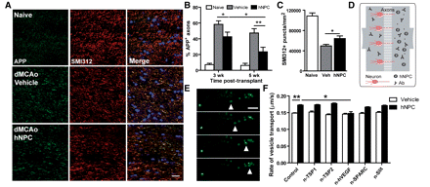
Figure 5 Effects of human NPCs on anterograde axonal transport in vivo and in vitro. (A) Representative confocal ...
Notes:
Figure 5 Effects of human NPCs on anterograde axonal transport in vivo and in vitro. (A) Representative confocal images of amyloid precursor protein (APP) and SMI312 staining of the corpus callosum at 6 weeks post-stroke (5 weeks post-transplant) in uninjured (naïve), vehicle treated (dMCAo, vehicle) and human NPC-grafted (dMCAo, hNPC) animals. Scale = 20 µm (B) Quantification of the percentage of amyloid precursor protein-positive SMI312 puncta to determine the percentage of amyloid precursor protein-positive axons; 3 weeks, n = 6; 5 weeks n = 12. (C) Quantification of total axonal density at 6 weeks post-stroke (n = 12). (D) Schematic of microfluidic assay system for analysis of axonal transport in vitro. (E) Time-lapse confocal images of dextran-labelled vesicles used to measure the rate of axonal transport. Arrowhead indicates the same vesicle at different times. Scale = 5 µm. (F) Human NPCs enhance the rate of axonal transport in cortical neurons compared with vehicle treatment. Neutralization of VEGF, but not other factors significantly reduced this human NPC-mediated effect. *P < 0.05, **P < 0.01. dMCAo = distal middle cerebral artery occlusion.
Unless provided in the caption above, the following copyright applies to the content of this slide: © The Author(s) 2011. Published by Oxford University Press on behalf of Brain.This is an Open Access article distributed under the terms of the Creative Commons Attribution Non-Commercial License (http://creativecommons.org/licenses/by-nc/2.5), which permits unrestricted non-commercial use, distribution, and reproduction in any medium, provided the original work is properly cited.

