Slide 1
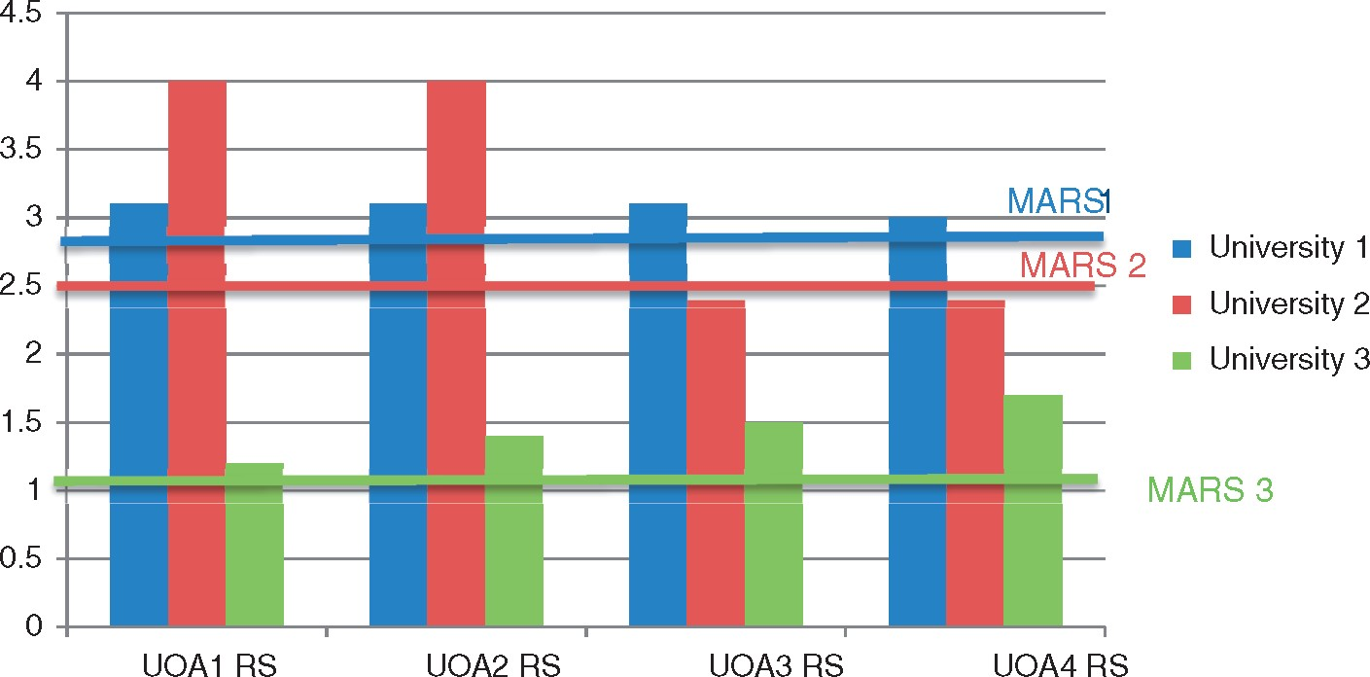
Figure 1. REE scores (RS), MARSS, and research support decisions.
Notes:
Figure 1. REE scores (RS), MARSS, and research support decisions.
Unless provided in the caption above, the following copyright applies to the content of this slide: © The Author 2017. Published by Oxford University Press. All rights reserved. For Permissions, please email: journals.permissions@oup.com

Slide 2
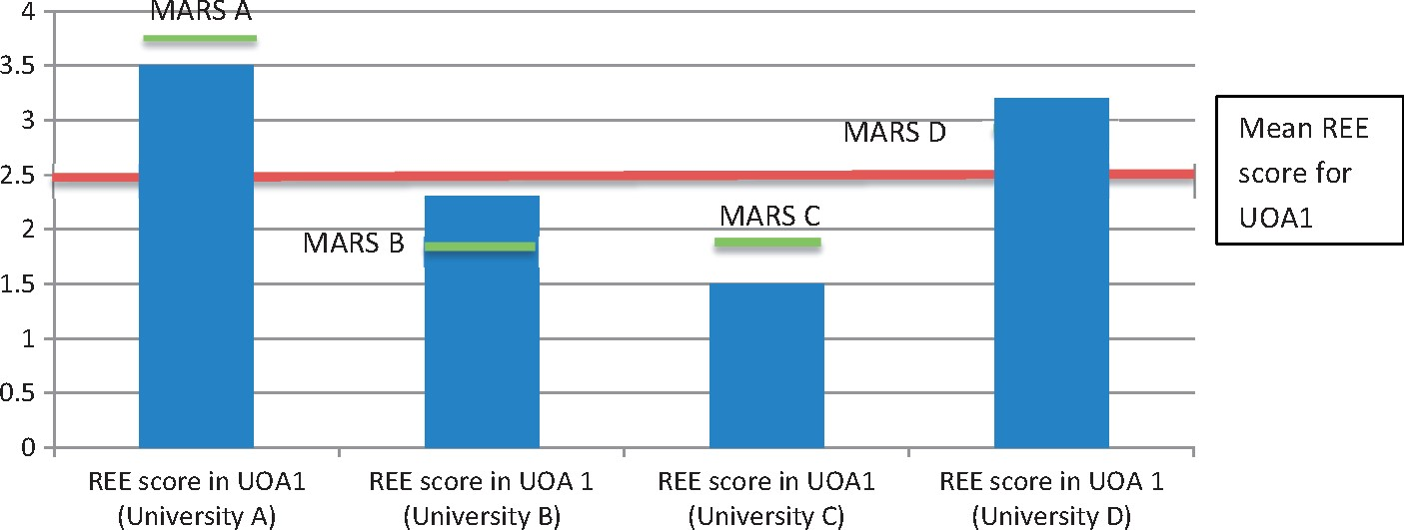
Figure 2. REE scores, the institutional MARS, and internal and external gaps.
Notes:
Figure 2. REE scores, the institutional MARS, and internal and external gaps.
Unless provided in the caption above, the following copyright applies to the content of this slide: © The Author 2017. Published by Oxford University Press. All rights reserved. For Permissions, please email: journals.permissions@oup.com

Slide 3
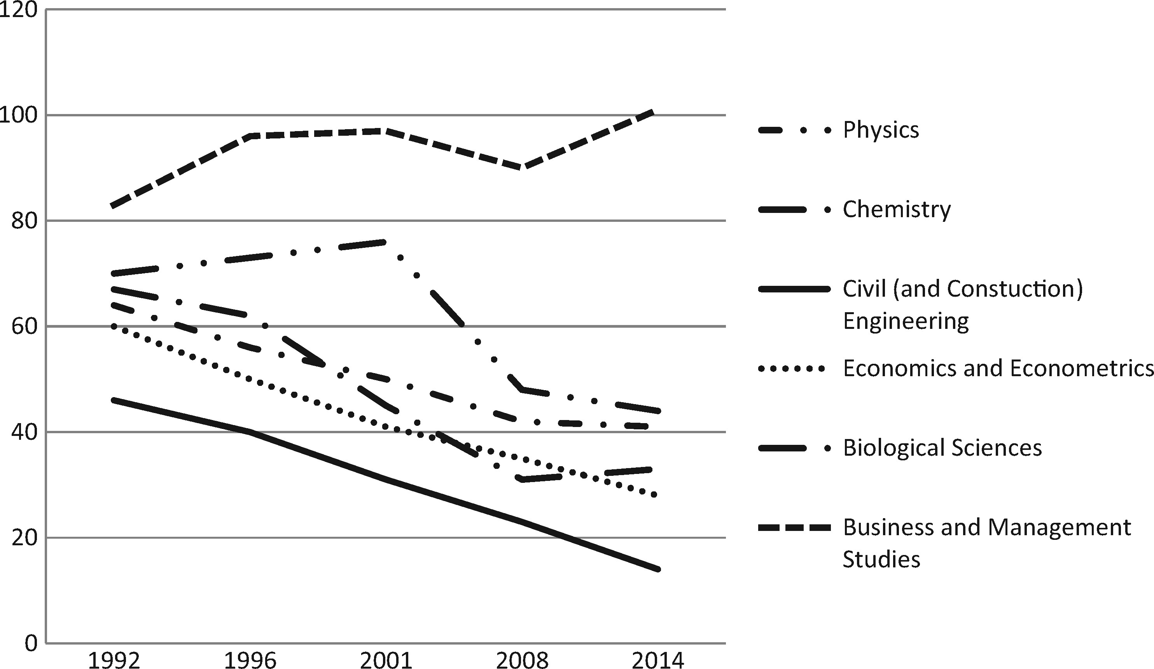
Figure 3. The number of universities submitting to selected UOAs 1992–2014.
Notes:
Figure 3. The number of universities submitting to selected UOAs 1992–2014.
Unless provided in the caption above, the following copyright applies to the content of this slide: © The Author 2017. Published by Oxford University Press. All rights reserved. For Permissions, please email: journals.permissions@oup.com

Slide 4
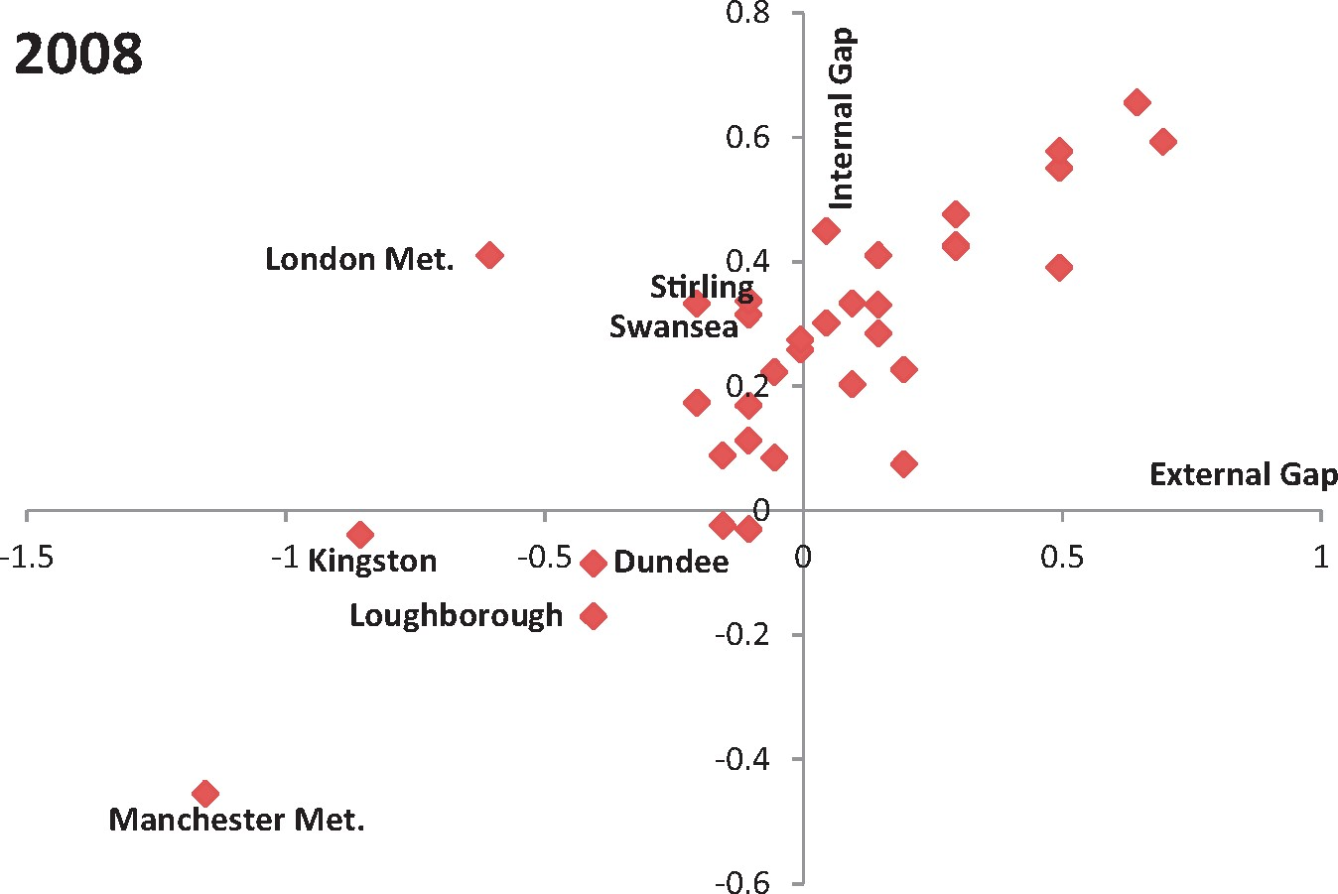
Figure 5. E&E internal and external gaps 2008.
Notes:
Figure 5. E&E internal and external gaps 2008.
Unless provided in the caption above, the following copyright applies to the content of this slide: © The Author 2017. Published by Oxford University Press. All rights reserved. For Permissions, please email: journals.permissions@oup.com

Slide 5
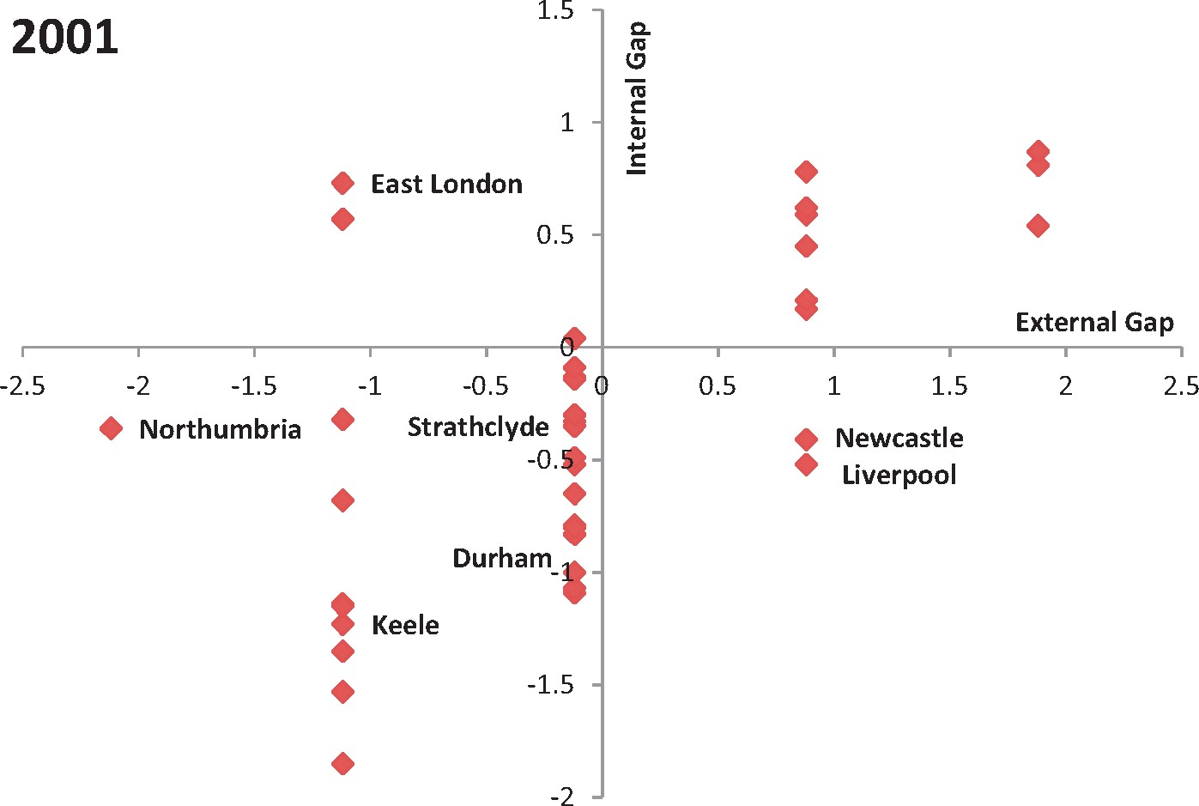
Figure 6. E&E internal and external gaps 2001.
Notes:
Figure 6. E&E internal and external gaps 2001.
Unless provided in the caption above, the following copyright applies to the content of this slide: © The Author 2017. Published by Oxford University Press. All rights reserved. For Permissions, please email: journals.permissions@oup.com

Slide 6
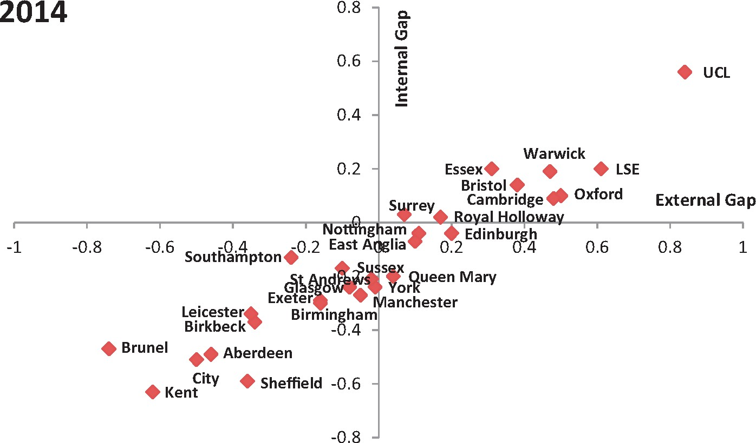
Figure 4. E&E internal and external gaps 2014.
Notes:
Figure 4. E&E internal and external gaps 2014.
Unless provided in the caption above, the following copyright applies to the content of this slide: © The Author 2017. Published by Oxford University Press. All rights reserved. For Permissions, please email: journals.permissions@oup.com

Slide 7
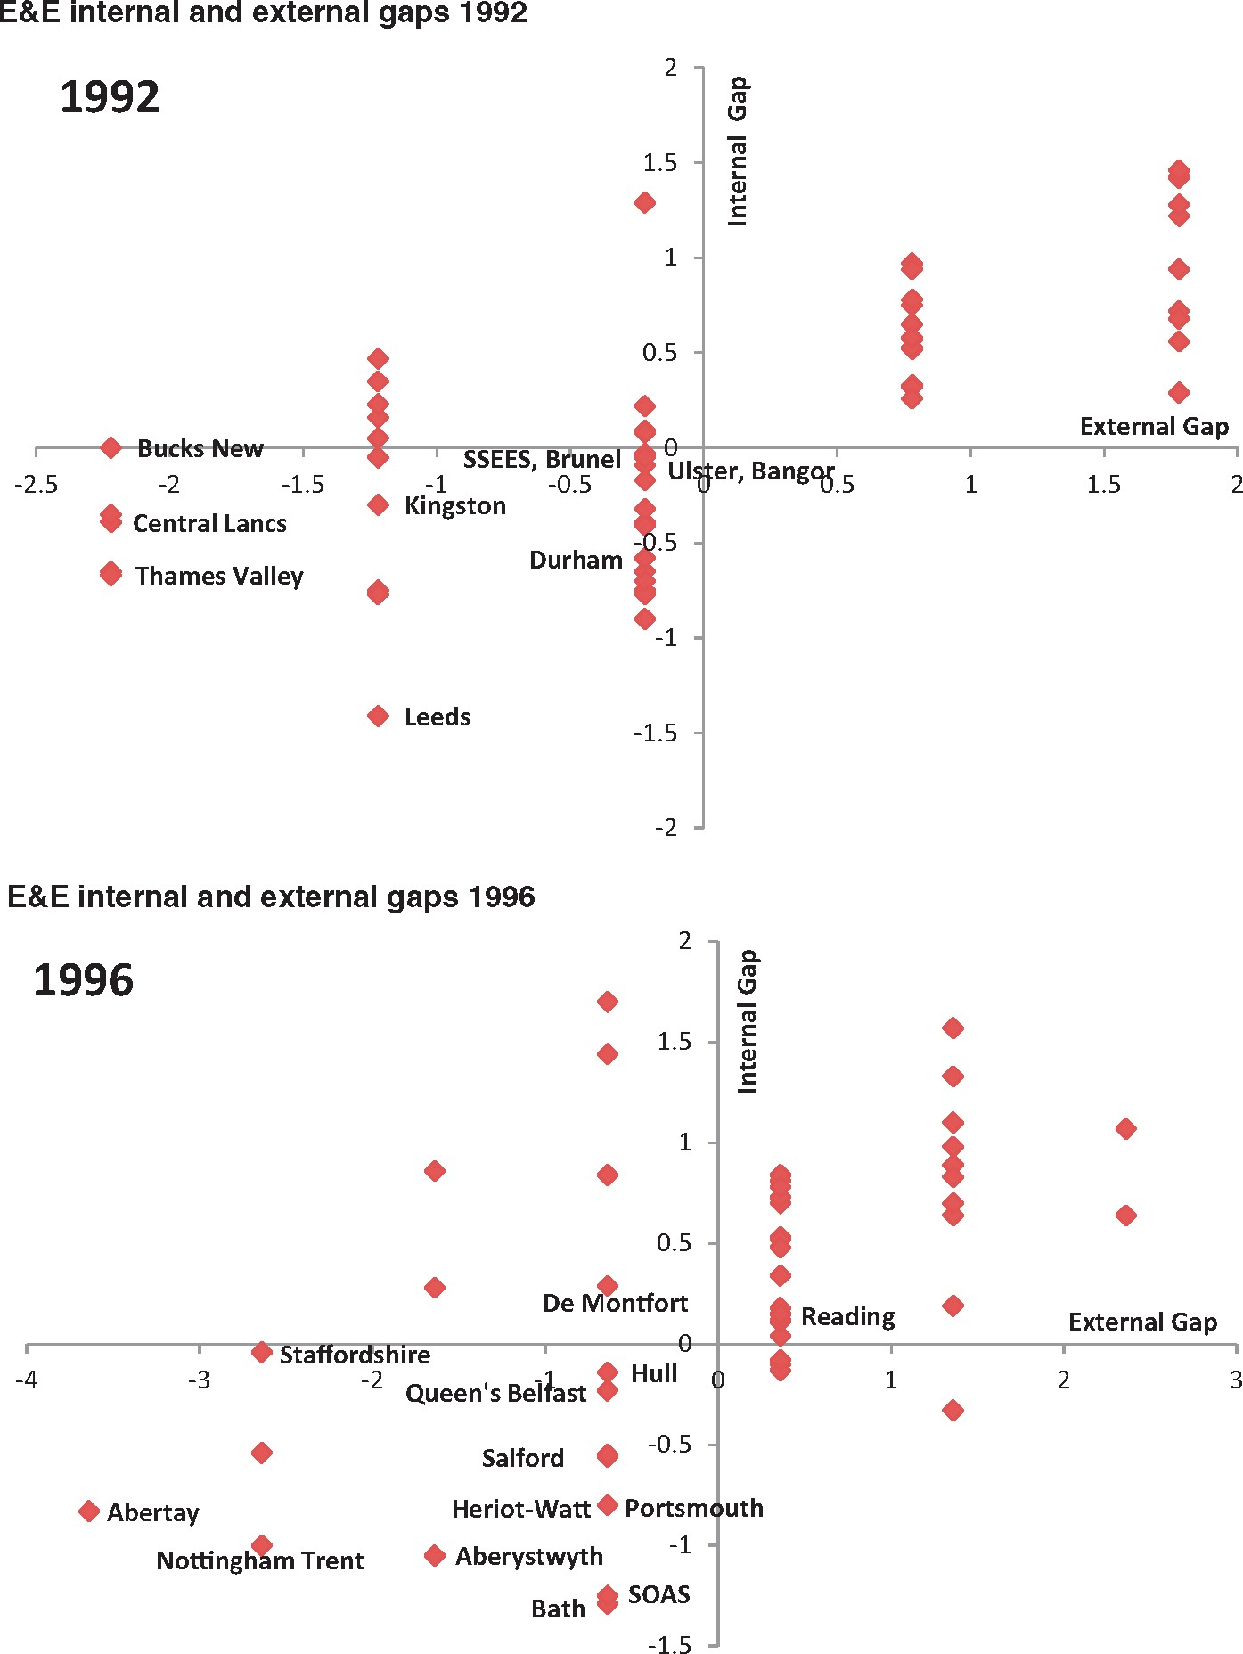
Figure A.1 E&E internal and external gaps 1992.
Notes:
Figure A.1 E&E internal and external gaps 1992.
Unless provided in the caption above, the following copyright applies to the content of this slide: © The Author 2017. Published by Oxford University Press. All rights reserved. For Permissions, please email: journals.permissions@oup.com

