Slide 1
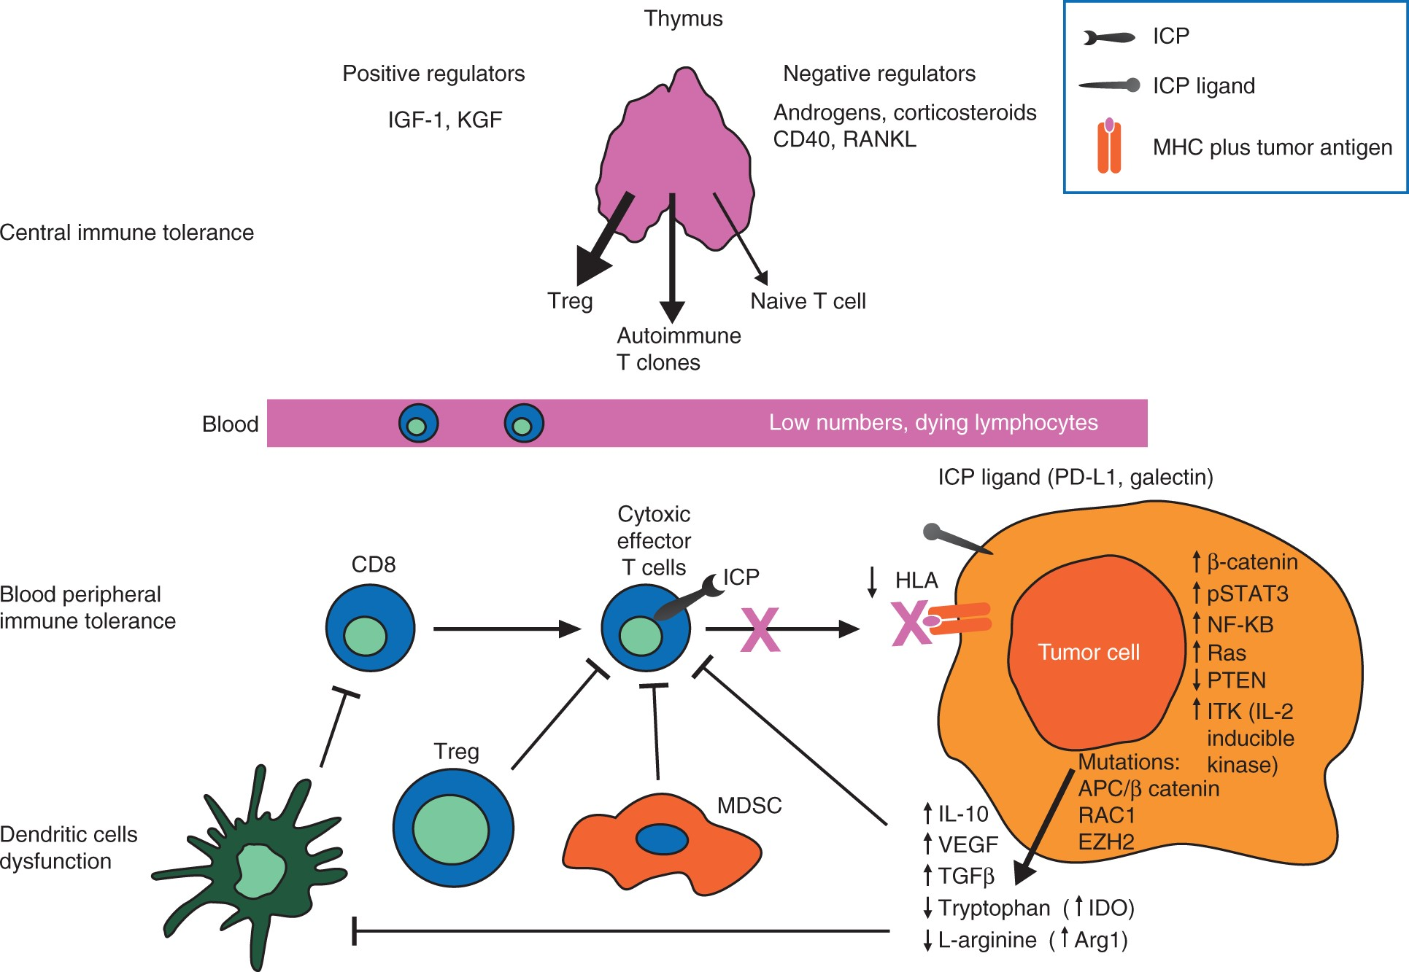
Figure 1. Mechanisms of immune tolerance. Immune tolerance involves a range of overlapping mechanisms that involve not ...
Notes:
Figure 1. Mechanisms of immune tolerance. Immune tolerance involves a range of overlapping mechanisms that involve not only the periphery (e.g. tumor site), but also central lymphoid organs, especially thymus. They include intrathymic negative regulation (central), decreased costimulation, anergic signals from tumor cells, and immunoregulation (e.g. from Treg and MDSC [peripheral]). Arg1, arginase 1; HLA, human leukocyte antigen; ICP, immune checkpoint protein; IDO, indoleamine 2,3-dioxygenase; IGF-1, insulin-like growth factor; IL-10, interleukin 10; KGF, keratinocyte growth factor; MDSC, myeloid-derived suppressor cell; MHC, major histocompatibility complex; NF-κB, nuclear factor kappa-B; PD-L1, programmed death ligand 1; STAT, signal transducer and activator of transcription; RANKL, receptor activator of nuclear factor kappa-B ligand; TGF, transforming growth factor; Treg, regulatory T cells; VEGF, vascular endothelial growth factor.
Unless provided in the caption above, the following copyright applies to the content of this slide: © The Author 2016. Published by Oxford University Press on behalf of the European Society for Medical Oncology. All rights reserved. For permissions, please email: journals.permissions@oup.com.

Slide 2
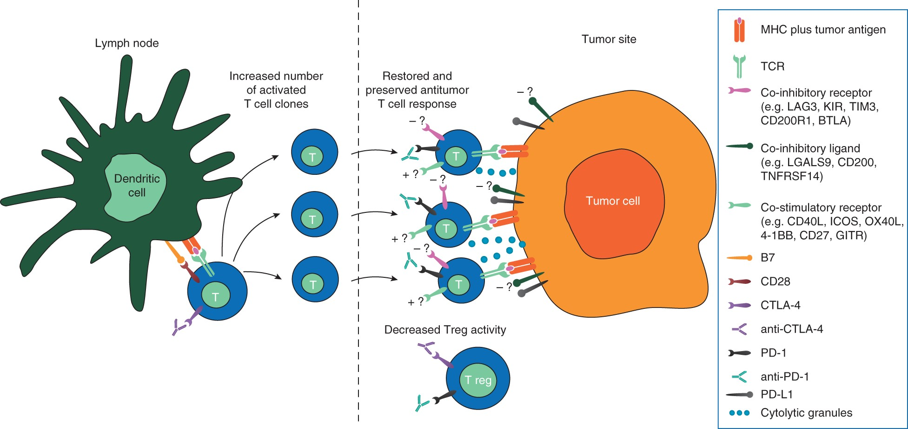
Figure 2. Implications of CTLA-4 and PD-1 dual pathway blockade. Interruption of CTLA-4:B7 binding by T cells in lymph ...
Notes:
Figure 2. Implications of CTLA-4 and PD-1 dual pathway blockade. Interruption of CTLA-4:B7 binding by T cells in lymph nodes via anti-CTLA-4 increases T-cell proliferation, activation, and survival, potentially leading to an increased number of activated T-cell clones that can respond to tumor antigens. Blockade of PD-1:PD-L1 binding at the tumor site via anti-PD-1 restores the activity of antitumor T cells that have become inactivated. CTLA-4 and PD-1 blockade may also reduce the suppressive effects of Tregs at the tumor site. Please note that T cells may express other (i.e. non-CTLA-4, non-PD-1, PD-L1) co-stimulatory (+?) as well as co-inhibitory immune checkpoint proteins (-?), whereas tumor cells upregulate almost exclusively co-inhibitory ICPs via genetic (gene amplification) [17] or epigenetic mechanisms (upregulation of PI3K) [87]. BTLA, B- and T-lymphocyte attenuator; CTLA-4, cytotoxic T-lymphocyte antigen 4; GITR, glucocorticoid-induced TNFR-related protein; ICOS, inducible costimulator; LAG-3, lymphocyte activation gene-3; LGALS9, lectin, galactoside-binding, soluble-9; KIR, killer-cell immunoglobulin-like receptor; PD-1, programmed death-1; PD-L1, programmed death ligand 1; TCR, T-cell receptor; TNFSRF, tumor necrosis factor receptor superfamily-14; Treg, regulatory T cells.
Unless provided in the caption above, the following copyright applies to the content of this slide: © The Author 2016. Published by Oxford University Press on behalf of the European Society for Medical Oncology. All rights reserved. For permissions, please email: journals.permissions@oup.com.

