Slide 1
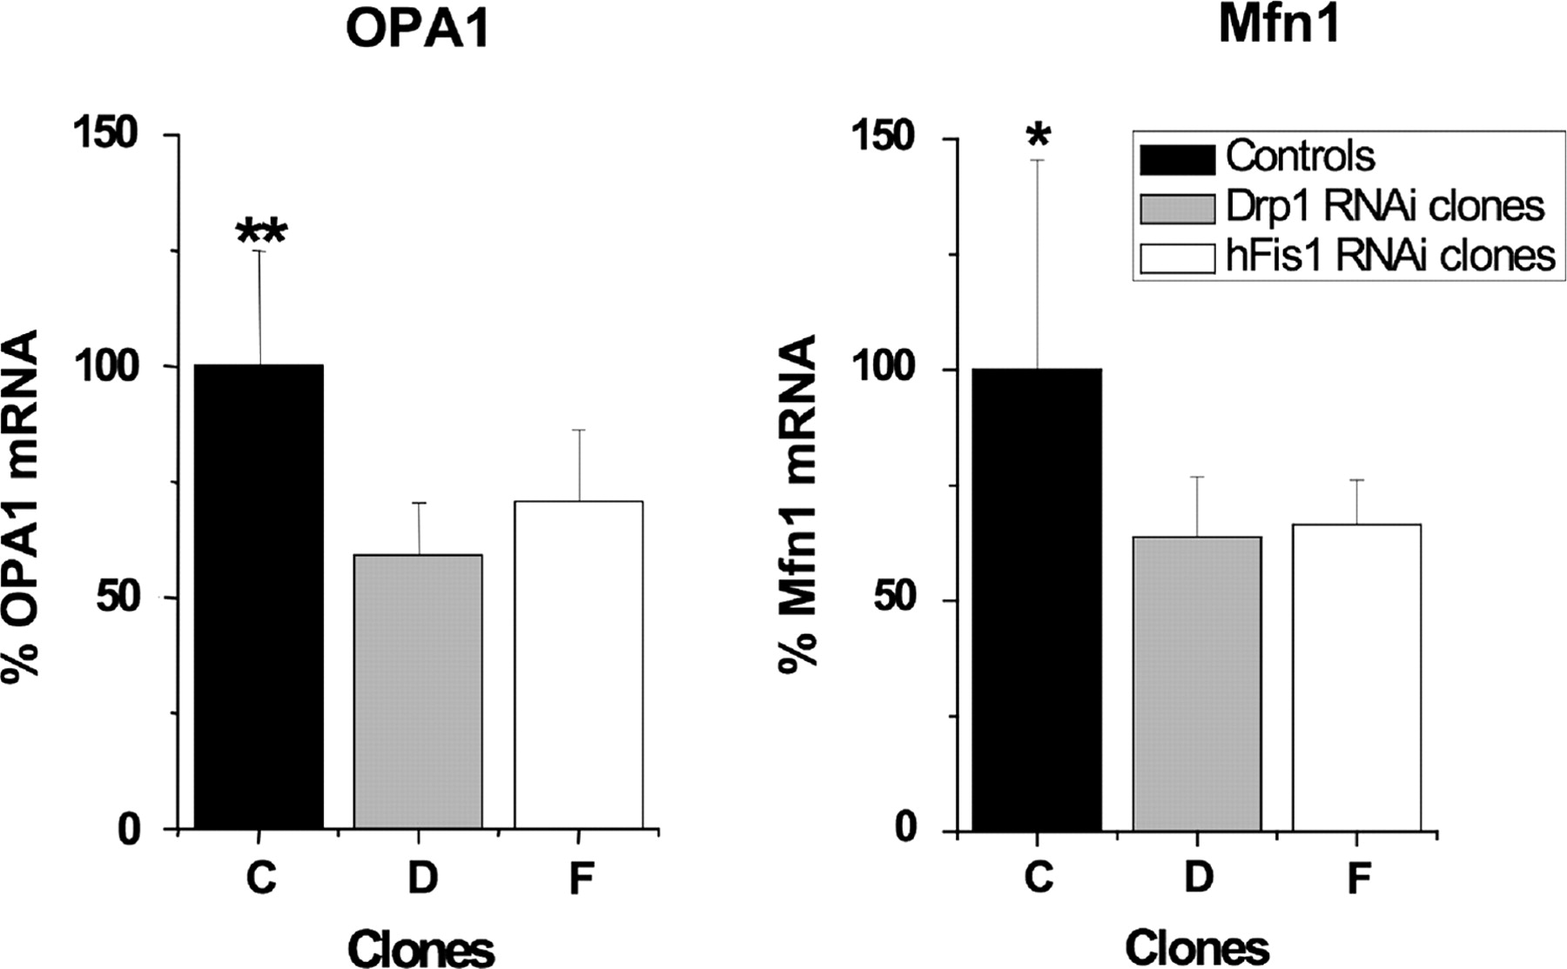
Figure 5. OPA1 and Mitofusion 1 (Mfn1) expression are reduced in RD cells carrying shRNAs targeting Drp1 or hFis1. OPA1 ...
Notes:
Figure 5. OPA1 and Mitofusion 1 (Mfn1) expression are reduced in RD cells carrying shRNAs targeting Drp1 or hFis1. OPA1 mRNA was significantly lower in four shRNA Drp1 clones (D) and in five clones downregulated for hFis1 (F) (**P < 0.01) than controls (four pRep4 vector containing AP4 clones, C). Mitofusin 1 mRNA abundance was reduced to a similar extent in the same clones (*P < 0.05). The values expressed are means ± one SD.
Unless provided in the caption above, the following copyright applies to the content of this slide: © The Author 2009. Published by Oxford University Press. All rights reserved. For Permissions, please email: journals.permissions@oxfordjournals.org

Slide 2
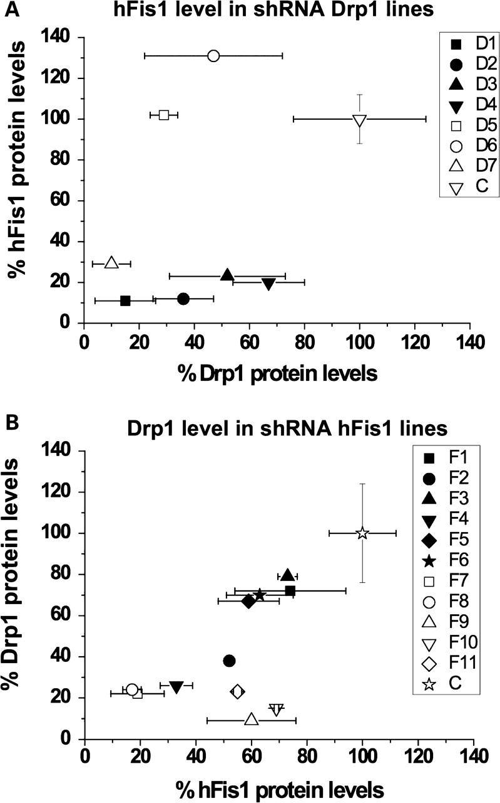
Figure 4. Drp1 and hFis1 expression are co-dependent in many clones. (A) hFis1 protein was quantified in Drp1 RNAi ...
Notes:
Figure 4. Drp1 and hFis1 expression are co-dependent in many clones. (A) hFis1 protein was quantified in Drp1 RNAi clones (D1–D7) and expressed relative to actin (i.e. the same reference as used for estimating the abundance of Drp1 protein). (B) The expression level of Drp1 in hFis1 RNAi clones (F1–F11).
Unless provided in the caption above, the following copyright applies to the content of this slide: © The Author 2009. Published by Oxford University Press. All rights reserved. For Permissions, please email: journals.permissions@oxfordjournals.org

Slide 3
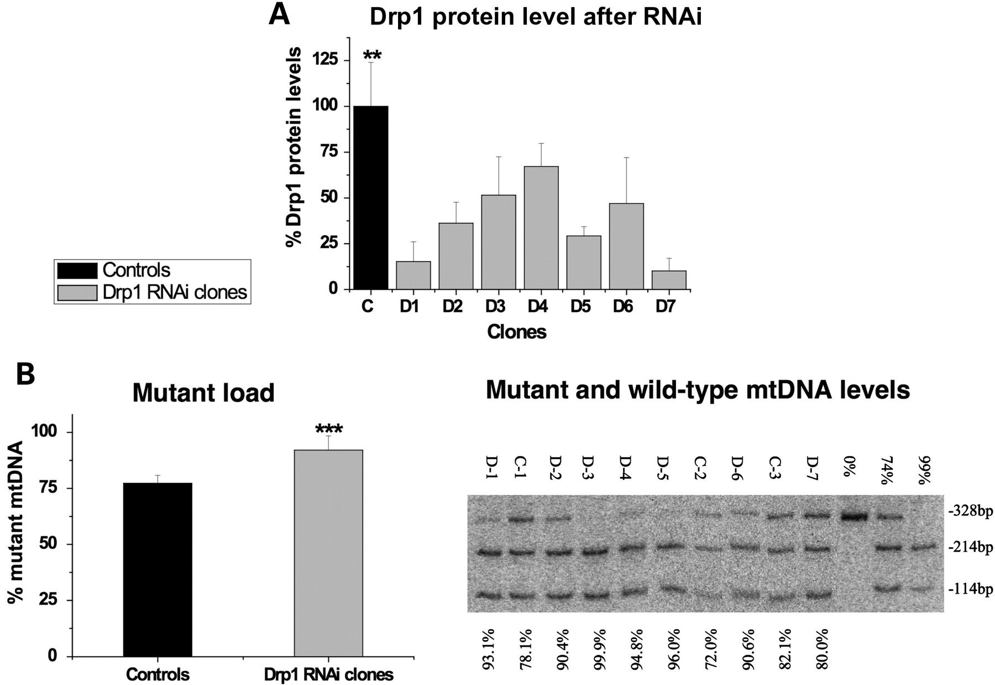
Figure 2. Drp1 protein (expression) is associated with an increase in the proportion of A3243G mutant mtDNA in RD ...
Notes:
Figure 2. Drp1 protein (expression) is associated with an increase in the proportion of A3243G mutant mtDNA in RD cells. (A) Quantification of Drp1 protein level in total cell lysates from Drp1 shRNA clones (D-1 to D-7) and controls (pRep4 vector containing clones C-1 to C-6). The abundance of Drp1 relative to the mitochondrial outer membrane protein (VDAC) and the cytoskeletal element (actin) was determined by immunoblotting. Drp1 was decreased relative to VDAC and actin based on visual inspection, and this was confirmed by quantifying Drp1 and actin, as indicated in the graph. Data represent the mean ± one SE, n ≥ 2. The mean Drp1 level among seven Drp1 RNAi clones was significantly lower than six control clones, P < 0.01 (**). (B) Mutant and wild-type mtDNA levels were analysed by phosphor-imaging, after LC-Hot PCR and ApaI digestion (see Materials and Methods). The percentage of mutant A3243G mtDNA is indicated at the base of the phosphorimage; quantification of the fragments indicated a higher mutant load (% A3243G mtDNA) among Drp1 RNAi clones, compared with controls. Each value represents the mean ± one SD, n ≥ 3. The mean mutant load of the seven Drp1 RNAi clones was significantly higher than the six control clones, P < 0.001 (***).
Unless provided in the caption above, the following copyright applies to the content of this slide: © The Author 2009. Published by Oxford University Press. All rights reserved. For Permissions, please email: journals.permissions@oxfordjournals.org

Slide 4
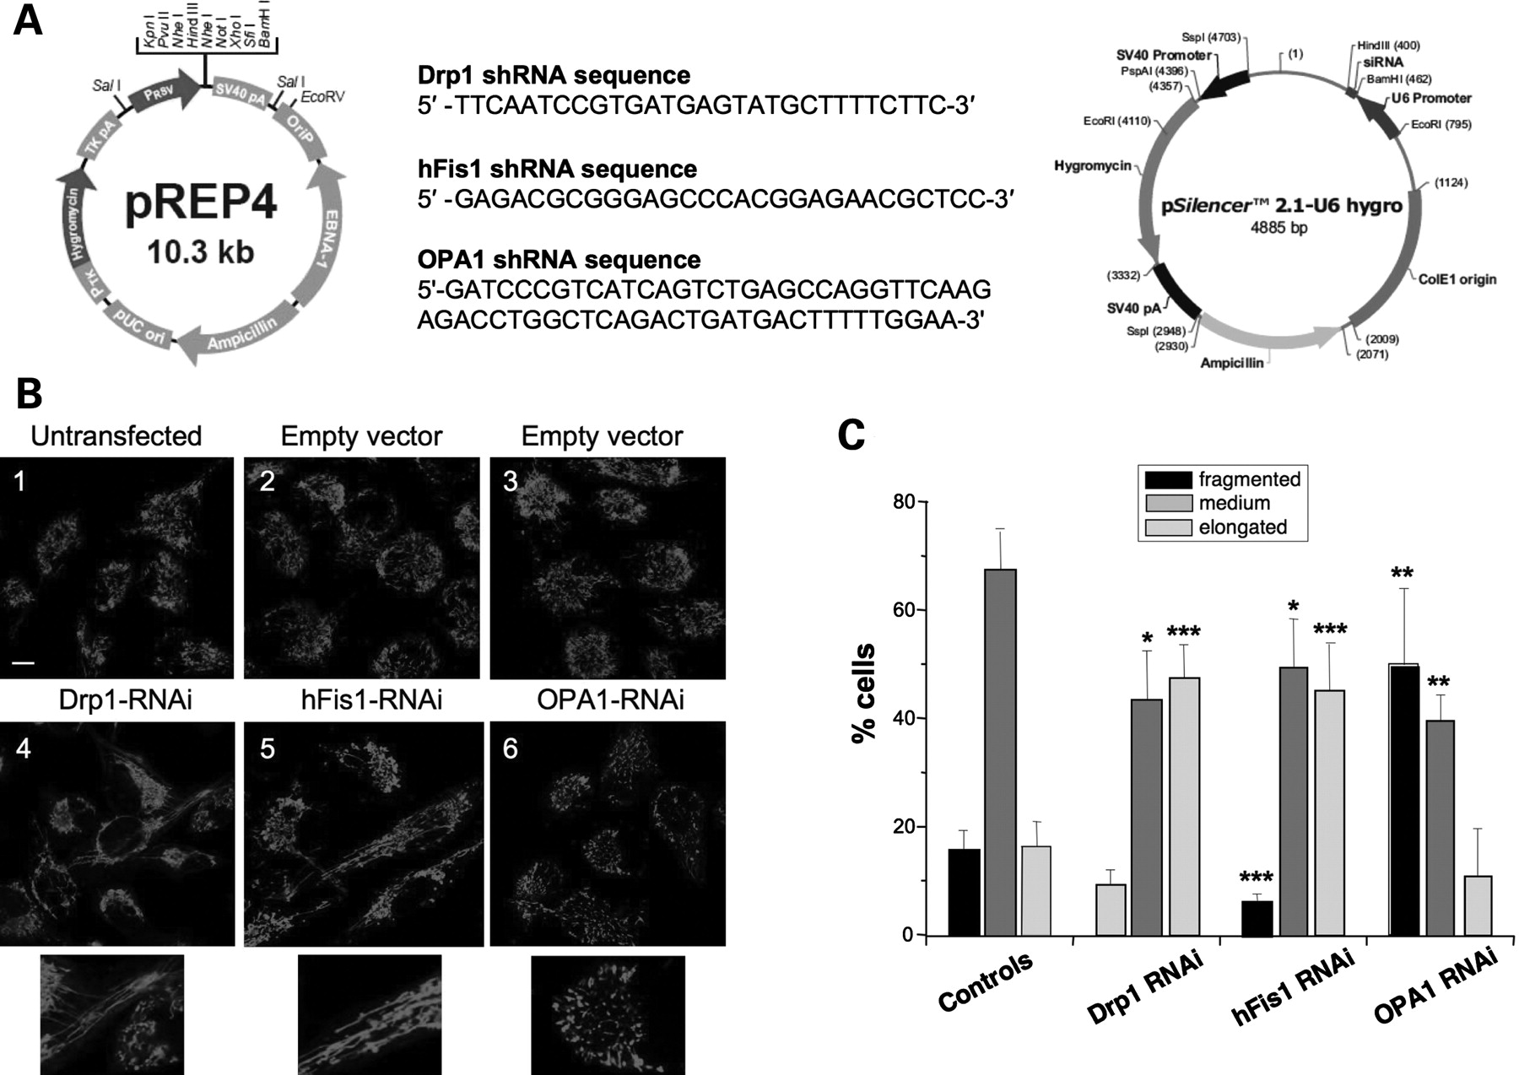
Figure 1. Gene-silencing of components of the mitochondrial fission and fusion apparatus alters mitochondrial ...
Notes:
Figure 1. Gene-silencing of components of the mitochondrial fission and fusion apparatus alters mitochondrial morphology in RD cells with mutant mtDNA. (A) Plasmids specifying shRNAs targeting Drp1 (21), hFis1 (21) or OPA1 (58) were used to transform rhabdomyosarcoma (RD) cells carrying 80% A3243G mtDNA. Controls were untransformed (parental) recipient cells or transformants with pRep4 lacking an insert (empty vector). (B) After 1 month’s growth in selective medium the mitochondrial morphology of Drp1, hFis1 and OPA1 RNAi cells was visualized with Mito-Tracker Red and analysed by confocal microscopy, and compared with controls. Enlargements show the detailed structure of mitochondria in shRNA transfected cells. Control cells (B1, B2 and B3) contained primarily ‘intermediate’ mitochondria; cells carrying shRNAs to Drp1 (B4) and hFis1 (B5) had many elongated mitochondria, whereas cells with OPA1 shRNA (B6) contained many more fragmented mitochondria than normal. Scale bar: 10 µm. (C) The percentage of cell population with fragmented, intermediate or elongated mitochondria in control cells or Drp1, hFis1 and OPA1 RNAi cells. Over 400 cells from multiple fields were scored for each category. Data represent the mean ± one SD of two clones chosen at random. Statistical significance *P < 0.05, **P < 0.01, ***P < 0.001.
Unless provided in the caption above, the following copyright applies to the content of this slide: © The Author 2009. Published by Oxford University Press. All rights reserved. For Permissions, please email: journals.permissions@oxfordjournals.org

Slide 5
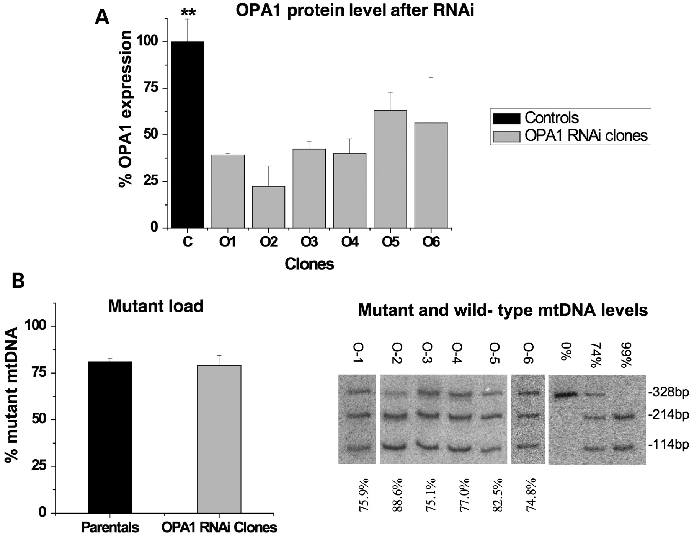
Figure 7. Decreased OPA1 expression has no effect on the proportion of A3243G mutant mtDNA in RD cells. (A) ...
Notes:
Figure 7. Decreased OPA1 expression has no effect on the proportion of A3243G mutant mtDNA in RD cells. (A) Quantification of OPA1 protein level, analysed by immunoblotting and quantified relative to actin in total cell lysates from OPA1 RNAi clones, along with control parental RD cells. Data represent the means ± one SE, n ≥ 2. OPA1 was significantly reduced in the OPA1 RNAi clones compared with the parental RD cybrids, P < 0.01. However, there was no appreciable change in the proportion of mutant and wild-type mtDNA in any of the OPA1 RNAi clones (B).
Unless provided in the caption above, the following copyright applies to the content of this slide: © The Author 2009. Published by Oxford University Press. All rights reserved. For Permissions, please email: journals.permissions@oxfordjournals.org

Slide 6
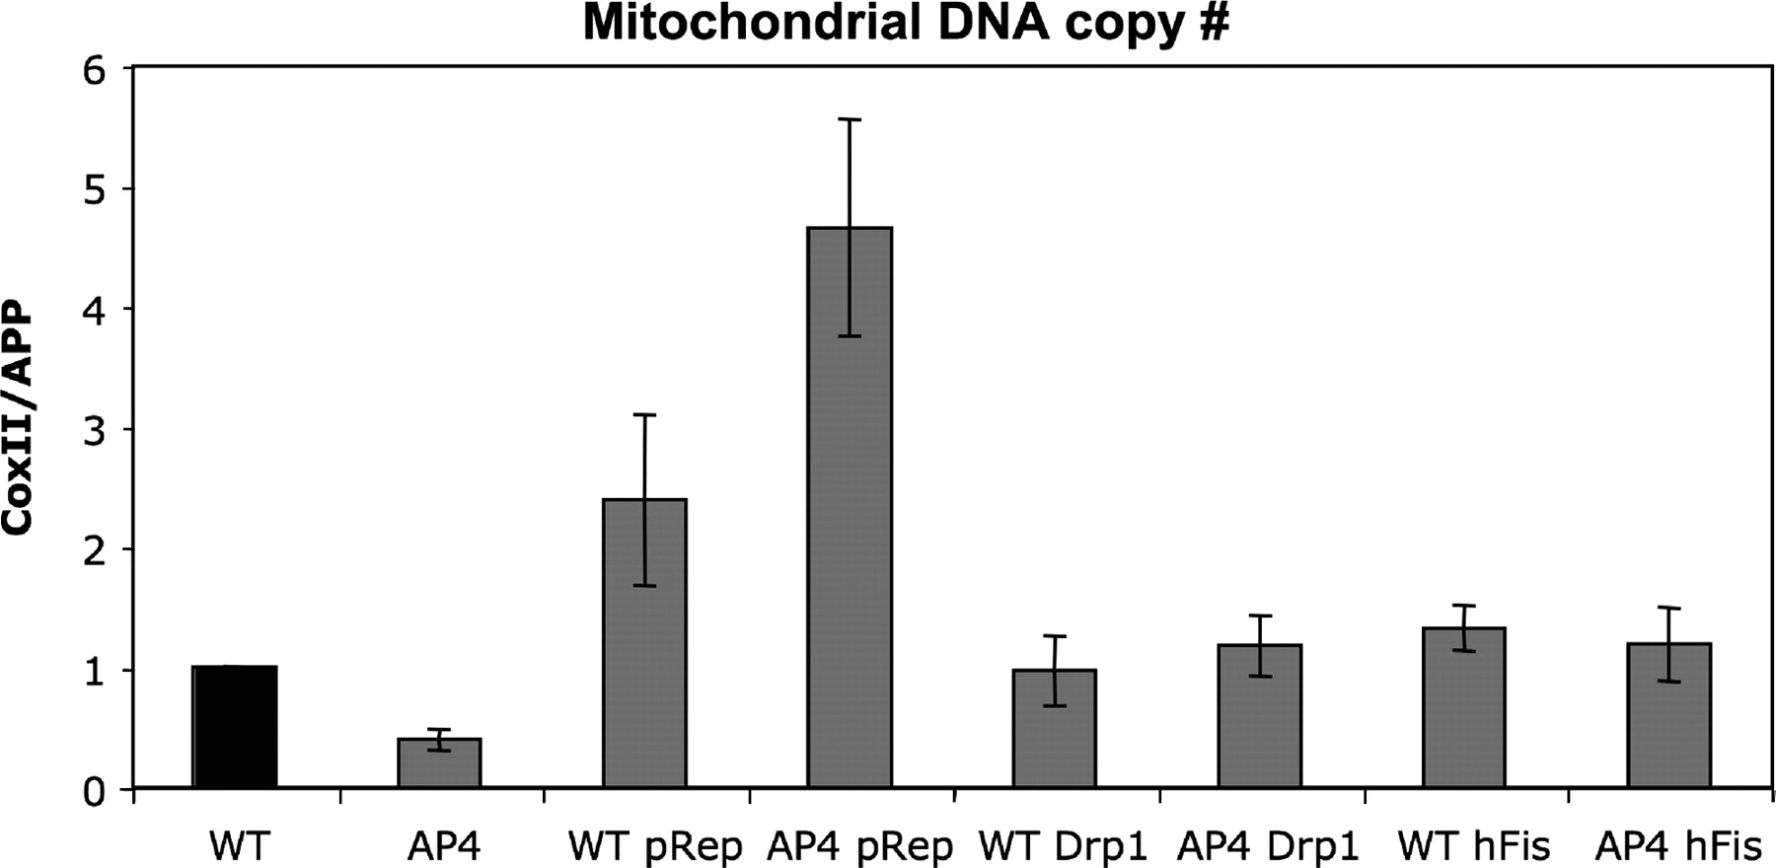
Figure 6. Mitochondrial DNA copy number of Drp1 and hFis1 RNAi clones. Mitochondrial DNA copy number was determined by ...
Notes:
Figure 6. Mitochondrial DNA copy number of Drp1 and hFis1 RNAi clones. Mitochondrial DNA copy number was determined by real-time PCR, by comparing how rapidly a PCR product derived from the mitochondrial cytochrome c oxidase II gene (COII) was amplified compared with the nuclear amyloid precursor protein gene (APP). WT—three DNA samples from the RD cybrid with 0% A3243G mtDNA; AP4—three DNA samples from the RD cybrid with 80% A3243G mtDNA; WT pRep4—five clones of RD cybrids with 0% A3243G mtDNA transformed with empty vector; AP4 pRep4—six clones of RD cybrids with 80% A3243G mtDNA transformed with empty vector; WT Drp1—two clones of RD cybrids with 0% A3243G mtDNA transformed with vector containing an shRNA to Drp1; AP4 Drp1—seven clones of RD cybrids with 80% A3243G mtDNA transformed with vector containing an shRNA to Drp1; WT hFis1—five clones of RD cybrids with 0% A3243G mtDNA transformed with vector containing an shRNA to hFis1; AP4 hFis1—11 clones of RD cybrids with 80% A3243G mtDNA transformed with vector containing an shRNA to hFis1.
Unless provided in the caption above, the following copyright applies to the content of this slide: © The Author 2009. Published by Oxford University Press. All rights reserved. For Permissions, please email: journals.permissions@oxfordjournals.org

Slide 7
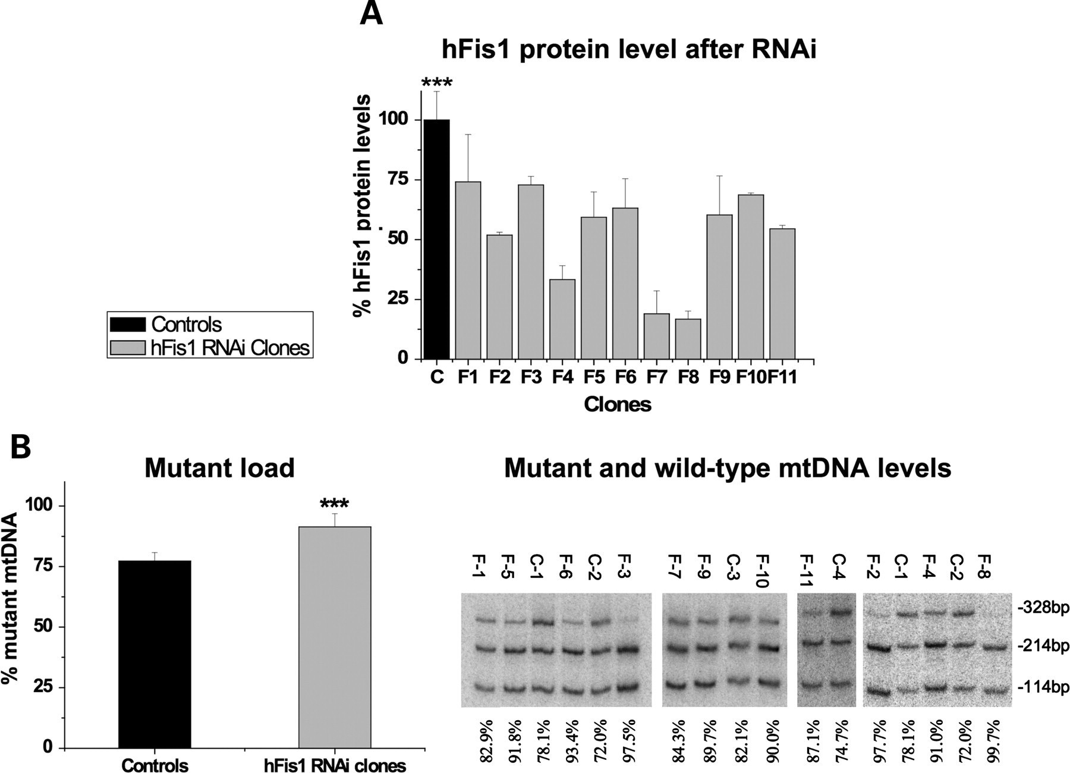
Figure 3. Decreased hFis1 protein (expression) is associated with an increase in the proportion of A3243G mutant mtDNA ...
Notes:
Figure 3. Decreased hFis1 protein (expression) is associated with an increase in the proportion of A3243G mutant mtDNA in RD cells. The layout is essentially as per Figure 2 except that the cells were transformed with pRep4 designed to yield clones (F-1 to F-11) with a shRNA targeting hFis1, rather than Drp1. Briefly, hFis1 abundance compared with VDAC and actin, indicated that the target gene was effectively repressed (A). The protein level of hFis1 of 11 hFis1 RNAi clones was significantly reduced compared with six controls, P = 0.001. (B) Analysis of the levels of mutant and wild-type mtDNA indicated an increase in mutant mtDNA in hFis1 RNAi clones, P < 0.001 (***).
Unless provided in the caption above, the following copyright applies to the content of this slide: © The Author 2009. Published by Oxford University Press. All rights reserved. For Permissions, please email: journals.permissions@oxfordjournals.org

