Slide 1
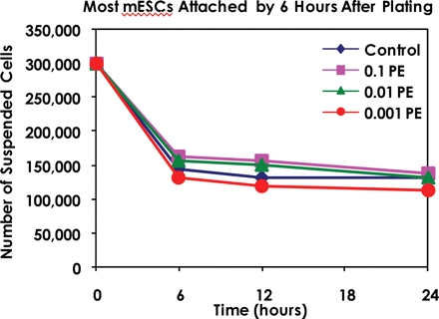
Figure 1 Representative experiment showing the number of suspended mouse embryonic stem cells (mESC) at various times ...
Notes:
Figure 1 Representative experiment showing the number of suspended mouse embryonic stem cells (mESC) at various times of incubation in control medium or various concentrations of mainstream (MS) smoke from 2R1 research cigarettes. Since the number of suspended cells remained unchanged in all groups after 6 h, cell attachment was interpreted to be complete by this time.
Unless provided in the caption above, the following copyright applies to the content of this slide: © The Author 2008. Published by Oxford University Press on behalf of the European Society of Human Reproduction and Embryology. All rights reserved. For Permissions, please email: journals.permissions@oxfordjournals.org

Slide 2
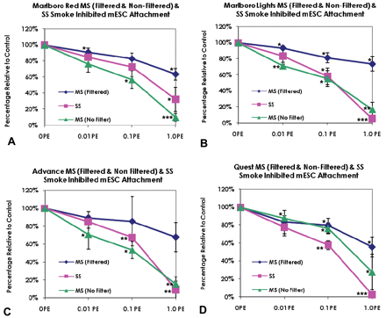
Figure 2 Traditional and harm-reduction MS and sidestream (SS) smoke inhibited mESC attachment dose dependently. Data ...
Notes:
Figure 2 Traditional and harm-reduction MS and sidestream (SS) smoke inhibited mESC attachment dose dependently. Data are shown for four groups of cigarettes: (A) Marlboro Red (traditional), (B) Marlboro Lights (harm reduction), (C) Advance (harm reduction) and (D) Quest (harm reduction, nicotine-free). Each point is the mean ± SD of three experiments. Statistical significance was determined using a one-sample t-test in which smoke treated groups were compared with a hypothetical mean of 100% (*P < 0.05, **P < 0.01 and ***P < 0.001).
Unless provided in the caption above, the following copyright applies to the content of this slide: © The Author 2008. Published by Oxford University Press on behalf of the European Society of Human Reproduction and Embryology. All rights reserved. For Permissions, please email: journals.permissions@oxfordjournals.org

Slide 3
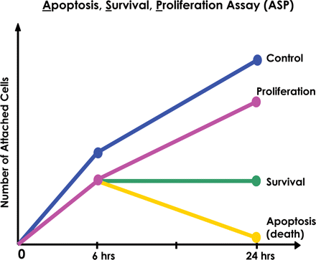
Figure 3 Basis for evaluating death, survival or proliferation of smoke-treated mESC. Schematic diagram demonstrates ...
Notes:
Figure 3 Basis for evaluating death, survival or proliferation of smoke-treated mESC. Schematic diagram demonstrates the three possible outcomes at 24 h when compared to the 6 h sample: (1) increase in cell number (proliferation), (2) no change in cell number (survival, but not proliferation) and (3) decrease in cell number (death).
Unless provided in the caption above, the following copyright applies to the content of this slide: © The Author 2008. Published by Oxford University Press on behalf of the European Society of Human Reproduction and Embryology. All rights reserved. For Permissions, please email: journals.permissions@oxfordjournals.org

Slide 4
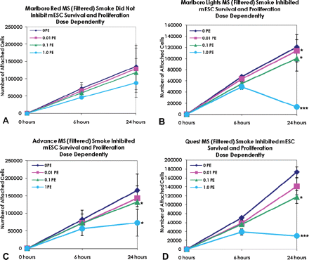
Figure 4 Filtered MS smoke inhibited survival and proliferation of mESC dose dependently. (A) Marlboro Red filtered MS ...
Notes:
Figure 4 Filtered MS smoke inhibited survival and proliferation of mESC dose dependently. (A) Marlboro Red filtered MS smoke, (B) Marlboro Lights filtered MS smoke, (C) Advance Lights filtered MS smoke and (D) Quest filtered MS smoke. Each point is the mean ± SD of three experiments. Statistical significance was determined using a one-sample t-test (*P < 0.05, **P < 0.01 and ***P < 0.001).
Unless provided in the caption above, the following copyright applies to the content of this slide: © The Author 2008. Published by Oxford University Press on behalf of the European Society of Human Reproduction and Embryology. All rights reserved. For Permissions, please email: journals.permissions@oxfordjournals.org

Slide 5
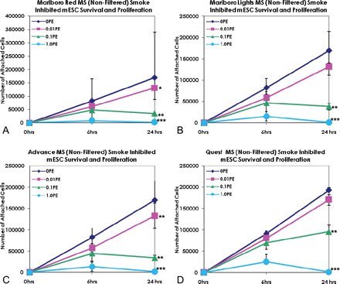
Figure 5 Non-filtered MS smoke inhibited mESC survival and proliferation dose dependently. (A) Marlboro Red ...
Notes:
Figure 5 Non-filtered MS smoke inhibited mESC survival and proliferation dose dependently. (A) Marlboro Red non-filtered MS smoke, (B) Marlboro Lights non-filtered MS smoke, (C) Advance Lights non-filtered MS smoke and (D) Quest non-filtered MS smoke. Each point is the mean ± SD of 3 experiments. Statistical significance was determined using a one-sample t-test (*P < 0.05, **P < 0.01 and ***P < 0.001).
Unless provided in the caption above, the following copyright applies to the content of this slide: © The Author 2008. Published by Oxford University Press on behalf of the European Society of Human Reproduction and Embryology. All rights reserved. For Permissions, please email: journals.permissions@oxfordjournals.org

Slide 6
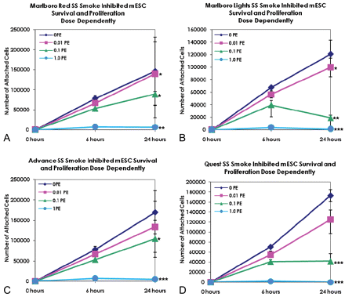
Figure 6 SS smoke inhibited mESC survival and proliferation dose dependently. (A) Marlboro Red SS smoke, (B) Marlboro ...
Notes:
Figure 6 SS smoke inhibited mESC survival and proliferation dose dependently. (A) Marlboro Red SS smoke, (B) Marlboro Lights SS smoke, (C) Advance Lights SS smoke and (D) Quest SS smoke. Each point is the mean ± SD of three experiments. Statistical significance was determined using a one-sample t-test (*P < 0.05, **P < 0.01 and ***P < 0.001).
Unless provided in the caption above, the following copyright applies to the content of this slide: © The Author 2008. Published by Oxford University Press on behalf of the European Society of Human Reproduction and Embryology. All rights reserved. For Permissions, please email: journals.permissions@oxfordjournals.org

Slide 7
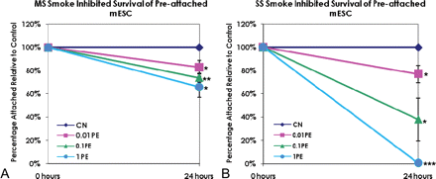
Figure 7 Advance MS (filtered) and SS smoke solutions caused detachment of pre-attached mESC dose dependently. Each ...
Notes:
Figure 7 Advance MS (filtered) and SS smoke solutions caused detachment of pre-attached mESC dose dependently. Each point is the mean ± SD of three experiments. Statistical significance was determined using a one-sample t-test (*P < 0.05, **P < 0.01 and ***P < 0.001).
Unless provided in the caption above, the following copyright applies to the content of this slide: © The Author 2008. Published by Oxford University Press on behalf of the European Society of Human Reproduction and Embryology. All rights reserved. For Permissions, please email: journals.permissions@oxfordjournals.org

Slide 8
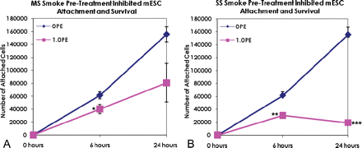
Figure 8 Pretreatment of mESCs with Advance MS (filtered) (A) or SS (B) smoke solutions before plating inhibited ...
Notes:
Figure 8 Pretreatment of mESCs with Advance MS (filtered) (A) or SS (B) smoke solutions before plating inhibited attachment (MS and SS), survival (SS) and proliferation (MS). Each point is the mean ± SD of three experiments. Statistical significance was determined using a t-test at 6 h and at 24 h (*P < 0.05, **P < 0.01 and ***P < 0.001).
Unless provided in the caption above, the following copyright applies to the content of this slide: © The Author 2008. Published by Oxford University Press on behalf of the European Society of Human Reproduction and Embryology. All rights reserved. For Permissions, please email: journals.permissions@oxfordjournals.org

Slide 9
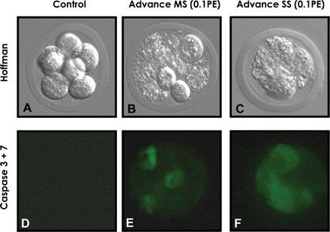
Figure 9 Smoke treatment induced apoptosis in mouse preimplantation embryos through activation of caspases 3 and ...
Notes:
Figure 9 Smoke treatment induced apoptosis in mouse preimplantation embryos through activation of caspases 3 and 7. (A–C) Hoffman contrast images of preimplantation embryos incubated in control medium (A), 0.1 puff equivalents (PE) of Advance MS smoke solution (B), or 0.1PE of Advance SS smoke solution (C). (D–F) The same preimplantation embryos viewed with fluorescence microscopy to visualize activated caspases 3 and 7. (D) Absence of activated caspases 3 and 7 in blastomeres of control untreated embryo, (E) Presence of activated caspases 3 and 7 in embryo treated with Advance filtered MS smoke, (F) Detection of activated caspases 3 and 7 in embryo treated with SS smoke.
Unless provided in the caption above, the following copyright applies to the content of this slide: © The Author 2008. Published by Oxford University Press on behalf of the European Society of Human Reproduction and Embryology. All rights reserved. For Permissions, please email: journals.permissions@oxfordjournals.org

