Slide 1
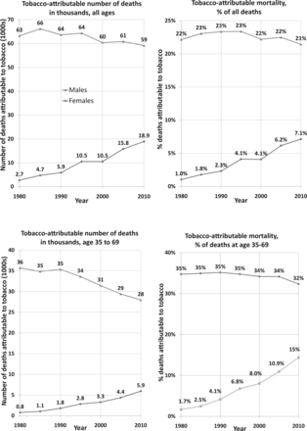
Figure 1 Number and proportion of tobacco-attributable deaths in France, for all ages on top, age 35–69 below
Notes:
Figure 1 Number and proportion of tobacco-attributable deaths in France, for all ages on top, age 35–69 below
Unless provided in the caption above, the following copyright applies to the content of this slide: © The Author 2015. Published by Oxford University Press on behalf of the European Public Health Association. All rights reserved.

