Slide 1
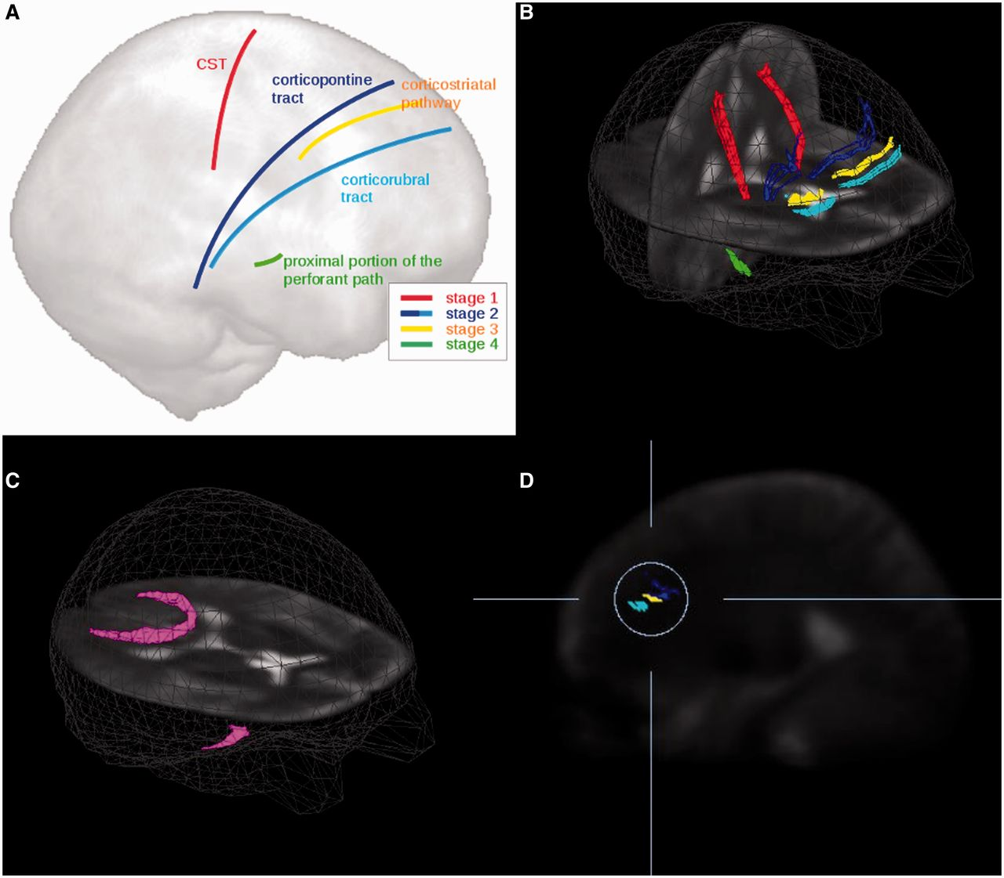
Figure 1 (A) Schematic representation of the pathways analysed. (B) Three-dimensional images of the corticospinal ...
Notes:
Figure 1 (A) Schematic representation of the pathways analysed. (B) Three-dimensional images of the corticospinal tract (CST, red) corresponding to ALS stage 1, corticopontine tract (dark blue) and corticorubral tract (light blue) corresponding to ALS stage 2, corticostriatal pathway (yellow) corresponding to ALS stage 3, and proximal portion of the perforant path (green) corresponding to ALS stage 4. (C) Reference paths (magenta) show starting points in the corpus callosum (area V) and starting points in the optic tract. (D) Sagittal slice for the illustration of the differences between the corticopontine tract (dark blue), corticorubral tract (light blue), and corticostriatal pathway (yellow).
Unless provided in the caption above, the following copyright applies to the content of this slide: © The Author (2014). Published by Oxford University Press on behalf of the Guarantors of Brain. All rights reserved. For Permissions, please email: journals.permissions@oup.com

Slide 2
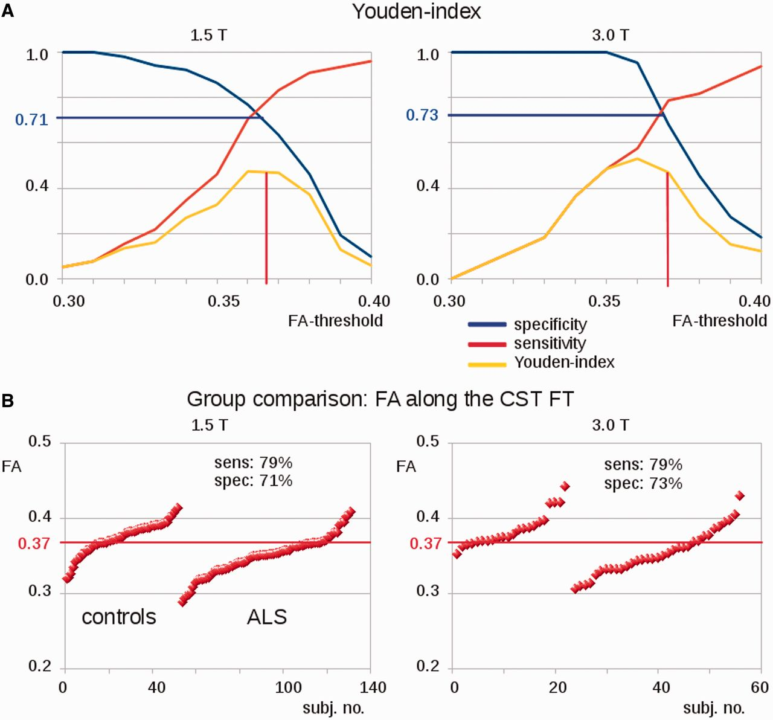
Figure 2 Comparison of results of TFAS analysis for ALS-patients versus controls. (A) Sensitivity (sens), specificity ...
Notes:
Figure 2 Comparison of results of TFAS analysis for ALS-patients versus controls. (A) Sensitivity (sens), specificity (spec) and Youden-index for fractional anisotropy (FA) thresholds at 1.5 T (left) and at 3.0 T (right). (B) Group separation for the corticospinal tract (CST) for 1.5 T (left) and 3.0 T (right).
Unless provided in the caption above, the following copyright applies to the content of this slide: © The Author (2014). Published by Oxford University Press on behalf of the Guarantors of Brain. All rights reserved. For Permissions, please email: journals.permissions@oup.com

Slide 3
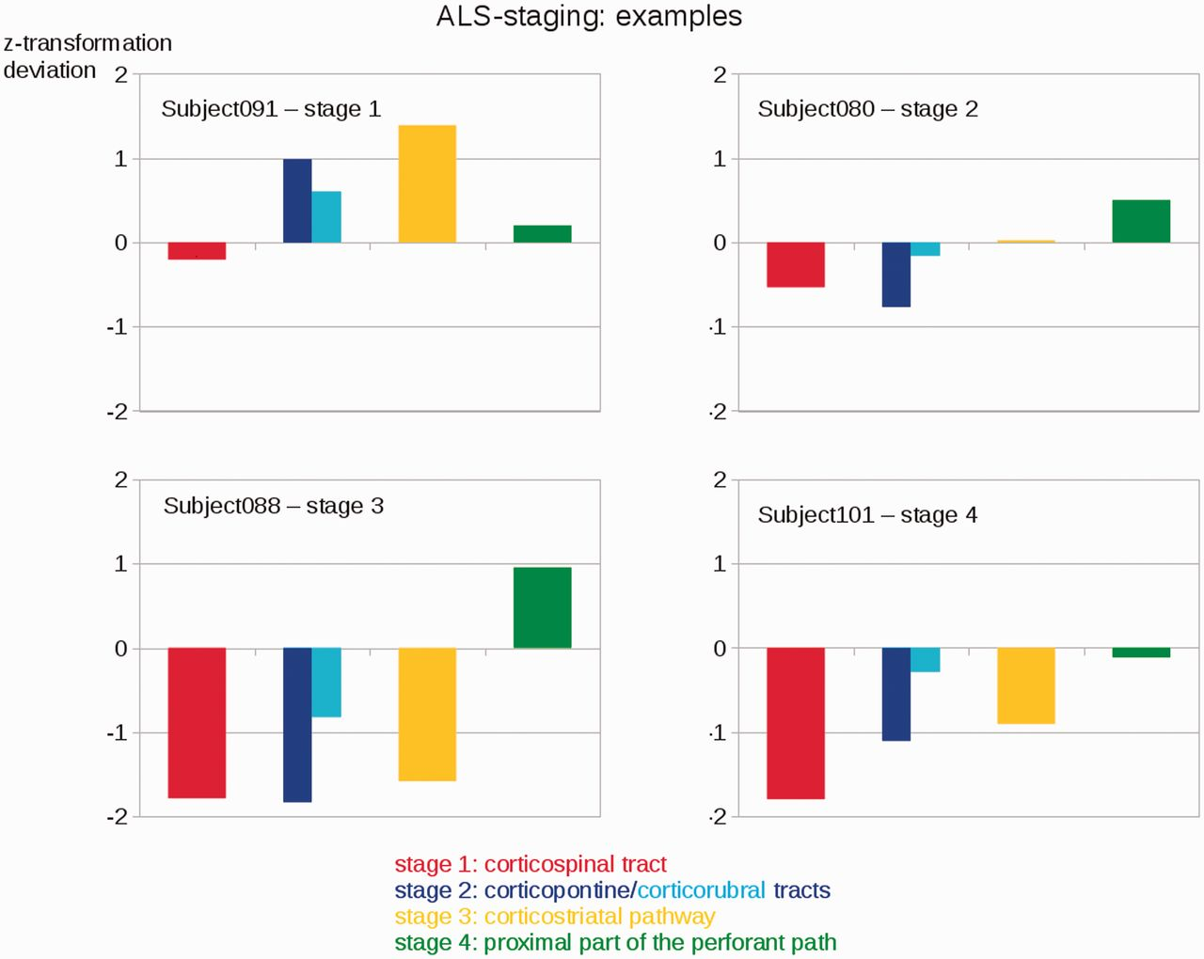
Figure 3 Individual examples (3.0 T data) for the categorization of patients with ALS into ALS stages based upon ...
Notes:
Figure 3 Individual examples (3.0 T data) for the categorization of patients with ALS into ALS stages based upon deviations of z-transformed fractional anisotropy-values (TFAS) from controls’ values for different ALS-stages.
Unless provided in the caption above, the following copyright applies to the content of this slide: © The Author (2014). Published by Oxford University Press on behalf of the Guarantors of Brain. All rights reserved. For Permissions, please email: journals.permissions@oup.com

Slide 4
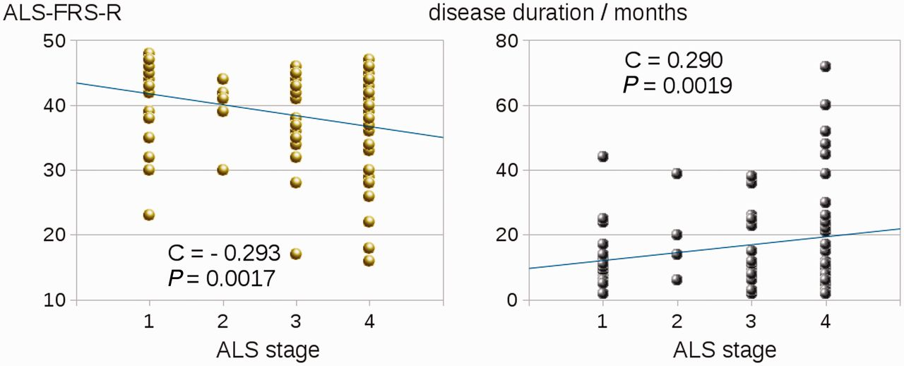
Figure 4 Correlation of ALS stages according to MRI-based classification with ALS-FRS-R (left) and with disease ...
Notes:
Figure 4 Correlation of ALS stages according to MRI-based classification with ALS-FRS-R (left) and with disease duration (right). 1.5 T and 3.0 T data sets of the study are included.
Unless provided in the caption above, the following copyright applies to the content of this slide: © The Author (2014). Published by Oxford University Press on behalf of the Guarantors of Brain. All rights reserved. For Permissions, please email: journals.permissions@oup.com

