Slide 1
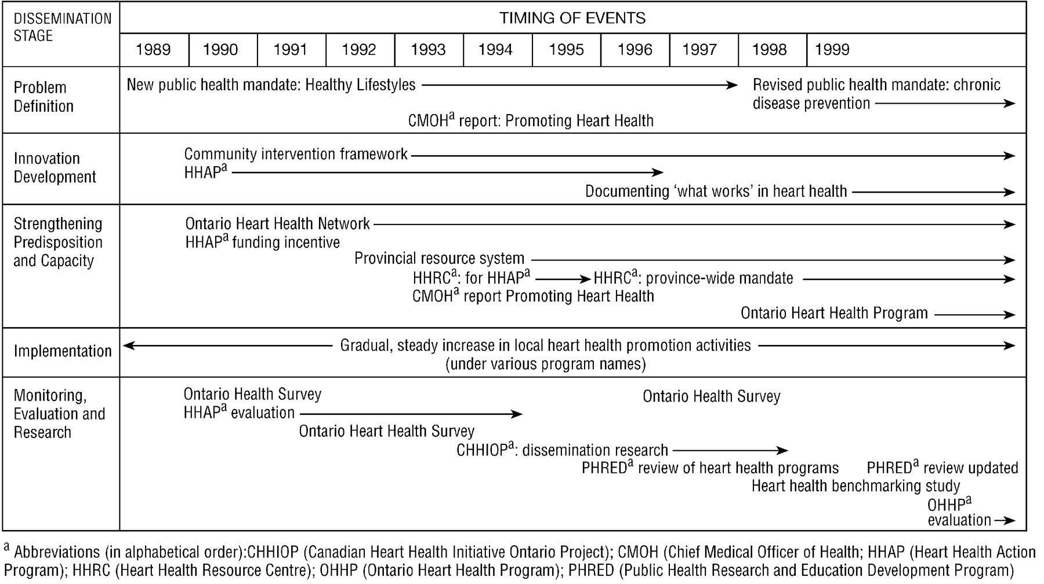
Fig. 1. Summary of heart health promotion activities in Ontario, 1989–1999.
Notes:
Fig. 1. Summary of heart health promotion activities in Ontario, 1989–1999.
Unless provided in the caption above, the following copyright applies to the content of this slide: © Oxford University Press

Slide 2
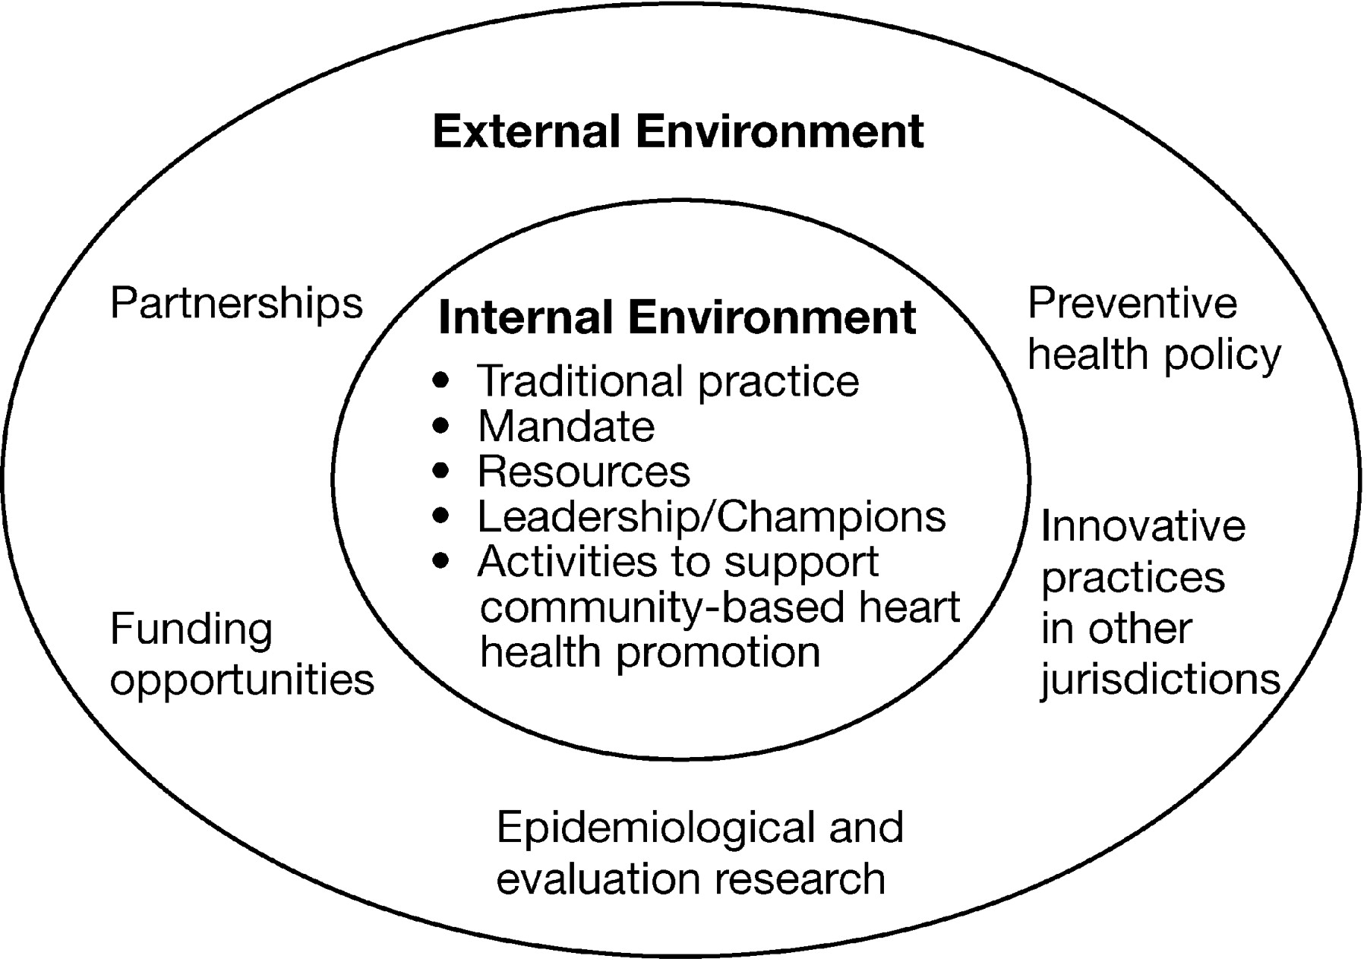
Fig. 2. Internal organizational and external system factors influencing the dissemination process.
Notes:
Fig. 2. Internal organizational and external system factors influencing the dissemination process.
Unless provided in the caption above, the following copyright applies to the content of this slide: © Oxford University Press

Slide 3
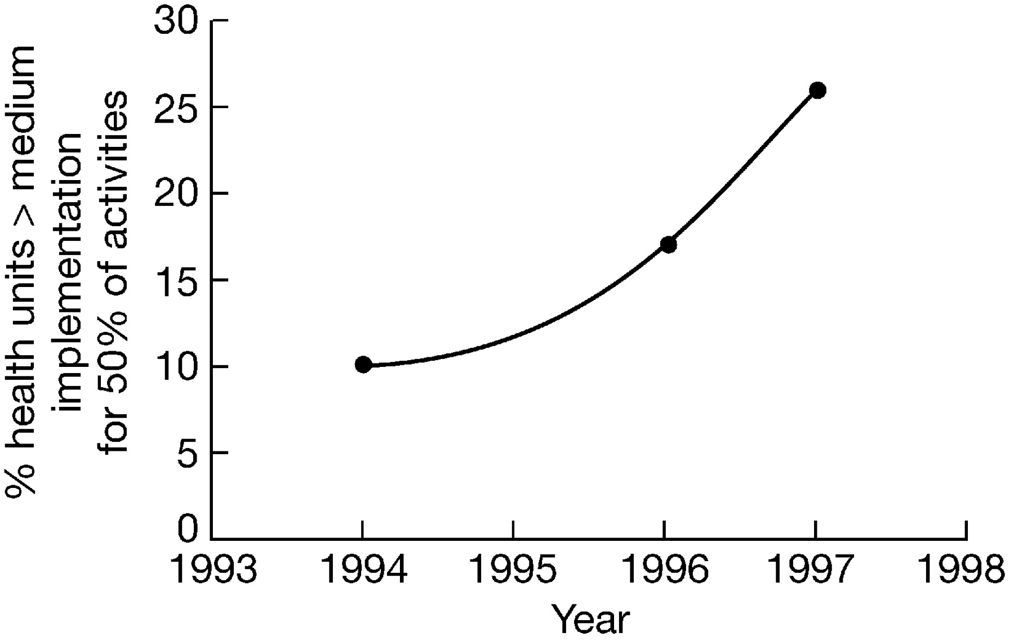
Fig. 3. Percent of health units implementing more than 50% of heart health promotion activities at or above a medium ...
Notes:
Fig. 3. Percent of health units implementing more than 50% of heart health promotion activities at or above a medium level of implementation, 1994–1997. Implementation was measured at three points in time: 1994, 1996 and 1997. The line joining the data points estimates progress with implementation over the 4-year period.
Unless provided in the caption above, the following copyright applies to the content of this slide: © Oxford University Press

Slide 4
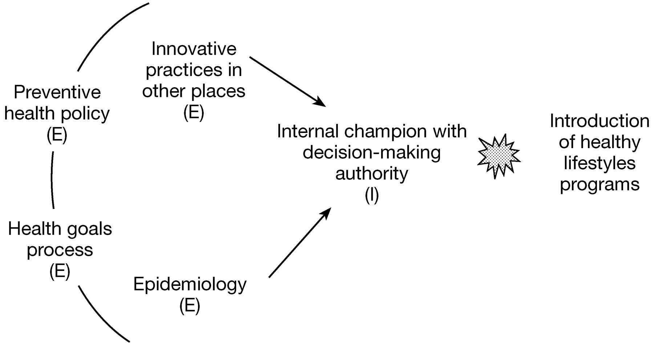
Fig. 4. Interplay of factors influencing the introduction of the healthy lifestyles programs in the 1989 public ...
Notes:
Fig. 4. Interplay of factors influencing the introduction of the healthy lifestyles programs in the 1989 public health mandate.
Unless provided in the caption above, the following copyright applies to the content of this slide: © Oxford University Press

