Slide 1
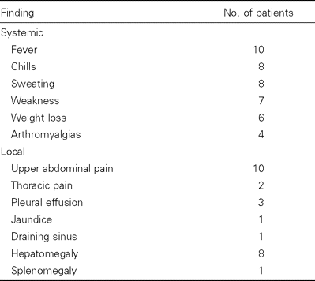
Table 1 Systemic and local findings in 15 patients with a total of 16 episodes of chronic hepatosplenic suppurative ...
Notes:
Table 1 Systemic and local findings in 15 patients with a total of 16 episodes of chronic hepatosplenic suppurative brucellosis.
Unless provided in the caption above, the following copyright applies to the content of this slide: © 2001 by the Infectious Diseases Society of America

Slide 2
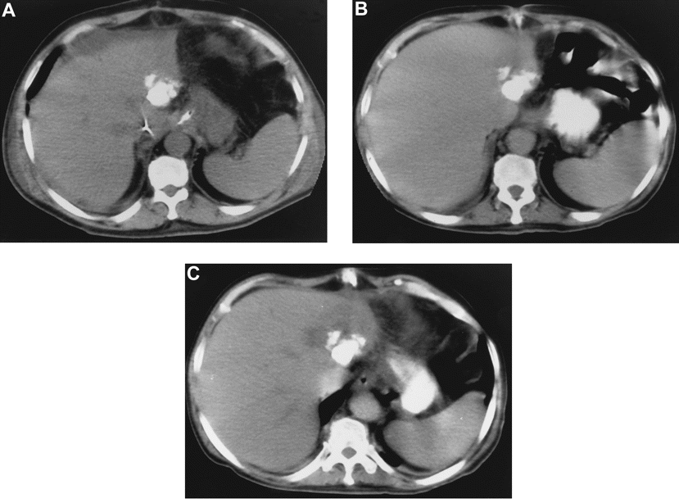
Figure 1 A, Noncontrast CT of the liver of patient 3 (table 2) at the time of admission to the hospital, showing large ...
Notes:
Figure 1 A, Noncontrast CT of the liver of patient 3 (table 2) at the time of admission to the hospital, showing large calcium density without surrounding hypodensity. Serological test results at this time were as follows: rose bengal, negative; agglutination, negative; and Coombs' test, 1/80. Diagnoses of liver abscess and brucellosis were delayed. B, Contrast CT of the liver of the same patient, performed 6 weeks after admission; only slight hypodensity next to calcium was apparent. C, Progression of hypodensity was obvious on a CT scan obtained 3 months later from the same patient, who had received antibiotic therapy for 10 weeks; fever persisted and surgical resection was required to achieve a good, early response. Serological test results were as follows: rose bengal, positive; agglutination, 1/80; Coombs' test, 1/20,480.
Unless provided in the caption above, the following copyright applies to the content of this slide: © 2001 by the Infectious Diseases Society of America

Slide 3
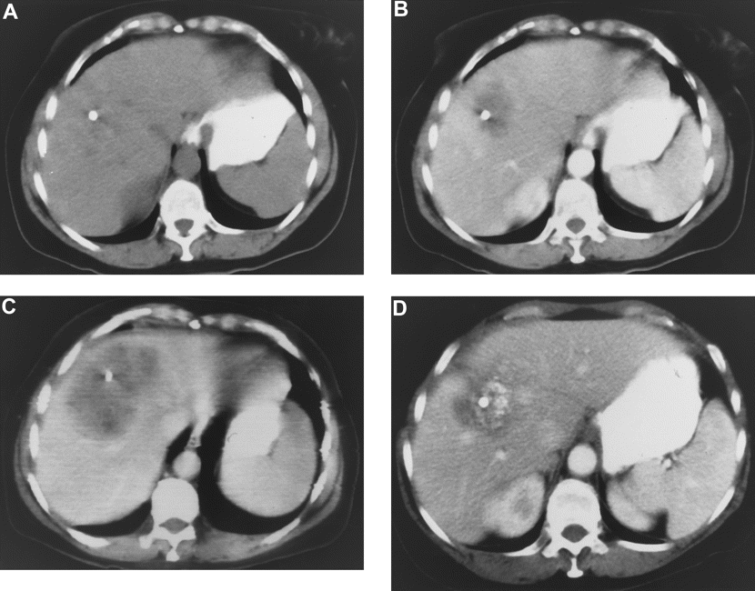
Figure 3 A and B, Noncontrast and contrast CT of the liver of patient 9 (table 2) at the time of admission to the ...
Notes:
Figure 3 A and B, Noncontrast and contrast CT of the liver of patient 9 (table 2) at the time of admission to the hospital; diagnosis of brucellosis was delayed because the rose bengal test, the only serological test done, yielded negative results. C, Contrast CT of the same patient done 3 weeks later, while the patient was receiving nonactive antibiotics against Brucella species and percutaneous drainage. Progression of hypodensity was evident and seroconversion was detected. D, Contrast CT of the same patient done 5 years after anti-Brucella antibiotic therapy was given for 45 days and repeated percutaneous drainage was done. Lesser but significant hypodensity was observed, along with persistence of previous calcium density and the appearance of new calcium deposits. The patient remained symptom free and was considered cured. This case illustrates problems in establishing radiological criteria to evaluate outcome.
Unless provided in the caption above, the following copyright applies to the content of this slide: © 2001 by the Infectious Diseases Society of America

Slide 4
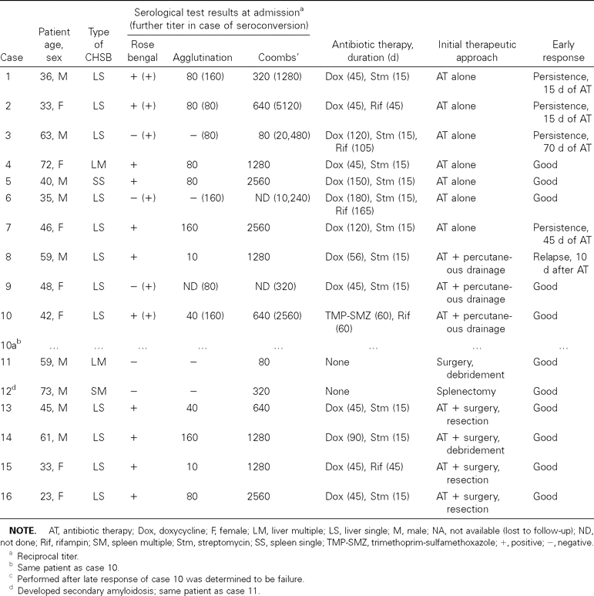
Table 2 Characteristics, therapy, and outcomes for 15 patients with 16 cases of chronic hepatosplenic suppurative ...
Notes:
Table 2 Characteristics, therapy, and outcomes for 15 patients with 16 cases of chronic hepatosplenic suppurative brucellosis (CHSB).
Unless provided in the caption above, the following copyright applies to the content of this slide: © 2001 by the Infectious Diseases Society of America

Slide 5
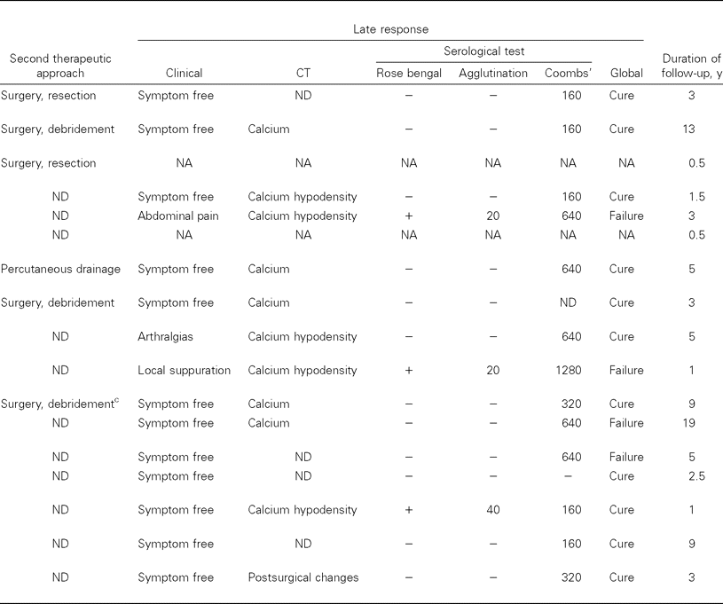
Table 2 Characteristics, therapy, and outcomes for 15 patients with 16 cases of chronic hepatosplenic suppurative ...
Notes:
Table 2 Characteristics, therapy, and outcomes for 15 patients with 16 cases of chronic hepatosplenic suppurative brucellosis (CHSB).
Unless provided in the caption above, the following copyright applies to the content of this slide: © 2001 by the Infectious Diseases Society of America

Slide 6
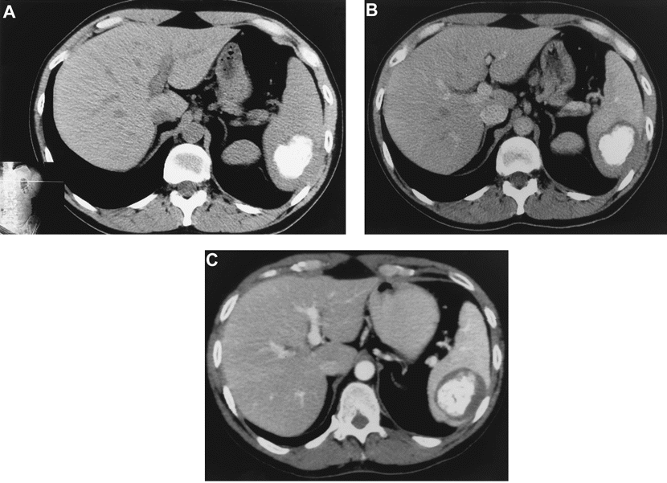
Figure 2 A and B, Noncontrast and contrast CT, respectively, of the spleen of patient 5 (table 2) at the time of ...
Notes:
Figure 2 A and B, Noncontrast and contrast CT, respectively, of the spleen of patient 5 (table 2) at the time of admission to the hospital; hypodensity around the calcium density observed in panel B was not apparent in panel A. C, CT of same patient done 3 years later. Progression of hypodensity was evident, and the patient had slight and intermittent upper left abdominal pain. This patient was considered to have late failure of therapy, despite having received 5 months of antibiotic therapy and having shown a good, early response.
Unless provided in the caption above, the following copyright applies to the content of this slide: © 2001 by the Infectious Diseases Society of America

