Slide 1
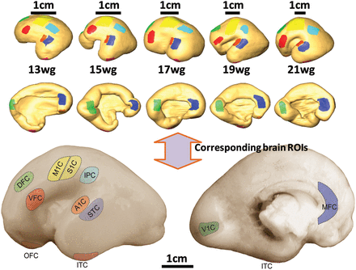
Figure 1. Upper images represent the cortical surface reconstructed from DTI data and the lower images demonstrate the ...
Notes:
Figure 1. Upper images represent the cortical surface reconstructed from DTI data and the lower images demonstrate the location of the tissues for transcriptome analysis. The corresponding 11 cortical ROIs (DFC, VFC, MFC, OFC, M1C, S1C, IPC, A1C, STC, ITC, and V1C) for both types of data are shown with the same color. In the upper panel, upper and lower rows demonstrate the lateral and medial views of the cortical surfaces, respectively. DFC, dorsolateral prefrontal cortex (PFC); VFC, ventrolateral PFC; MFC, medial PFC; OFC, orbital PFC; M1C, motor cortex; S1C, somatosensory cortex; IPC, posterior inferior parietal cortex; A1C, primary auditory cortex; STC, posterior superior temporal cortex; ITC, inferior temporal cortex; V1C, primary visual (occipital) cortex.
Unless provided in the caption above, the following copyright applies to the content of this slide: © The Author 2012. Published by Oxford University Press. All rights reserved. For Permissions, please e-mail: journals.permissions@oup.com

Slide 2
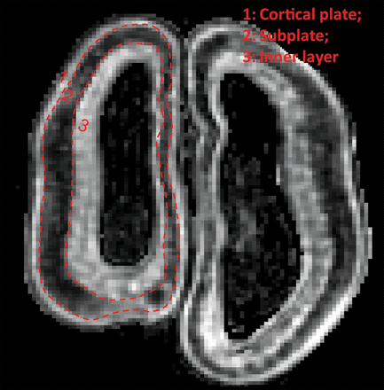
Figure 2. Three layers from the pial surface to the ventricle are the cortical plate (designated layer 1), subplate ...
Notes:
Figure 2. Three layers from the pial surface to the ventricle are the cortical plate (designated layer 1), subplate (designated layer 2), and the inner layer (designated layer 3), and can be clearly identified with the FA map of a typical second trimester fetal brain at 17 wg.
Unless provided in the caption above, the following copyright applies to the content of this slide: © The Author 2012. Published by Oxford University Press. All rights reserved. For Permissions, please e-mail: journals.permissions@oup.com

Slide 3
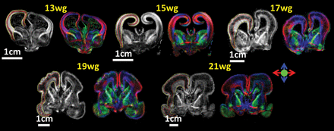
Figure 3. Coronal images of FA (left in each pair) and color-encoded FA map (right in each pair), both derived from ...
Notes:
Figure 3. Coronal images of FA (left in each pair) and color-encoded FA map (right in each pair), both derived from DTI, of 13, 15, 17, 19, and 21 wg fetal brains are shown. Red, blue, and green in color-encoded FA map encodes left-right, superior-inferior, and anterior-posterior orientation, respectively. Red curves in the FA maps separate the 3 layers in the cerebral wall. Yellow curves in the FA maps separate the cerebral wall from others.
Unless provided in the caption above, the following copyright applies to the content of this slide: © The Author 2012. Published by Oxford University Press. All rights reserved. For Permissions, please e-mail: journals.permissions@oup.com

Slide 4
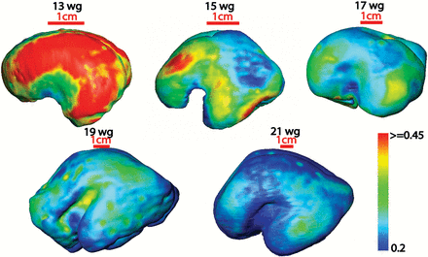
Figure 4. FA mapping of the cortical surface of fetal brains at the gestational ages shown. Color bar indicates the FA ...
Notes:
Figure 4. FA mapping of the cortical surface of fetal brains at the gestational ages shown. Color bar indicates the FA values in the cortical surface FA maps.
Unless provided in the caption above, the following copyright applies to the content of this slide: © The Author 2012. Published by Oxford University Press. All rights reserved. For Permissions, please e-mail: journals.permissions@oup.com

Slide 5
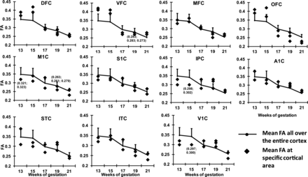
Figure 5. A distinctive time course of FA decreases across 11 ROIs in the cortical plate during the fetal brain ...
Notes:
Figure 5. A distinctive time course of FA decreases across 11 ROIs in the cortical plate during the fetal brain development. The FA values averaged across all cortical ROIs are shown as reference curves, with error bars indicating standard deviations. The 2 slightly different measured FA values are marked beside each of the overlapping points.
Unless provided in the caption above, the following copyright applies to the content of this slide: © The Author 2012. Published by Oxford University Press. All rights reserved. For Permissions, please e-mail: journals.permissions@oup.com

Slide 6
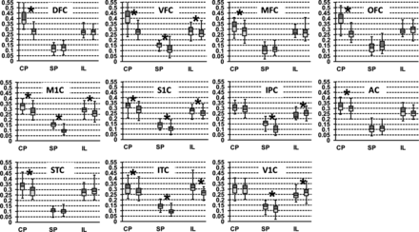
Figure 6. Diagrams of FA measurements of the 11 ROIs from early (left of the box pair) and middle (right of the box ...
Notes:
Figure 6. Diagrams of FA measurements of the 11 ROIs from early (left of the box pair) and middle (right of the box pair) fetal period for all 3 layers of the cerebral wall. Abbreviations: CP, cortical plate; SP, subplate; IL, inner layer. Statistically significant differences of FA measurements between early and middle fetal period after FDR correction are marked with asterisks. Blue and red colors indicate the median (50th percentile) to the 75th percentile and the median to the 25th percentile, respectively.
Unless provided in the caption above, the following copyright applies to the content of this slide: © The Author 2012. Published by Oxford University Press. All rights reserved. For Permissions, please e-mail: journals.permissions@oup.com

Slide 7
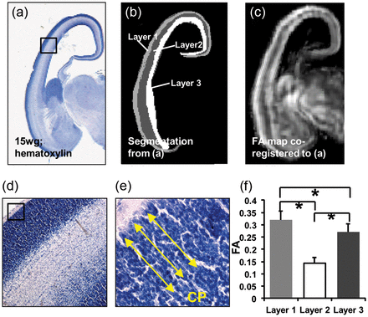
Figure 7. The highly organized layer 1 or cortical plate in hematoxylin-stained histological section is characterized ...
Notes:
Figure 7. The highly organized layer 1 or cortical plate in hematoxylin-stained histological section is characterized by the highest FA value among all layers in the cerebral wall. (a) An image of a hematoxylin-stained histological section of a 15 wg fetal brain. (d) A magnified image of the boxed region of (a). (e) shows a further magnified image of the boxed region in (d). Radial microstructures in the cortical plate are clearly visible in (e), indicated by yellow lines. (b) Segmentation based on contrast of histological image (a), dividing the cerebral wall into 3 layers. These layers, layer 1, layer 2 and layer 3, match cortical plate, subplate and inner layer differentiated from the FA map. (c) Coregistered FA map after LDDMM transformation. (f) FA measurements of these 3 layers. CP in (e) is the abbreviation of cortical plate. Asterisks in (f) indicate P <0.001.
Unless provided in the caption above, the following copyright applies to the content of this slide: © The Author 2012. Published by Oxford University Press. All rights reserved. For Permissions, please e-mail: journals.permissions@oup.com

Slide 8
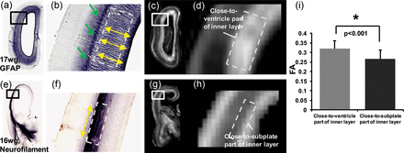
Figure 8. GFAP histological (a,b) image of a 17 wg fetal brain and the corresponding FA maps (c,d) are shown in the ...
Notes:
Figure 8. GFAP histological (a,b) image of a 17 wg fetal brain and the corresponding FA maps (c,d) are shown in the upper panel. The close-to-ventricle part of the inner layer (layer 3) has clear radial fibers in GFAP images (a,b). Neurofilament histology image of 16 wg fetal brain and corresponding FA maps (g,h) are shown in the lower panel. Tangential fibers can be observed in the close-to-subplate part of inner layer (layer 3). The ROIs for FA measurements in (i) are shown in (d) and (h) as dashed boxes, which are consistent with those derived from histology contrasts in (b) and (f), respectively. The close-to-ventricle part has more uniformly distributed radial fibers and hence has a higher FA value than close-to-subplate region where tangential and radial fibers may cross to each other. Yellow lines in (b,f) indicate the orientations of the microstructures. Green lines in (b) point to the region where GFAP stain color changes and possibly the crossing of tangential and radial fibers takes place. Asterisk in (i) indicates P <0.001.
Unless provided in the caption above, the following copyright applies to the content of this slide: © The Author 2012. Published by Oxford University Press. All rights reserved. For Permissions, please e-mail: journals.permissions@oup.com

Slide 9
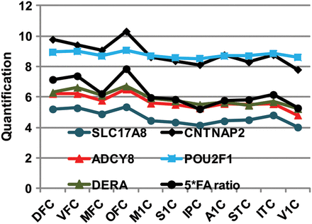
Figure 9. Regional profiles of expression of 5 most significantly correlated genes and anisotropy changes (FA ratio).
Notes:
Figure 9. Regional profiles of expression of 5 most significantly correlated genes and anisotropy changes (FA ratio).
Unless provided in the caption above, the following copyright applies to the content of this slide: © The Author 2012. Published by Oxford University Press. All rights reserved. For Permissions, please e-mail: journals.permissions@oup.com

