Slide 1
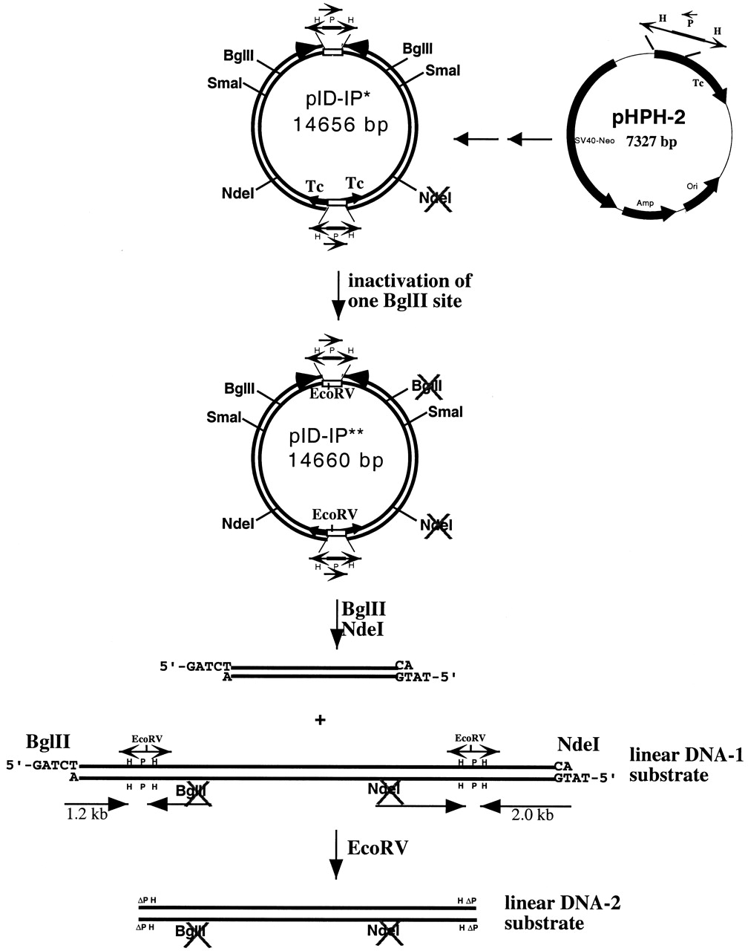
Figure 1. Construction of the linear DNA substrate containing two pairs of inverted repeats. pID-IP*, derived ...
Notes:
Figure 1. Construction of the linear DNA substrate containing two pairs of inverted repeats. pID-IP*, derived from pID-IP by inactivation one of its NdeI sites, was used to generate pID-IP**, by inactivation of a BglII site located on the same side of the inverted dimer as the inactivated NdeI site (see Materials and Methods for details). The linear DNA-1 substrate containing two pairs of inverted repeats is the larger of the two fragments generated by BglII and NdeI digestion of pID-IP**. The length of the repeated H fragment in the HPH cassette is 350 bp and the length of the P fragment is 651 bp. The linear DNA-2 substrate without HPH/tet cassettes (only ΔPH sequences) was generated by digesting linear DNA-1 with EcoRV.
Unless provided in the caption above, the following copyright applies to the content of this slide:

Slide 2
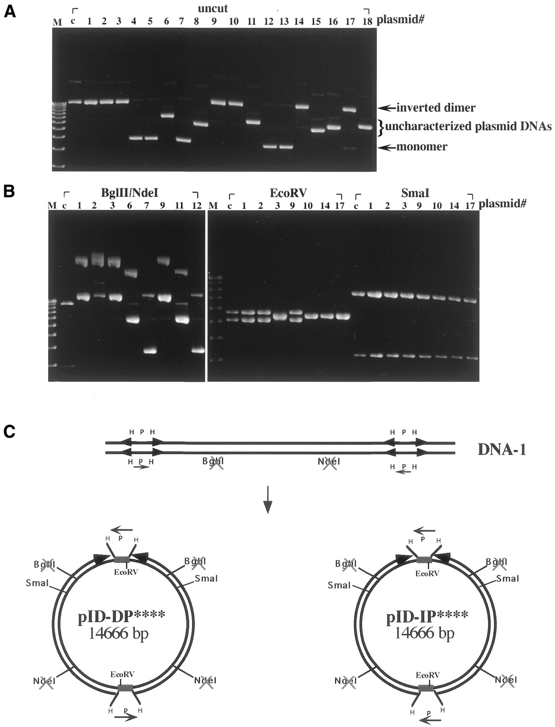
Figure 2. Analysis of plasmid DNAs isolated from E.coli DH5α transformed with the linear DNA substrate. The ...
Notes:
Figure 2. Analysis of plasmid DNAs isolated from E.coli DH5α transformed with the linear DNA substrate. The linear DNA substrate containing terminal inverted repeats was used to transform E.coli DH5α. (A) Plasmid DNAs isolated from 18 different clones (see lanes labeled plasmid# 1–18 at the top of the lanes) were analyzed by electrophoresis in 0.8% agarose gel. (B) Plasmid DNAs isolated from various clones (plasmid# indicated at the top of the lanes) were digested with BglII and NdeI, EcoRV or SmaI. Lanes M, the 1 kb DNA ladder used as the marker; lanes c, pID-IP** DNA used as the control DNA. (C) A schematic illustrating the two isomeric forms of circular inverted dimers generated from linear DNA substrates.
Unless provided in the caption above, the following copyright applies to the content of this slide:

Slide 3
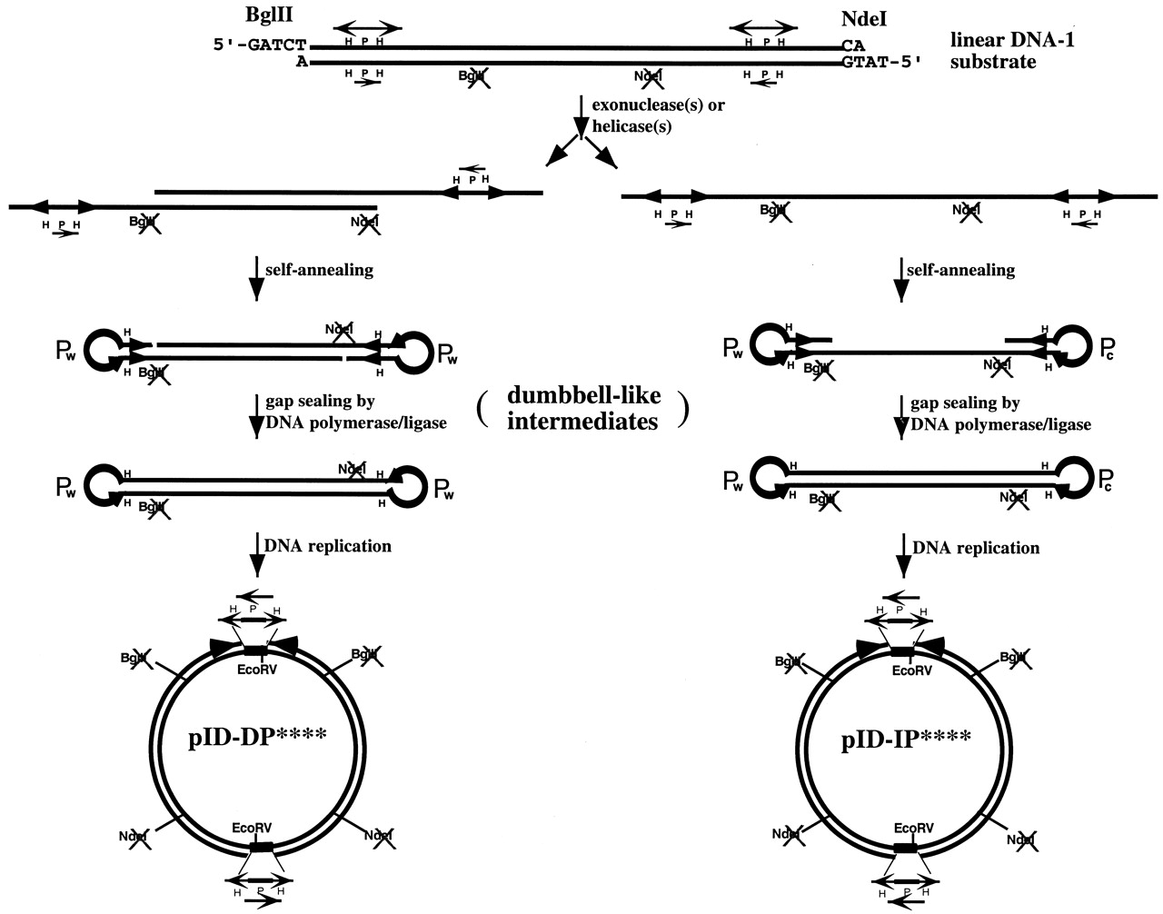
Figure 3. Two isomeric forms of circular inverted dimers derived from the linear DNA substrate. The linear ...
Notes:
Figure 3. Two isomeric forms of circular inverted dimers derived from the linear DNA substrate. The linear DNA substrate containing terminal inverted repeats is converted to the dumbbell-like DNA intermediate via processing by exonuclease or helicase/nuclease. Two types of circular inverted dimers can be generated depending on specificity of the exonuclease/helicase. As shown to the left, a double-stranded 5′→3′ or 3′→5′ exonuclease can expose the two HPH/tet cassettes as protruding single-stranded DNA on opposite DNA strands. Formation of terminal hairpin loops at the HPH sites converts the DNA into a dumbbell-like intermediate with identical terminal loops (P elements at the terminal loops have the same sequence). Subsequent DNA replication converts the dumbbell-like DNA into the circular inverted dimer, pID-DP****. To the right, the same or a different exonuclease/helicase (such as RecBCD) can convert the linear DNA substrate into single-stranded DNA. This can be achieved by either a single exonuclease or helicase working processively from one end. Annealing of the inverted repeats on the single-stranded DNA results in formation of dumbbell-like DNA with complementary terminal loops. Subsequent DNA replication converts the dumbbell-like DNA into the circular inverted dimer, pID-IP****.
Unless provided in the caption above, the following copyright applies to the content of this slide:

Slide 4
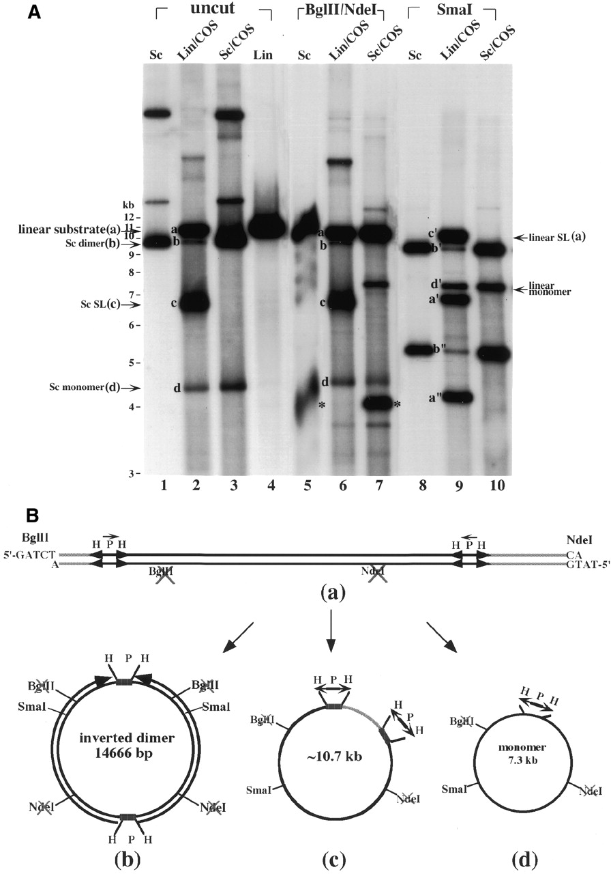
Figure 4. (A) Southern blotting analysis of episomal DNAs isolated from transfected COS cells. Episomal DNAs ...
Notes:
Figure 4. (A) Southern blotting analysis of episomal DNAs isolated from transfected COS cells. Episomal DNAs were isolated from transfected COS cells with either supercoiled (Sc) pID-IP** DNA (labeled Sc/COS at the top of the lanes) or the linear DNA substrate containing two pairs of inverted repeats (labeled Lin/COS at the top of the lanes) (see Materials and Methods). Untreated DNAs (labeled uncut at the top of the lanes) or DNAs digested with either BglII and NdeI or SmaI (see the respective labels at the top of the lanes) were analyzed by gel electrophoresis. Lanes 1, 5 and 8, supercoiled pID-IP** DNA controls (labeled Sc at the top of the lanes); lanes 2, 6 and 9, episomal DNAs isolated from COS cells transfected with the gel-purified linear DNA substrate (labeled Lin/COS at the top of the lanes); lanes 3, 7 and 10, episomal DNAs isolated from COS cells transfected with supercoiled pID-IP** (labeled Sc/COS at the top of the lanes); lane 4, the gel-purified linear DNA substrate derived from pID-IP** DNA restricted with BglII and NdeI (labeled Lin at the top of the lane). The bands marked * and a were generated from pID-IP** DNA digested with BglII and NdeI. The bands marked a–d correspond to the linear DNA substrate, supercoiled (Sc) inverted dimers (e.g. pID-IP**), supercoiled (Sc) self-ligated (SL) DNA substrate and supercoiled (Sc) monomer, respectively. (B) A schematic illustrating the formation of various DNA products in COS cells transfected with the linear DNA substrate. The linear DNA substrate with the two pairs of inverted repeats was transfected into COS cells. The proposed structures of various DNA products corresponding to bands a–d are shown schematically.
Unless provided in the caption above, the following copyright applies to the content of this slide:

