Slide 1
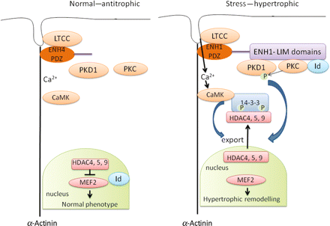
Figure 1 Schematic representation of a hypothetical pathway by which the splice variants of ENH could promote or ...
Notes:
Figure 1 Schematic representation of a hypothetical pathway by which the splice variants of ENH could promote or prevent hypertrophy. ENH1-PDZ, Enigma homologue 1 PDZ (PSD-95, DLG, ZO-1) domain; ENH1-Lim, Enigma homologue 1 Lim (LIN-11, Isl-1, MEC-3) domains; LTCC, L-type voltage-gated Ca2+ channel; PKD1, protein kinase D1; PKC, protein kinase C; Id, Inhibitor of differentiation/DNA binding; CaMK, Ca2+/calmodulin kinase; 14-3-3, chaperone protein 14-3-3; HDAC4,5,9, histone deacetylase type 4, 5, and 9; MEF2, myocyte enhance factor 2; P, phosphorylation.
Unless provided in the caption above, the following copyright applies to the content of this slide: Published on behalf of the European Society of Cardiology. All rights reserved. © The Author 2010. For permissions please email: journals.permissions@oxfordjournals.org.

