Slide 1
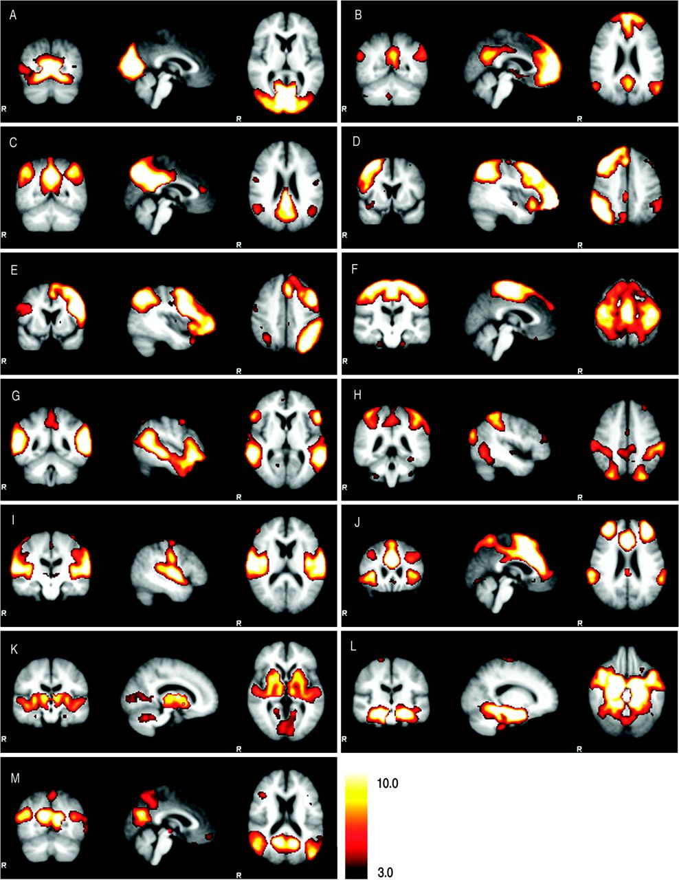
Figure 1. Potentially functionally relevant RSNs. Thirteen out of the 20 estimated components visually identified as ...
Notes:
Figure 1. Potentially functionally relevant RSNs. Thirteen out of the 20 estimated components visually identified as being potentially functionally relevant. Ten of these components (A–J) resemble the RSNs described in our previous study (Damoiseaux et al. 2006), consisting of regions previously known to be involved in visual processing (A), the DMN (B, C), working memory (D, E), motor function (F), auditory processing (I), and executive functioning (J). Three additional potentially functionally relevant components were found, encompassing: the thalamus, putamen, insular, and transverse temporal gyrus (K); the anterior temporal lobe, including the (para) hippocampal gyrus (L); and occipitoparietal areas, posterior cingulate, parahippocampus, and superior frontal (M). Images (coronal, sagittal, and axial views) are z-statistics overlaid on the average high-resolution scan transformed into standard (MNI152) space. Black to yellow are z values, ranging from 3.0–10.0. The left hemisphere of the brain corresponds to the right side of the image.
Unless provided in the caption above, the following copyright applies to the content of this slide: © The Author 2007. Published by Oxford University Press. All rights reserved. For permissions, please e-mail: journals.permissions@oxfordjournals.org

Slide 2
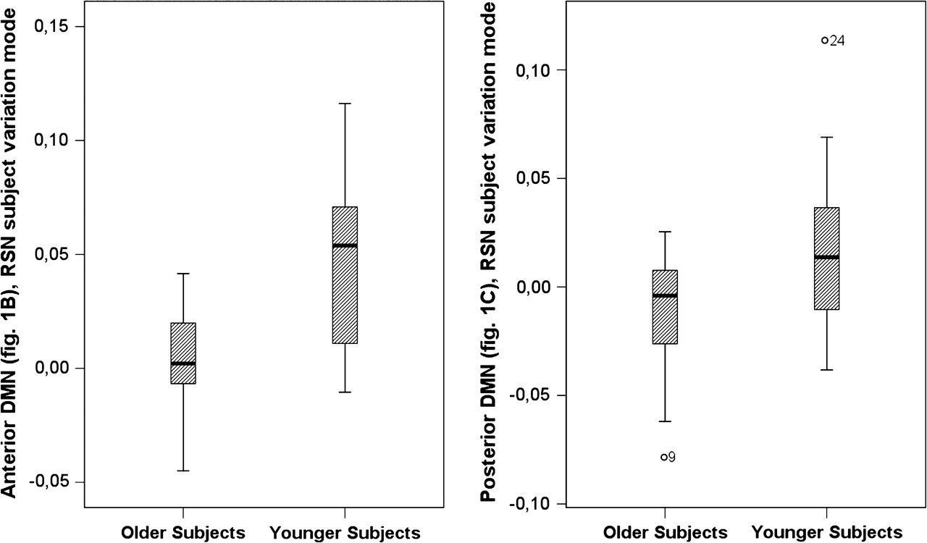
Figure 2. Boxplots showing a group difference on the resting-state components affected by aging. The difference between ...
Notes:
Figure 2. Boxplots showing a group difference on the resting-state components affected by aging. The difference between the younger subjects and older subjects on the subject variation mode of both the first and second best-fit default-mode RSNs (see components C and B in Fig. 1) are displayed in boxplots. The left boxplot shows the posterior DMN (1C), consisting of the posterior cingulate (BA 23/31) and bilateral superior parietal regions (BA 7). The right boxplot shows the difference between groups for the the anterior DMN (1B), encompassing the superior and middle frontal gyrus (BA 9/10/11), posterior cingulate (BA 23/31), and the superior parietal region (BA 7). The older subjects show decreased activity in both RSNs compared with the younger subjects (component C: t = 2.57, P = 0.015; B: t = 3.28, P = 0.007, inequality in variance). Note that these boxplots show the raw data before correction for GM volume was applied.
Unless provided in the caption above, the following copyright applies to the content of this slide: © The Author 2007. Published by Oxford University Press. All rights reserved. For permissions, please e-mail: journals.permissions@oxfordjournals.org

Slide 3
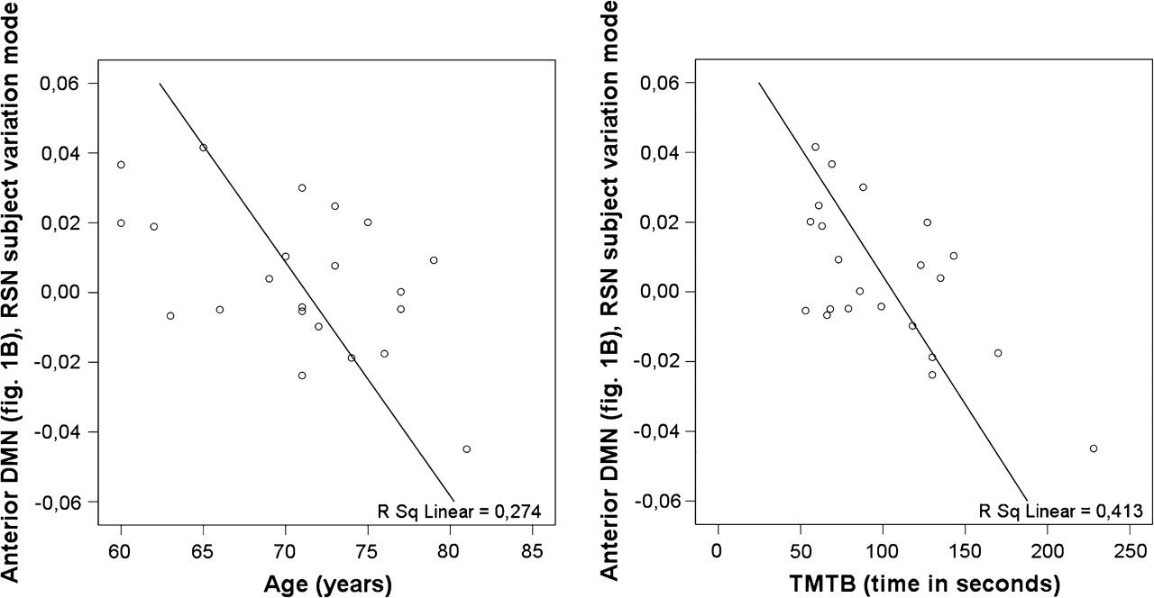
Figure 3. Correlations between resting-state activity, age, and cognitive function. Scatter plots of the correlations ...
Notes:
Figure 3. Correlations between resting-state activity, age, and cognitive function. Scatter plots of the correlations between the subject values of the older controls of the anterior DMN (Fig. 1B) with age (r = −0.58, P < 0.003, 1 tailed; corrected for GM volume) and the trail making test B (r = −0.60, P = 0.003, 1 tailed; corrected for GM volume and age). The values on the y-axis are the relative contributions of every subject to RSN 1B. The correlation between resting-state activity of RSN 1B, age, and the trail making test B remains significant after removal of the outlier.
Unless provided in the caption above, the following copyright applies to the content of this slide: © The Author 2007. Published by Oxford University Press. All rights reserved. For permissions, please e-mail: journals.permissions@oxfordjournals.org

