Slide 1
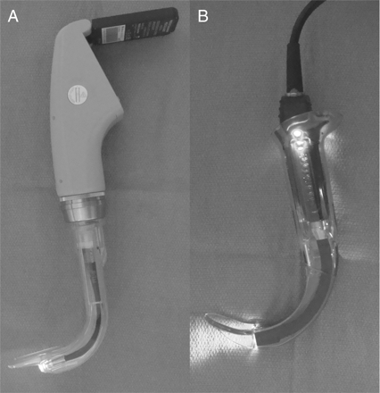
Fig 1 (a) Photograph of the Pentax AWS® laryngoscope with a single-use blade clipped onto camera system. ...
Notes:
Fig 1 (a) Photograph of the Pentax AWS® laryngoscope with a single-use blade clipped onto camera system. (b) Photograph of Glidescope® Cobalt with a single-use blade clipped onto fibreoptic system.
Unless provided in the caption above, the following copyright applies to the content of this slide: © The Author [2009]. Published by Oxford University Press on behalf of the British Journal of Anaesthesia. All rights reserved. For Permissions, please email: journals.permissions@oxfordjournal.org

Slide 2
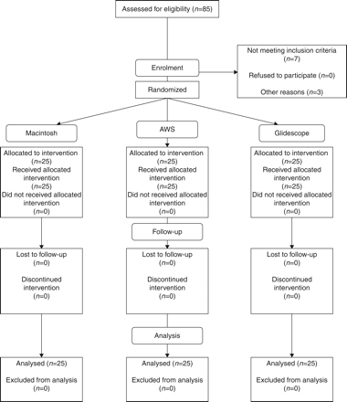
Fig 2 Consort diagram for study demonstrating the number of patients assessed for inclusion into the study, number ...
Notes:
Fig 2 Consort diagram for study demonstrating the number of patients assessed for inclusion into the study, number enrolled in the study, the numbers followed up, and numbers of patients analysed.
Unless provided in the caption above, the following copyright applies to the content of this slide: © The Author [2009]. Published by Oxford University Press on behalf of the British Journal of Anaesthesia. All rights reserved. For Permissions, please email: journals.permissions@oxfordjournal.org

Slide 3
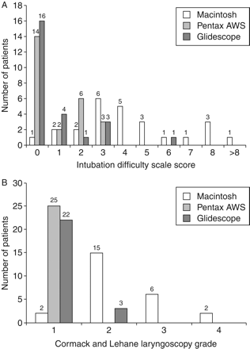
Fig 3 (a) Comparison of IDS score distributions with each laryngoscope. The number of patients is shown above each ...
Notes:
Fig 3 (a) Comparison of IDS score distributions with each laryngoscope. The number of patients is shown above each bar. The distribution of IDS scores in each group is significantly different (P<0.001, Kruskal–Wallis anova on ranks). (b) Cormack and Lehane grade view during the first tracheal intubation attempt with each laryngoscope. The number of patients is shown above each bar. The distribution of Cormack and Lehane grades in each group is significantly different (P<0.001, Kruskal–Wallis anova on ranks).
Unless provided in the caption above, the following copyright applies to the content of this slide: © The Author [2009]. Published by Oxford University Press on behalf of the British Journal of Anaesthesia. All rights reserved. For Permissions, please email: journals.permissions@oxfordjournal.org

Slide 4
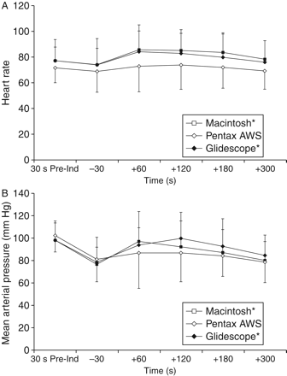
Fig 4 (a) Graph representing the changes in heart rate after tracheal intubation with each device. The data are ...
Notes:
Fig 4 (a) Graph representing the changes in heart rate after tracheal intubation with each device. The data are given as mean values. The error bars indicate 1 sd. (b) Graph representing the changes in mean arterial pressure after tracheal intubation with each device. The data are given as mean values. The error bars indicate 1 sd. *Significant change over time within each group. 30 s Pre-Ind, 30 s before induction of anaesthesia; −30, 30 s before tracheal intubation, +60, 60 s post-tracheal intubation; +120, 120 s post-tracheal intubation; +180, 180 s post-tracheal intubation; +300, 300 s post-tracheal intubation.
Unless provided in the caption above, the following copyright applies to the content of this slide: © The Author [2009]. Published by Oxford University Press on behalf of the British Journal of Anaesthesia. All rights reserved. For Permissions, please email: journals.permissions@oxfordjournal.org

