Slide 1
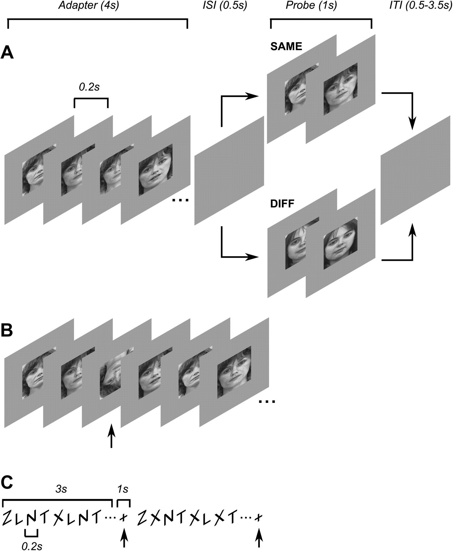
Figure 1. Experimental design and stimuli. (A) Event-related adaptation design. Each trial began with a 4 s adapter ...
Notes:
Figure 1. Experimental design and stimuli. (A) Event-related adaptation design. Each trial began with a 4 s adapter stimulus (consisting of multiple different images of the same person randomly alternating every 0.2 s) followed by a blank screen for 0.5 s, followed by a 1 s probe stimulus. On SAME trials, the probe stimulus consisted of images of the same person as the adapter stimulus; on DIFF trials, the probe stimulus was of a different person. Each trial ended with a blank screen that lasted between 0.5 and 3.5 s. (B) Focused attention task (FOCUS condition). Subjects fixated a central cross while monitoring the face stimuli and were instructed to respond to infrequently occurring inverted faces by pressing a response button. The inverted face was shown for 100 ms and could appear at any time during either of the adapter or probe epochs. (C) Diverted attention task (DIVERT condition). Independent of and asynchronous with the face stimuli, subjects monitored a stream of letters at the center of the display and counted the number or target letters (X) among the distractors (Z, L, N, T). After 3 s, the letters were replaced by a cross, cueing subjects to indicate how many targets (between 0 and 3) they had seen.
Unless provided in the caption above, the following copyright applies to the content of this slide: © The Author 2011. Published by Oxford University Press. All rights reserved. For permissions, please e-mail: journals.permissions@oup.com

Slide 2
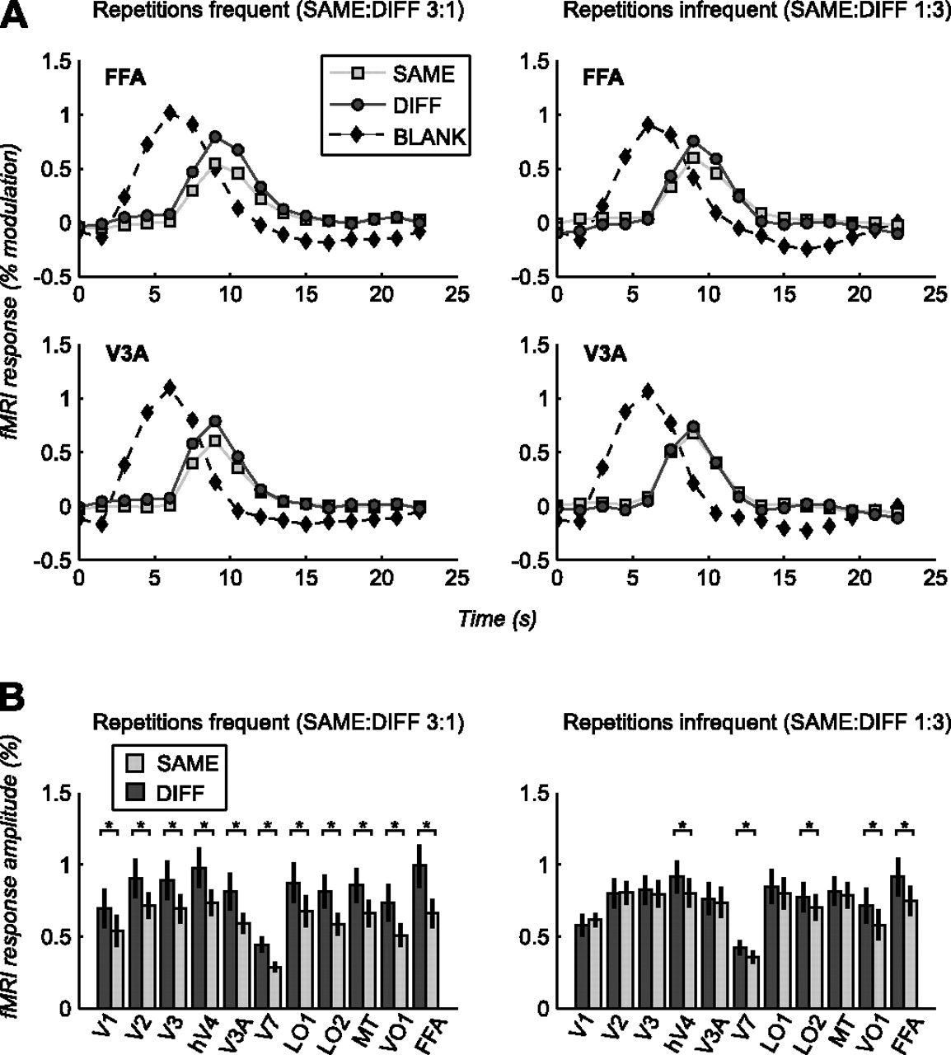
Figure 2. Perceptual expectation modulates repetition suppression when stimuli are attended. (A) Average ...
Notes:
Figure 2. Perceptual expectation modulates repetition suppression when stimuli are attended. (A) Average stimulus-evoked response time courses to adapter (BLANK) and probe (SAME, DIFF) stimuli in FFA (upper panels) and V3A (lower panels) for frequent repetition runs (left hand panels) and infrequent repetition runs (right hand panels) in the focused attention condition (FOCUS). For SAME and DIFF trials, only the response components evoked by the probe stimuli are shown (obtained by subtracting the response to the BLANK trials from the overall trial-triggered response; see Materials and Methods). Error bars (standard error of the mean across subjects) are smaller than plot symbols. Repetition suppression (larger responses to DIFF than to SAME trials) is greater when stimulus repetitions are frequent than when they are infrequent. (B) Average response amplitudes to probe stimuli across visual areas for the SAME and DIFF trials for frequent repetition runs (left hand panels) and infrequent repetition runs (right hand panels) in the FOCUS condition. In all areas, the magnitude of repetition suppression (larger responses to DIFF than to SAME trials) is greater in the frequent repetition runs than in the infrequent repetition runs. Error bars, standard error of the mean across subjects. Asterisks (*) indicate significant repetition suppression (greater response to DIFF than SAME trials, paired t-test, P < 0.05).
Unless provided in the caption above, the following copyright applies to the content of this slide: © The Author 2011. Published by Oxford University Press. All rights reserved. For permissions, please e-mail: journals.permissions@oup.com

Slide 3
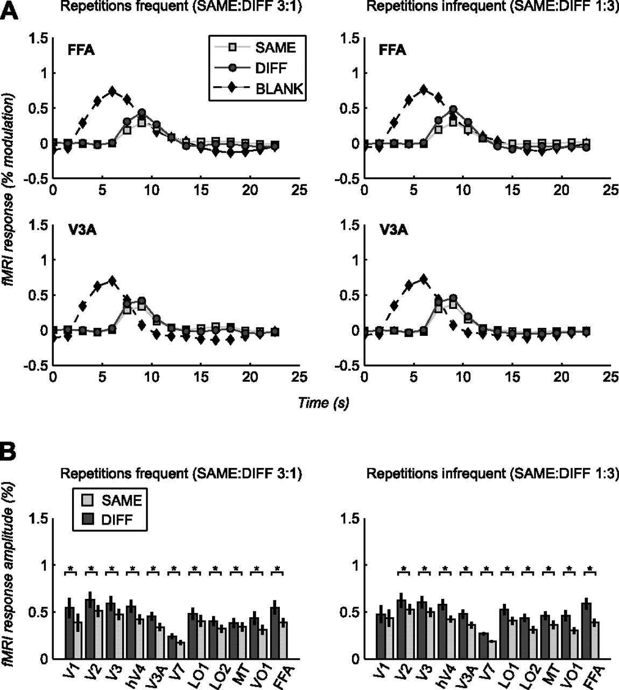
Figure 3. Perceptual expectation effects disappear when attention is diverted away from stimuli. Response time courses ...
Notes:
Figure 3. Perceptual expectation effects disappear when attention is diverted away from stimuli. Response time courses (A) and response amplitudes (B) as in Figure 2, but for the diverted attention condition (DIVERT). Repetition suppression magnitudes do not differ between frequent and infrequent runs (see text for details). Asterisks (*) indicate significant repetition suppression (greater response to DIFF than SAME trials, paired t-test, P < 0.05).
Unless provided in the caption above, the following copyright applies to the content of this slide: © The Author 2011. Published by Oxford University Press. All rights reserved. For permissions, please e-mail: journals.permissions@oup.com

Slide 4
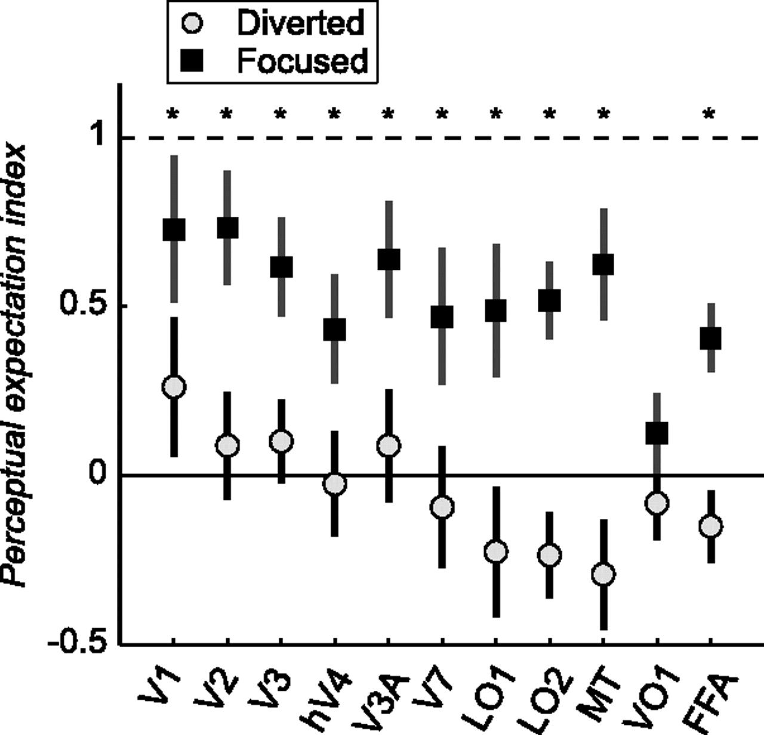
Figure 4. Perceptual expectation modulates repetition suppression magnitude in most visual areas. Perceptual ...
Notes:
Figure 4. Perceptual expectation modulates repetition suppression magnitude in most visual areas. Perceptual expectation indexes across areas for the focused attention condition (FOCUS) and the diverted attention condition (DIVERT). Perceptual expectation indexes were significantly greater than 0 (P < 0.05, one-tailed permutation test) in all areas except VO1 in the focused attention condition but were not significantly different from 0 in any area in the diverted attention condition. Dashed line indicates an index of 1 (repetition suppression entirely due to perceptual expectation); solid line an index of 0 (repetition suppression entirely due to response adaptation). Error bars, bootstrapped 68% confidence intervals across subjects and trials (see Materials and Methods). Asterisks (*) indicate significant differences between perceptual expectation indexes for the focused and diverted attention conditions (one-tailed permutation test, P < 0.05).
Unless provided in the caption above, the following copyright applies to the content of this slide: © The Author 2011. Published by Oxford University Press. All rights reserved. For permissions, please e-mail: journals.permissions@oup.com

