Slide 1
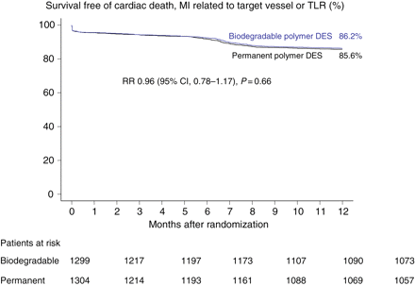
Figure 1 Survival curve for freedom from the primary endpoint of cardiac death, myocardial infarction (MI) related to ...
Notes:
Figure 1 Survival curve for freedom from the primary endpoint of cardiac death, myocardial infarction (MI) related to the target vessel (TLR) or revascularization related to the target lesion (TLR) for biodegradable polymer and permanent polymer drug-eluting stents. CI, confidence interval; DES, drug-eluting stent; RR, relative risk. P-values are two-sided from superiority testing (log-rank test).
Unless provided in the caption above, the following copyright applies to the content of this slide: Published on behalf of the European Society of Cardiology. All rights reserved. © The Author 2009. For permissions please email: journals.permissions@oxfordjournals.org

Slide 2
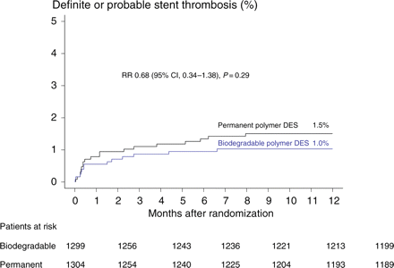
Figure 2 Time to event curve for definite/probable stent thrombosis according to Academic Research Consortium criteria ...
Notes:
Figure 2 Time to event curve for definite/probable stent thrombosis according to Academic Research Consortium criteria for biodegradable polymer and permanent polymer drug-eluting stent. CI, confidence interval; DES, drug-eluting stent; RR, relative risk. P-value are two-sided from superiority testing (log-rank test).
Unless provided in the caption above, the following copyright applies to the content of this slide: Published on behalf of the European Society of Cardiology. All rights reserved. © The Author 2009. For permissions please email: journals.permissions@oxfordjournals.org

Slide 3
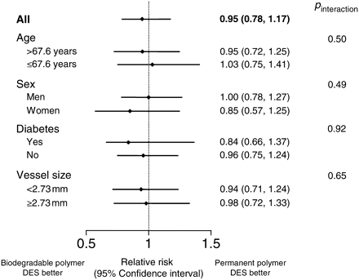
Figure 3 Comparison of biodegradable polymer or permanent polymer drug-eluting stent in pre-specified subgroups ...
Notes:
Figure 3 Comparison of biodegradable polymer or permanent polymer drug-eluting stent in pre-specified subgroups regarding the primary composite endpoint. Cut-off values for age and vessel size are those defining the median value for the entire population. DES, drug-eluting stent.
Unless provided in the caption above, the following copyright applies to the content of this slide: Published on behalf of the European Society of Cardiology. All rights reserved. © The Author 2009. For permissions please email: journals.permissions@oxfordjournals.org

