Slide 1
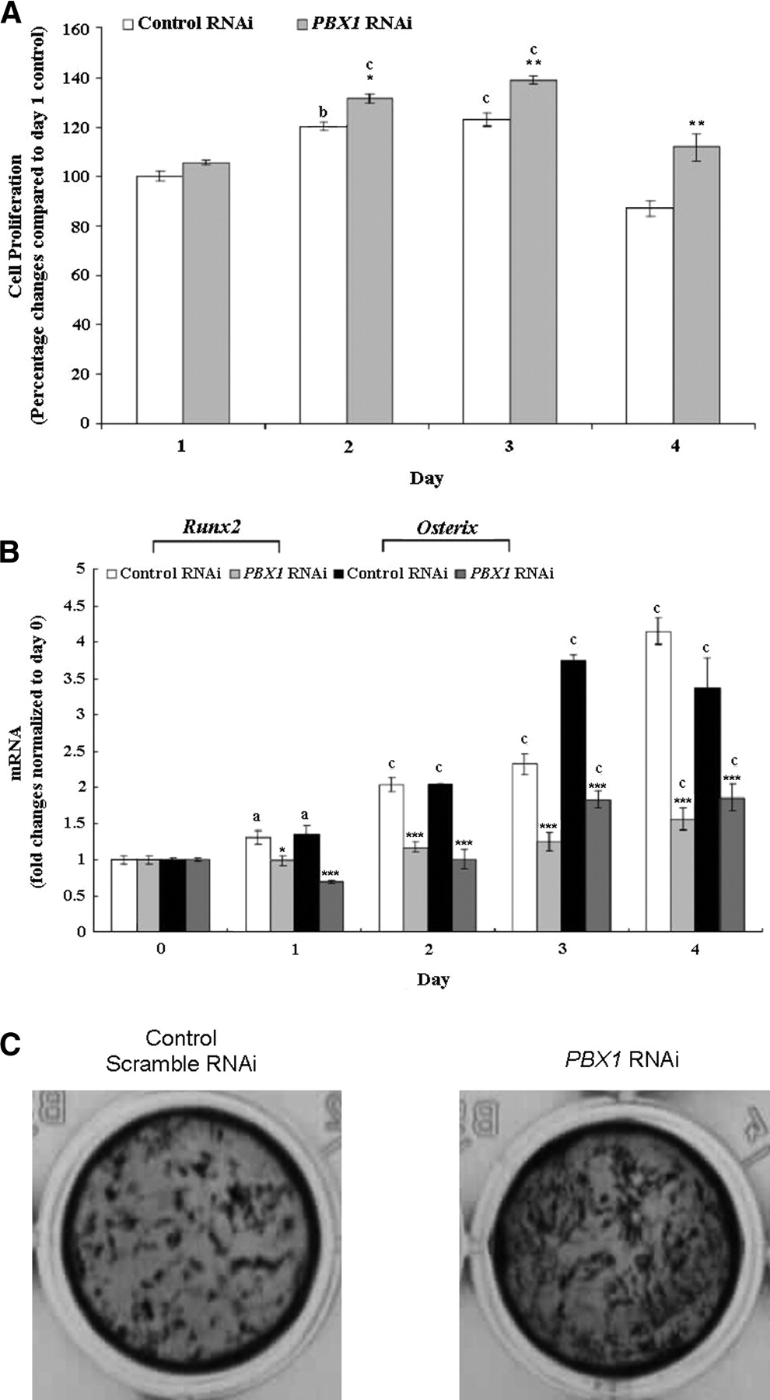
Figure 2. Transient knock-down of PBX1 significantly enhanced cell proliferation of murine MC3T3-E1 pre-osteoblasts ...
Notes:
Figure 2. Transient knock-down of PBX1 significantly enhanced cell proliferation of murine MC3T3-E1 pre-osteoblasts compared with scramble RNAi control (A). The two master genes controlling osteoblast differentiation, Runx2 and Osterix, were significantly downregulated by PBX1 knock-down (B). Enhanced matrix mineralization was observed at Day 30 by Von-Kossa silver stain (C). Results are expressed as mean ± SD. aP < 0.05; bP < 0.01; cP < 0.001 (versus Day 0); *P < 0.05; **P < 0.01; ***P < 0.001 (versus control).
Unless provided in the caption above, the following copyright applies to the content of this slide: © The Author 2008. Published by Oxford University Press. All rights reserved. For Permissions, please email: journals.permissions@oxfordjournals.org

Slide 2
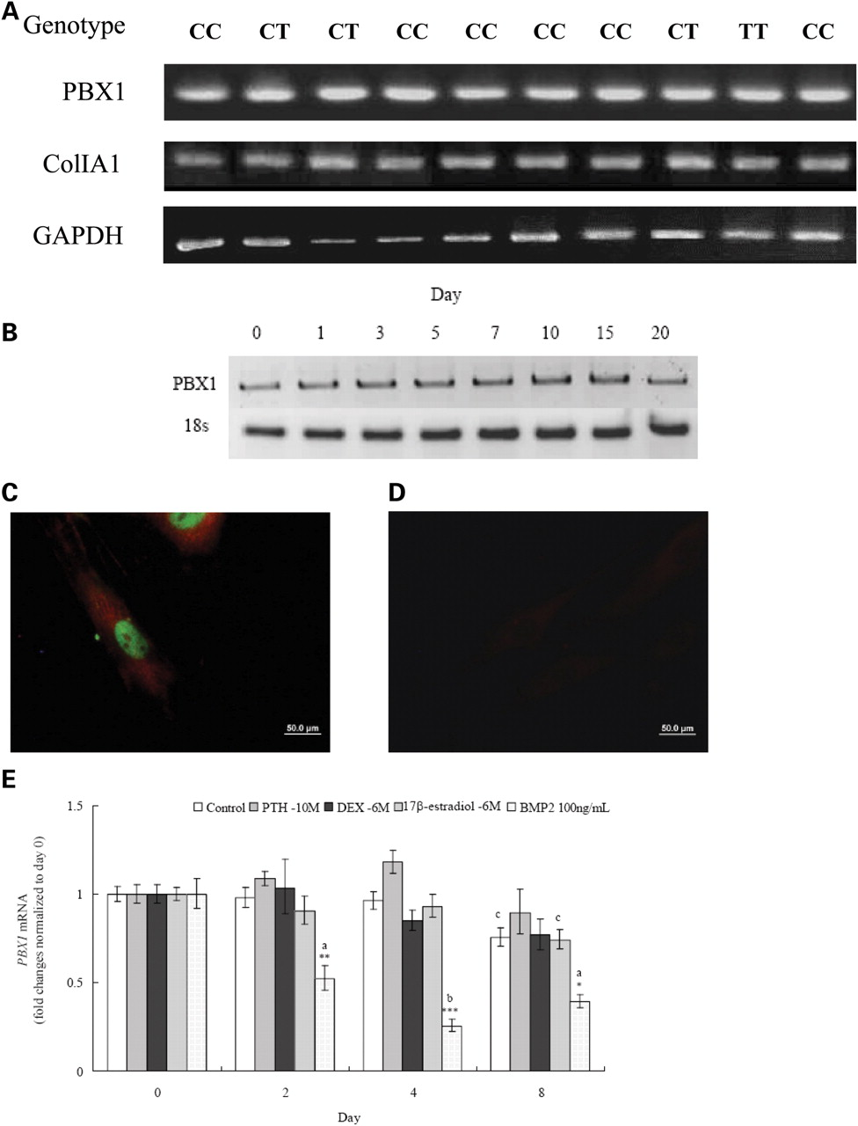
Figure 1. PBX1 mRNA was consistently expressed in human bone-derived cells (HBDC) (A) and murine MC3T3-E1 ...
Notes:
Figure 1. PBX1 mRNA was consistently expressed in human bone-derived cells (HBDC) (A) and murine MC3T3-E1 pre-osteoblast cells (B). PBX1, pre-B-cell leukemia homeobox 1; col1a1, collagen type 1α1; GAPDH, glyceraldehyde 3-phosphate dehydrogenase. Immunofluorescence staining HBDCs showing PBX1 (green) in the nucleus and col1aI (red) in the cytoplasm (C), with mice sera as negative control (D). Effect of PTH (10−10m), Dexamethasone (10−6m), 17β-estradiol (10−6m) and BMP2 (100 ng/ml) on PBX1 mRNA expression (E). Results are expressed as mean ± SD. aP < 0.05; bP < 0.01; cP < 0.001 (versus Day 0); *P < 0.05; **P < 0.01; ***P < 0.001 (versus control).
Unless provided in the caption above, the following copyright applies to the content of this slide: © The Author 2008. Published by Oxford University Press. All rights reserved. For Permissions, please email: journals.permissions@oxfordjournals.org

