Slide 1
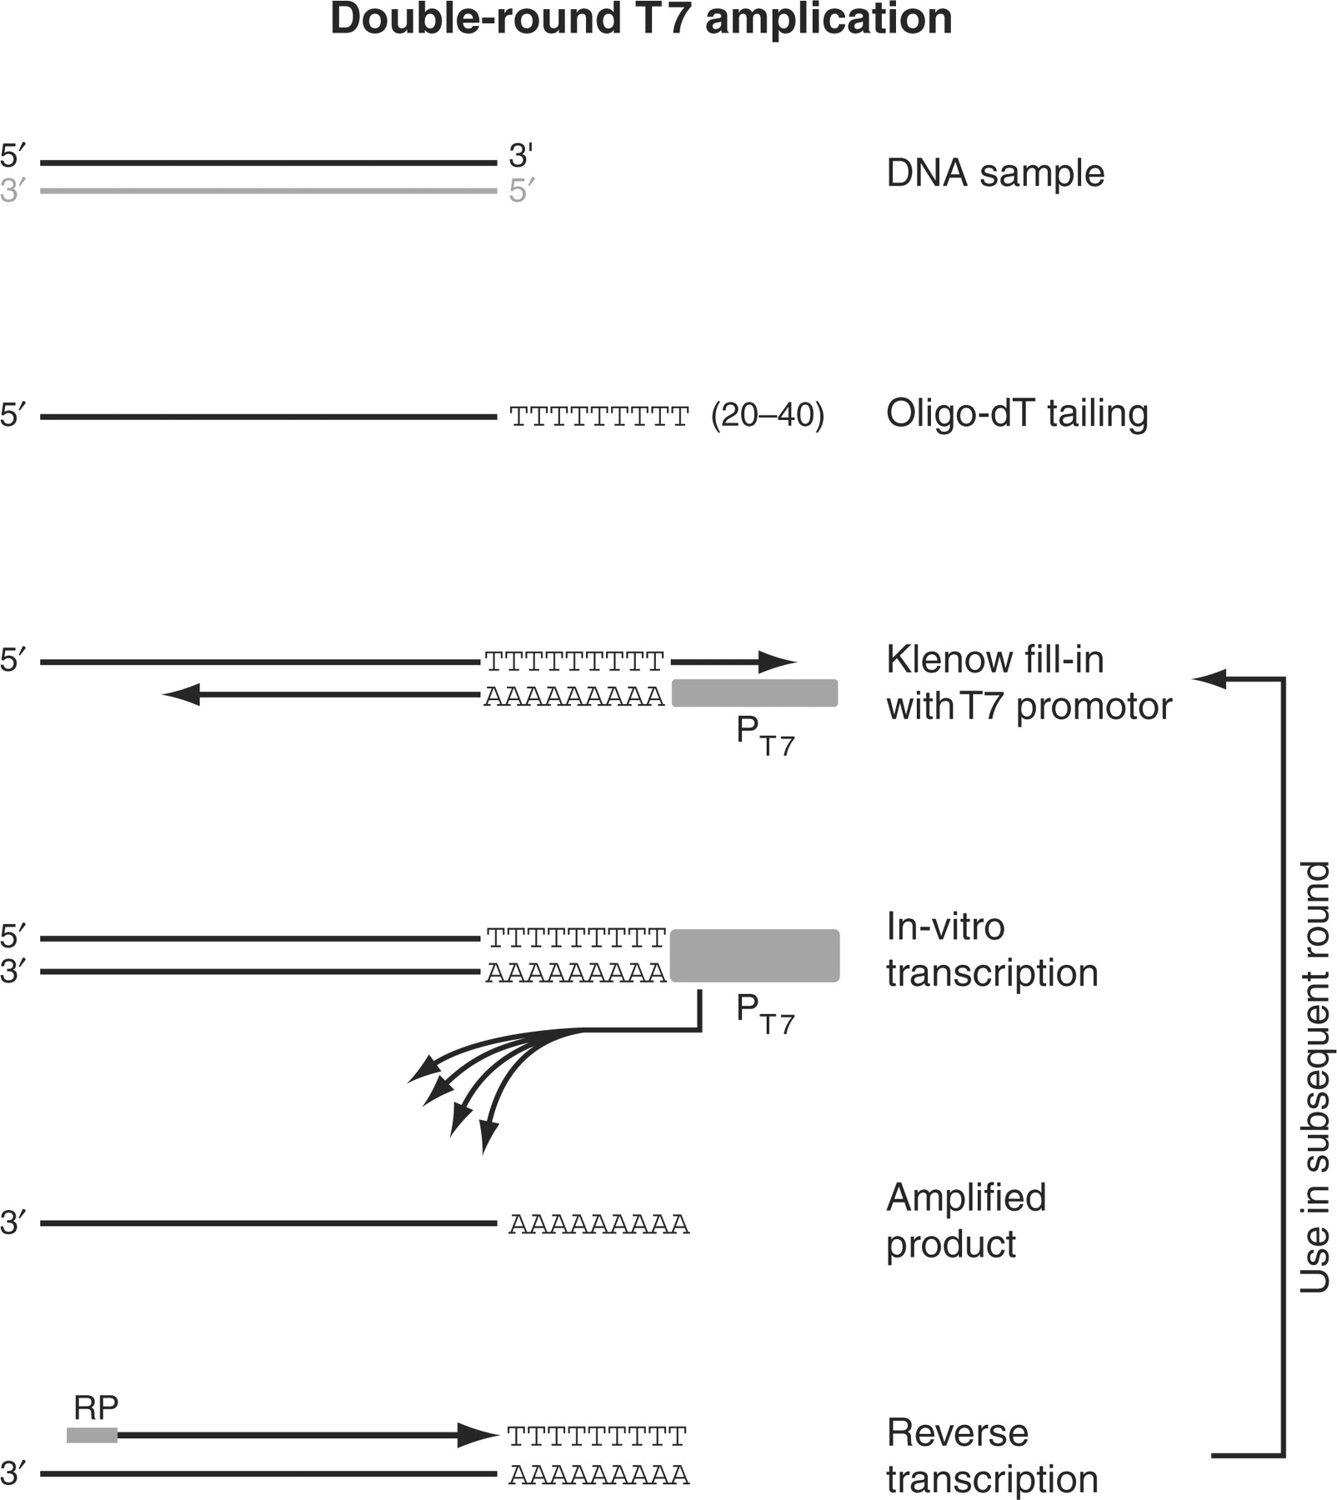
Figure 1. Overview of the double-T7 RNA polymerase based linear amplification method. The steps in the T7 ...
Notes:
Figure 1. Overview of the double-T7 RNA polymerase based linear amplification method. The steps in the T7 amplification protocol are illustrated for the top strand (black) of a double-stranded DNA template. The bottom strand (gray) is analogously amplified but omitted from this figure for clarity. After addition of poly(dT), an anchored T7-(dA) 18 oligo is annealed and the overhangs are filled in using the Klenow fragment of DNA polymerase I. The resulting double-stranded DNA fragment contains a functional T7 promoter that drives the in vitro transcription reaction, generating multiple RNA copies of the DNA template. To increase the yield for low starting amounts of ChIP material, a second amplification round is performed after reverse transcription using random primers (RP = random primers).
Unless provided in the caption above, the following copyright applies to the content of this slide: © 2008 The Author(s)This is an Open Access article distributed under the terms of the Creative Commons Attribution Non-Commercial License (http://creativecommons.org/licenses/by-nc/2.0/uk/) which permits unrestricted non-commercial use, distribution, and reproduction in any medium, provided the original work is properly cited.

Slide 2
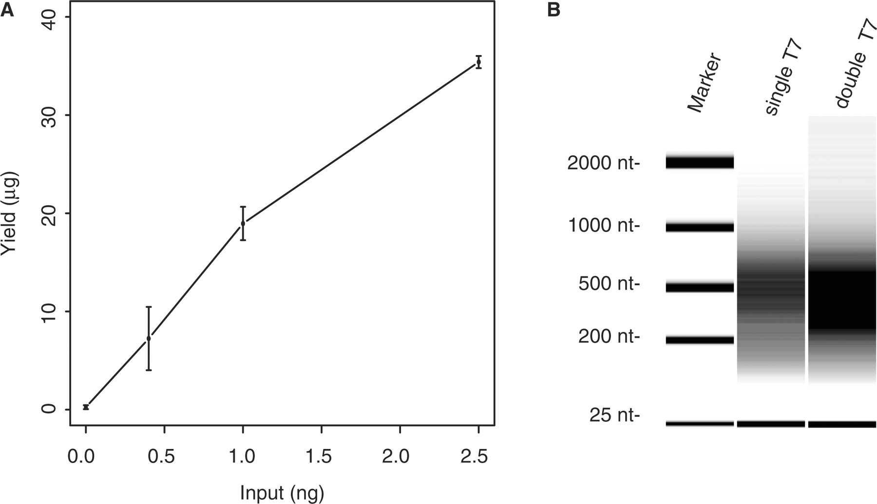
Figure 2. Yields obtained from amplification of different amounts of input DNA. An input DNA sample was obtained by ...
Notes:
Figure 2. Yields obtained from amplification of different amounts of input DNA. An input DNA sample was obtained by reverse crosslinking chromatin extracts from a wild-type yeast culture, and used as starting material for a double-round T7 amplification. ( A ) Averaged RNA yields after two rounds of amplification are plotted as function of the amount of starting material used, which ranged from 0.4 to 2.5 ng. The concentration of T7 oligo added to the Klenow reactions was scaled proportionally with the amount of starting material, and set to 25 nM and 250 nM for the first and second round, respectively. Assays were performed in duplicate and error bars indicate the standard deviation. ( B ) Analysis of fragment size of amplified material after single round or double round of T7 amplification. One hundred and fifty nanograms of each sample was analyzed on an Agilent 2100 Bioanalyzer together with a RNA size marker. The fragment sizes of the RNA marker are indicated.
Unless provided in the caption above, the following copyright applies to the content of this slide: © 2008 The Author(s)This is an Open Access article distributed under the terms of the Creative Commons Attribution Non-Commercial License (http://creativecommons.org/licenses/by-nc/2.0/uk/) which permits unrestricted non-commercial use, distribution, and reproduction in any medium, provided the original work is properly cited.

Slide 3
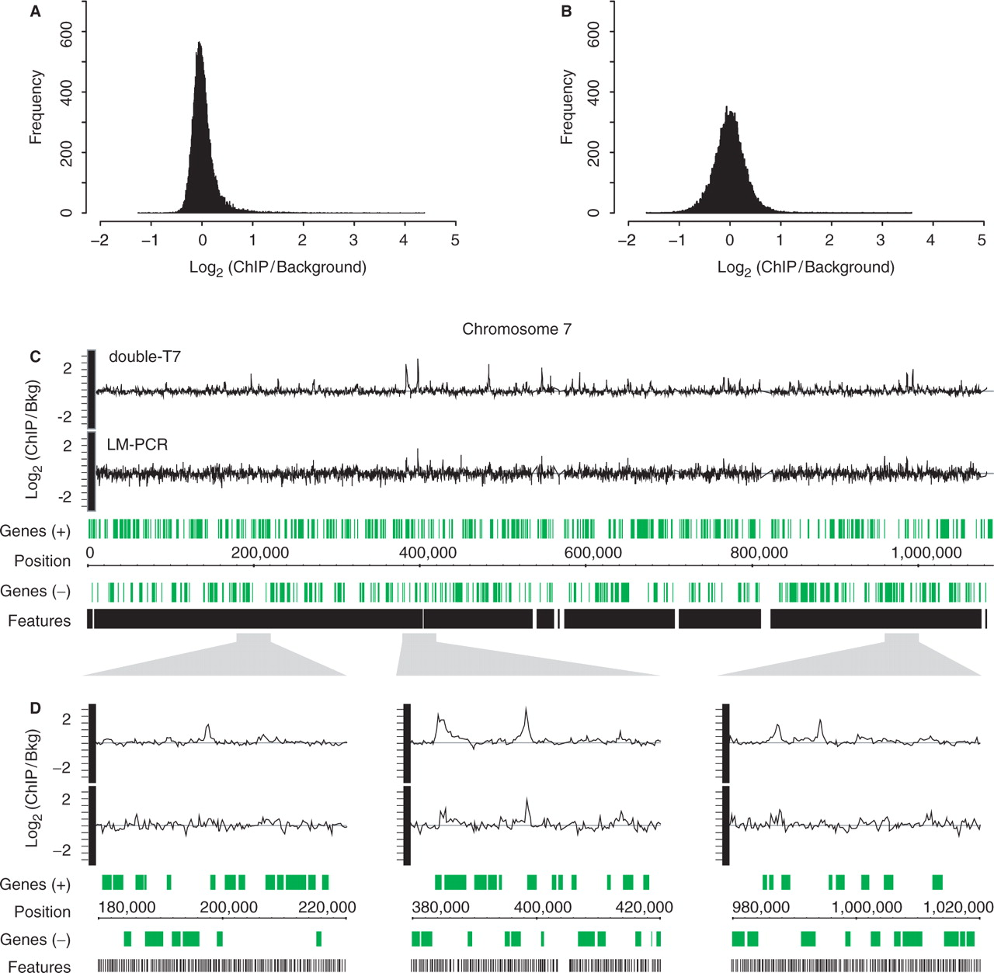
Figure 3. Double-round T7 amplification results in reduced technical variation compared to LM-PCR. Histograms of ...
Notes:
Figure 3. Double-round T7 amplification results in reduced technical variation compared to LM-PCR. Histograms of averaged binding ratios of four hybridizations with double-T7 ( A ) or LM-PCR amplified samples ( B ) across all DNA microarray probes. ( C ) Overview plot of chromosome 7 showing locations of array probes (black) and genes (green). Graphs of binding ratios of input versus ChIP show the background and binding signals for double-round T7 amplification (double-T7) (top) and LM-PCR (bottom). ( D ) Enlargement of indicated regions in (C).
Unless provided in the caption above, the following copyright applies to the content of this slide: © 2008 The Author(s)This is an Open Access article distributed under the terms of the Creative Commons Attribution Non-Commercial License (http://creativecommons.org/licenses/by-nc/2.0/uk/) which permits unrestricted non-commercial use, distribution, and reproduction in any medium, provided the original work is properly cited.

Slide 4
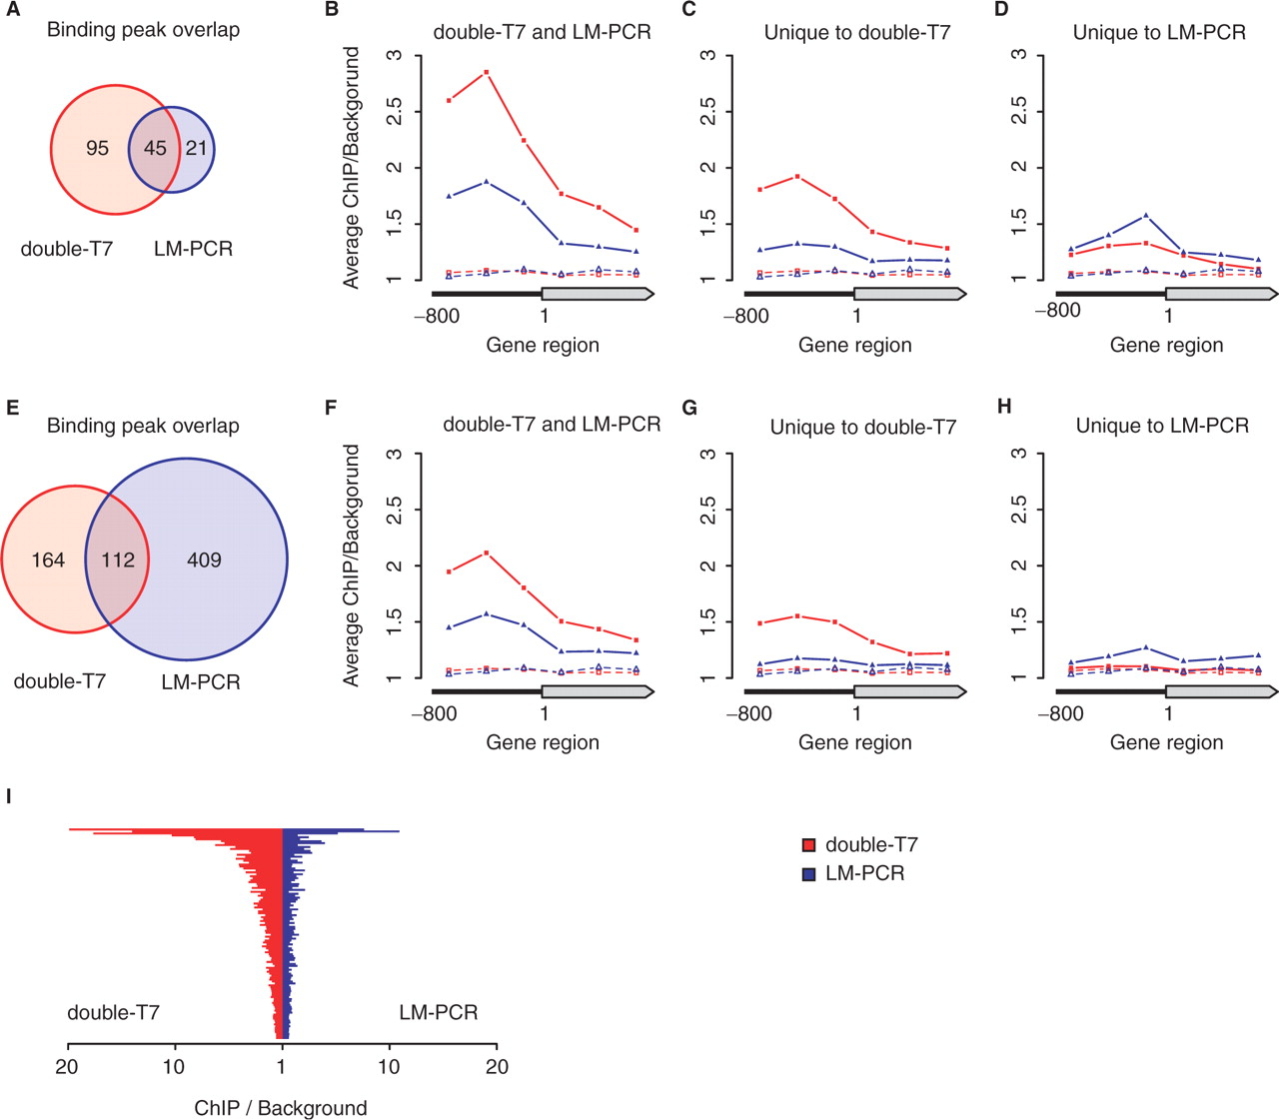
Figure 4. Comparison of significantly Gsm1p-bound regions after double-round T7 or LM-PCR amplification. The ...
Notes:
Figure 4. Comparison of significantly Gsm1p-bound regions after double-round T7 or LM-PCR amplification. The Gsm1p-bound regions identified after double-round T7 amplification (double-T7) and LM-PCR were compared after ANOVA analysis with high- (q 2) (A–D) or low-stringency (q 1.5) cutoffs ( E–H ). Venn diagrams (A and E) indicate the degree of overlap between the binding peaks identified after double-T7 or LM-PCR amplification. Average binding profiles were determined for gene regions with significant binding on the ORF or 800 bp of promoter region as indicated (B–D, F–H). Averaged background binding profiles derived from randomly selected sets of genes of similar size are shown as dashed lines. ( I ) Direct comparison of the maximal peak height after double-T7 (red) or LM-PCR (blue) for all overlapping binding peaks identified in (E).
Unless provided in the caption above, the following copyright applies to the content of this slide: © 2008 The Author(s)This is an Open Access article distributed under the terms of the Creative Commons Attribution Non-Commercial License (http://creativecommons.org/licenses/by-nc/2.0/uk/) which permits unrestricted non-commercial use, distribution, and reproduction in any medium, provided the original work is properly cited.

Slide 5
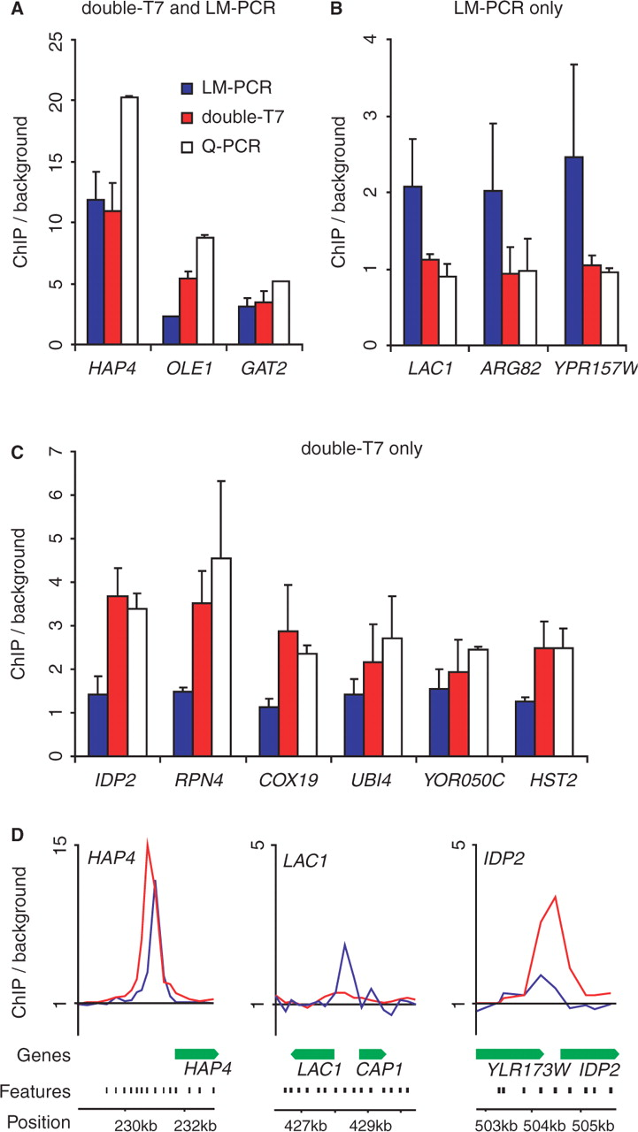
Figure 5. Quantitative PCR validation of Gsm1p-bound regions identified after double-round T7 amplification and LM-PCR ...
Notes:
Figure 5. Quantitative PCR validation of Gsm1p-bound regions identified after double-round T7 amplification and LM-PCR amplification. Quantitative PCR validation of Gsm1p-binding peaks identified by both double-round T7 amplification (double-T7) and LM-PCR ( A ), LM alone ( B ) or double-T7 alone ( C ). Binding to tested regions is represented as enrichment over the HMR silent mating-type locus. ( D ) Enlarged overview of Gsm1p-binding ratios on the indicated loci using either double-T7 (red) or LM-PCR (blue). Locations of array probes (black) and genes (green) are indicated.
Unless provided in the caption above, the following copyright applies to the content of this slide: © 2008 The Author(s)This is an Open Access article distributed under the terms of the Creative Commons Attribution Non-Commercial License (http://creativecommons.org/licenses/by-nc/2.0/uk/) which permits unrestricted non-commercial use, distribution, and reproduction in any medium, provided the original work is properly cited.

