Slide 1
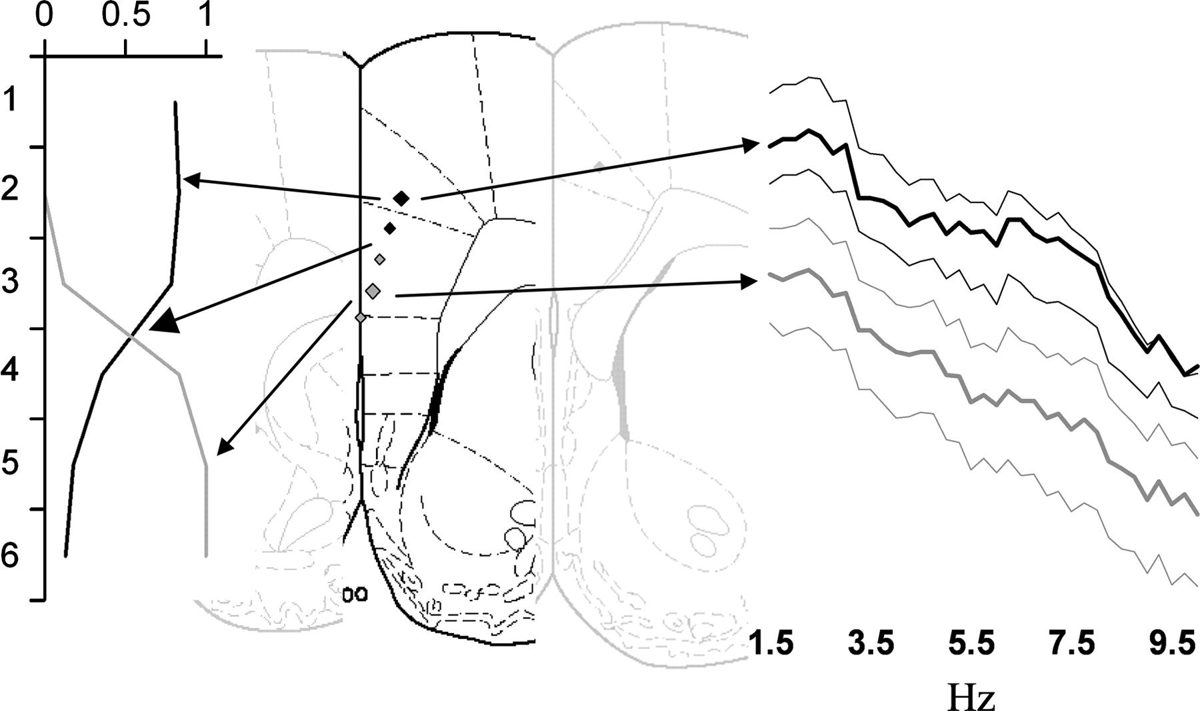
Figure 1. Schematic illustration of data reduction by factor analysis and power spectra. The graph on the left plots ...
Notes:
Figure 1. Schematic illustration of data reduction by factor analysis and power spectra. The graph on the left plots the unique factor loadings for each electrode in a 6-electrode array on 2 extracted factors. The unique loading includes only the variance in power for that electrode that can be attributed solely to the factor (which can be thought of as a mathematically estimated source of unknown location). The variance common to the 2 factors has been eliminated. In this example, the 6-electrode array delivers 2 separate profiles. Electrodes 1–3 are largely driven by 1 source—electrodes 5 and 6 by the other. Electrode 4 receives unique contributions from both sources. Brain drawings are displayed in the center, with the electrode placements depicted by diamonds through the rrACC and the mPFC (+2.2 mm from Bregma). The electrodes with the largest factor loading values of the set corresponding to a particular factor profile (largest symbols) are designated as the “representative” electrode, representing the field activity of the given area and are the only ones used for subsequent analysis of activity from the relevant histologically defined area (rrACC and mPFC in this case). Power spectra (on the right) from each electrode are also used to corroborate the designation of “representative” electrodes by spectral power with those showing the largest discursion in the theta range (thick lines) being chosen as the representative electrodes when factor loadings were similar among a set of electrodes.
Unless provided in the caption above, the following copyright applies to the content of this slide: © The Author 2008. Published by Oxford University Press. All rights reserved. For permissions, please e-mail: journals.permissions@oxfordjournals.org

Slide 2
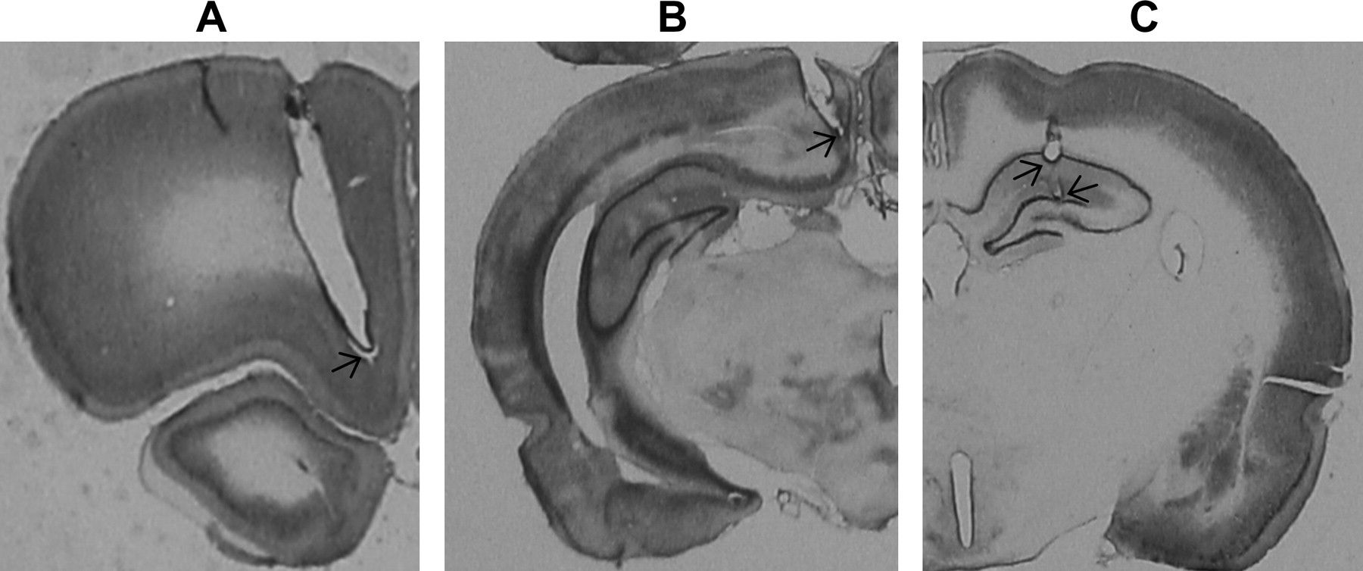
Figure 2. Histological preparations used to determine electrode positions. (A) A 6-electrode array transecting the mPFC ...
Notes:
Figure 2. Histological preparations used to determine electrode positions. (A) A 6-electrode array transecting the mPFC area. (B) A 4-electrode array transecting the cRS area. (C) A hippocampal bipolar recording electrode track. Despite the size of the arrays, no extensive injuries or necrosis were observed in the brain sections. The arrows point to the deepest recording tips from the arrays and the bipolar electrode tips in the hippocampus.
Unless provided in the caption above, the following copyright applies to the content of this slide: © The Author 2008. Published by Oxford University Press. All rights reserved. For permissions, please e-mail: journals.permissions@oxfordjournals.org

Slide 3
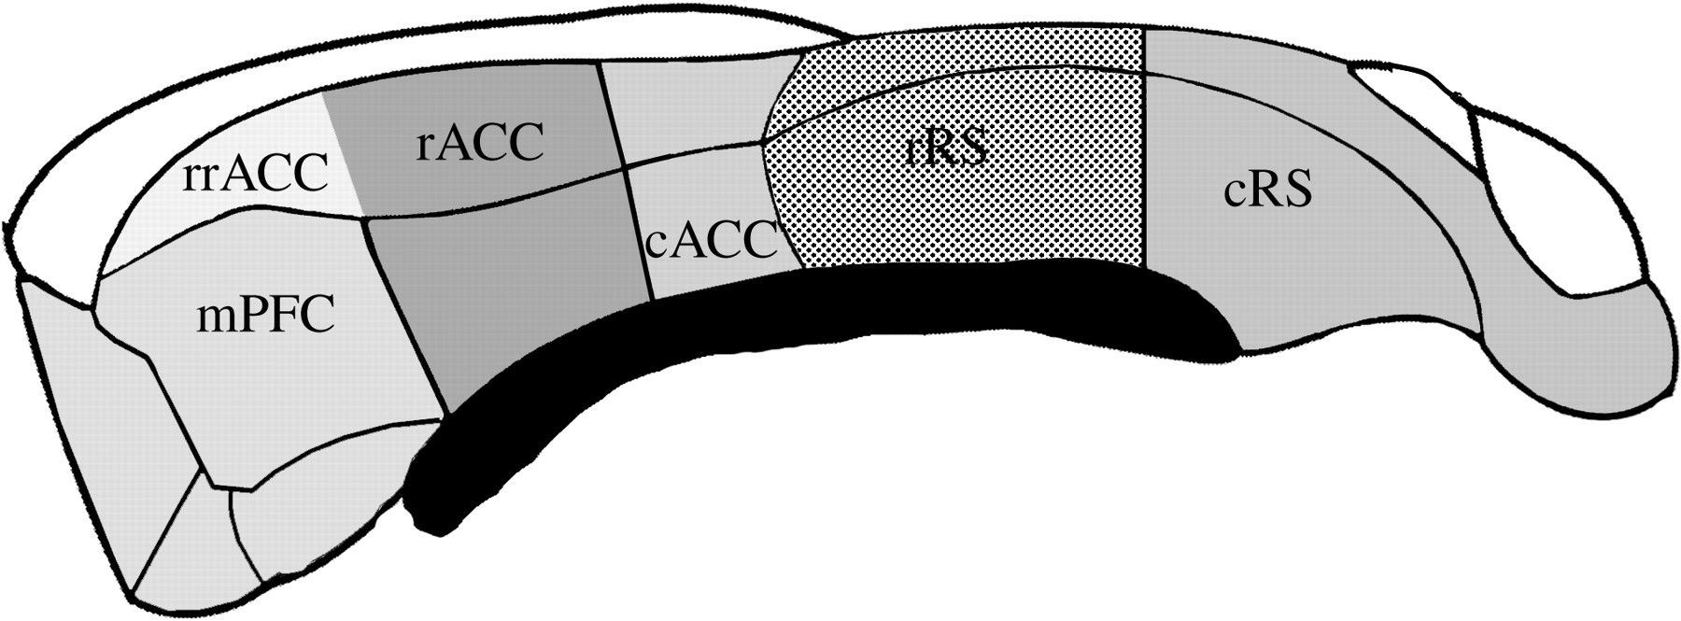
Figure 3. Median section of the rat brain illustrating the grouping of structures into cortical areas investigated in ...
Notes:
Figure 3. Median section of the rat brain illustrating the grouping of structures into cortical areas investigated in this study. The basis of anatomical grouping was on the rostro-caudal differences in connectivity, cytoarchitecture and biochemistry of the midline cortices. The anterior half of the medial cortex contains the medial prefrontal region (mPFC), which included the infralimbic (IL) and PrL cortices. The ACC was divided into the most rostral region just dorsal to the mPFC (rrACC), the rostral anterior cingulate with dorsal and ventral aspects (rACC), and their caudal counterparts (cACC). More caudally, the RS cortex was divided into rRS and cRS, which contain both the granular and agranular divisions. Figure redrawn from Palomero-Gallagher and Zilles (2004).
Unless provided in the caption above, the following copyright applies to the content of this slide: © The Author 2008. Published by Oxford University Press. All rights reserved. For permissions, please e-mail: journals.permissions@oxfordjournals.org

Slide 4
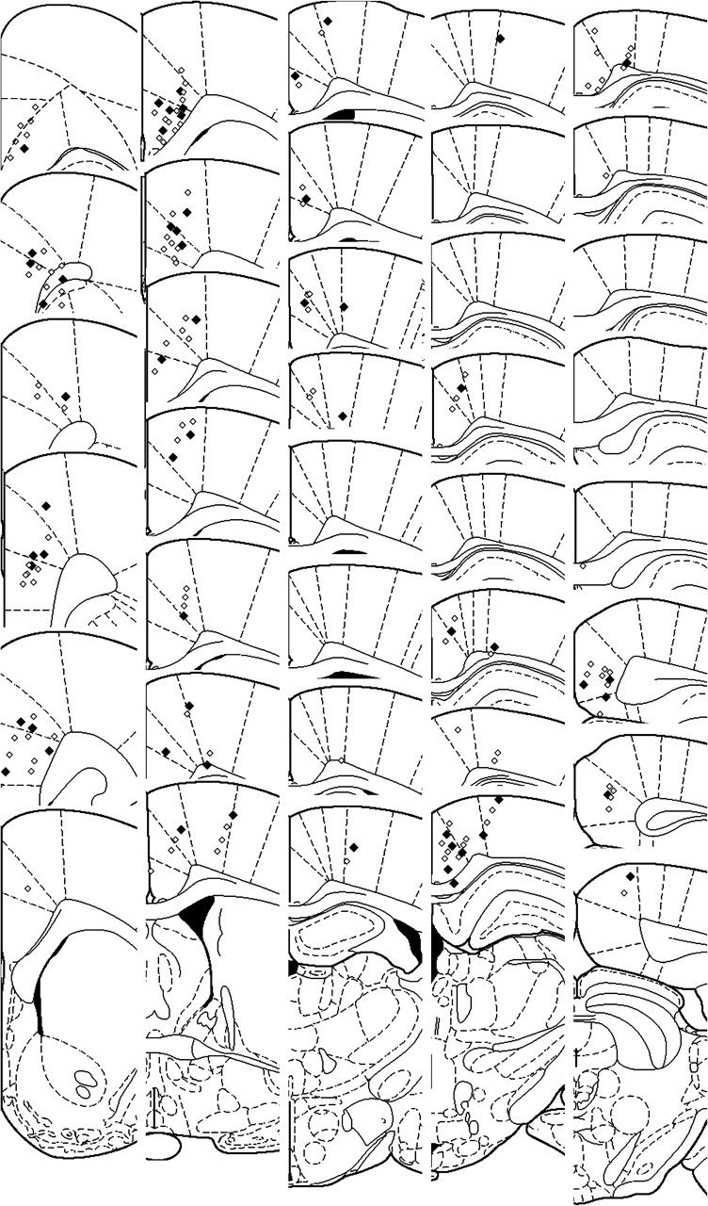
Figure 4. Collated electrode placements for the study. The filled diamonds represent the “representative” electrodes ...
Notes:
Figure 4. Collated electrode placements for the study. The filled diamonds represent the “representative” electrodes and the unfilled diamonds represent other electrodes used to determine the representative electrodes but were not included in the analyses of the differences between anatomical areas. In addition, “representative” electrodes falling outside of the midline cortex were not included in the analysis. For a detailed account of the number of electrodes in structures of interest, see Table 1. The distance to Bregma increases progressively from top to bottom in each row and then from left to right across rows.
Unless provided in the caption above, the following copyright applies to the content of this slide: © The Author 2008. Published by Oxford University Press. All rights reserved. For permissions, please e-mail: journals.permissions@oxfordjournals.org

Slide 5
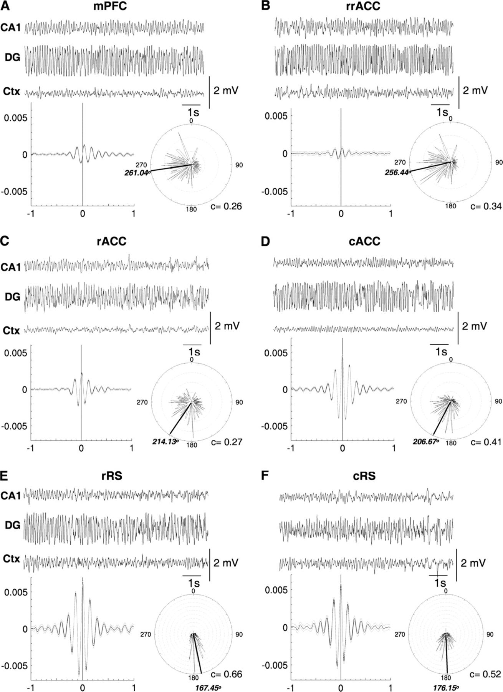
Figure 5. Examples of individual raw EEG recordings, together with group field-triggered-field averages and rose ...
Notes:
Figure 5. Examples of individual raw EEG recordings, together with group field-triggered-field averages and rose diagrams showing cortical phase relative to DG. They are arranged rostro-caudally: (A) mPFC, (B) rrACC, (C) rACC, (D) cACC, (E) rRS, and (F) cRS. Each section of raw EEG contains 10 s of the record and was digitally filtered (1 Hz high pass). The top traces for each raw record are from CA1, middle traces are from DG and bottom traces are from the relevant midline cortex. Clear theta oscillations can be seen in the raw examples for all cortical recording sites. The field-triggered field averages were calculated between the cortical and DG recordings using DG theta troughs as triggers. A predominant sinusoidal waveform in the theta frequency range suggests cortical theta is closely coupled with hippocampal (DG) theta. The rose diagrams contain the number of cortical theta troughs (each annulus = 100 incidences) falling on particular phases of a DG theta cycle. The mean phase is represented as the black bar radiating from the center of the plot, with the actual value just outside the rose plot. Phase concentration coefficients (c) are displayed on the bottom right corner of each rose plots. Rayleigh's test of uniformity revealed the phase distribution of all cortical theta negative peaks were nonuniform within a DG theta cycle (P < 0.0001).
Unless provided in the caption above, the following copyright applies to the content of this slide: © The Author 2008. Published by Oxford University Press. All rights reserved. For permissions, please e-mail: journals.permissions@oxfordjournals.org

Slide 6
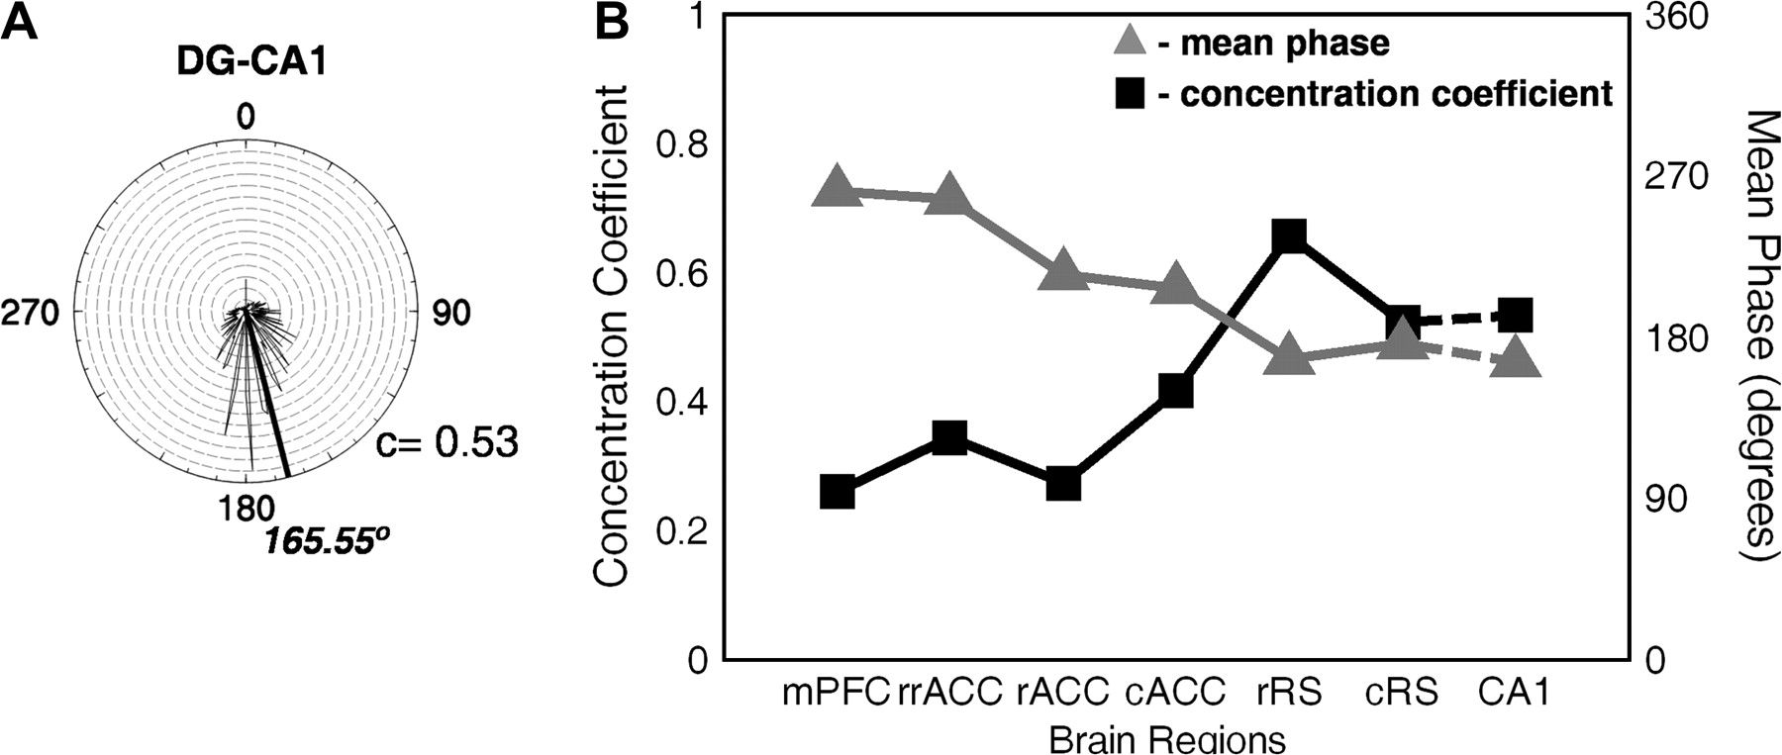
Figure 6. Intrahippocampal phase relations (CA1–DG) are depicted in (A), where a near 180° (166° averaged) phase ...
Notes:
Figure 6. Intrahippocampal phase relations (CA1–DG) are depicted in (A), where a near 180° (166° averaged) phase preference was found. A summary of circular statistics is presented in (B), where a shift of preferred phase from ∼270° to ∼180° in the rostro-caudal axis was observed between cortical and DG theta troughs. Note that the phase of posterior cortical areas was similar to that of area CA1, but anterior cortices differed from CA1 and, to some extent, from each other. Also, phase concentration increased progressively in the rosto-caudal direction.
Unless provided in the caption above, the following copyright applies to the content of this slide: © The Author 2008. Published by Oxford University Press. All rights reserved. For permissions, please e-mail: journals.permissions@oxfordjournals.org

Slide 7
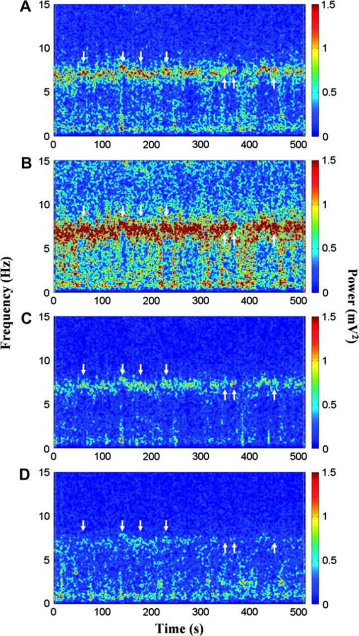
Figure 7. An example of changes in the power spectrum with time taken from a single animal within a single trial at ...
Notes:
Figure 7. An example of changes in the power spectrum with time taken from a single animal within a single trial at several recording sites: (A) CA1, (B) DG, (C) rRS, and (D) rACC. Spectral power is indicated by color (with the scale to the right of each panel). Within the 1- to 15-Hz frequency band (the signal was high-pass filtered at 1 Hz), all sites exhibit the highest power between 5 and 8 Hz. The power of theta-ranged oscillations is higher in hippocampal subregions and rRS. In contrast, the rACC has a more diffuse band of oscillatory activities that is predominantly theta, but also include slower oscillations down to 2 Hz. Down pointing white arrows illustrate a point in time at which the frequency structure is similar across all electrodes. Up pointing white arrows illustrate relative inconsistencies in theta frequency power across the electrodes. The discrepancy between the 2 types of case argues for distinct cortical generators of theta frequency rhythms.
Unless provided in the caption above, the following copyright applies to the content of this slide: © The Author 2008. Published by Oxford University Press. All rights reserved. For permissions, please e-mail: journals.permissions@oxfordjournals.org

Slide 8
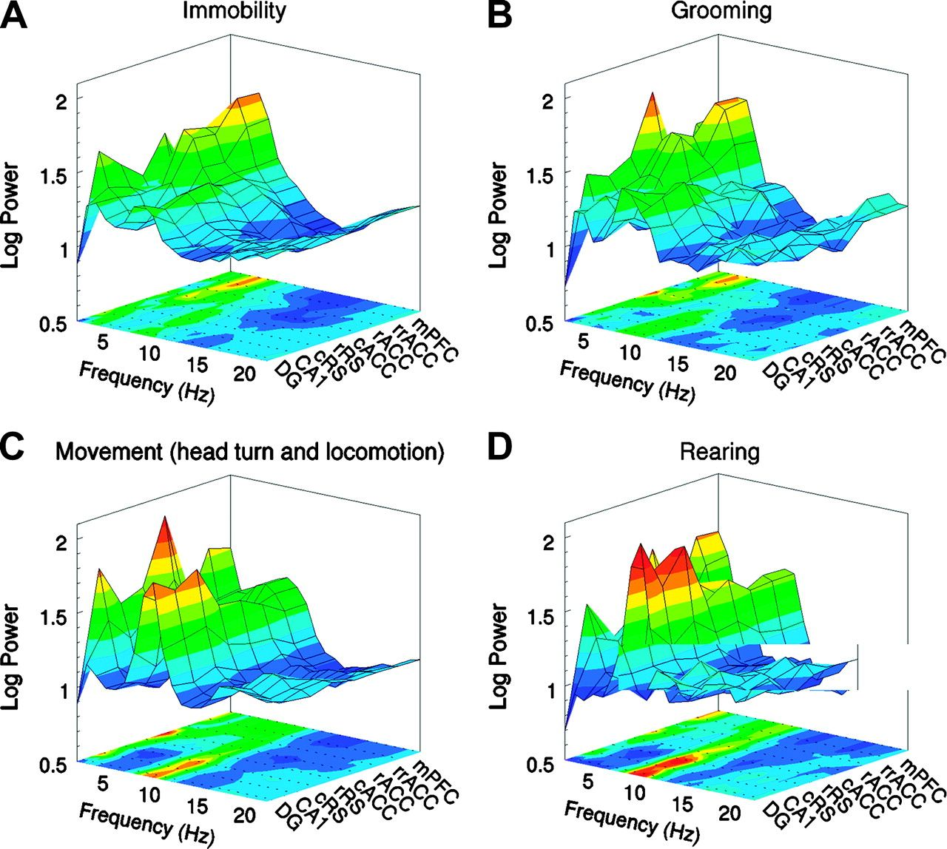
Figure 8. FFTs, averaged across animals and epochs, from different brain regions under various behavioral states: (A) ...
Notes:
Figure 8. FFTs, averaged across animals and epochs, from different brain regions under various behavioral states: (A) grooming, (B) immobility, (C) movement (head turn and locomotion, and (D) rearing. Oscillatory processes in the delta and theta frequencies dominate the power spectra. During grooming and immobility modest theta is present in all areas, more so in the posterior cortex and the hippocampus than the anterior cortex. But, delta oscillations dominate anterior cortical activities. When animals are engaged in locomotion, head movements, and rearing, delta oscillations decrease in power, whereas theta oscillations increase in power. This modulation of oscillatory activities in different frequency bands is more prominent in the anterior cortex compared with the posterior cortex and the hippocampus.
Unless provided in the caption above, the following copyright applies to the content of this slide: © The Author 2008. Published by Oxford University Press. All rights reserved. For permissions, please e-mail: journals.permissions@oxfordjournals.org

Slide 9
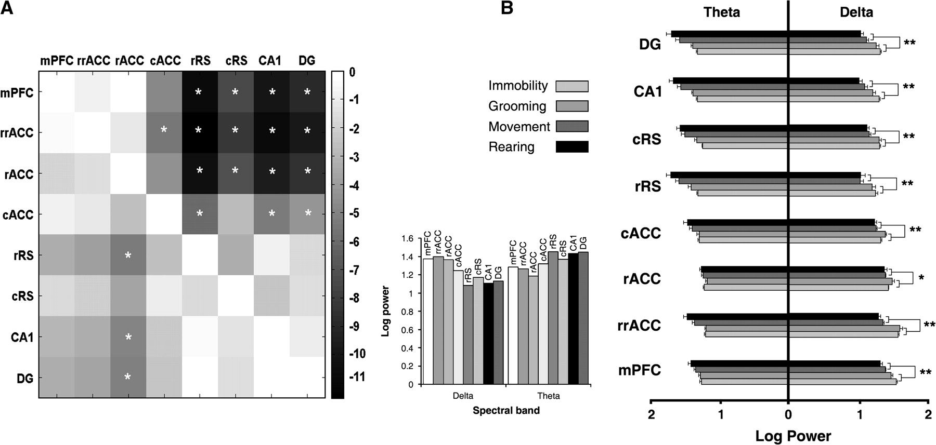
Figure 9. Average log power of delta (1–4 Hz) and theta (6–10 Hz) band oscillations throughout the neocortex and the ...
Notes:
Figure 9. Average log power of delta (1–4 Hz) and theta (6–10 Hz) band oscillations throughout the neocortex and the hippocampus. (A) Spectral power across all structures sampled irrespective of behavior (vertical histograms). The triangular matrices plot the t-statistics for differences between structures: top right for the delta band and bottom left for the theta band. The cell intensities in the matrix show structure grouping among the anterior cortices, up to cACC and among the posterior cortices up to and including the cACC. White asterisks denote statistical significance (P < 0.05) after Bonferroni correction. (B) Spectral power during different behavioral epochs. The data clearly show that theta band power was most prominent during voluntary behaviors and delta band power was most prominent during grooming and behavioral immobility. ANOVA revealed, with the exception of rACC in the theta band, that delta and theta band power were modulated by behavior. Specifically, post hoc comparisons revealed that the differences in power only existed between 2 main classes of behavior, voluntary (bodily movements and rearing) and grooming/behavioral immobility. *Significant differences observed in delta band power only between the 2 behavioral classes; **significant differences observed in both theta and delta band power between the 2 behavioral classes.
Unless provided in the caption above, the following copyright applies to the content of this slide: © The Author 2008. Published by Oxford University Press. All rights reserved. For permissions, please e-mail: journals.permissions@oxfordjournals.org

Slide 10
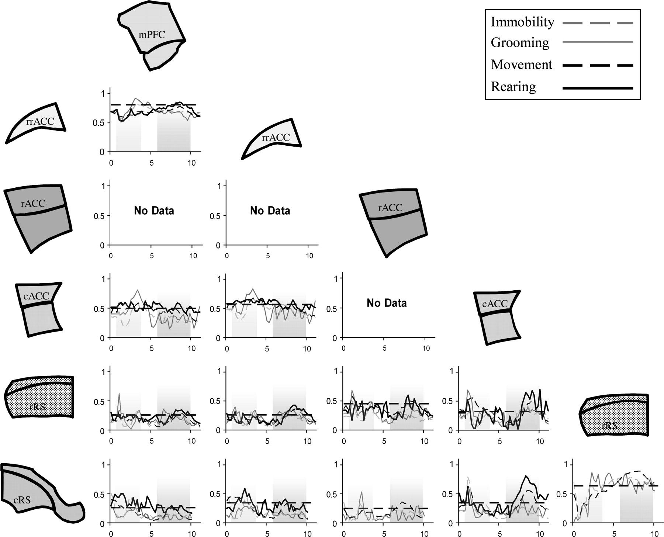
Figure 10. Cortico-cortical coherences between 0 and 10 Hz. The coherence plots are organized in a triangular matrix. ...
Notes:
Figure 10. Cortico-cortical coherences between 0 and 10 Hz. The coherence plots are organized in a triangular matrix. Frequency is on the x-axis and coherence is on the y-axis of each coherence plot. Missing plots are due to the lack of sufficient data to construct reliable coherence plots. Coherences under each behavioral state are plotted in differently styled lines, as seen in the legend at the top right. Dashed horizontal lines in each coherence spectrum represent the 95% confidence interval for coherence values across all behavioral epochs. The anterior half of the cortex examined has high coherences across the 0–10 Hz range and the posterior half has preferential frequency coupling in the theta range. Between the rostro-caudal parts, only voluntary behavior associated theta activities were found to be above the set confidence interval. Interestingly, cACC appears to be preferentially coupled in the delta range with the anterior half of the midline cortices and preferentially coupled at theta frequencies with the posterior cortices.
Unless provided in the caption above, the following copyright applies to the content of this slide: © The Author 2008. Published by Oxford University Press. All rights reserved. For permissions, please e-mail: journals.permissions@oxfordjournals.org

Slide 11
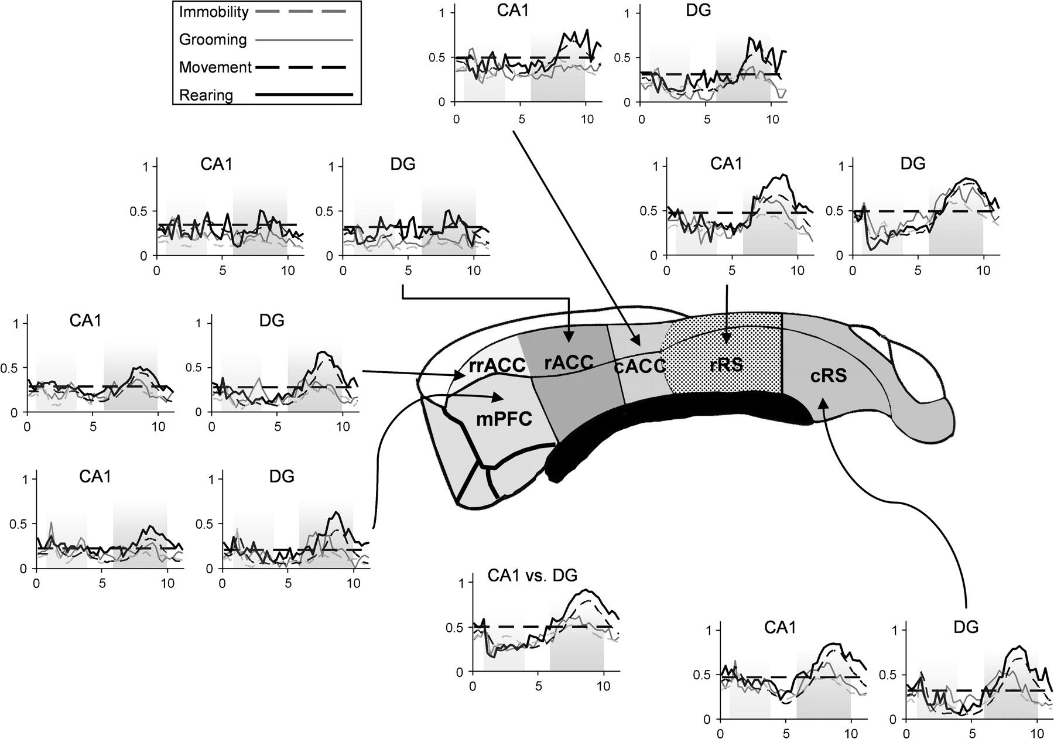
Figure 11. Cortico-hippocampal coherences between 0 and 10 Hz. Coherences (y-axis) across 0–10 Hz (x-axis) are plotted ...
Notes:
Figure 11. Cortico-hippocampal coherences between 0 and 10 Hz. Coherences (y-axis) across 0–10 Hz (x-axis) are plotted for each hippocampal subfield (CA1 and DG) compared with the midline cortex. Coherences under different behavioral states are represented by different line styles shown in the legend on the top left. Also, CA1 versus DG coherences are shown below the median section of the cortex for comparison. Dotted horizontal lines in each coherence spectrum represent the 95% confidence interval for coherence values across all behavioral epochs. Coherences within the theta range (dark gray shade) have prominent peaks well over the set significance level. A shift of higher cortico-DG coherences in the anterior cortex to higher cortico-CA1 coherences in the posterior cortex can be observed.
Unless provided in the caption above, the following copyright applies to the content of this slide: © The Author 2008. Published by Oxford University Press. All rights reserved. For permissions, please e-mail: journals.permissions@oxfordjournals.org

Slide 12
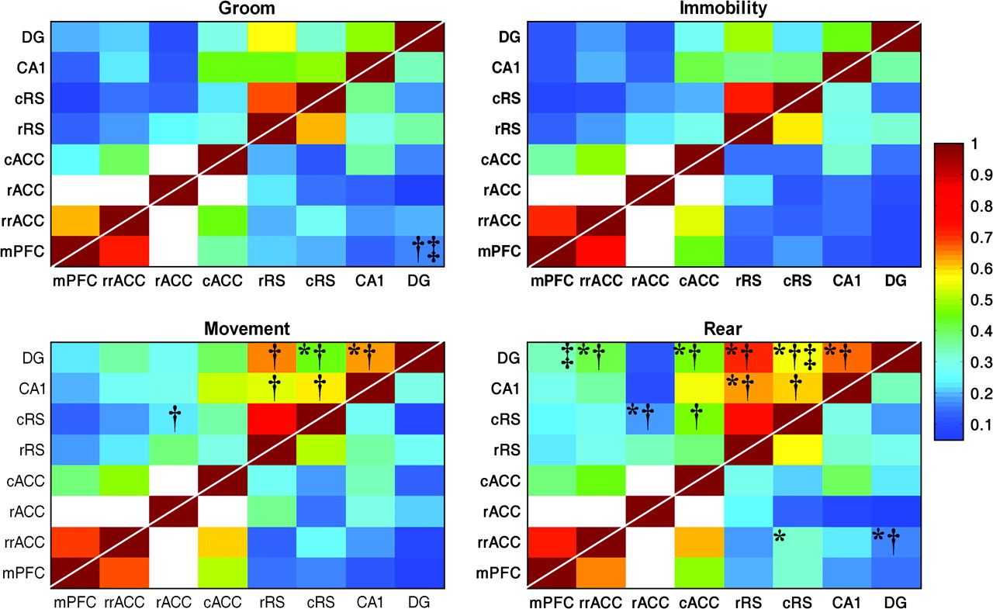
Figure 12. Mean coherences within the delta (1–4 Hz) and theta (6–10 Hz) bands in all structural-pair comparisons. The 4 ...
Notes:
Figure 12. Mean coherences within the delta (1–4 Hz) and theta (6–10 Hz) bands in all structural-pair comparisons. The 4 matrices represent the coherences in the delta and theta bands during the 4 behavioral states. Coherences in the theta band are represented in the top-left triangular matrix and coherences in the delta band are in the bottom right. The coherences in each frequency band were scaled and displayed as colors. White cells in the matrix denote missing data. The level of coherence between any pair is roughly proportional to the physical distance between the 2 structures. A general increase in synchronization can be seen when the animals engaged in motor activities compared with immobility and grooming. A clear increase in theta-range activities can be seen between the switch from immobility and grooming to motor behaviors. Post hoc statistical differences (P < 0.05, Bonferroni corrected) within a particular frequency band across the behaviors are presented as: *coherences are significantly higher than grooming; †coherences are significantly higher than immobility; ‡coherences are higher than movement.
Unless provided in the caption above, the following copyright applies to the content of this slide: © The Author 2008. Published by Oxford University Press. All rights reserved. For permissions, please e-mail: journals.permissions@oxfordjournals.org

