Slide 1
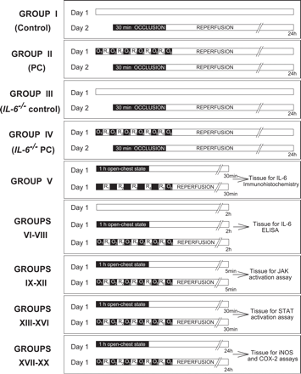
Fig. 1 Experimental protocol. Twenty groups of mice were used. On day 2, mice in groups I–IV underwent a 30-min ...
Notes:
Fig. 1 Experimental protocol. Twenty groups of mice were used. On day 2, mice in groups I–IV underwent a 30-min coronary occlusion followed by 24 h of reperfusion. On day 1, mice in group II (n=9, late PC group) and group IV (n=9, IL-6−/− late PC group) underwent a sequence of six 4-min coronary occlusion (O)/4-min reperfusion (R) cycles, while mice in group I (n=17, control group) and group III (n=9, IL-6−/− control group) did not undergo any intervention. Mice in group V (n=6) underwent 1 h of open-chest state (n=3) or six cycles of 4-min coronary occlusion/4-min reperfusion (n=3), and the hearts were harvested 30 min later for IL-6 immunolocalization. In groups VI–VIII (n=6 in each group), wild-type mice underwent no intervention (group VI), 1 h of open-chest state (group VII), or six cycles of 4-min coronary occlusion/4-min reperfusion (group VIII), and myocardial tissue samples were harvested 2 h later for the measurement of myocardial IL-6 levels by ELISA. In groups IX–XX (n=6 in each group), wild-type (groups IX, X, XIII, XIV, XVII, and XVIII) and IL-6−/− (groups XII, XV, XVI, XIX, and XX) mice underwent six cycles of 4-min coronary occlusion/4-min reperfusion (groups X, XII, XIV, XVI, XVIII, and XX) or 1-h open-chest state (groups IX, XIII, XV, XVII, and XIX), and myocardial tissue samples were harvested 5 min [groups IX–XII (JAK activity assays)], 30 min [groups XIII–XVI (STAT activation assays)] and 24 h [groups XVII–XX (iNOS and COX-2 levels)] later for biochemical assays.
Unless provided in the caption above, the following copyright applies to the content of this slide: Copyright © 2004, European Society of Cardiology

Slide 2
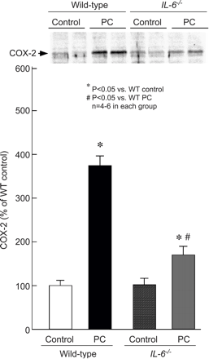
Fig. 8 Myocardial COX-2 expression 24 h after ischemic PC in wild-type and IL-6^{−/−} mice. Myocardial ...
Notes:
Fig. 8 Myocardial COX-2 expression 24 h after ischemic PC in wild-type and IL-6−/− mice. Myocardial samples were obtained from mice that underwent a sham operation (control) and from the ischemic/reperfused region of preconditioned (PC) wild-type and IL-6−/− mice. Upper panel: Western blots showing a marked increase in COX-2 immunoreactivity in the membranous fraction in the ischemic/reperfused region 24 h after ischemic PC in wild-type mice. Lower panel: Densitometric analysis of COX-2 signals in the membranous fraction. In all samples, the densitometric measurements of COX-2 immunoreactivity were expressed as a percentage of the average value measured in the anterior left ventricular wall of sham-operated wild-type mice. Data are mean±S.E.M.
Unless provided in the caption above, the following copyright applies to the content of this slide: Copyright © 2004, European Society of Cardiology

Slide 3
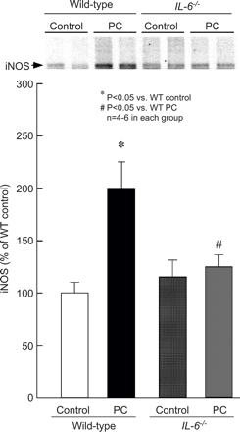
Fig. 7 Myocardial iNOS expression 24 h after ischemic PC in wild-type and IL-6^{−/−} mice. Myocardial ...
Notes:
Fig. 7 Myocardial iNOS expression 24 h after ischemic PC in wild-type and IL-6−/− mice. Myocardial samples were obtained from mice that underwent a sham operation (control) and from the ischemic/reperfused region of preconditioned (PC) wild-type and IL-6−/− mice. Upper panels: Western blot showing that the immunoreactivity of iNOS in the cytosolic fraction increased 24 h after ischemic PC, and that this increase was ablated in the absence of IL-6. Lower panels: Densitometric analysis of immunoreactive iNOS. Data are mean±S.E.M.
Unless provided in the caption above, the following copyright applies to the content of this slide: Copyright © 2004, European Society of Cardiology

Slide 4
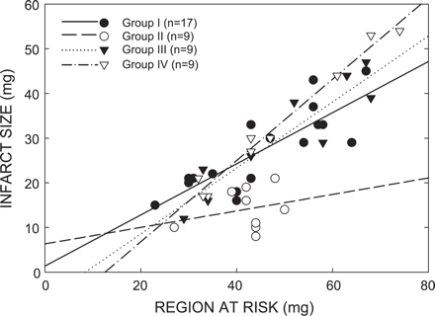
Fig. 3 Relationship between size of the region at risk and size of myocardial infarction. Illustrated are both ...
Notes:
Fig. 3 Relationship between size of the region at risk and size of myocardial infarction. Illustrated are both individual values and regression lines obtained by linear regression analysis for groups I (control group), II (PC group), III (IL-6−/− control group), and IV (IL-6−/− PC group). In groups I, III, and IV, infarct size was positively and linearly related to the risk region size. Linear regression equations were as follows: group I, y=0.572x+1.37 (r=0.83); group III, y=0.784x−6.234 (r=0.92); and group IV, y=0.910x−11.42 (r=0.99). For any risk region size, infarct size was smaller in group II compared with groups I and IV. In contrast, for any risk region size, infarct size was similar in groups IV and III. These data demonstrate that late PC reduced infarct size independent of risk region size and that this effect was abrogated in mice lacking IL-6.
Unless provided in the caption above, the following copyright applies to the content of this slide: Copyright © 2004, European Society of Cardiology

Slide 5
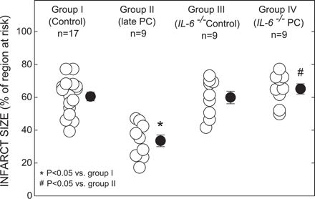
Fig. 2 Myocardial infarct size in groups I (control group), II (PC group), III (IL-6^{−/−} control group), ...
Notes:
Fig. 2 Myocardial infarct size in groups I (control group), II (PC group), III (IL-6−/− control group), and IV (IL-6−/− PC group). Infarct size is expressed as a percentage of the region at risk of infarction. (○) Individual mice. (●) Mean±S.E.M. (n, number of mice).
Unless provided in the caption above, the following copyright applies to the content of this slide: Copyright © 2004, European Society of Cardiology

Slide 6
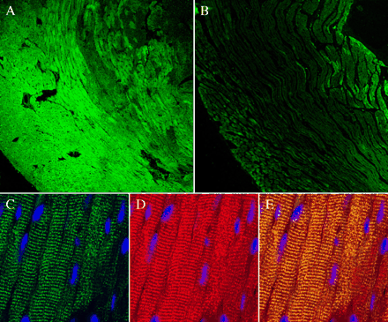
Fig. 4 Immunolocalization of myocardial IL-6. Representative lower magnification images (100 ×, panels A and B) ...
Notes:
Fig. 4 Immunolocalization of myocardial IL-6. Representative lower magnification images (100 ×, panels A and B) demonstrate increased expression of IL-6 in the ischemic/reperfused myocardium. Minimal IL-6 immunoreactivity (green fluorescence) was noted in the sham-operated hearts (panel B). In contrast, extensive IL-6 expression was noted in the ischemic/reperfused zone in the hearts of preconditioned mice 30 min after the preconditioning ischemia (panel A). Higher magnification images (630 ×, panels C–E) demonstrate the cytoplasmic distribution of IL-6 (panel C, green fluorescence) in cardiomyocytes. Cardiomyocytes are identified by the red fluorescence of troponin T (panel D). Colocalization of IL-6 and troponin T in yellow fluorescence (panel E) confirms the cytoplasmic distribution of intracellular IL-6 in cardiomyocytes. Nuclei are identified by DAPI (panel E, blue fluorescence).
Unless provided in the caption above, the following copyright applies to the content of this slide: Copyright © 2004, European Society of Cardiology

Slide 7
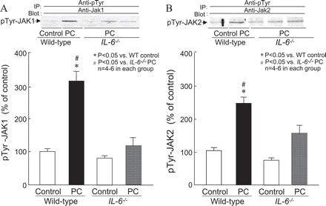
Fig. 5 Tyrosine phosphorylation of JAK1 and JAK2 by ischemic PC in wild-type and IL-6^{−/−} mice. Myocardial ...
Notes:
Fig. 5 Tyrosine phosphorylation of JAK1 and JAK2 by ischemic PC in wild-type and IL-6−/− mice. Myocardial samples were obtained from mice that underwent a sham operation (control) and from the ischemic/reperfused region of preconditioned (PC) wild-type and IL-6−/− mice. All mice were euthanized 5 min after the sixth reperfusion. Upper panels: Western blots showing that the immunoreactivity of the tyrosine-phosphorylated forms of JAK1 (panel A) and JAK2 (panel B) increased markedly 5 min after ischemic PC in wild-type mice, and that this increase was ablated in preconditioned IL-6−/− mice. Lower panels: Densitometric analysis of tyrosine-phosphorylated JAK1 and JAK2 signals. Data are mean±S.E.M.
Unless provided in the caption above, the following copyright applies to the content of this slide: Copyright © 2004, European Society of Cardiology

Slide 8
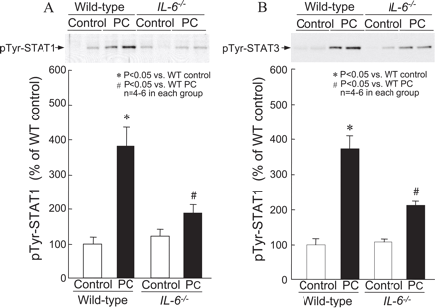
Fig. 6 Tyrosine phosphorylation of STAT1 and STAT3 by ischemic PC in wild-type and IL-6^{−/−} mice. Nuclear ...
Notes:
Fig. 6 Tyrosine phosphorylation of STAT1 and STAT3 by ischemic PC in wild-type and IL-6−/− mice. Nuclear extracts were prepared from mice that underwent a sham operation (control), and from the ischemic/reperfused region of preconditioned (PC) wild-type and IL-6−/− mice that were euthanized 30 min after the sixth reperfusion. Upper panels: Western blots showing that the immunoreactivity of tyrosine-phosphorylated STAT1 (panel A) and STAT3 (panel B) in nuclear extracts increased markedly 30 min after ischemic PC in wild-type mice, and that this increase was significantly attenuated in preconditioned IL-6−/− mice. Lower panels: Densitometric analysis of tyrosine-phosphorylated STAT1 and STAT3 in nuclear extracts at 30 min after PC. Data are mean±S.E.M.
Unless provided in the caption above, the following copyright applies to the content of this slide: Copyright © 2004, European Society of Cardiology

