Slide 1
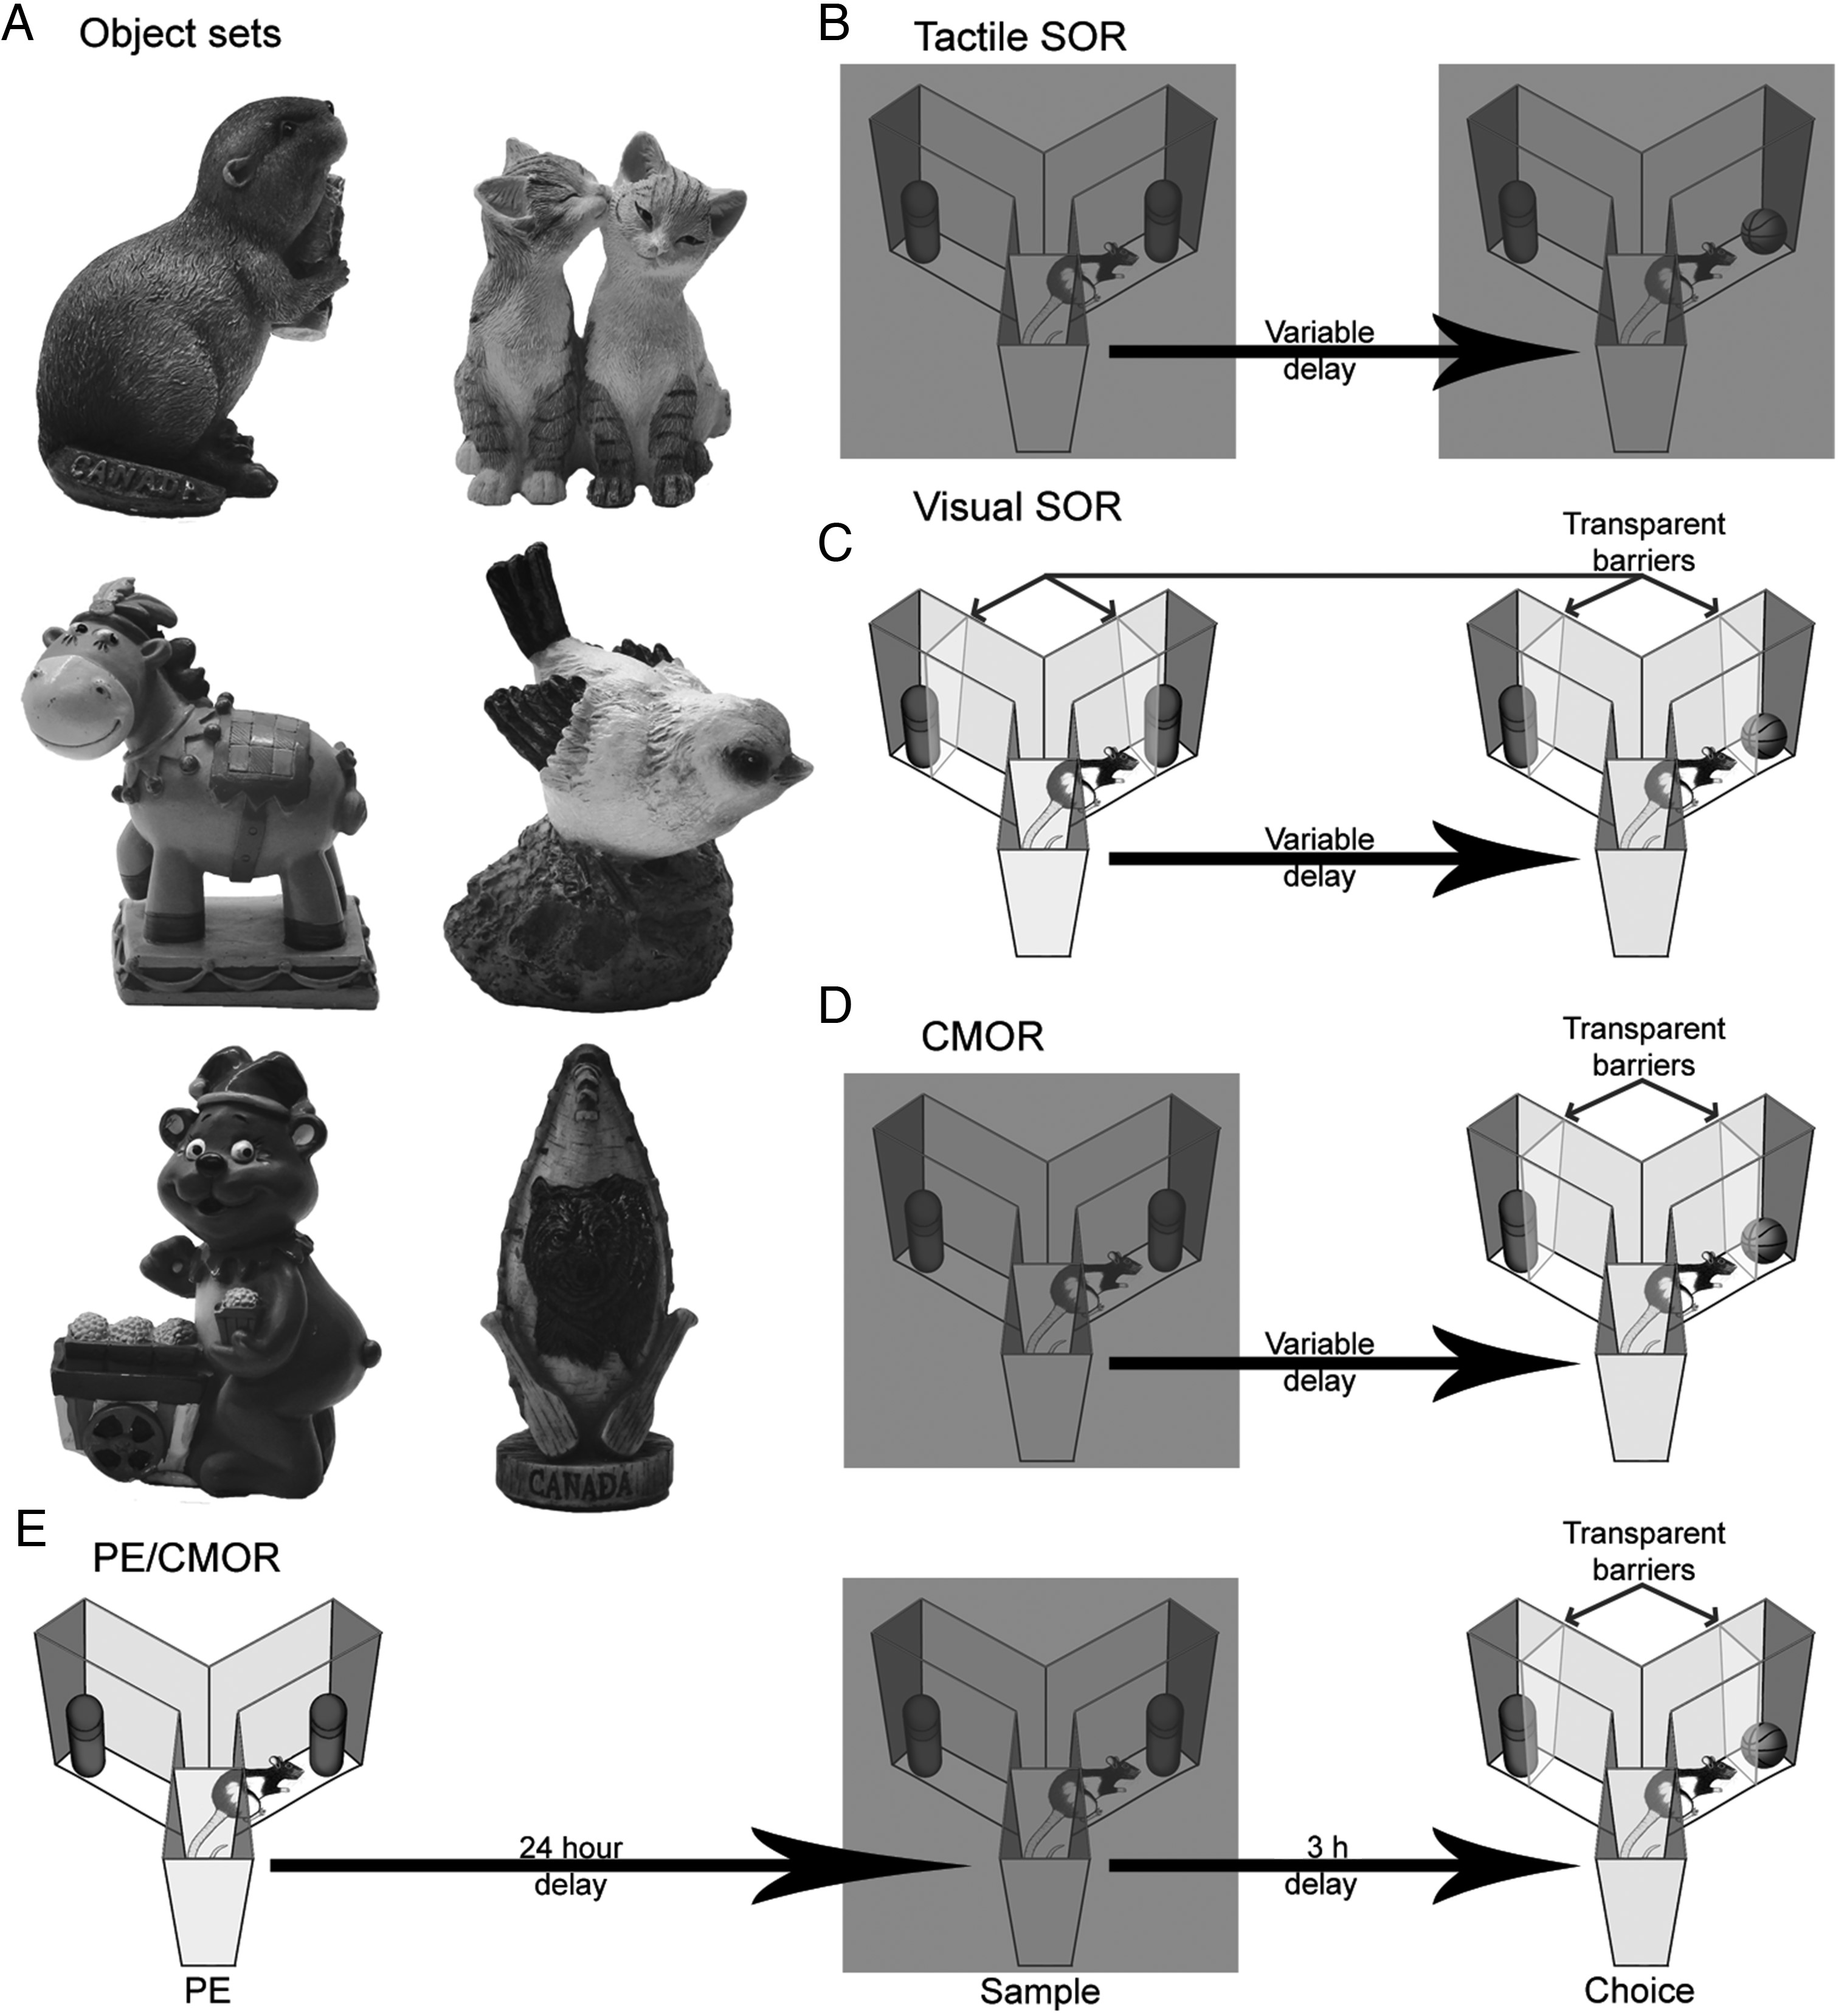
Figure 1. The 4 versions of SOR used in this study. (A) Examples of typical object sets used for all versions. (B) ...
Notes:
Figure 1. The 4 versions of SOR used in this study. (A) Examples of typical object sets used for all versions. (B) Tactile-only SOR: The sample and choice phases are run in red light to prevent visual exploration of objects. (C) Visual-only SOR: The sample and choice phases are run in white light with transparent barriers separating the rat and the objects to prevent tactile exploration. (D) The original CMOR task: The sample phase is run in red light, and the choice phase is run in white light with the transparent barriers in place. Rats are therefore required to use the visual information available during the choice phase to recognize an object based on tactile information previously acquired in the sample phase. (E) The modified CMOR task with multimodal object pre-exposure (PE/CMOR): Format is the same as CMOR, except that rats can explore the eventual sample objects in white light and without the barriers in a pre-exposure session 24 h before the tactile sample phase; in the control (no pre-exposure) condition, rats remain in their home cages for this session. The multimodal pre-exposure extends CMOR task performance beyond the standard 1-h retention delay; we typically run PE/CMOR with a 3-h retention delay to compare performance in rats with and without pre-exposure.
Unless provided in the caption above, the following copyright applies to the content of this slide: © The Author 2013. Published by Oxford University Press. All rights reserved. For Permissions, please e-mail: journals.permissions@oup.com

Slide 2
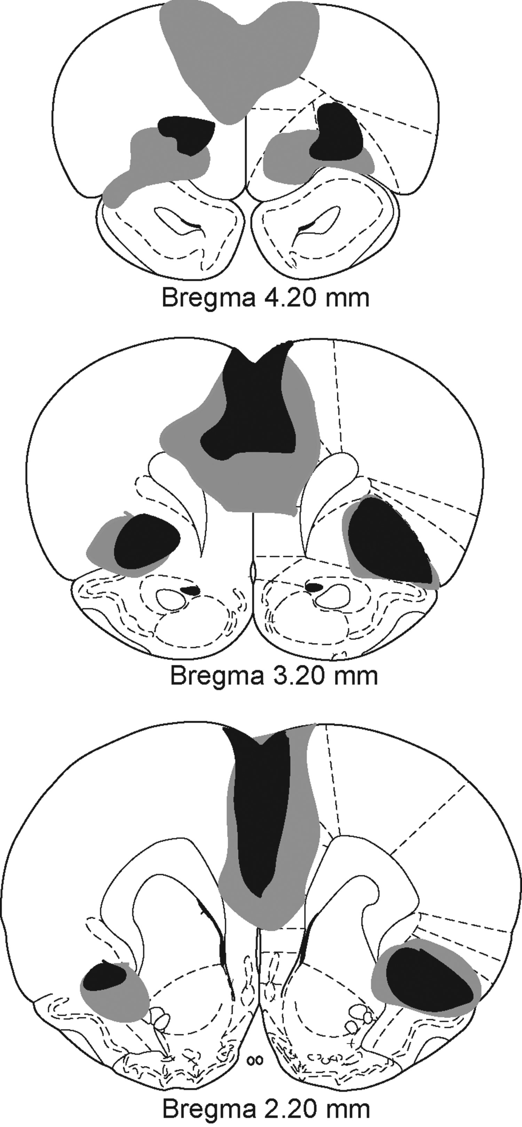
Figure 2. Extent of the inclusive excitotoxic prefrontal cortex lesions. The largest lesion is illustrated in gray, and ...
Notes:
Figure 2. Extent of the inclusive excitotoxic prefrontal cortex lesions. The largest lesion is illustrated in gray, and the smallest lesion is in black. Anatomical figures are from Paxinos and Watson (1998). Coronal sections are 4.20 mm through 2.20 mm anterior to bregma.
Unless provided in the caption above, the following copyright applies to the content of this slide: © The Author 2013. Published by Oxford University Press. All rights reserved. For Permissions, please e-mail: journals.permissions@oup.com

Slide 3
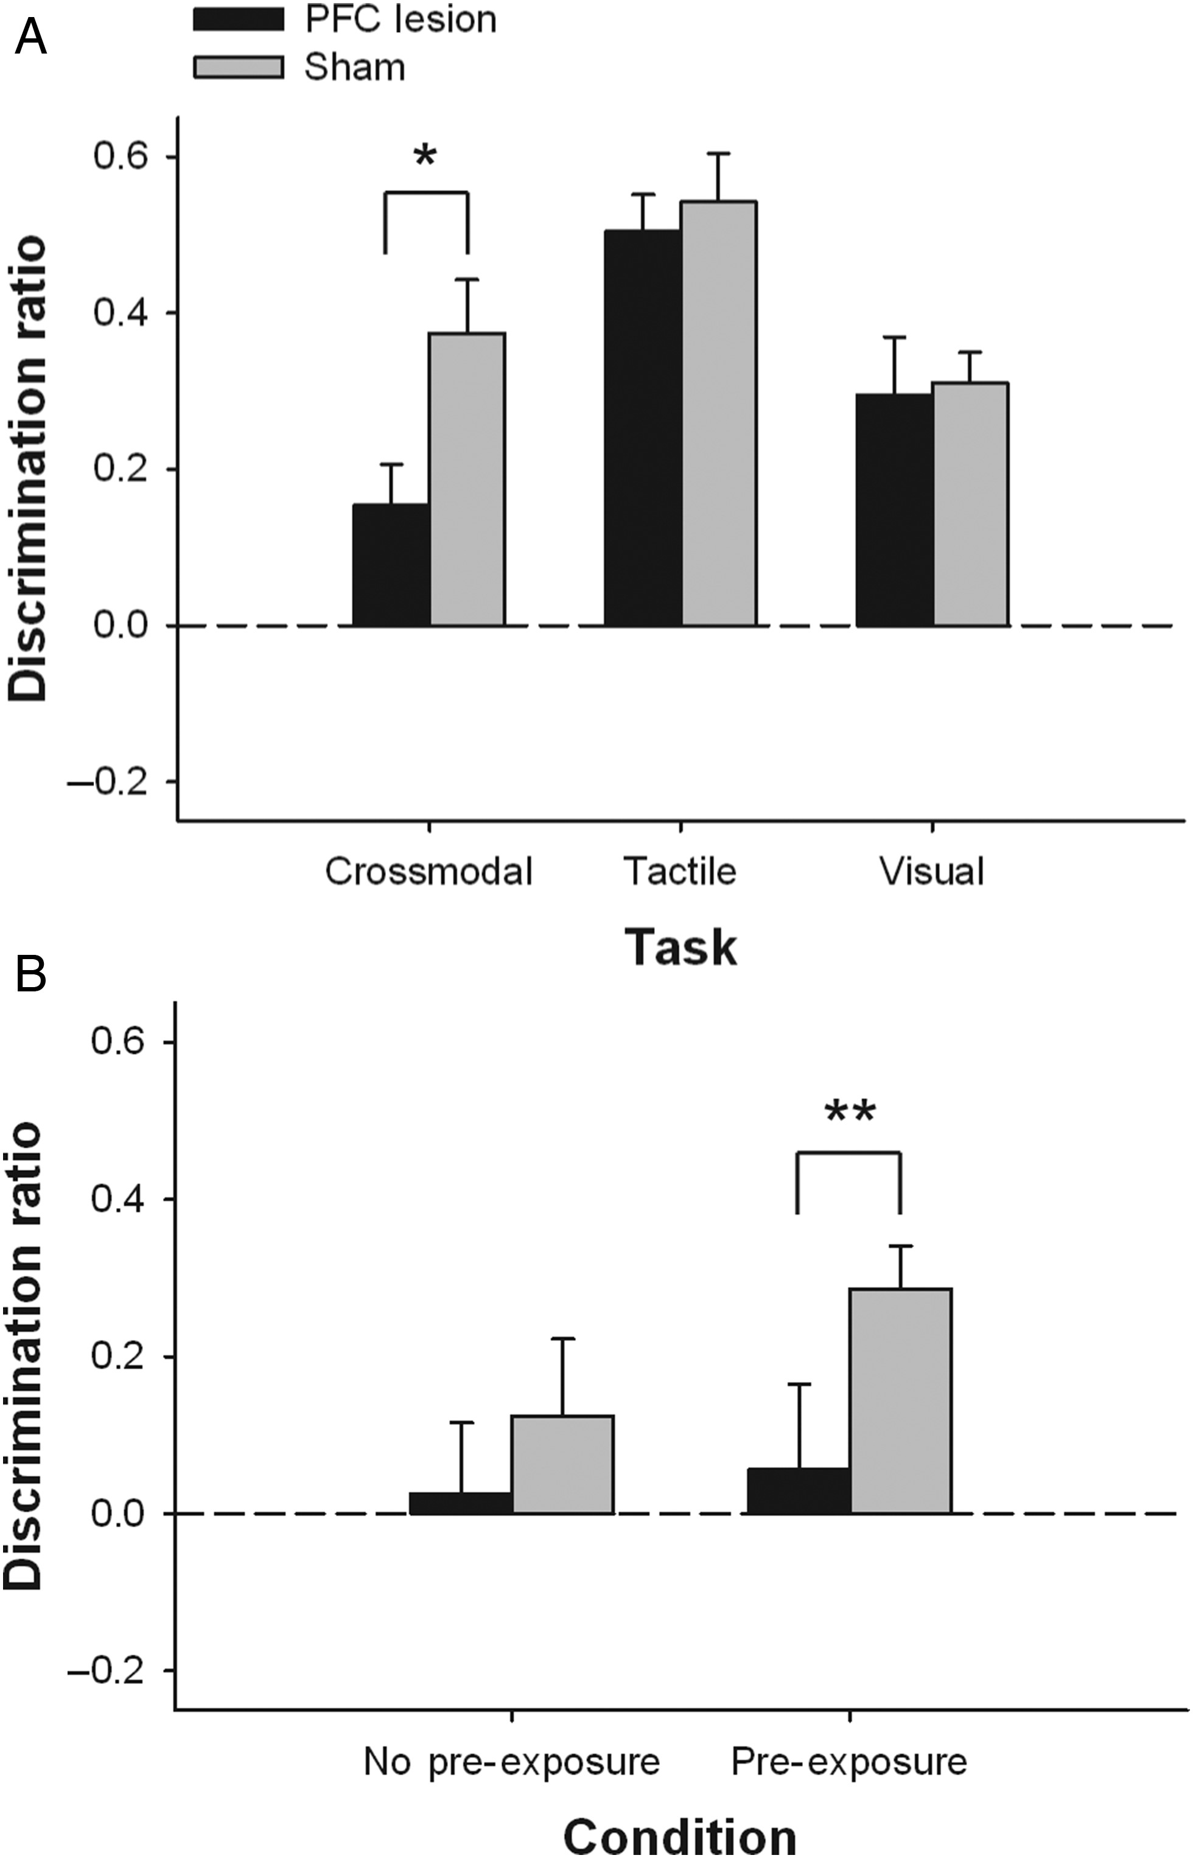
Figure 3. Performance of rats with inclusive PFC lesions on (A) CMOR, as well as tactile-only and visual-only SOR, each ...
Notes:
Figure 3. Performance of rats with inclusive PFC lesions on (A) CMOR, as well as tactile-only and visual-only SOR, each with a 1-h retention delay between sample and choice phases and (B) 3-h CMOR with and without multimodal object pre-exposures 24 h prior to the tactile sample phase. Data are presented as average discrimination ratio (±SEM). *P < 0.05; **P < 0.01, lesion versus sham.
Unless provided in the caption above, the following copyright applies to the content of this slide: © The Author 2013. Published by Oxford University Press. All rights reserved. For Permissions, please e-mail: journals.permissions@oup.com

Slide 4
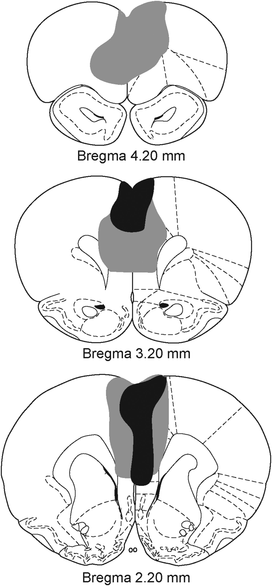
Figure 4. Extent of the excitotoxic medial prefrontal cortex lesions. The largest lesion is displayed in gray, and the ...
Notes:
Figure 4. Extent of the excitotoxic medial prefrontal cortex lesions. The largest lesion is displayed in gray, and the smallest lesion is shown in black. Coronal sections are 4.20 mm through 2.20 mm anterior to bregma.
Unless provided in the caption above, the following copyright applies to the content of this slide: © The Author 2013. Published by Oxford University Press. All rights reserved. For Permissions, please e-mail: journals.permissions@oup.com

Slide 5
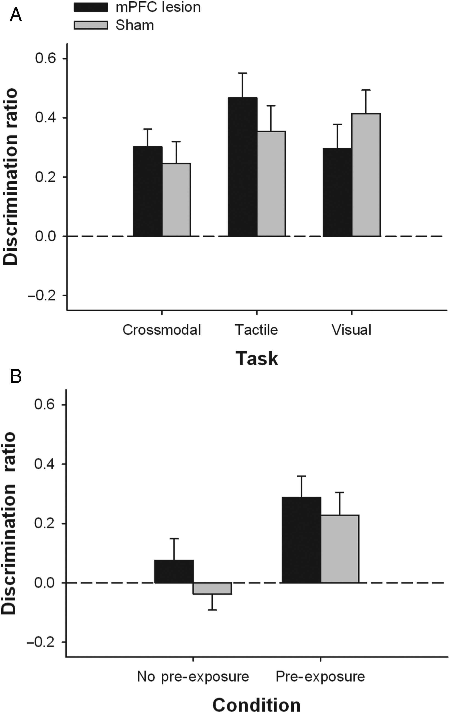
Figure 5. Performance of rats with mPFC lesions on (A) CMOR, tactile-only, and visual-only SOR, each with a 1-h ...
Notes:
Figure 5. Performance of rats with mPFC lesions on (A) CMOR, tactile-only, and visual-only SOR, each with a 1-h retention delay between sample and choice phases and (B) 3-h CMOR with and without multimodal object pre-exposures 24 h prior to the tactile sample phase. Data are presented as the average discrimination ratio (±SEM). Dashed line (0.0) represents equal preference for sample and novel objects.
Unless provided in the caption above, the following copyright applies to the content of this slide: © The Author 2013. Published by Oxford University Press. All rights reserved. For Permissions, please e-mail: journals.permissions@oup.com

Slide 6
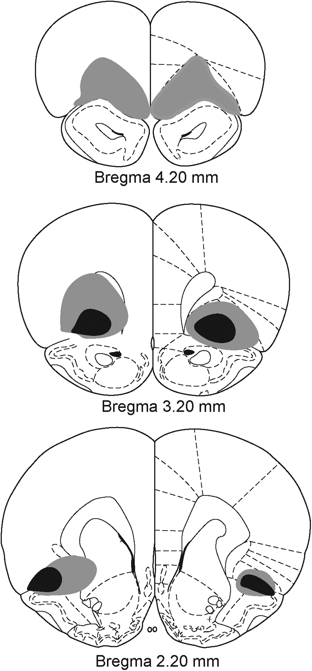
Figure 6. Extent of the excitotoxic ventral and lateral orbitofrontal cortex lesions. The largest lesion is shown in ...
Notes:
Figure 6. Extent of the excitotoxic ventral and lateral orbitofrontal cortex lesions. The largest lesion is shown in gray and the smallest lesion in black. Coronal sections are 4.20 mm through 2.20 mm anterior to bregma.
Unless provided in the caption above, the following copyright applies to the content of this slide: © The Author 2013. Published by Oxford University Press. All rights reserved. For Permissions, please e-mail: journals.permissions@oup.com

Slide 7
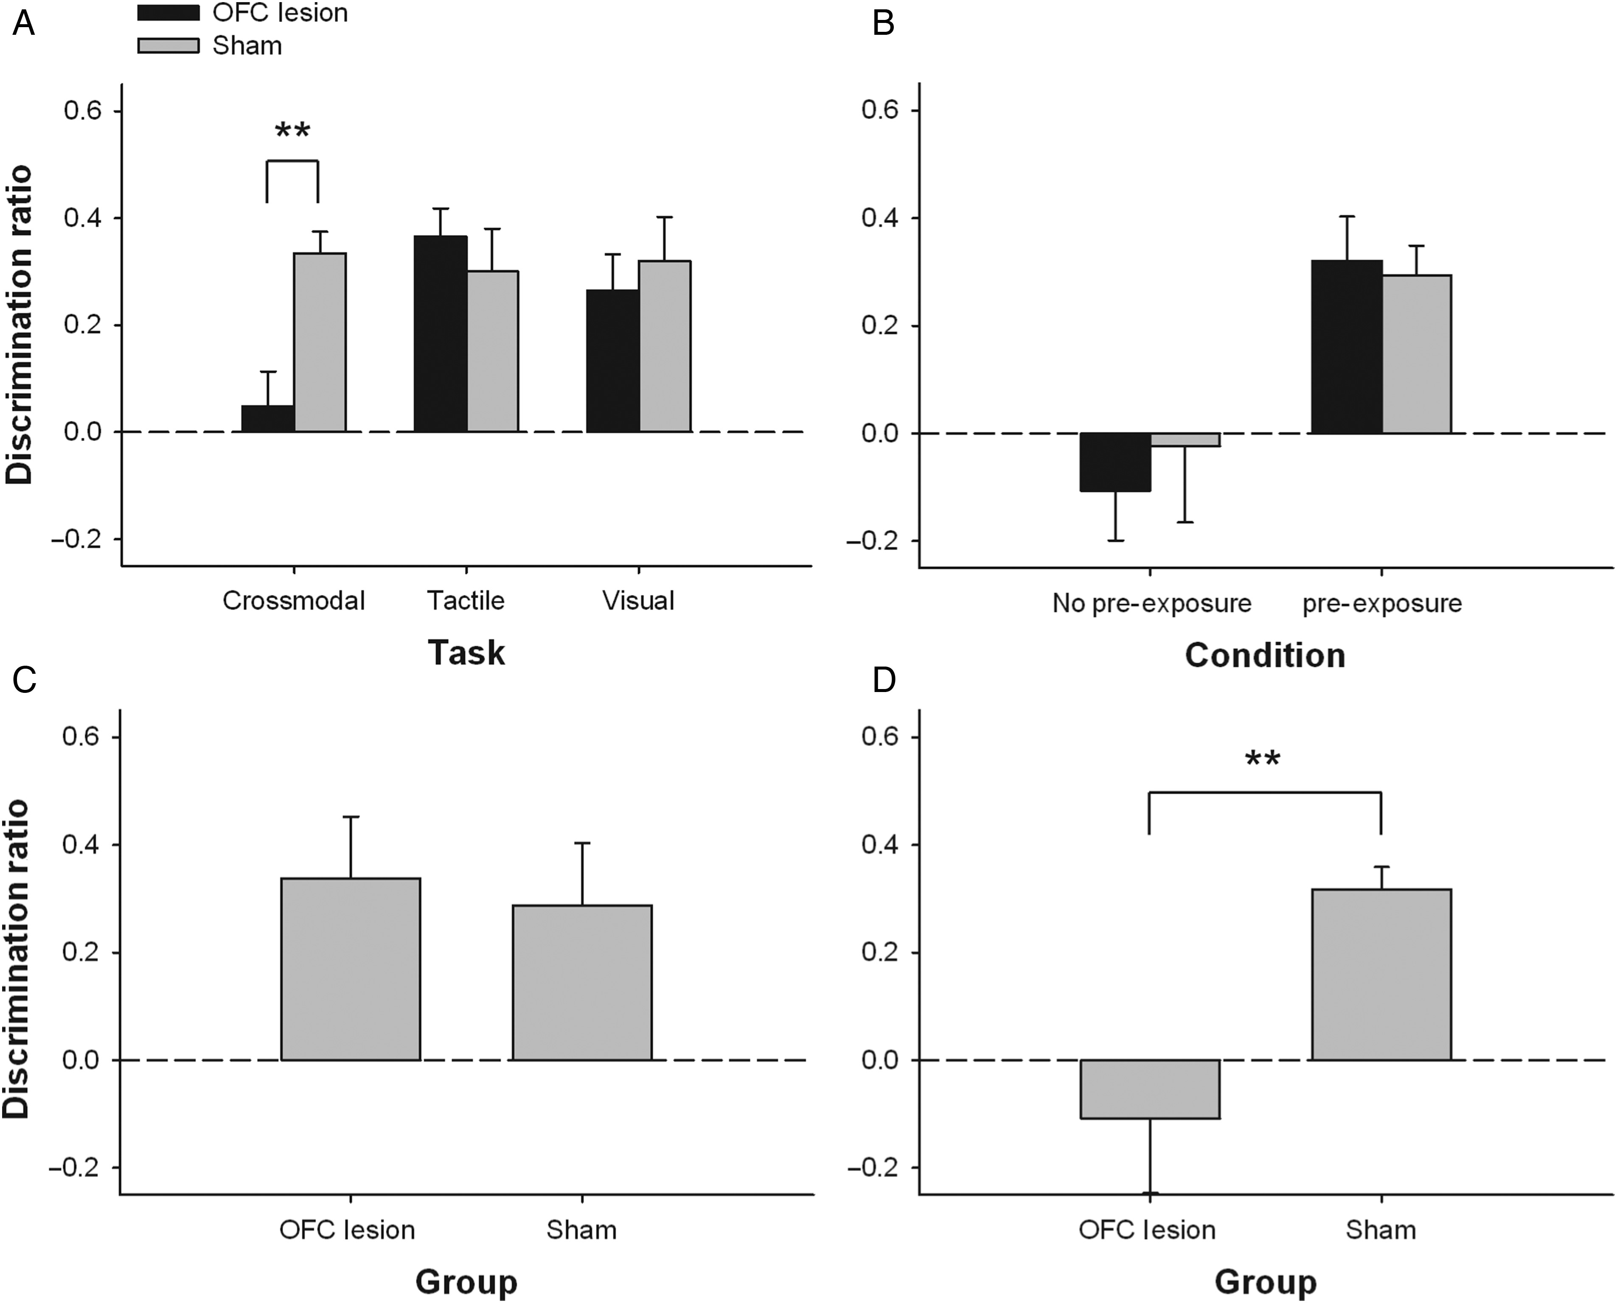
Figure 7. Performance of rats with OFC lesions on (A) CMOR, tactile-only, and visual-only SOR, each with a 1-h ...
Notes:
Figure 7. Performance of rats with OFC lesions on (A) CMOR, tactile-only, and visual-only SOR, each with a 1-h retention delay between sample and choice phases; (B) 3-h CMOR with and without multimodal object pre-exposures 24 h prior to the tactile sample phase; (C) CMOR with the “immediate” retention delay and no pre-exposure; and (D) Retest with the 1-h delay CMOR task (no pre-exposure). Data are presented as the average discrimination ratio (±SEM). Dashed line (0.0) represents equal preference for sample and novel objects. **P < 0.01, lesion versus sham.
Unless provided in the caption above, the following copyright applies to the content of this slide: © The Author 2013. Published by Oxford University Press. All rights reserved. For Permissions, please e-mail: journals.permissions@oup.com

