Slide 1
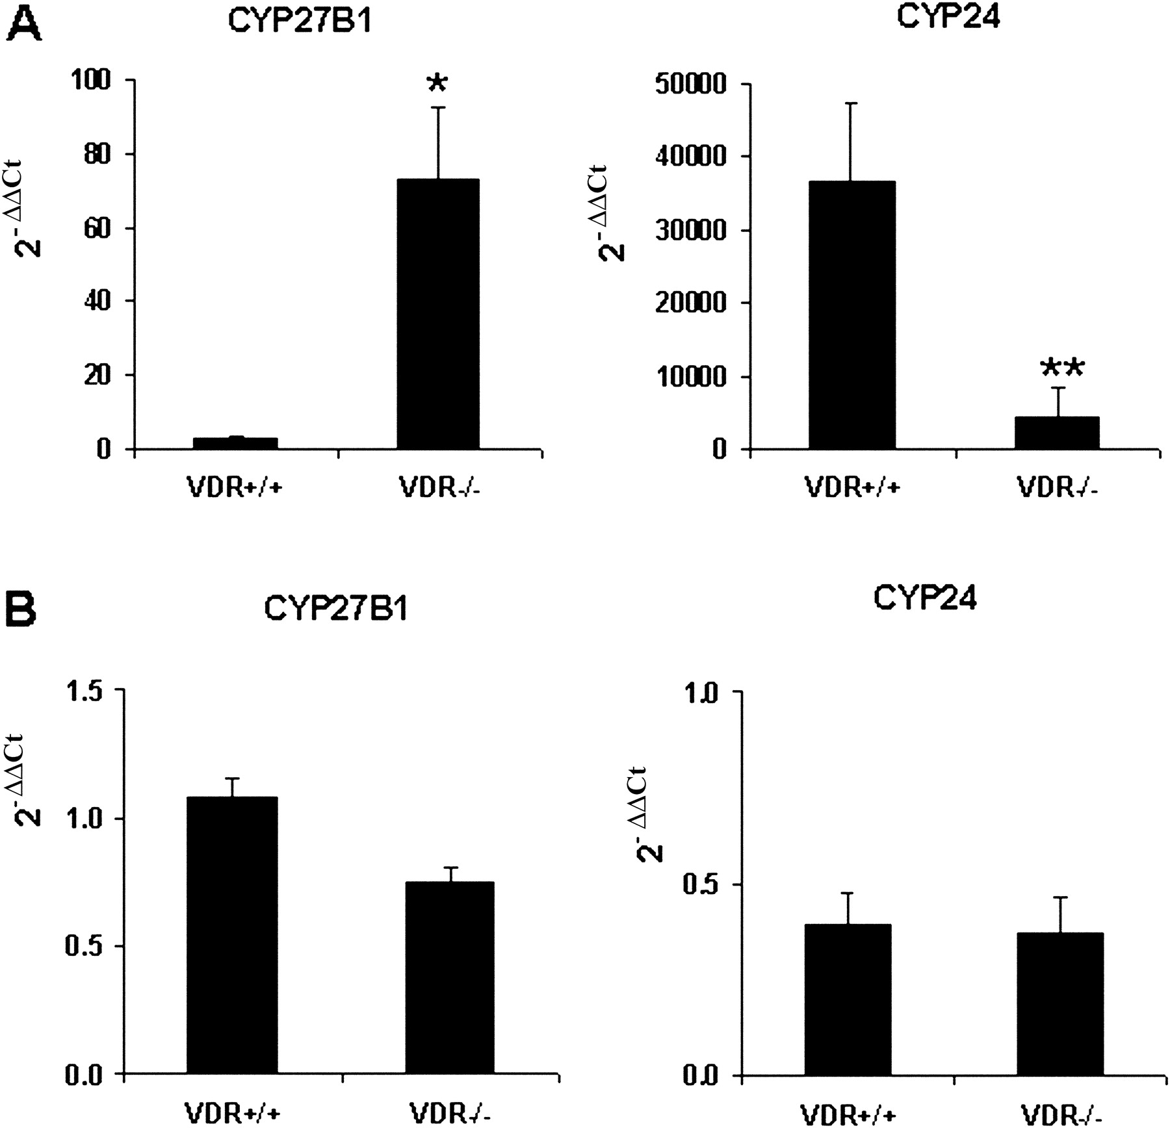
Fig. 1. Expression of CYP27B1 and CYP24 mRNA ( A ) in kidney and ( B ) in colon of VDR ^{+/+} and VDR ...
Notes:
Fig. 1. Expression of CYP27B1 and CYP24 mRNA ( A ) in kidney and ( B ) in colon of VDR +/+ and VDR −/− mice. Data determined by real-time RT–PCR were quantified by the comparative ΔΔC T (C T : threshold cycle) method and were calculated with respect to 18S rRNA as endogenous control and compared with the pooled cDNA calibrator. Data are mean ± SE ( n = 6 mice). *P < 0.05; **P < 0.01 versus VDR +/+ mice.
Unless provided in the caption above, the following copyright applies to the content of this slide: Carcinogenesis vol.26 no.9 © Oxford University Press 2005; all rights reserved.

Slide 2
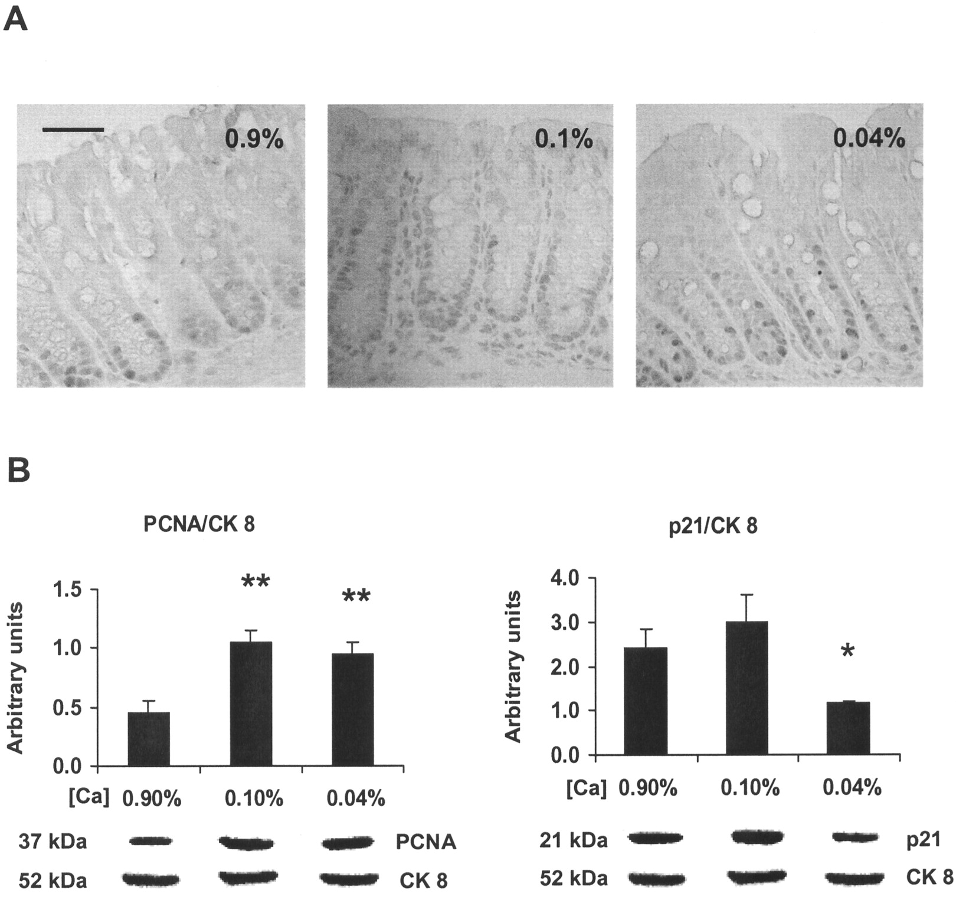
Fig. 2. Effect of dietary calcium concentration on proliferation and p21 expression in the colon of C57BL/6 mice. ( ...
Notes:
Fig. 2. Effect of dietary calcium concentration on proliferation and p21 expression in the colon of C57BL/6 mice. ( A ) Immunohistochemical detection of PCNA in formalin-fixed mouse colon sections. Animals received basic AIN 76A diet containing 0.9, 0.1 and 0.04% calcium. Bar = 50 µm. ( B ) Quantification of PCNA and p21 protein expression by densitometric evaluation of western blots compared with the epithelial cell marker cytokeratin (CK) 8. In the upper panel data are expressed as mean ± SE ( n = 6 animals). *P < 0.05; **P < 0.01 versus mice on 0.9% calcium diet. Lower panel shows representative immunoblots of 150 µg total proteins extracted from mouse colon and resolved by SDS–PAGE. (The size of the specific bands in kDa is shown on the left.)
Unless provided in the caption above, the following copyright applies to the content of this slide: Carcinogenesis vol.26 no.9 © Oxford University Press 2005; all rights reserved.

Slide 3
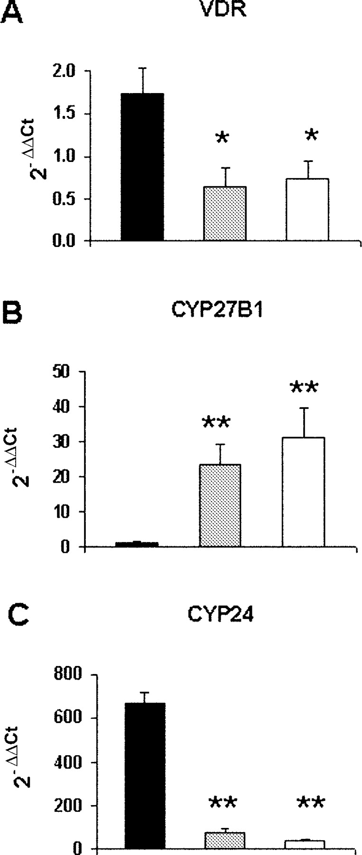
Fig. 3. Effect of dietary calcium concentration on the expression of ( A ) VDR, ( B ) CYP27B1 and ( C ) CYP24 mRNA ...
Notes:
Fig. 3. Effect of dietary calcium concentration on the expression of ( A ) VDR, ( B ) CYP27B1 and ( C ) CYP24 mRNA in the kidney. Animals received basic AIN 76A diet containing 0.9% (black bars), 0.1% (grey bars) and 0.04% calcium (white bars). Data expressed as mean 2 -ΔΔCT ± SE ( n = 6 mice) were assessed by real-time RT–PCR analysis and were calculated with respect to 18S rRNA as endogenous control and compared with the pooled cDNA calibrator. *P < 0.05; **P < 0.01 versus mice on 0.9% calcium diet.
Unless provided in the caption above, the following copyright applies to the content of this slide: Carcinogenesis vol.26 no.9 © Oxford University Press 2005; all rights reserved.

Slide 4
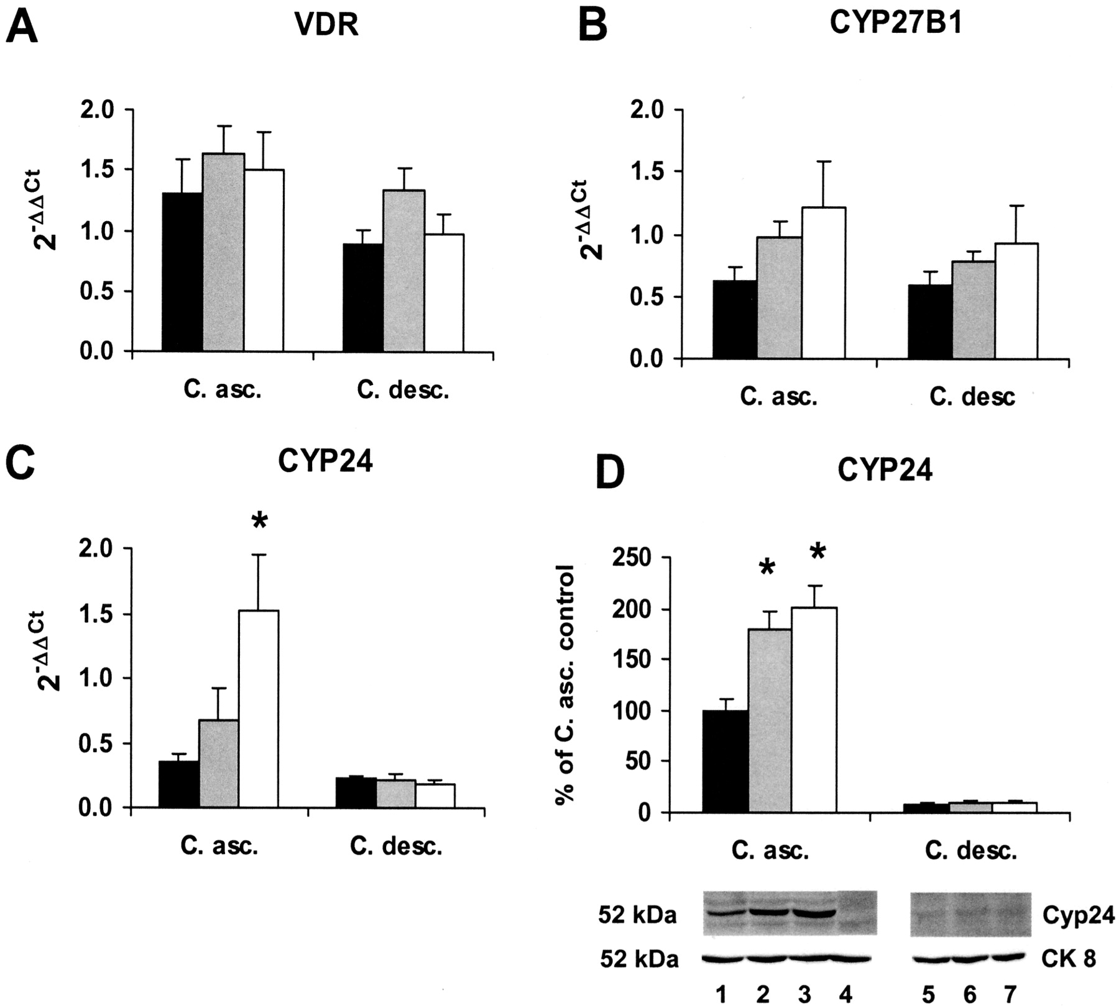
Fig. 4. Effect of dietary calcium concentration on expression of ( A ) VDR, ( B ) CYP27B1 and ( C ) CYP24 mRNA in ...
Notes:
Fig. 4. Effect of dietary calcium concentration on expression of ( A ) VDR, ( B ) CYP27B1 and ( C ) CYP24 mRNA in ascending (C. asc.) and descending (C. desc.) colon of mice. Animals received basic AIN 76A diet containing 0.9% (black bars), 0.1% (grey bars) and 0.04% (white bars) calcium. Data determined by real-time RT–PCR were quantified by the comparative ΔΔC T method and were calculated with respect to 18S rRNA as endogenous control and compared with the pooled cDNA calibrator. Data are mean ± SE ( n = 6 mice). ( D ) Western blot analysis of CYP24 protein expression in mouse colon. Data are expressed as mean ± SE ( n = 6 mice). Lower panel shows representative immunoblots: 150 µg total proteins were extracted from ascending (C. asc.) and descending (C. desc.) colon, resolved by SDS–PAGE, transferred to nitrocellulose and probed with a polyclonal antibody against CYP24 or CK 8. Specificity of the CYP24 antibody was demonstrated by the absence of staining when the antibody was pre-absorbed with the synthetic peptide against which it was raised (lane 4). *P < 0.05 versus mice on 0.9% calcium diet.
Unless provided in the caption above, the following copyright applies to the content of this slide: Carcinogenesis vol.26 no.9 © Oxford University Press 2005; all rights reserved.

Slide 5
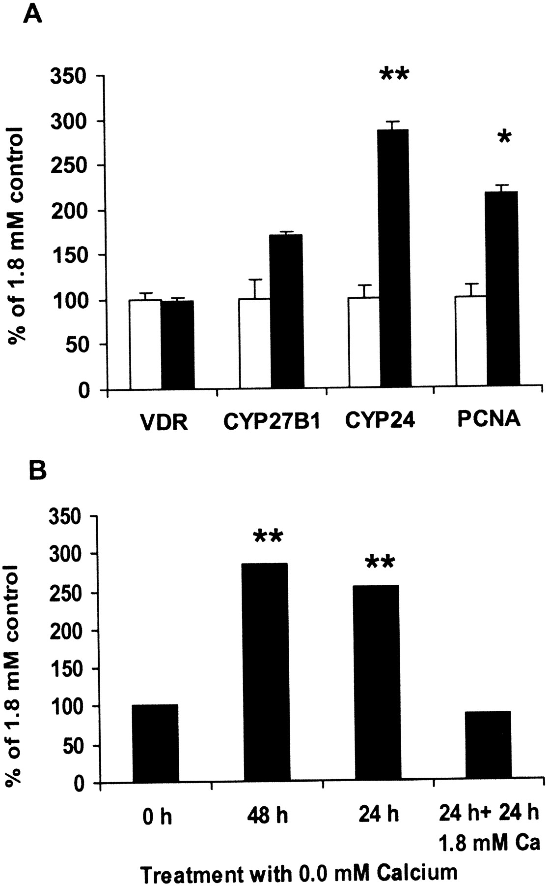
Fig. 5. ( A ) Effect of low extracellular calcium concentration (1.8 mM: white bars, 0.0 mM: black bars) on VDR, ...
Notes:
Fig. 5. ( A ) Effect of low extracellular calcium concentration (1.8 mM: white bars, 0.0 mM: black bars) on VDR, CYP27B1, CYP24 and PCNA mRNA expression in the Caco-2 cell line. Data expressed as mean 2 -ΔΔCT ± SE ( n = 3 experiments) were assessed by real-time RT–PCR analysis and were calculated with respect to 18S rRNA as endogenous control and compared with the 1.8 mM calcium-treated control. The real-time PCR was performed with FAM-labeled ‘Assays-on-Demand™Gene Expression’ products for human 18S rRNA, PCNA, VDR, CYP27B1 and CYP24 (Applied Biosystems). *P < 0.05; **P < 0.01 versus 1.8 mM calcium-treatment. ( B) Time-dependent effect of calcium-free medium (0.0 mM) on CYP24 mRNA expression. Caco-2 cells were treated for the given time-periods with calcium-free medium. In the last group, after 24 h treatment with calcium-free medium the calcium concentration was raised again to 1.80 mM [Ca 2+ ] o for 24 h prior to RNA extraction. CYP24 expression was calculated relative to the control (treatment with 1.8 mM calcium for 48 h).
Unless provided in the caption above, the following copyright applies to the content of this slide: Carcinogenesis vol.26 no.9 © Oxford University Press 2005; all rights reserved.

