Slide 1
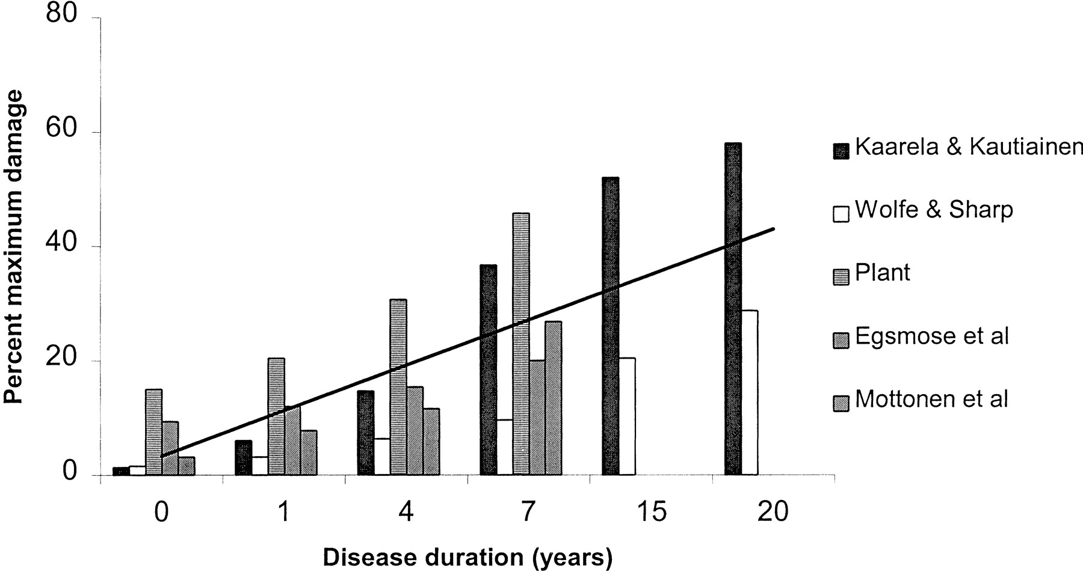
Fig. 1. The increase in joint damage in RA. Based on an amalgamation of data from six studies using Larsen and Sharp ...
Notes:
Fig. 1. The increase in joint damage in RA. Based on an amalgamation of data from six studies using Larsen and Sharp scores [15–18, 20]. The average rate of progression, shown by the trendline, was an annual increase of 1.8% of possible maximum damage.
Unless provided in the caption above, the following copyright applies to the content of this slide: © British Society for Rheumatology

Slide 2
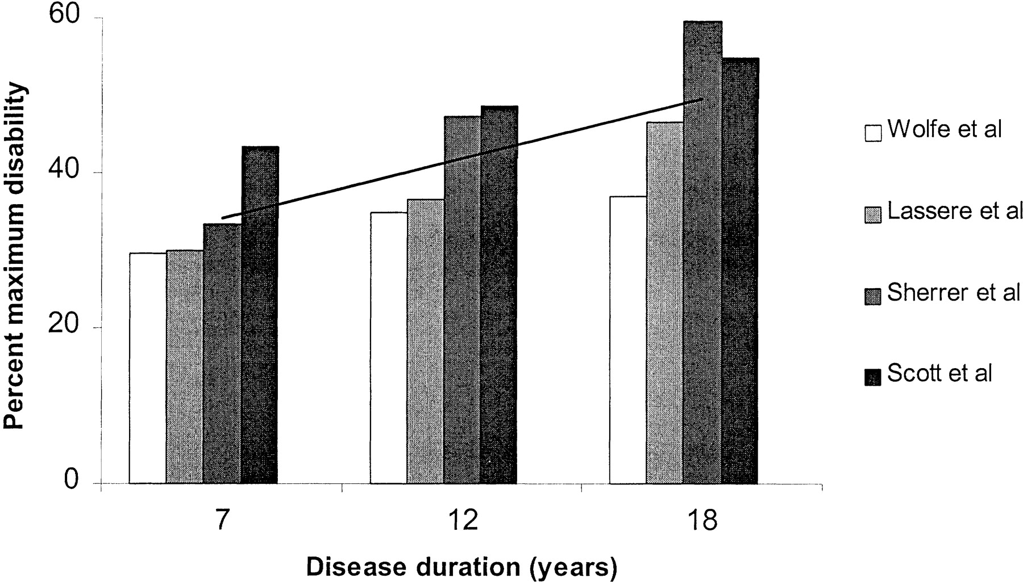
Fig. 2. The increase in disability in RA. Based on an amalgamation of data from four studies [33–35, and additional ...
Notes:
Fig. 2. The increase in disability in RA. Based on an amalgamation of data from four studies [33–35, and additional primary data from Kings College Hospital] using the HAQ to assess disability. The average increase in disability, shown by the trendline, was an annual increase of 1.4% of possible maximum disability.
Unless provided in the caption above, the following copyright applies to the content of this slide: © British Society for Rheumatology

Slide 3
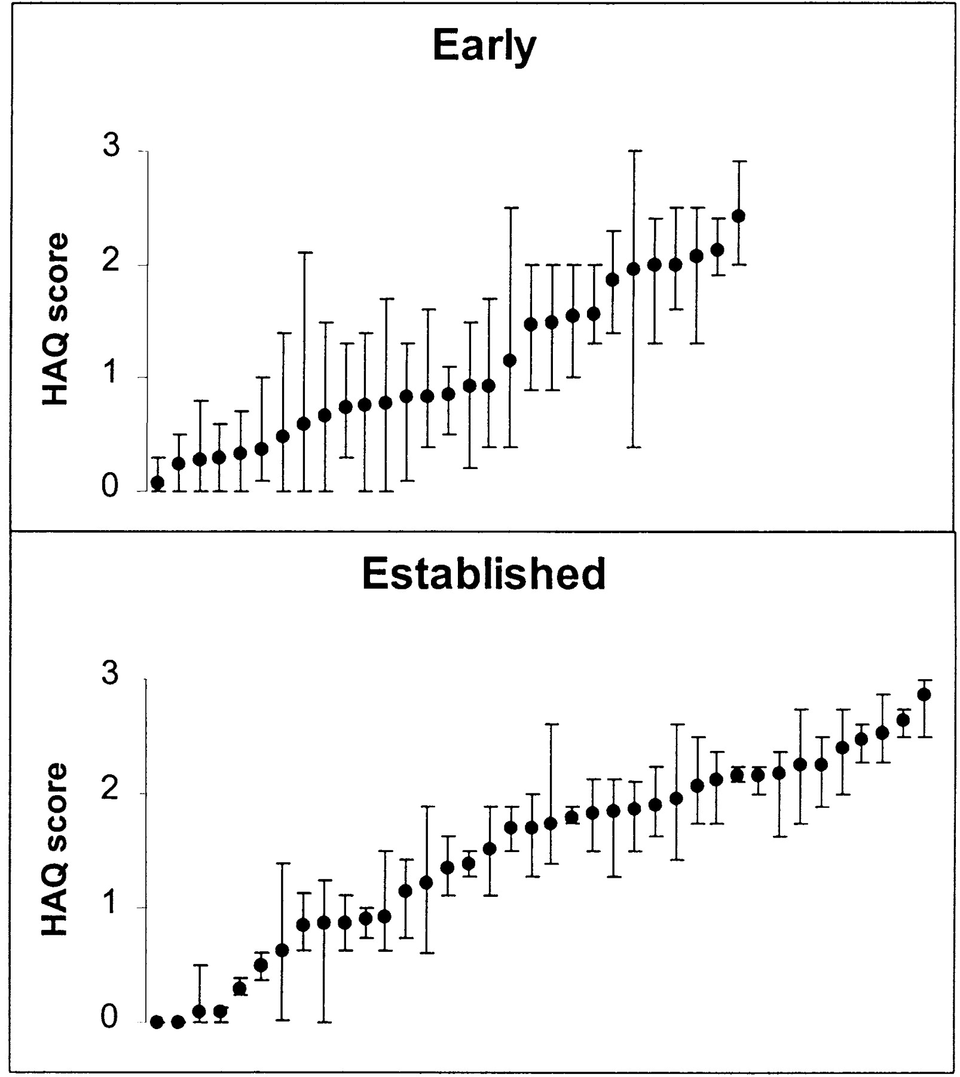
Fig. 3. Variability in HAQ in early and late RA. Mean scores and ranges are shown for 33 patients with early RA ...
Notes:
Fig. 3. Variability in HAQ in early and late RA. Mean scores and ranges are shown for 33 patients with early RA followed 6 monthly for 5 yr and 46 patients with established RA followed annually for 4 yr.
Unless provided in the caption above, the following copyright applies to the content of this slide: © British Society for Rheumatology

Slide 4
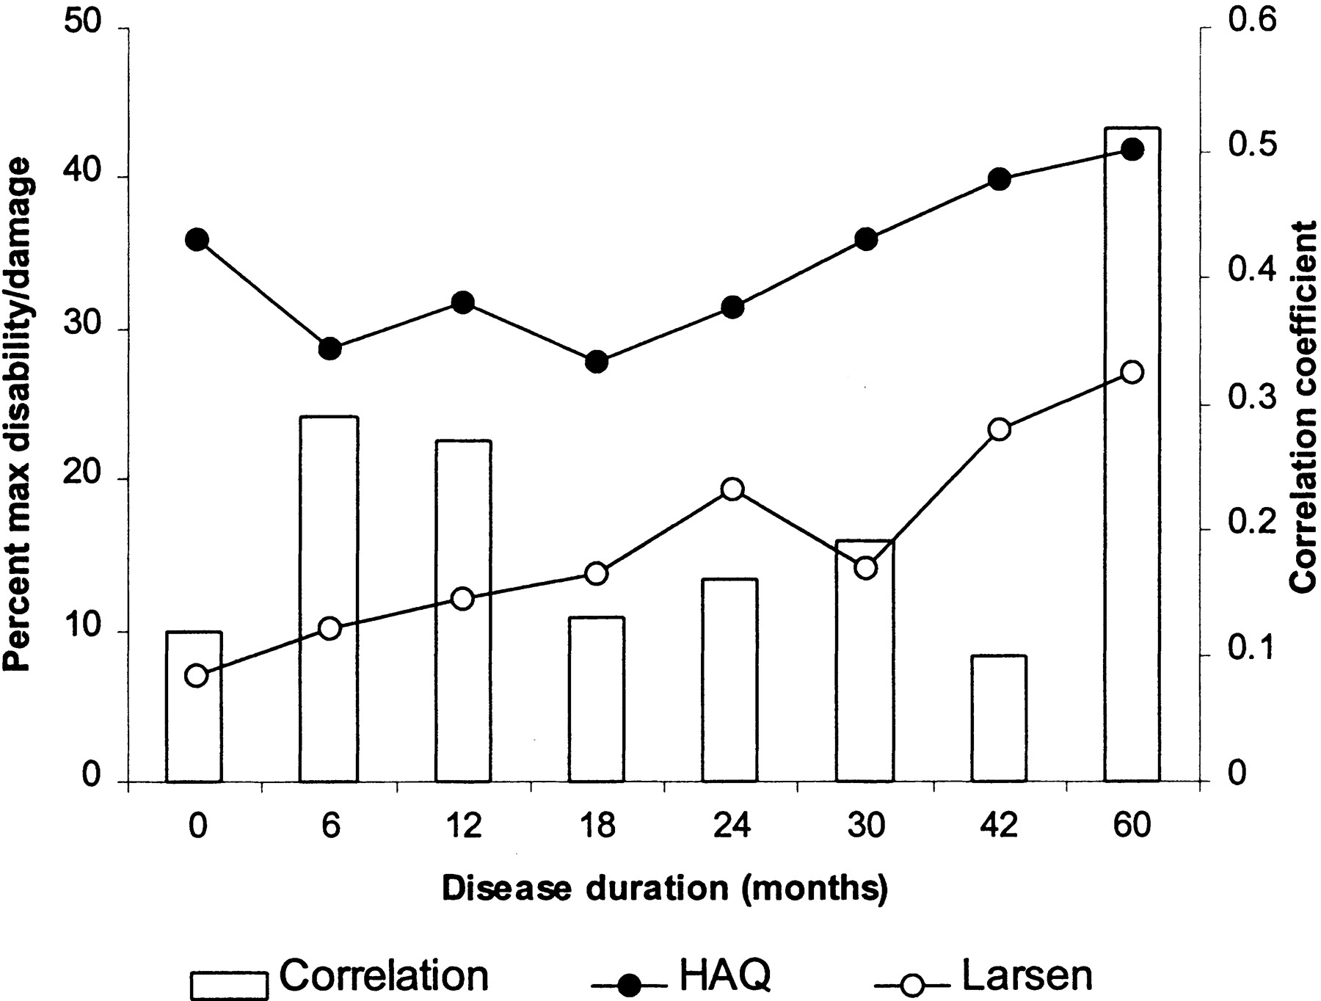
Fig. 4. Sequential mean changes in damage and function over 5 yr in the Truro early RA cohort. The results are ...
Notes:
Fig. 4. Sequential mean changes in damage and function over 5 yr in the Truro early RA cohort. The results are expressed as per cent maximal damage and disability scores. The correlations between them at each time point are also shown.
Unless provided in the caption above, the following copyright applies to the content of this slide: © British Society for Rheumatology

Slide 5
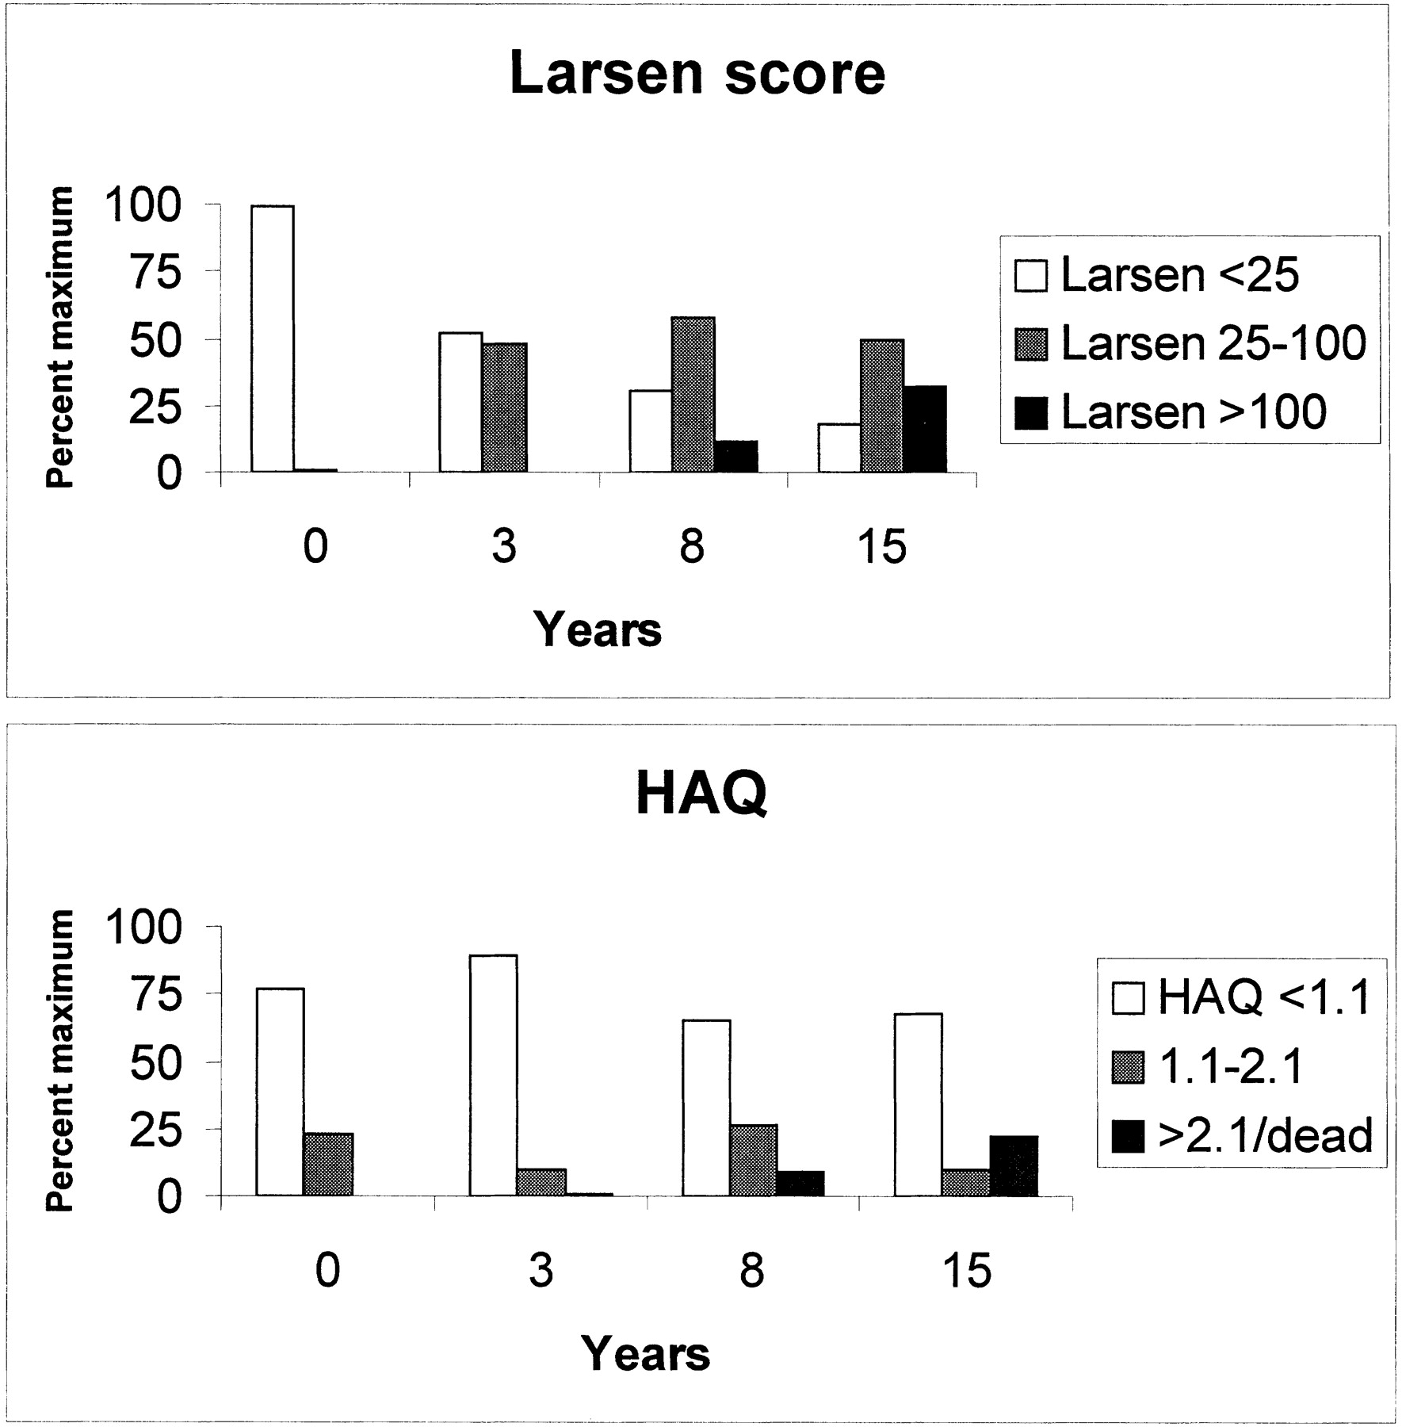
Fig. 5. The relationship of changes in Larsen score and HAQ over 15 yr from Jönsson, Kaarela and Kolbert (unpublished ...
Notes:
Fig. 5. The relationship of changes in Larsen score and HAQ over 15 yr from Jönsson, Kaarela and Kolbert (unpublished observations). Results are expressed as percentages of patients in different radiological (Larsen score) and functional (HAQ score) categories.
Unless provided in the caption above, the following copyright applies to the content of this slide: © British Society for Rheumatology

