Slide 1
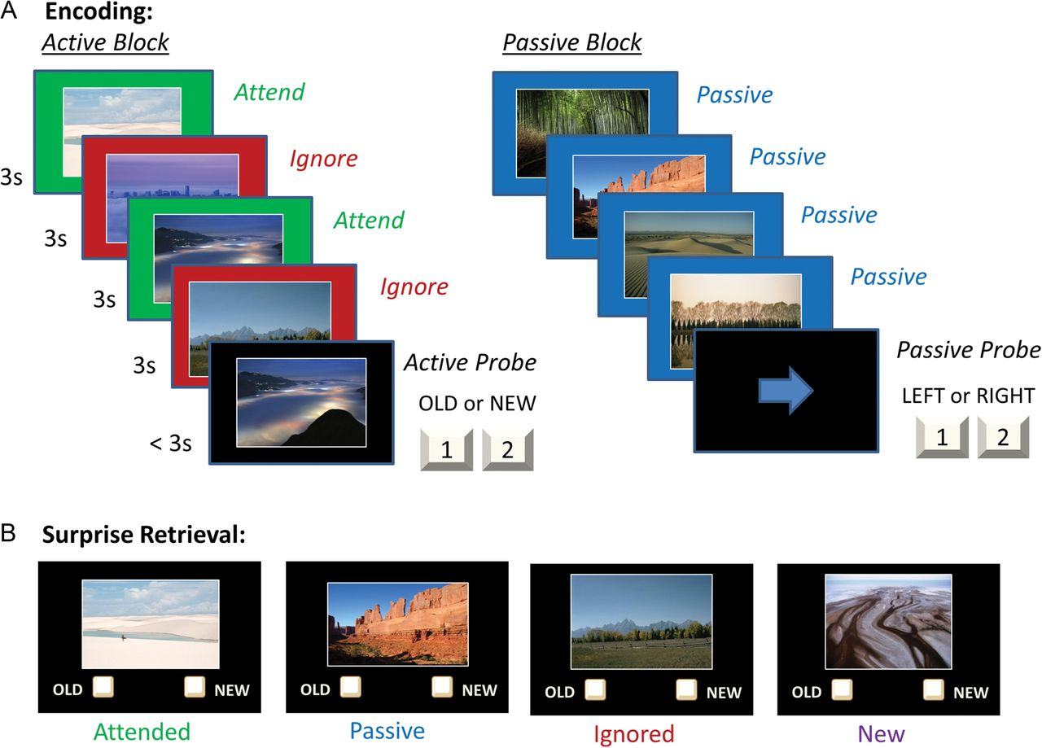
Figure 1. (A) The selective encoding task started with an encoding phase, during which participants observed sequences ...
Notes:
Figure 1. (A) The selective encoding task started with an encoding phase, during which participants observed sequences of scenes. (B) This was followed by a surprise retrieval phase, during which participants viewed scenes and indicated which had been observed during the encoding phase.
Unless provided in the caption above, the following copyright applies to the content of this slide: © The Author 2014. Published by Oxford University Press. All rights reserved. For Permissions, please e-mail: journals.permissions@oup.com

Slide 2
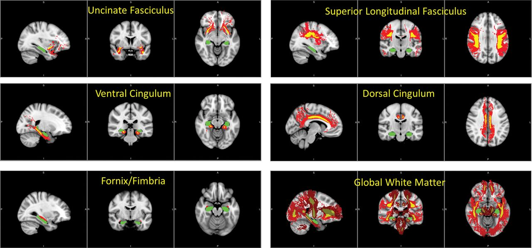
Figure 2. White matter region of interests (ROIs), from the JHU white matter tractography atlas. In each image, ...
Notes:
Figure 2. White matter region of interests (ROIs), from the JHU white matter tractography atlas. In each image, hippocampus is shown in green. For fornix/fimbria, the ROI is shown in red. For the other tracts, yellow indicates the ROI and red illustrates a more extensive version of the tract.
Unless provided in the caption above, the following copyright applies to the content of this slide: © The Author 2014. Published by Oxford University Press. All rights reserved. For Permissions, please e-mail: journals.permissions@oup.com

Slide 3
Figure 3. (A) Recognition performance for each of the 4 conditions. Note that the y-axis indicates the percentage of ...
Notes:
Figure 3. (A) Recognition performance for each of the 4 conditions. Note that the y-axis indicates the percentage of yes responses, so bars represent accuracy for Attended, Passive, and Ignored scenes but represent the false alarm rate for New scenes. (B) MM scores, for children versus adults and as a function of age in children.
Unless provided in the caption above, the following copyright applies to the content of this slide: © The Author 2014. Published by Oxford University Press. All rights reserved. For Permissions, please e-mail: journals.permissions@oup.com

Slide 4
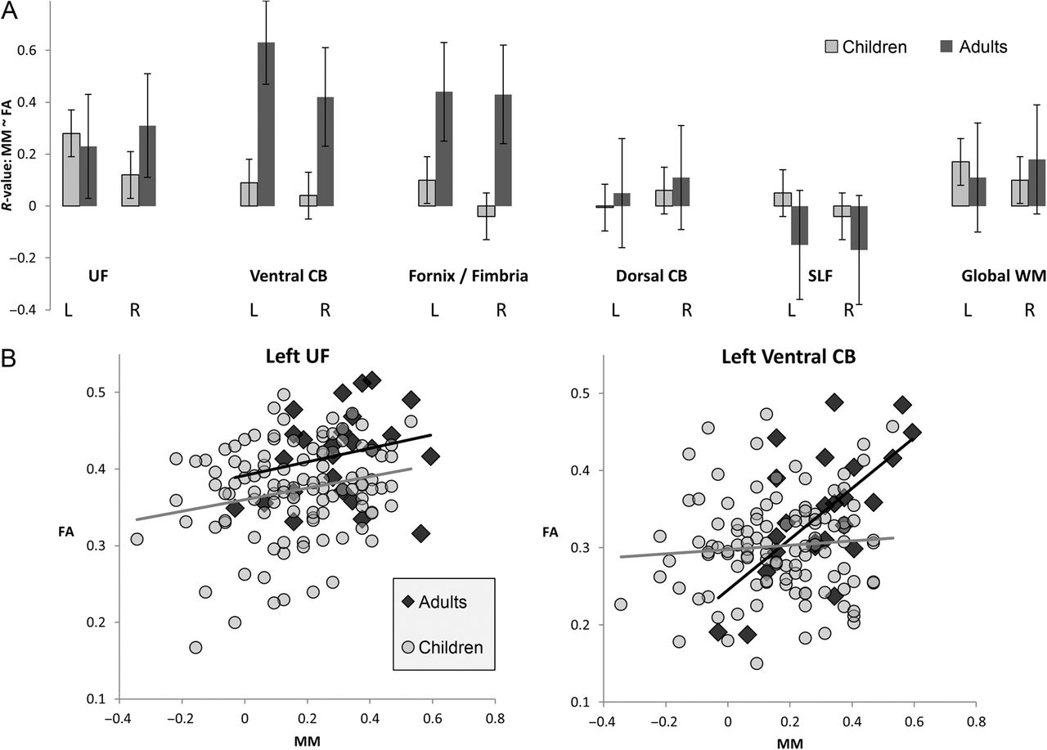
Figure 4. (A) Effects of FA on MM, in children and adults, across all 12 ROIs. Bars indicate correlation r-values, with ...
Notes:
Figure 4. (A) Effects of FA on MM, in children and adults, across all 12 ROIs. Bars indicate correlation r-values, with standard error. (B) Scatter-plots of the relationship between MM and FA, for left UF (which showed an effect across the entire sample of participants) and for left ventral CB (which showed an effect in adults but not in children). In both graphs, adult data are dark gray and data from children are light gray.
Unless provided in the caption above, the following copyright applies to the content of this slide: © The Author 2014. Published by Oxford University Press. All rights reserved. For Permissions, please e-mail: journals.permissions@oup.com

