Slide 1
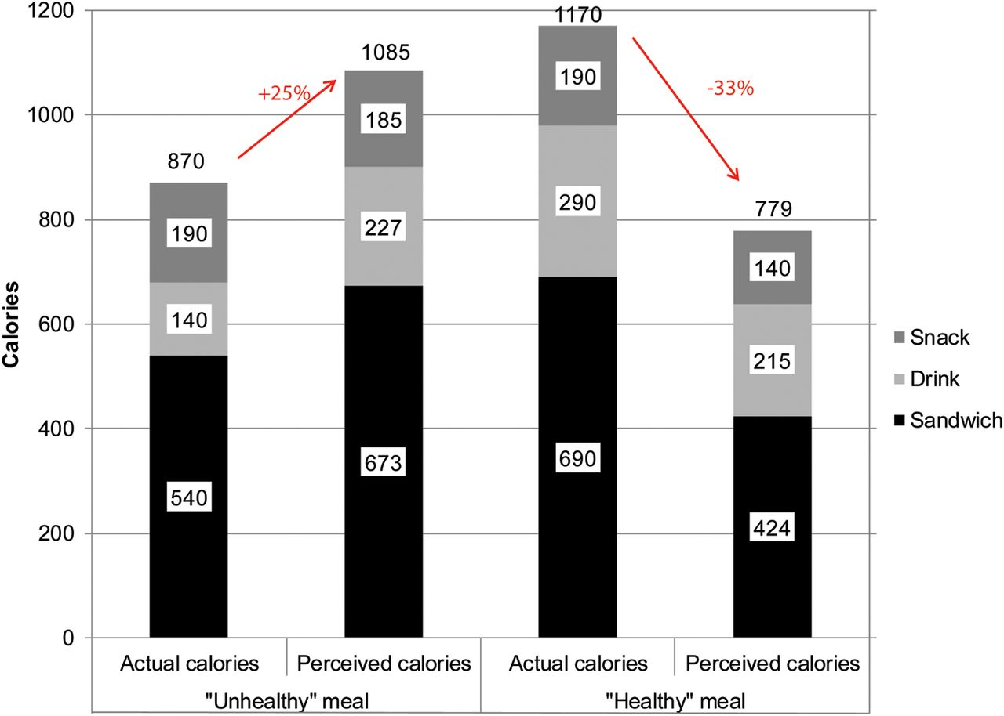
Figure 1 Positive and Negative Health Halo Effects on Calorie Perception
Notes:
Figure 1 Positive and Negative Health Halo Effects on Calorie Perception Notes: The “healthy” foods were one Prêt-a-Manger® brie, basil and tomato baguette sandwich, one 12 oz. Odwalla® Super Protein fruit smoothie, and two tablespoons of Jif® low sodium, 33% less sugar peanut butter. The “unhealthy foods” were one Big Mac®, a 12 oz. can of Coca-Cola® classic, and two tablespoons of Jif® regular peanut butter.
Unless provided in the caption above, the following copyright applies to the content of this slide: © The Author(s) 2012. Published by Oxford University Press, on behalf of Agricultural and Applied Economics Association. All rights reserved. For permissions, please email: journals.permissions@oup.com.

Slide 2
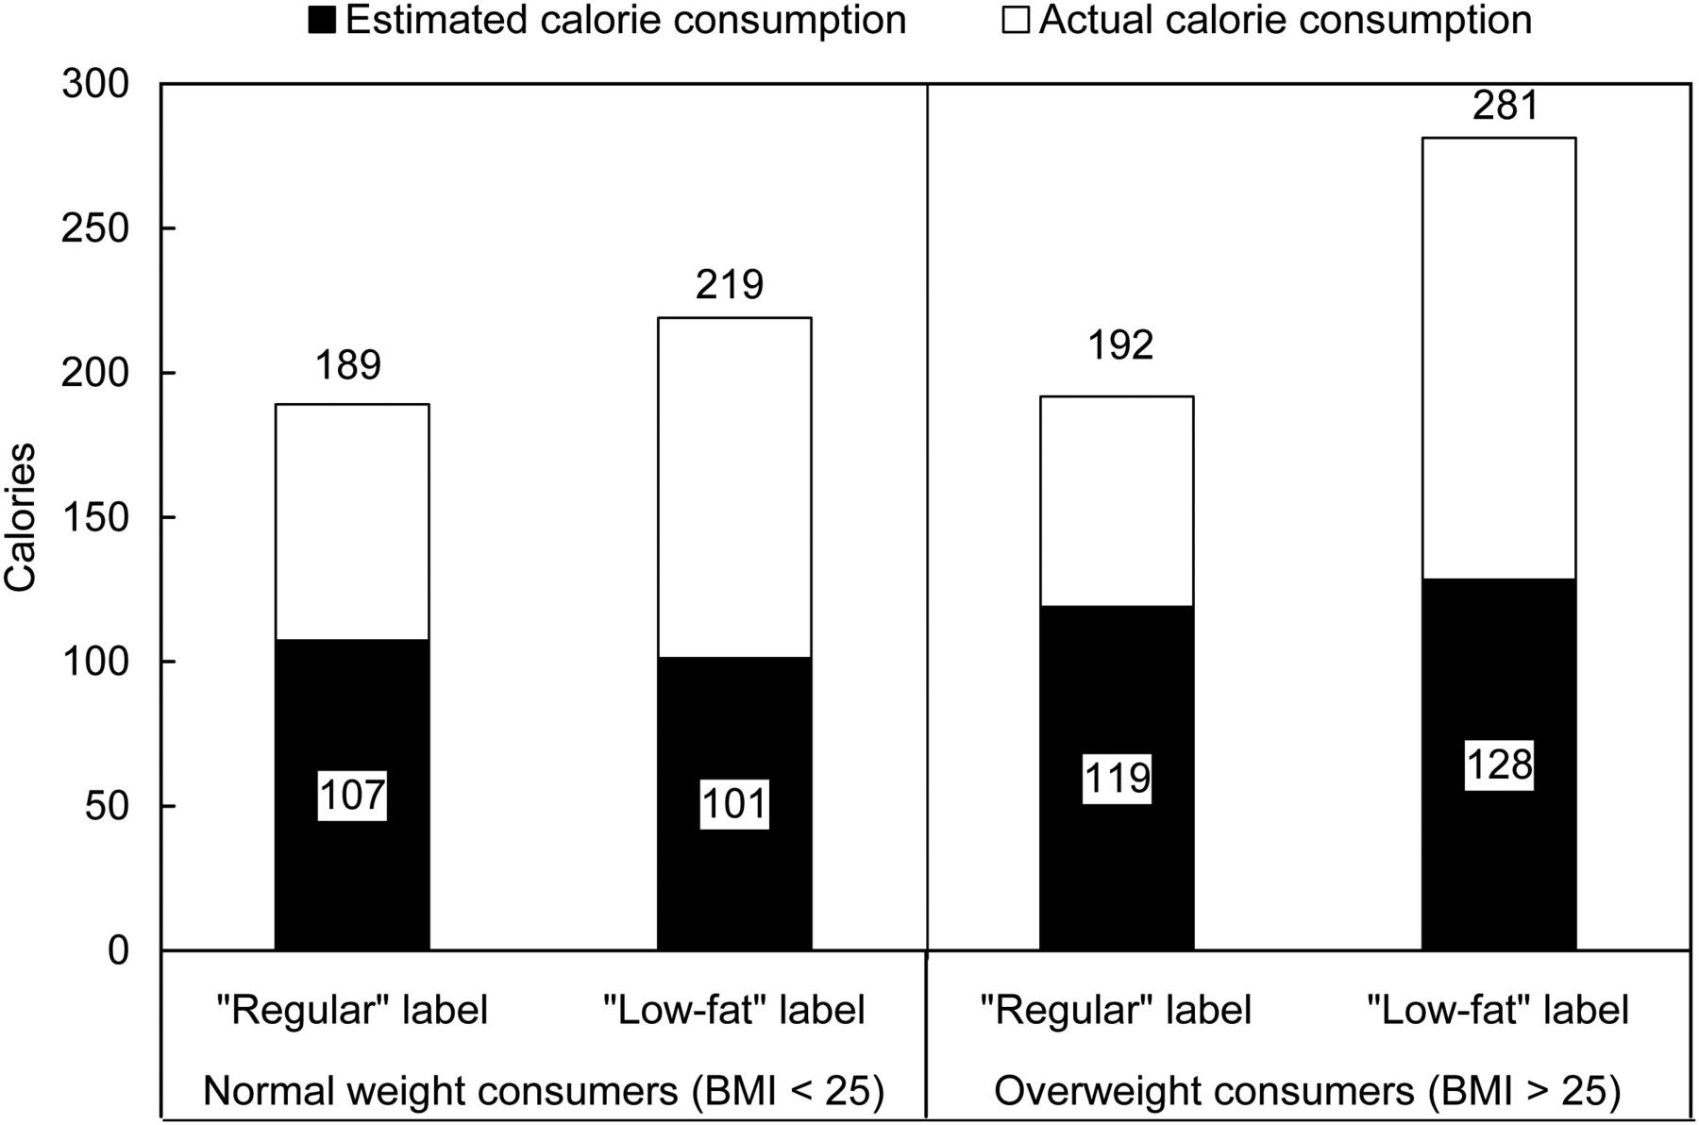
Figure 2 Health Halos: “Low-fat” Claims Increase Actual (but not Perceived) Snack Food Consumption
Notes:
Figure 2 Health Halos: “Low-fat” Claims Increase Actual (but not Perceived) Snack Food Consumption Note: Reproduced from Wansink, B., and P. Chandon. 2006. Can 'Low-Fat' Nutrition Labels Lead to Obesity? Journal of Marketing Research 43(4):605–617.
Unless provided in the caption above, the following copyright applies to the content of this slide: © The Author(s) 2012. Published by Oxford University Press, on behalf of Agricultural and Applied Economics Association. All rights reserved. For permissions, please email: journals.permissions@oup.com.

Slide 3
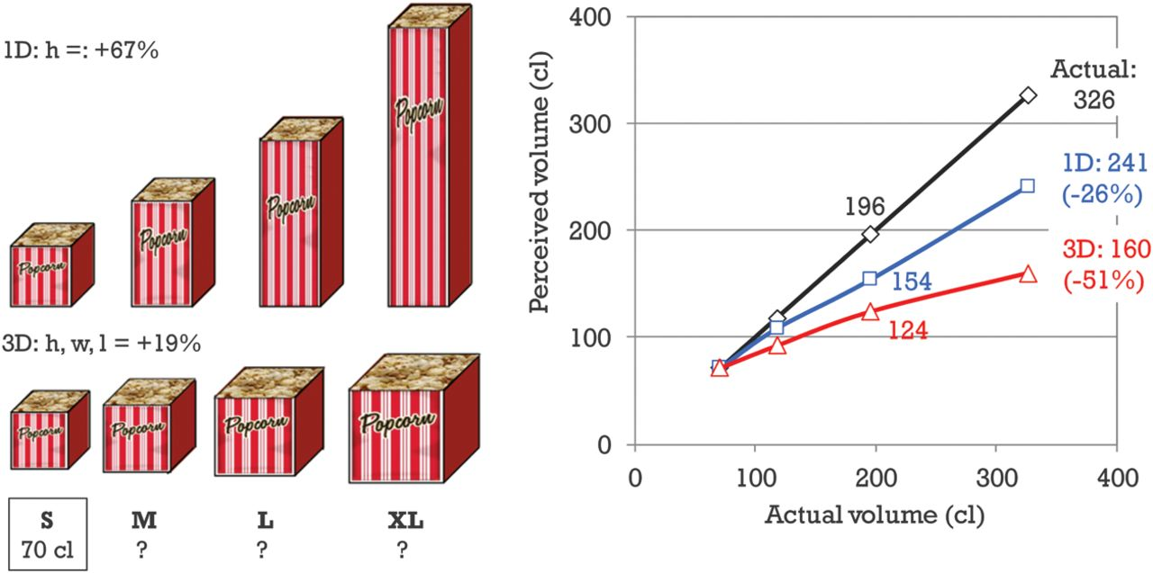
Figure 4 Underestimation of Package Supersizing, Especially for Proportional Package Change
Notes:
Figure 4 Underestimation of Package Supersizing, Especially for Proportional Package Change
Unless provided in the caption above, the following copyright applies to the content of this slide: © The Author(s) 2012. Published by Oxford University Press, on behalf of Agricultural and Applied Economics Association. All rights reserved. For permissions, please email: journals.permissions@oup.com.

Slide 4
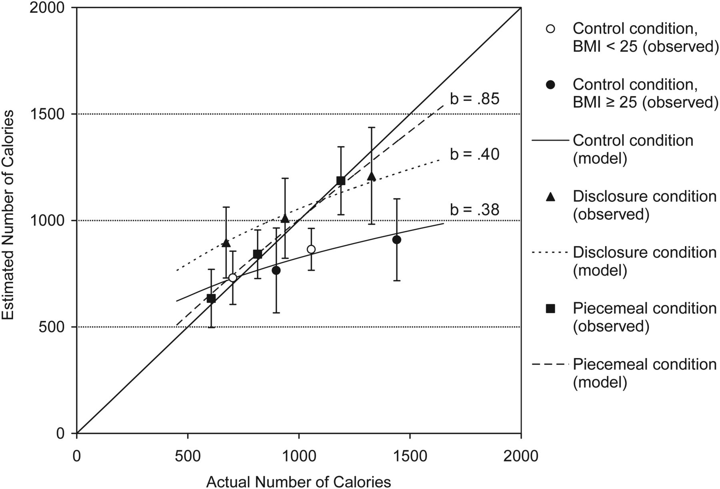
Figure 3 Errors in the Perceived Calories of Meals are Driven by Meal size, not Body Size, and Corrected by Piecemeal ...
Notes:
Figure 3 Errors in the Perceived Calories of Meals are Driven by Meal size, not Body Size, and Corrected by Piecemeal Estimation, not by Education Note: Reproduced from Chandon, P., and B. Wansink. 2007b. Is Obesity Caused by Calorie Underestimation? A Psychophysical Model of Meal Size Estimation. Journal of Marketing Research 44(1):84–99.
Unless provided in the caption above, the following copyright applies to the content of this slide: © The Author(s) 2012. Published by Oxford University Press, on behalf of Agricultural and Applied Economics Association. All rights reserved. For permissions, please email: journals.permissions@oup.com.

