Slide 1
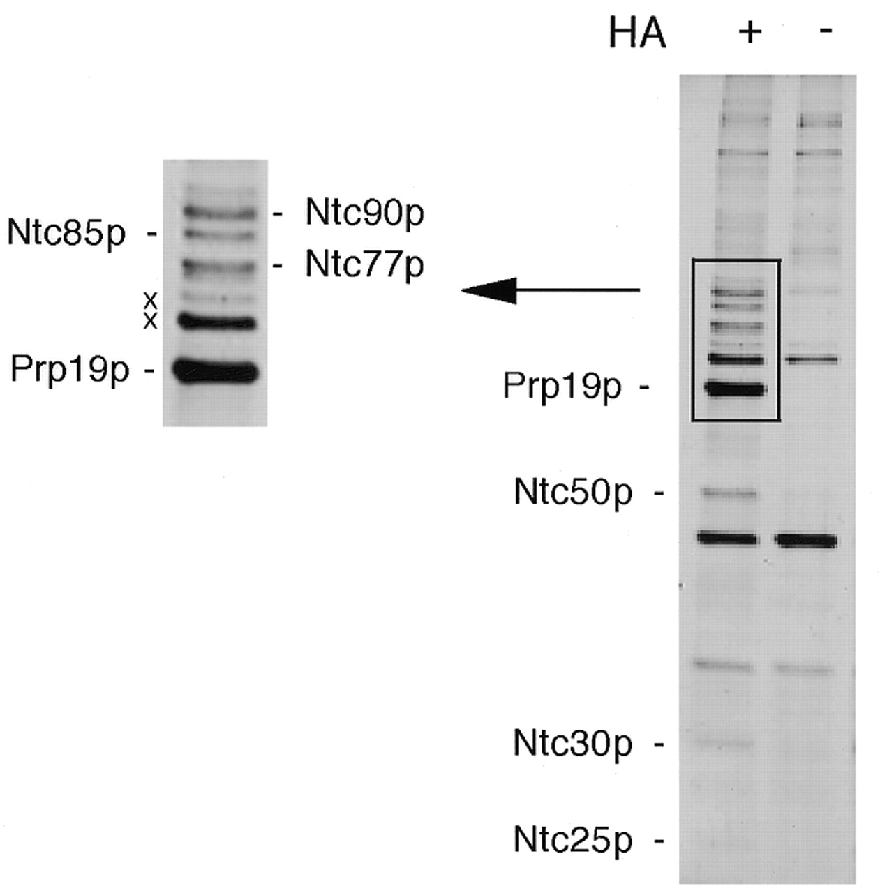
Figure 1. The Prp19p-associated complex was isolated by affinity chromatography on an anti-HA antibody column ...
Notes:
Figure 1. The Prp19p-associated complex was isolated by affinity chromatography on an anti-HA antibody column using the PRP19-HA extract and the components were fractionated by SDS–PAGE on a 10% gel. The extract without a tag was used as the background control (–). The high molecular weight region was enlarged as shown on the left.
Unless provided in the caption above, the following copyright applies to the content of this slide:

Slide 2
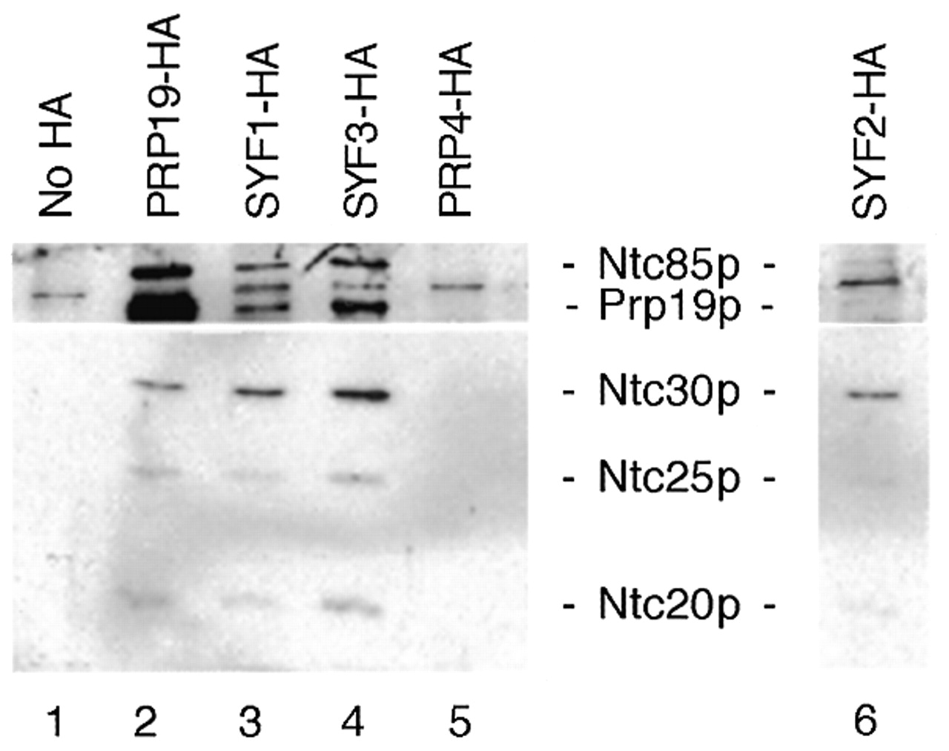
Figure 2. Identification of Syf1p, Syf2p and Syf3p as components of the Prp19p-associated complex. Syf1p, ...
Notes:
Figure 2. Identification of Syf1p, Syf2p and Syf3p as components of the Prp19p-associated complex. Syf1p, Syf2p and Syf3p were individually tagged with the HA epitope. Immunoprecipitation with the anti-HA antibody of extracts prepared from these strains (lanes 3, 4 and 6) revealed co-precipitation of the identified Prp19p-associated components.
Unless provided in the caption above, the following copyright applies to the content of this slide:

Slide 3
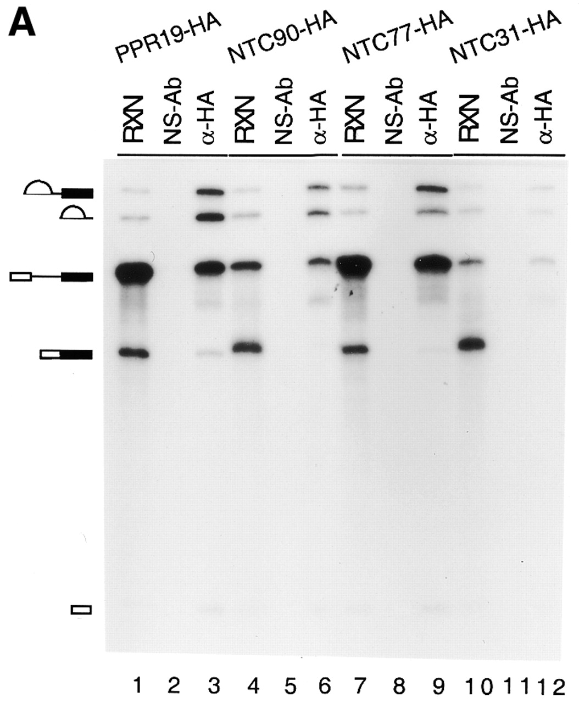
Figure 3. (A) Immunoprecipitation of the spliceosome formed in PRP19-HA (lanes 1–3), NTC90-HA (lanes 4–6), ...
Notes:
Figure 3. (A) Immunoprecipitation of the spliceosome formed in PRP19-HA (lanes 1–3), NTC90-HA (lanes 4–6), NTC77-HA (lanes 7–9) and NTC31-HA (lanes 10–12) extracts with the anti-HA antibody (lanes 3, 6, 9 and 12). (B) Immunoprecipitation of the spliceosome formed at various ATP concentrations in extracts prepared from a strain in which Prp19p was tagged with the c-Myc epitope and Prp4p tagged with the HA epitope. The splicing reaction was carried out at 0.5 mM (lanes 1–7), 0.1 mM (lanes 8–14) and 0.05 mM (lanes 15–21) ATP and the reaction mixtures (15 µl each) were subjected to immunoprecipitation with protein A–Sepharose alone (lanes 2, 9 and 16), anti-Myc (lanes 3, 10 and 17), anti-HA (lanes 4, 11 and 18), anti-Ntc90p (lanes 5, 12 and 19), anti-Ntc77p (lanes 6, 13 and 20) and anti-Ntc31p antibodies (lanes 7, 14 and 21). RXN, 2 µl of the reaction mixture; NS-Ab, non-specific antibody; PAS, protein A–Sepharose.
Unless provided in the caption above, the following copyright applies to the content of this slide:

Slide 4
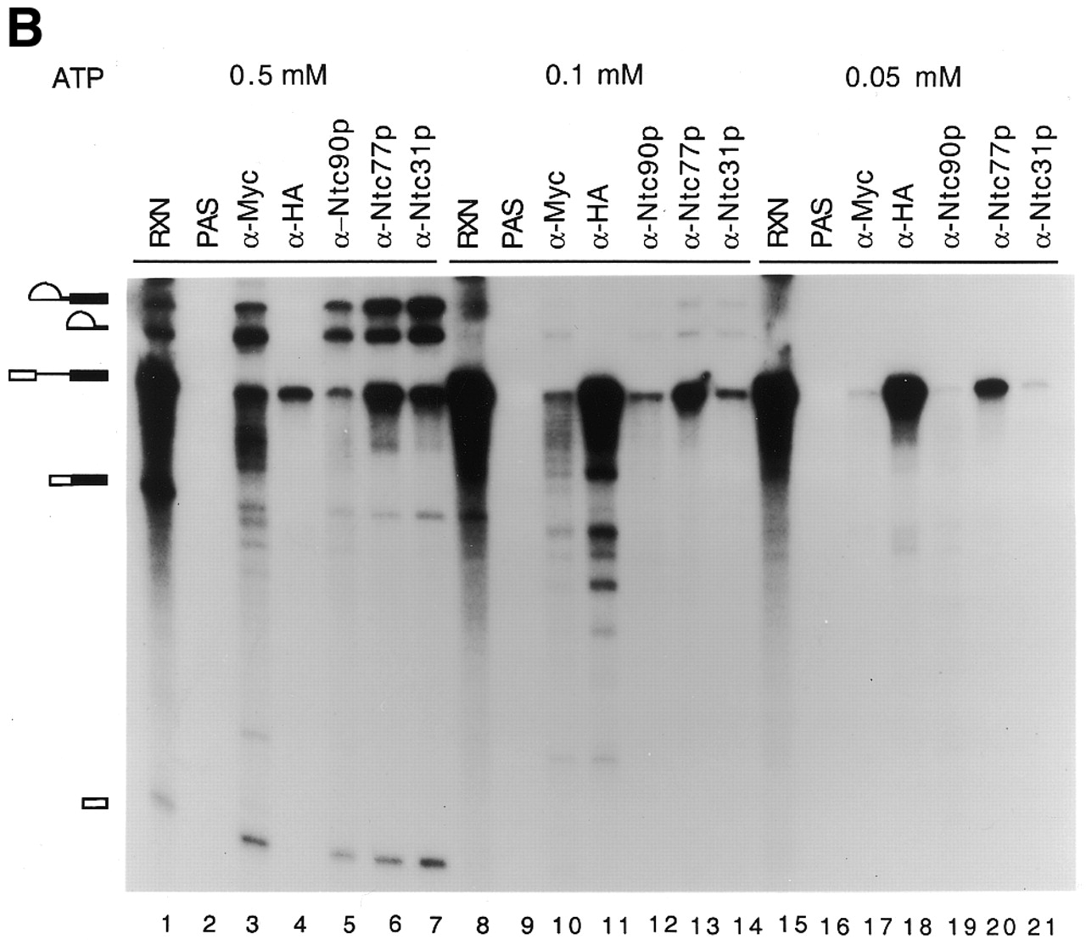
Figure 3. (A) Immunoprecipitation of the spliceosome formed in PRP19-HA (lanes 1–3), NTC90-HA (lanes 4–6), ...
Notes:
Figure 3. (A) Immunoprecipitation of the spliceosome formed in PRP19-HA (lanes 1–3), NTC90-HA (lanes 4–6), NTC77-HA (lanes 7–9) and NTC31-HA (lanes 10–12) extracts with the anti-HA antibody (lanes 3, 6, 9 and 12). (B) Immunoprecipitation of the spliceosome formed at various ATP concentrations in extracts prepared from a strain in which Prp19p was tagged with the c-Myc epitope and Prp4p tagged with the HA epitope. The splicing reaction was carried out at 0.5 mM (lanes 1–7), 0.1 mM (lanes 8–14) and 0.05 mM (lanes 15–21) ATP and the reaction mixtures (15 µl each) were subjected to immunoprecipitation with protein A–Sepharose alone (lanes 2, 9 and 16), anti-Myc (lanes 3, 10 and 17), anti-HA (lanes 4, 11 and 18), anti-Ntc90p (lanes 5, 12 and 19), anti-Ntc77p (lanes 6, 13 and 20) and anti-Ntc31p antibodies (lanes 7, 14 and 21). RXN, 2 µl of the reaction mixture; NS-Ab, non-specific antibody; PAS, protein A–Sepharose.
Unless provided in the caption above, the following copyright applies to the content of this slide:

Slide 5
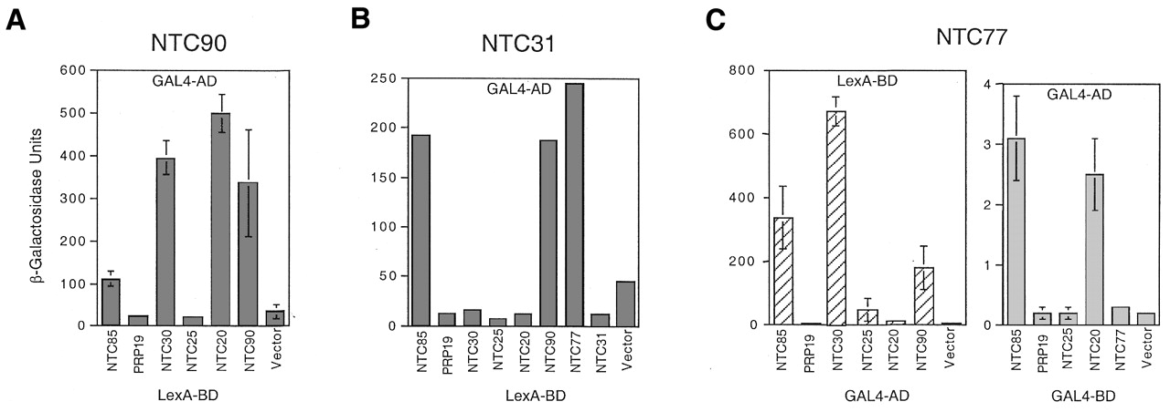
Figure 4. Two-hybrid assays showing interactions between the Prp19p-associated components. (A) Ntc90p was ...
Notes:
Figure 4. Two-hybrid assays showing interactions between the Prp19p-associated components. (A) Ntc90p was fused to the GAL4 AD and the counterparts fused to the LexA BD. (B) Ntc31p was fused to the GAL4 AD and the counterparts fused to the LexA BD. (C) Left, Ntc77p was fused to the LexA BD and the counterparts fused to the GAL4 AD. Right, Ntc77p was fused to the GAL4 AD and the counterparts fused to the GAL4 BD.
Unless provided in the caption above, the following copyright applies to the content of this slide:

Slide 6
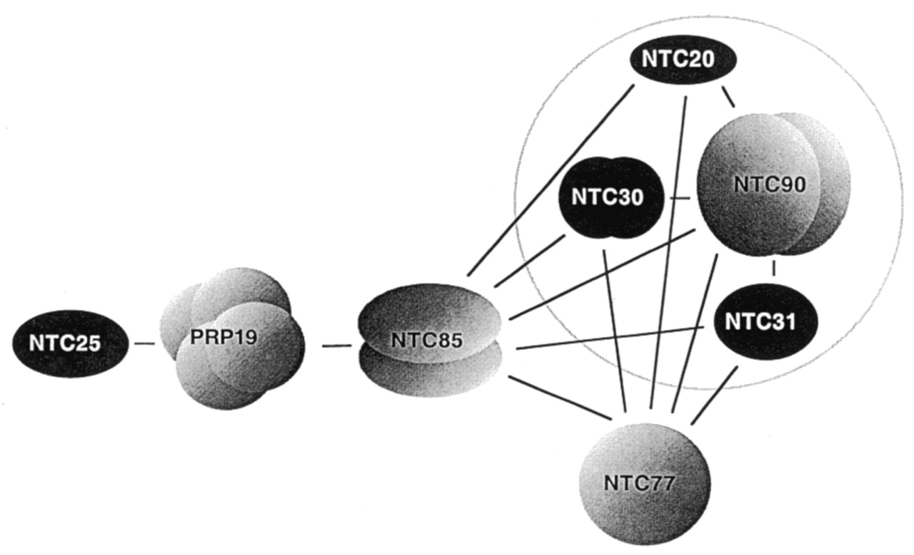
Figure 5. A scheme showing interactions between the components of the Prp19p-associated complex. Prp19p, ...
Notes:
Figure 5. A scheme showing interactions between the components of the Prp19p-associated complex. Prp19p, Ntc90p, Ntc85p and Ntc30p are shown as multi-subunit homo-oligomers due to observed self-interactions in two-hybrid assays. Prp19p was demonstrated to be in tetrameric form. Self-interaction was not detected for Ntc77p, Ntc31p, Ntc25p or Ntc20p. Proteins encoded by essential genes are shown in gray and non-essential genes in black. The circle indicates stable association of Ntc90p, Ntc31p, Ntc30p and Ntc20p in a subcomplex.
Unless provided in the caption above, the following copyright applies to the content of this slide:

Slide 7
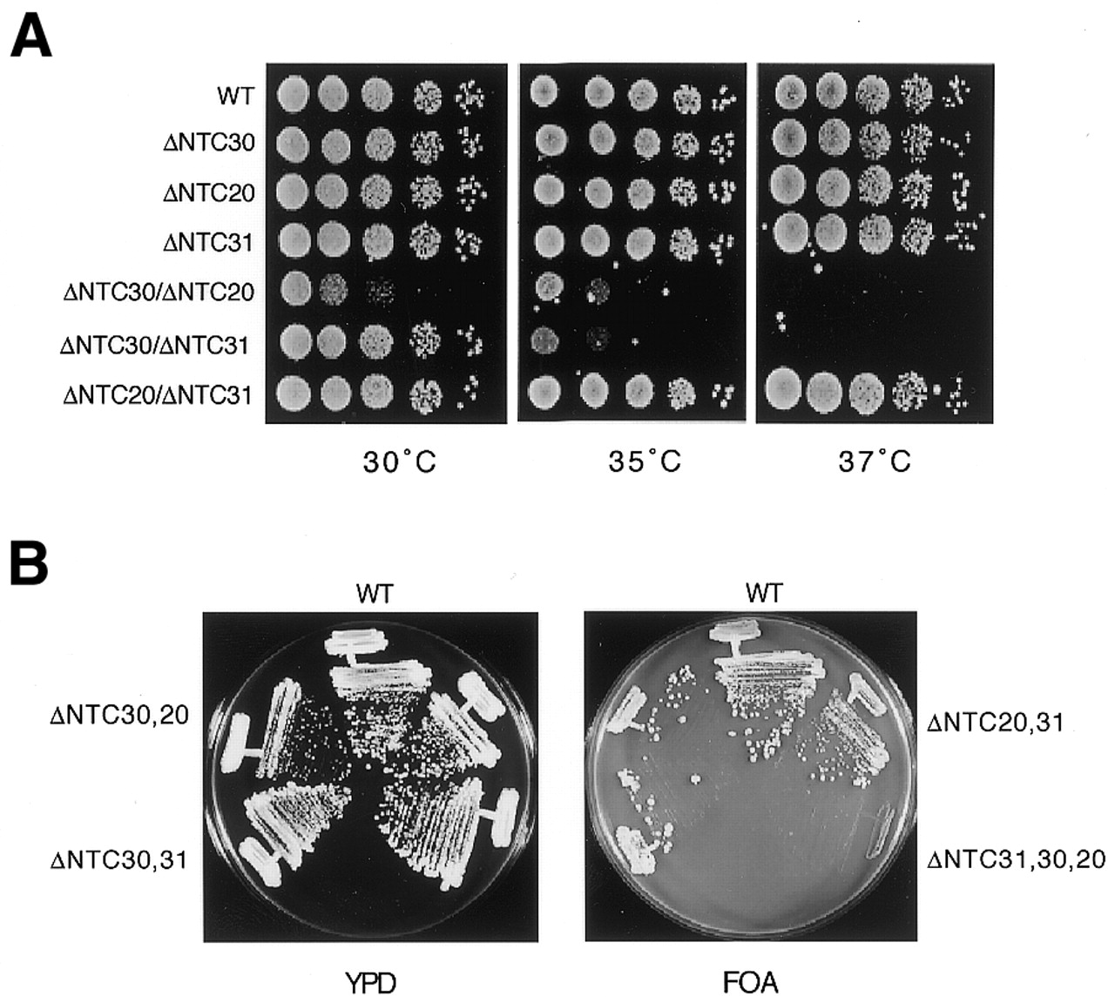
Figure 6. Growth analysis of NTC31, NTC30 and NTC20 single, double and triple deletion mutants. (A) Growth ...
Notes:
Figure 6. Growth analysis of NTC31, NTC30 and NTC20 single, double and triple deletion mutants. (A) Growth phenotypes of single and double deletion mutants of NTC31, NTC30 and NTC20 were examined by spot assay on YPD plates. (B) Cells of the wild-type, double deletion and triple deletion strains carrying plasmid pRS416.NTC30 were streaked on YPD or 5-FOA plates. WT, wild-type.
Unless provided in the caption above, the following copyright applies to the content of this slide:

Slide 8
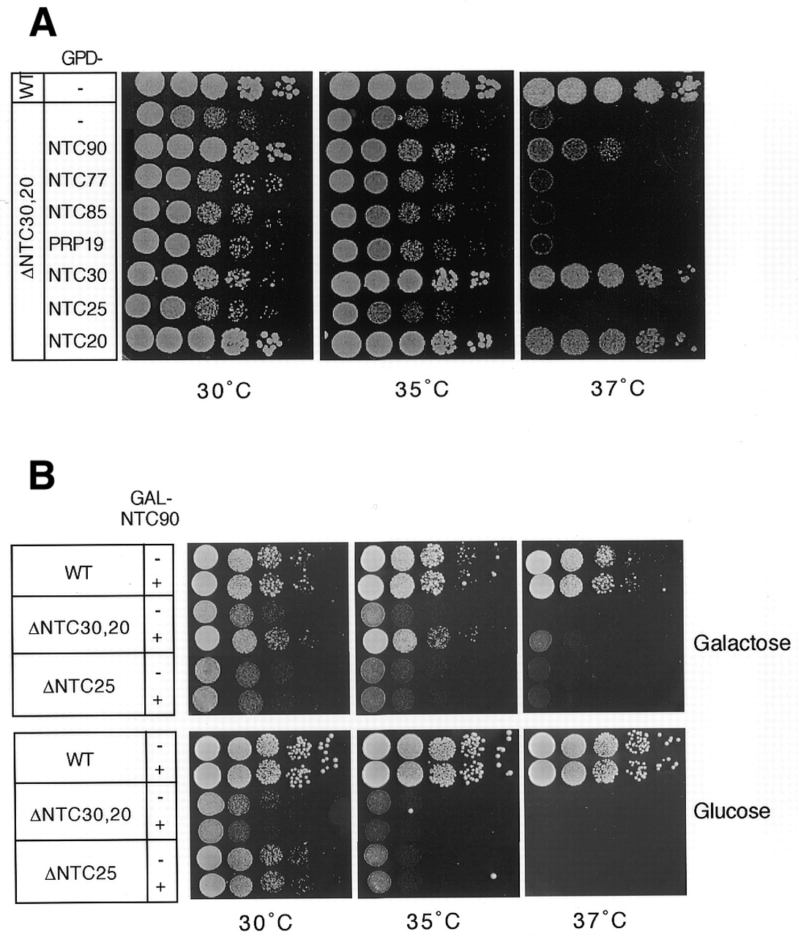
Figure 7. The growth defect of a ΔNTC30/ΔNTC20 mutant could be partially rescued by overexpression of NTC90. ...
Notes:
Figure 7. The growth defect of a ΔNTC30/ΔNTC20 mutant could be partially rescued by overexpression of NTC90. (A) ΔNTC30/ΔNTC20 cells carrying plasmids containing individual genes encoding components of the Prp19p-associated complex in plasmid vector pG1 were spotted on YPD plates and grown at 30, 35 and 37°C. (B) Wild-type, ΔNTC30/ΔNTC20 or ΔNTC25 cells carrying the NTC90 gene under control of the GAL promoter on plasmid vector pRS414 were spotted on tryptophan drop-out–SMM plates supplemented with galactose or glucose and grown at 30, 35 and 37°C. WT, wild-type.
Unless provided in the caption above, the following copyright applies to the content of this slide:

Slide 9
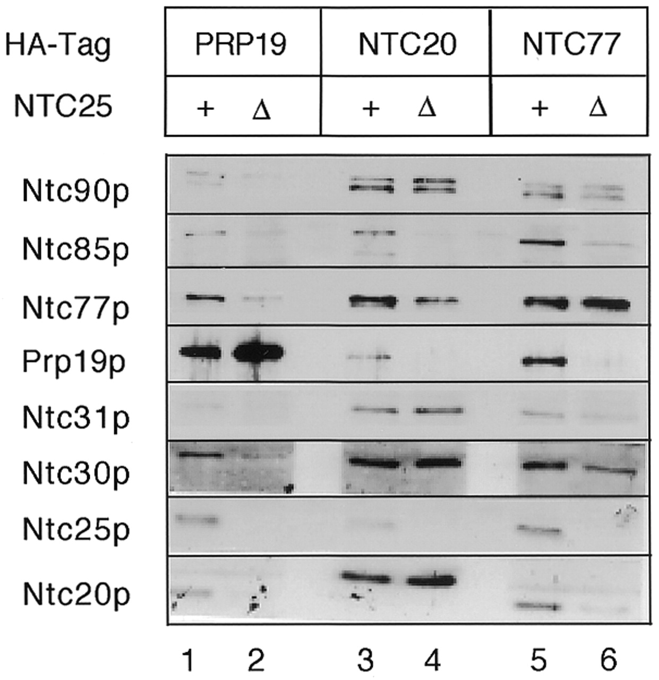
Figure 8. Immunoprecipitation of ΔNTC25 extracts revealed stable association of Ntc90p, Ntc31p, Ntc30p and ...
Notes:
Figure 8. Immunoprecipitation of ΔNTC25 extracts revealed stable association of Ntc90p, Ntc31p, Ntc30p and Ntc20p in a subcomplex. Prp19p, Ntc20p or Ntc77p was tagged with the HA epitope in a strain in which the NTC25 gene was deleted. Extracts prepared from such strains were precipitated with anti-HA antibody followed by western blotting.
Unless provided in the caption above, the following copyright applies to the content of this slide:

