Slide 1
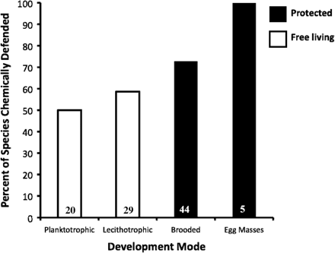
Fig. 1 The frequency of chemical defenses in marine invertebrates with different developmental modes. Bars represent ...
Notes:
Fig. 1 The frequency of chemical defenses in marine invertebrates with different developmental modes. Bars represent the percent of species found to be chemically-defended against at least one predator during at least one developmental stage. Open bars represent offspring derived from broadcast spawning. Closed bars represent offspring that are brooded or encapsulated for all or part of their development. Data were taken from 22 studies covering 98 species. See Appendix 1 for more details.
Unless provided in the caption above, the following copyright applies to the content of this slide: © The Author 2010. Published by Oxford University Press on behalf of the Society for Integrative and Comparative Biology. All rights reserved. For permissions please email: journals.permissions@oxfordjournals.org.

Slide 2
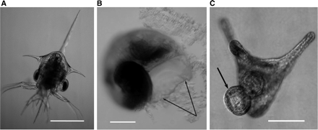
Fig. 2 (A) Zoea of rock crab with flared spines and appendages. Scale = 1 mm. (B) Veliger of a periwinkle snail. ...
Notes:
Fig. 2 (A) Zoea of rock crab with flared spines and appendages. Scale = 1 mm. (B) Veliger of a periwinkle snail. Arrows indicate damage along the edge of the shell aperture following a sublethal attack by predatory larval crabs. Scale = 100 µm. (C) Pluteus of a sand dollar in the process of cloning. The arrow indicates a bud on the aboral surface of the primary larva that will subsequently be released as a gastrula-like individual. Scale = 100 µm. Photo credits: D. Vaughn. [Veliger (B) from Vaughn, Ecology, 88(4) 1030–9, 2007; Cloning pluteus (C) from Vaughn and Strathmann, Science, 319:1503, 2008.]
Unless provided in the caption above, the following copyright applies to the content of this slide: © The Author 2010. Published by Oxford University Press on behalf of the Society for Integrative and Comparative Biology. All rights reserved. For permissions please email: journals.permissions@oxfordjournals.org.

