Slide 1
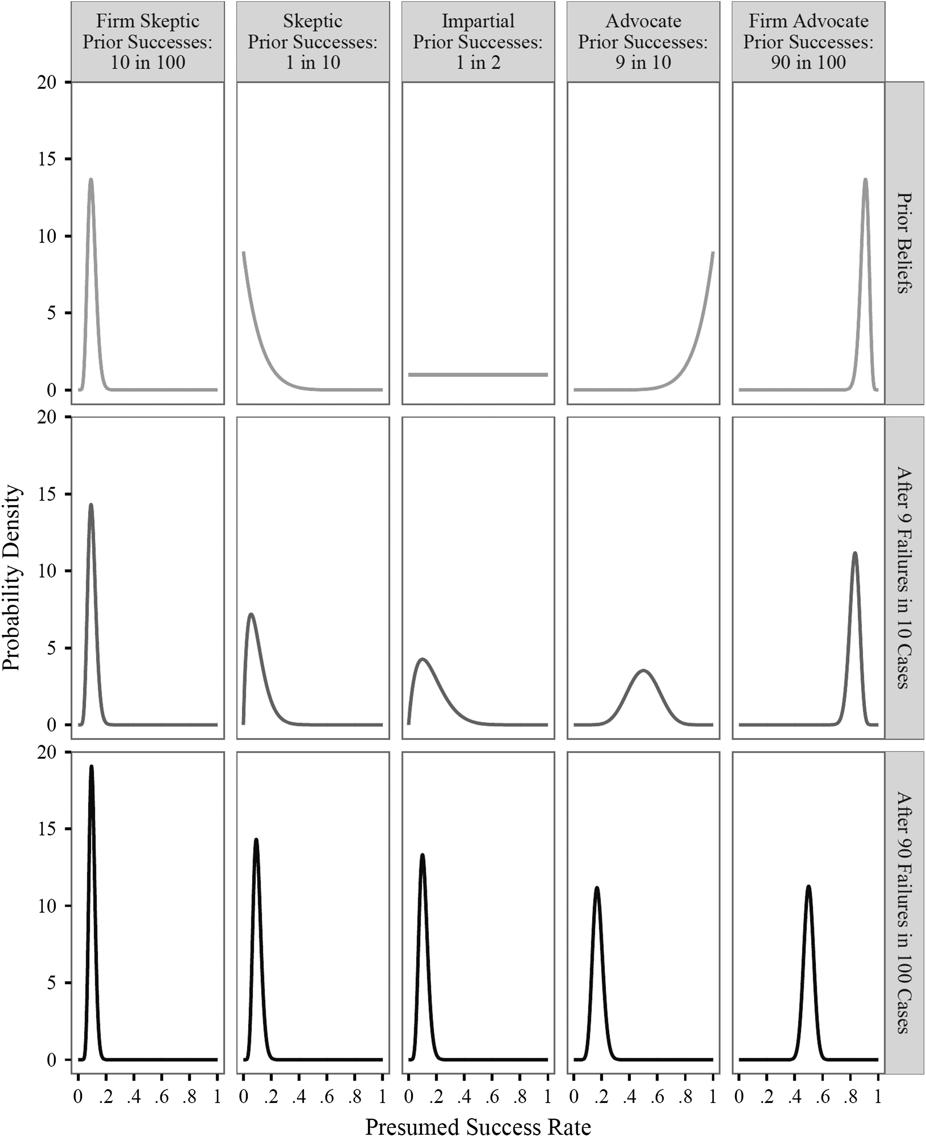
Fig. 1. The differential effect of new evidence on perfectly rational people (Bayesian updaters) with different prior ...
Notes:
Fig. 1. The differential effect of new evidence on perfectly rational people (Bayesian updaters) with different prior experiences.
Unless provided in the caption above, the following copyright applies to the content of this slide: © The Author 2016. Published by Oxford University Press. All rights reserved. For permissions, please e-mail: journals.permissions@oup.com.

