Slide 1
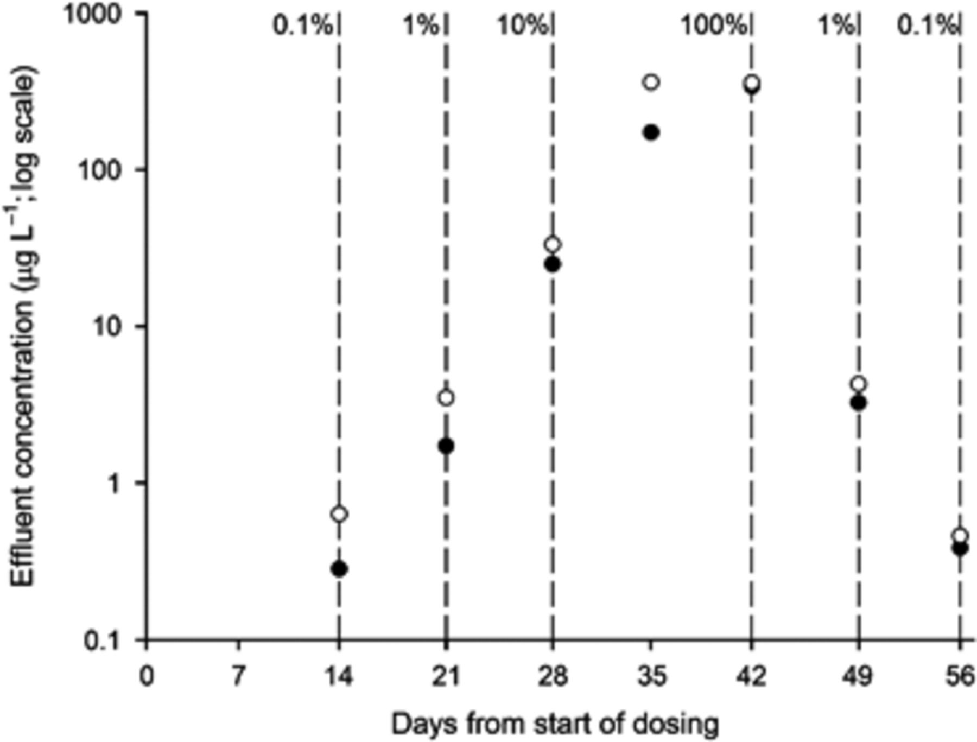
1 Effluent OC concentration, showing observed values (filled circles) and predicted values assuming no ...
Notes:
1 Effluent OC concentration, showing observed values (filled circles) and predicted values assuming no degradation (open circles). Dotted lines represent the ends of a particular dosing regime and indicate the OC dosing level as a percentage of the maximum dose.
Unless provided in the caption above, the following copyright applies to the content of this slide: © 2010 Federation of European Microbiological Societies. Published by Blackwell Publishing Ltd. All rights reserved

Slide 2
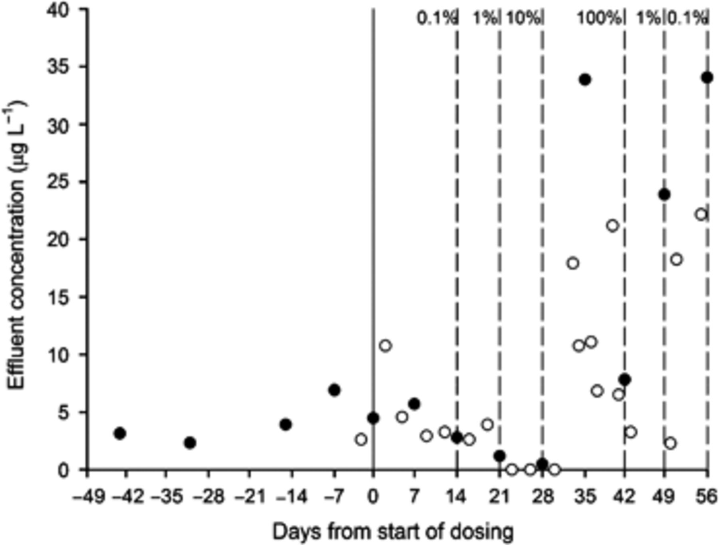
2 Effluent P-PO₄⁻³ concentrations, from flow injection analysis (filled circles) and ...
Notes:
2 Effluent P-PO4−3 concentrations, from flow injection analysis (filled circles) and colourimetric tests (open circles). Dotted lines represent the ends of a particular dosing regime and indicate the OC dosing level as a percentage of the maximum dose.
Unless provided in the caption above, the following copyright applies to the content of this slide: © 2010 Federation of European Microbiological Societies. Published by Blackwell Publishing Ltd. All rights reserved

Slide 3
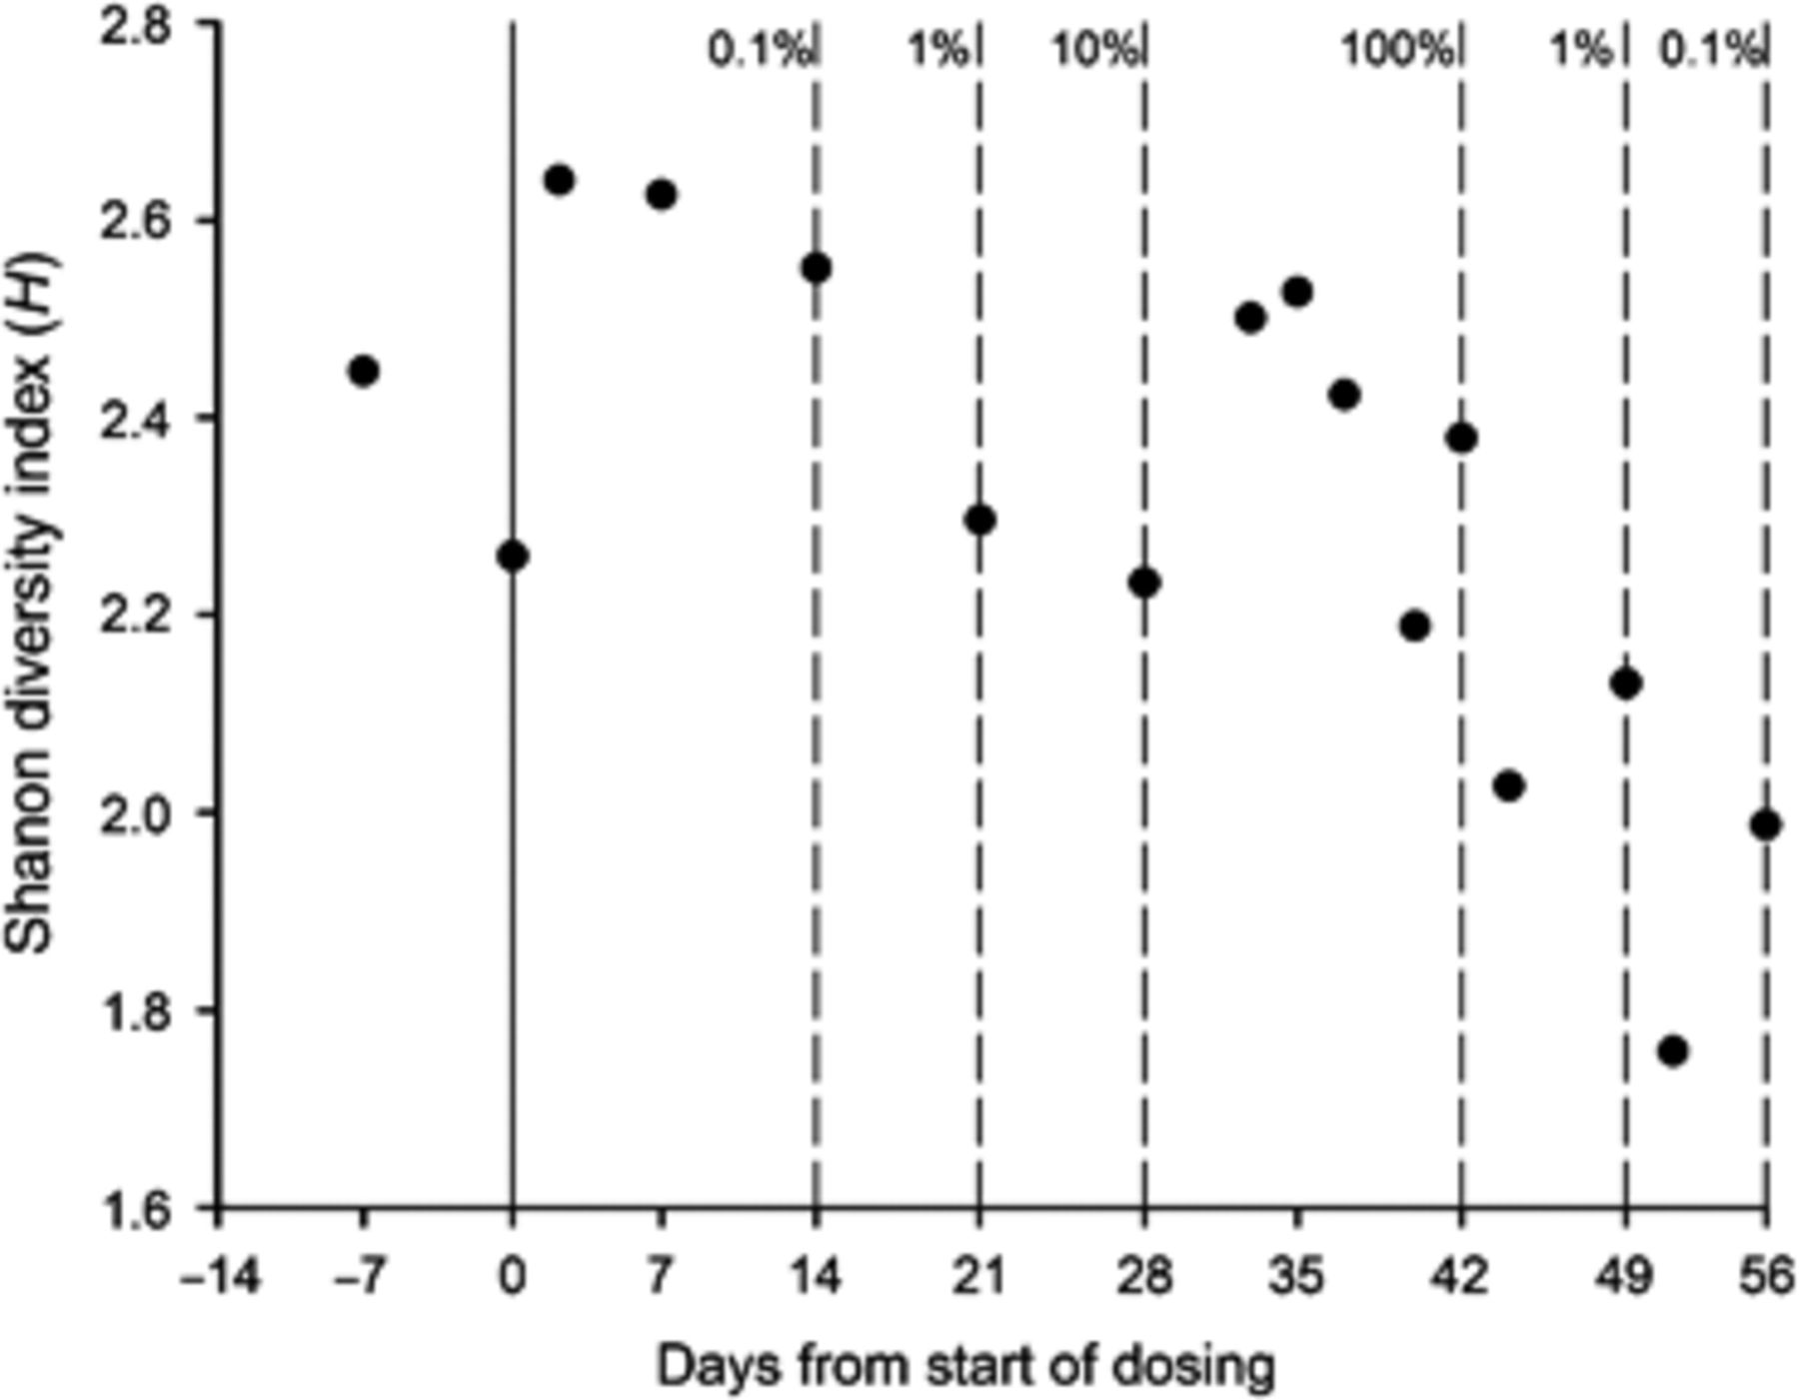
3 Shannon diversity, H, derived from analysis of T-RFLP data. Dotted lines represent the ends of a particular ...
Notes:
3 Shannon diversity, H, derived from analysis of T-RFLP data. Dotted lines represent the ends of a particular dosing regime and indicate the OC dosing level as a percentage of the maximum dose.
Unless provided in the caption above, the following copyright applies to the content of this slide: © 2010 Federation of European Microbiological Societies. Published by Blackwell Publishing Ltd. All rights reserved

