Slide 1
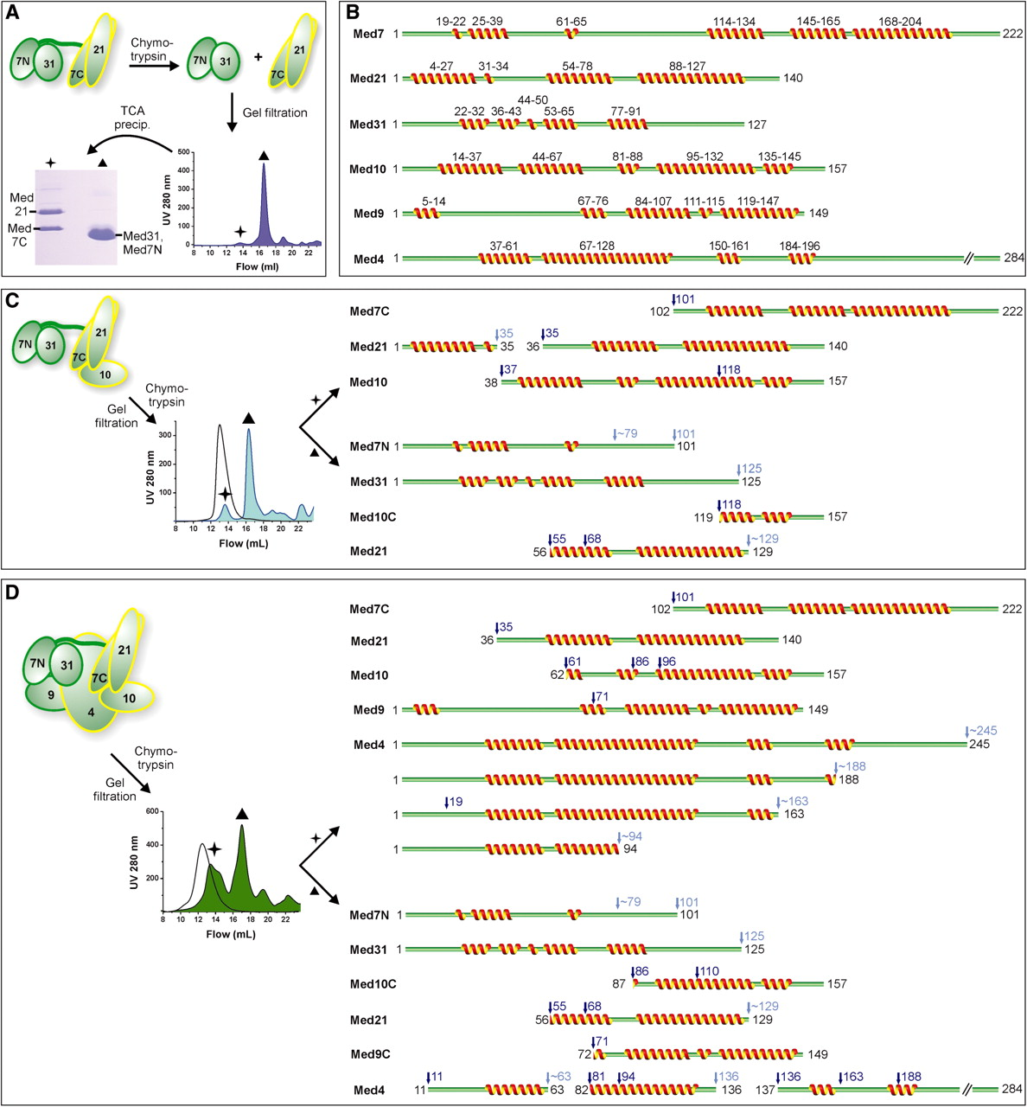
Figure 4. Limited proteolysis analysis of Mediator middle module. (A) Recombinant complexes were subjected to limited ...
Notes:
Figure 4. Limited proteolysis analysis of Mediator middle module. (A) Recombinant complexes were subjected to limited proteolysis by chymotrypsin after identifying suitable digestion durations using time courses. The samples were subjected to gel filtration, the eluting peaks precipitated by TCA, fractions separated on SDS-PAGE and subjected to Edman sequencing. (B) Secondary structure predictions for yeast middle module subunits. Multiple sequence alignments were used whenever possible. Given are consensus predictions by HHpred (45), I-Tasser (46), PSIpred (47) and CDM (48). (C) Schematic diagram of limited proteolysis of Med7/10/21/31 using chymotrypsin, analogous to (A). The chromatogram of undigested complex is indicated by the black curve. Proteolytic cleavage sites are indicated above the protein cleavage schemes in dark blue (sequenced) and light blue (estimated from SDS-PAGE). Ambiguous C-terminal sites are marked with a tilde. In cases in which more than one N-terminus was sequenced, the alternative N-terminal cleavage sites are marked additionally. (D) Schematic diagram of limited proteolysis results for the Med4/7/9/10/21/31 complex using chymotrypsin, analogous to (C).
Unless provided in the caption above, the following copyright applies to the content of this slide: © The Author(s) 2010. Published by Oxford University Press.This is an Open Access article distributed under the terms of the Creative Commons Attribution Non-Commercial License (http://creativecommons.org/licenses/by-nc/2.5), which permits unrestricted non-commercial use, distribution, and reproduction in any medium, provided the original work is properly cited.

Slide 2
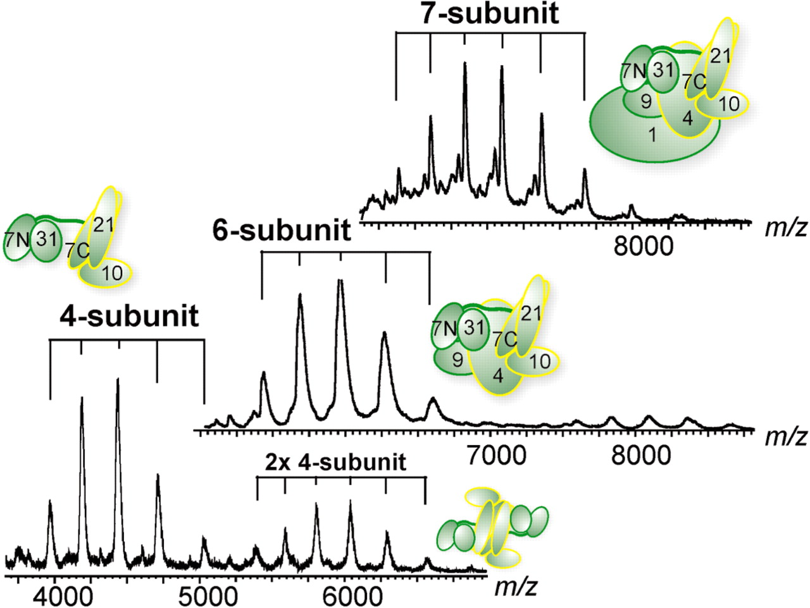
Figure 3. Native mass spectrometry analyses of Mediator middle module. Shown are from top to bottom spectra of the 7-, ...
Notes:
Figure 3. Native mass spectrometry analyses of Mediator middle module. Shown are from top to bottom spectra of the 7-, 6- and 4-subunit middle module complexes. All individual subunits are present in equimolar stoichiometry. The distributions are labeled accordingly to the corresponding schematics.
Unless provided in the caption above, the following copyright applies to the content of this slide: © The Author(s) 2010. Published by Oxford University Press.This is an Open Access article distributed under the terms of the Creative Commons Attribution Non-Commercial License (http://creativecommons.org/licenses/by-nc/2.5), which permits unrestricted non-commercial use, distribution, and reproduction in any medium, provided the original work is properly cited.

Slide 3
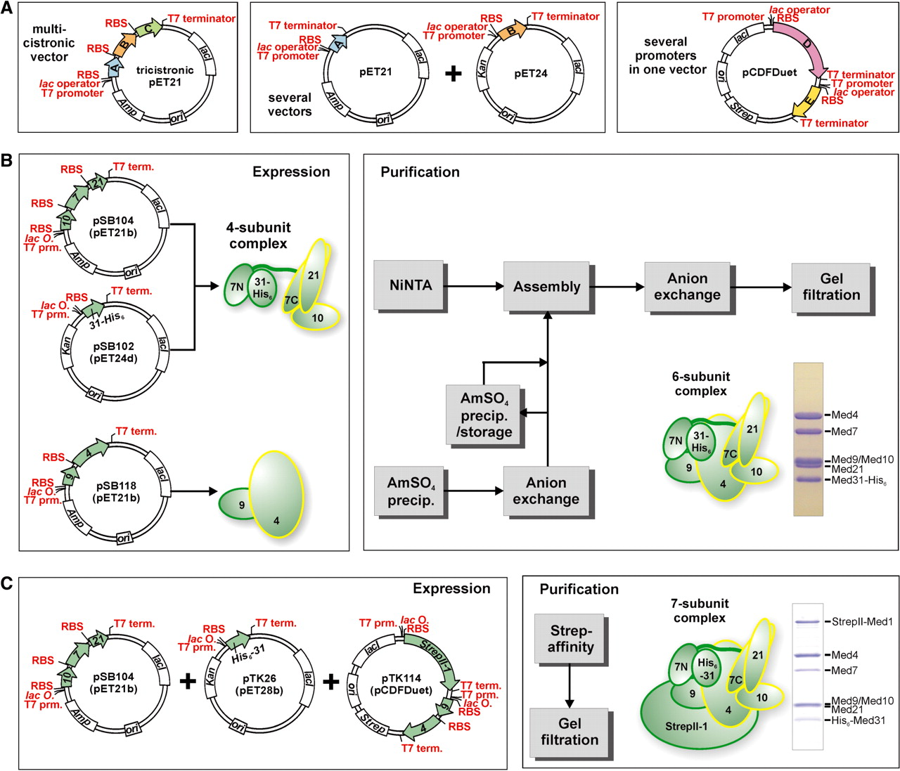
Figure 2. Recombinant Mediator middle module. (A) Recombinant coexpression of multisubunit protein complexes in E. coli ...
Notes:
Figure 2. Recombinant Mediator middle module. (A) Recombinant coexpression of multisubunit protein complexes in E. coli is possible by using multicistronic expression vectors, several compatible vectors cotransformed into E. coli, vectors with several promoters, and combinations of these. (B) Coexpression of 4-subunit Mediator middle complex containing Med7/10/21/31 is accomplished using a tricistronic pET21 and a monocistronic pET24 vector. The dimeric Med4/9 complex is coexpressed using a bicistronic pET21 vector. After cell-disruption and prepurification, both complexes are assembled into the 6-subunit middle complex containing Med4/7/9/10/21/31 and purified further to homogeneity. (C) Recombinant 7-subunit middle module consisting of Med1/4/7/9/10/21/31 is obtained by coexpression using a tricistronic vector encoding for Med7/10/21, a monocistronic vector encoding for His6-Med31 and a pCDFDuet vector with StrepII-tagged Med1 from multiple cloning site I (MCS I) and Med4/9 bicistronically expressed from MCS II. Purification after cell disruption is performed by StrepII-affinity purification and subsequent gel filtration.
Unless provided in the caption above, the following copyright applies to the content of this slide: © The Author(s) 2010. Published by Oxford University Press.This is an Open Access article distributed under the terms of the Creative Commons Attribution Non-Commercial License (http://creativecommons.org/licenses/by-nc/2.5), which permits unrestricted non-commercial use, distribution, and reproduction in any medium, provided the original work is properly cited.

Slide 4
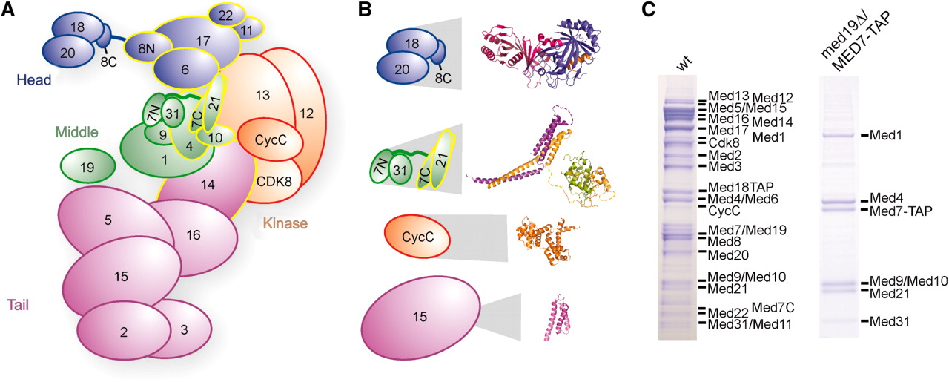
Figure 1. Endogenous Mediator and its middle module. (A) Schematic view of Mediator subunit arrangement and modular ...
Notes:
Figure 1. Endogenous Mediator and its middle module. (A) Schematic view of Mediator subunit arrangement and modular structure, taking into account known and found (see below) subunit interactions. Subunits that are essential for yeast viability are outlined in yellow. (B) Available detailed structural information on subunits and subcomplexes of Mediator (13–17). Structures are enlarged in proportion to the full subcomplex or subunit sizes. (C) SDS-PAGE analysis of endogenous Mediator and 7-subunit Mediator middle module purified from wild-type (left) and med19Δ yeast strains containing a C-terminal TAP tag on the Med7 subunit. Copurifying proteins from 4 l yeast cells were separated on a 12% NuPAGE gel (Invitrogen), and bands were stained with Coomassie blue. The identity of all Mediator subunits could be confirmed by mass spectrometry (data not shown).
Unless provided in the caption above, the following copyright applies to the content of this slide: © The Author(s) 2010. Published by Oxford University Press.This is an Open Access article distributed under the terms of the Creative Commons Attribution Non-Commercial License (http://creativecommons.org/licenses/by-nc/2.5), which permits unrestricted non-commercial use, distribution, and reproduction in any medium, provided the original work is properly cited.

Slide 5
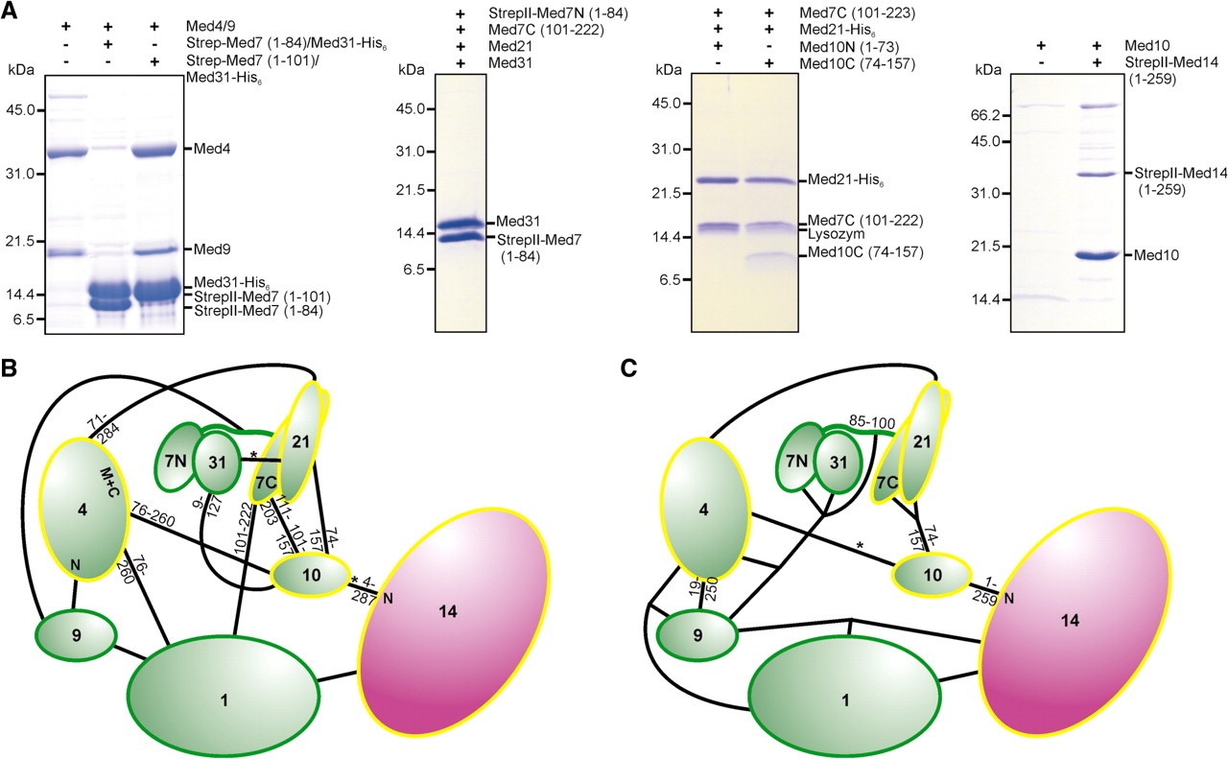
Figure 5. Intra-module subunit interactions within the middle module. (A) Middle module subunits and subcomplexes were ...
Notes:
Figure 5. Intra-module subunit interactions within the middle module. (A) Middle module subunits and subcomplexes were tested for interaction with other middle module subunits or subcomplexes by coexpression and subsequent copurification pull-down assays. (B) Mediator middle module interaction map based on previously published (19) yeast-two-hybrid (Y2H) assays and structural data (13,15). The length of truncated subunit variants that gave interactions with its partner, are indicated closely to the molecules. Interactions based only on single Y2H clones are indicated by a star. (C) Mediator middle module interaction map based on coexpression and copurifications. The map integrates published data (13,15) with the findings depicted in Figures 2B, C, 5A and Supplementary Table S2. As coexpression and copurification was required to obtain stable complexes, connections to more than one partner are indicated for some proteins. Weak interactions are indicated by a star.
Unless provided in the caption above, the following copyright applies to the content of this slide: © The Author(s) 2010. Published by Oxford University Press.This is an Open Access article distributed under the terms of the Creative Commons Attribution Non-Commercial License (http://creativecommons.org/licenses/by-nc/2.5), which permits unrestricted non-commercial use, distribution, and reproduction in any medium, provided the original work is properly cited.

Slide 6
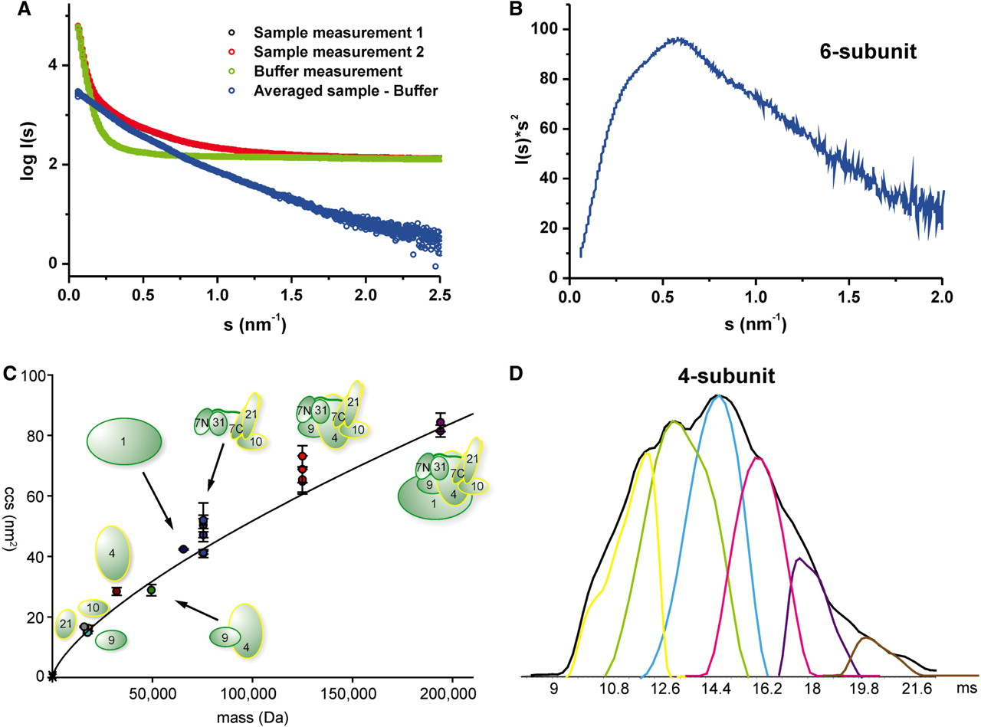
Figure 6. Shape of the middle module. (A) The experimental SAXS curve of 6-subunit Mediator middle module indicates an ...
Notes:
Figure 6. Shape of the middle module. (A) The experimental SAXS curve of 6-subunit Mediator middle module indicates an elongated protein complex. I0 signal intensity in comparison with the BSA standard measurement suggested a molecular weight of the complex far above the theoretical weight. Therefore, the Guinier radius could not be reliably determined and useful models could not be calculated. (B) The corresponding Kratky-plot shows no classical bell shape, but is stretched toward higher scattering angles. The complex is nevertheless folded and exhibits also few globular areas. (C) Ion mobility MS experiments. Plotted are the calibrated collision cross sections (CCSs) of the single subunits and (sub-)complexes (for detailed information see Supplementary Table S4). The graph indicates a general trend of CCS versus mass for globular proteins [determined both experimentally (34) and derived from globular structures deposited in the PDB http://www.rcsb.org]. The graph extends up to a mass of 801 kDa and a CCS of 229 nm2. Only the section relevant for the Mediator complexes is shown. The color-coding is: grey: Med21, cyan: Med9, orange: Med10, brown: Med4, dark green: Med4/7, dark blue: Med1, blue: 4-subunit middle, red: 6-subunit middle, purple: 7-subunit middle. (D) Flexibility of the Mediator middle module. From IM-MS measurements, we generated the averaged drift time plot (in ms) for the 4-subunit Mediator middle (charge 16+) (shown in black). Using the Drift Scope software (Waters, UK), we extracted the different conformations that contribute to the averaged drift time plot. We can detect up to six conformations that make up this charge state of the 4-subunit Mediator middle in the gas phase, thereby reflecting the flexibility of the Mediator middle module.
Unless provided in the caption above, the following copyright applies to the content of this slide: © The Author(s) 2010. Published by Oxford University Press.This is an Open Access article distributed under the terms of the Creative Commons Attribution Non-Commercial License (http://creativecommons.org/licenses/by-nc/2.5), which permits unrestricted non-commercial use, distribution, and reproduction in any medium, provided the original work is properly cited.

