Slide 1
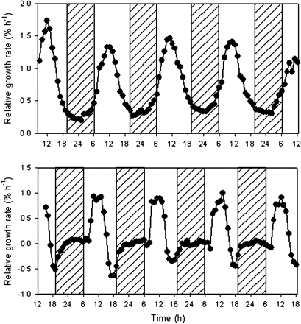
Fig. 1. Diel patterns of growth in cladodes of Opuntia oricola in the desert biome of the Biosphere 2 Laboratory ...
Notes:
Fig. 1. Diel patterns of growth in cladodes of Opuntia oricola in the desert biome of the Biosphere 2 Laboratory (upper) and O. engelmanii in the field Oracle AZ (lower) [redrawn from data in Gouws et al. (2005), with permission from CSIRO Publishing (http://www.publish.csiro.au/nid/103/issue/948.htm)].
Unless provided in the caption above, the following copyright applies to the content of this slide: © The Author [2008]. Published by Oxford University Press [on behalf of the Society for Experimental Biology]. All rights reserved. For Permissions, please e-mail: journals.permissions@oxfordjournals.org

Slide 2
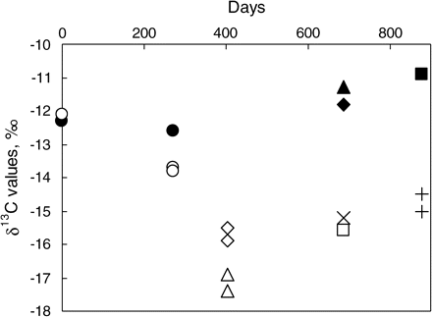
Fig. 2. Changes in δ¹³C values of total plant carbon in O. stricta cladodes following growth and ...
Notes:
Fig. 2. Changes in δ13C values of total plant carbon in O. stricta cladodes following growth and development in day–night cycles of 17 °C night; 14 h/23 °C; 10 h day (filled symbols) or under continuous light (open symbols) in controlled environment chambers. Parent cladodes, circles; new cladodes in each environment: first, triangles; second, diamonds; third, squares; fourth crosses; fifth, plus signs (data from Osmond et al., 1979).
Unless provided in the caption above, the following copyright applies to the content of this slide: © The Author [2008]. Published by Oxford University Press [on behalf of the Society for Experimental Biology]. All rights reserved. For Permissions, please e-mail: journals.permissions@oxfordjournals.org

Slide 3
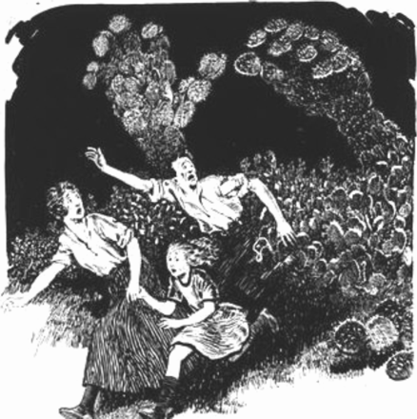
Fig. 3. Newspaper cartoonist's perception of the prickly pear threat circa 1909–10 when O. stricta was headlined as ...
Notes:
Fig. 3. Newspaper cartoonist's perception of the prickly pear threat circa 1909–10 when O. stricta was headlined as ‘a silent terror that has captured 29,000,000 acres (6.3×106 ha) of our inheritance’ (from the National Library of Australia; image nla.pic-an24261643 reproduced with permission).
Unless provided in the caption above, the following copyright applies to the content of this slide: © The Author [2008]. Published by Oxford University Press [on behalf of the Society for Experimental Biology]. All rights reserved. For Permissions, please e-mail: journals.permissions@oxfordjournals.org

Slide 4
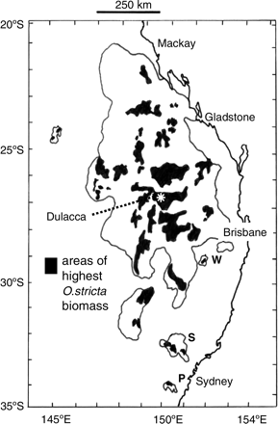
Fig. 4. Occupation of 25×10⁶ ha of central eastern Australia by O. stricta in 1925 showing earliest ...
Notes:
Fig. 4. Occupation of 25×106 ha of central eastern Australia by O. stricta in 1925 showing earliest recorded locations at Parramatta (P), at Scone (S), at Warwick (W), and the location of the Dulacca research station (redrawn from Mann, 1970).
Unless provided in the caption above, the following copyright applies to the content of this slide: © The Author [2008]. Published by Oxford University Press [on behalf of the Society for Experimental Biology]. All rights reserved. For Permissions, please e-mail: journals.permissions@oxfordjournals.org

Slide 5
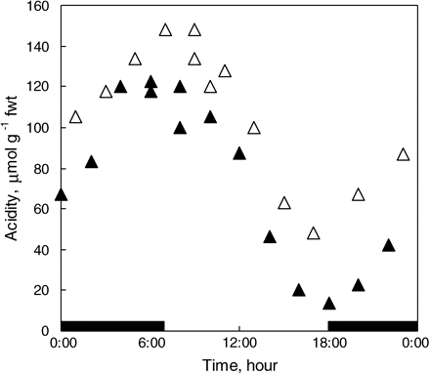
Fig. 5. Early reports of diel changes in acidity of B. calycinum (closed symbols), taste-tested by Heyne (1815) but ...
Notes:
Fig. 5. Early reports of diel changes in acidity of B. calycinum (closed symbols), taste-tested by Heyne (1815) but titrated by Kraus (1884), and in O. versicolor (open symbols) adjacent to the Carnegie Institution Desert Botanical Laboratory, Tumamoc Hill, Tucson, AZ, 11–12 April 1911 (28.5 °C day/15.5 °C night; data of Richards, 1915).
Unless provided in the caption above, the following copyright applies to the content of this slide: © The Author [2008]. Published by Oxford University Press [on behalf of the Society for Experimental Biology]. All rights reserved. For Permissions, please e-mail: journals.permissions@oxfordjournals.org

Slide 6
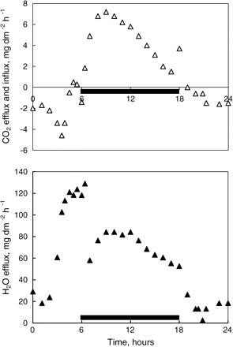
Fig. 6. Gas exchange in a potted plant of O. stricta kept in a growth chamber (10 °C/12 h dark, black bar; 25 °C/12 h ...
Notes:
Fig. 6. Gas exchange in a potted plant of O. stricta kept in a growth chamber (10 °C/12 h dark, black bar; 25 °C/12 h light; 480 μmol photons m−2 s−1) 5 d after cessation of watering. Note CO2 efflux and higher transpiration in the light period and CO2 influx and lower transpiration in the dark. Redrawn from unpublished PhD thesis of Lai (1977).
Unless provided in the caption above, the following copyright applies to the content of this slide: © The Author [2008]. Published by Oxford University Press [on behalf of the Society for Experimental Biology]. All rights reserved. For Permissions, please e-mail: journals.permissions@oxfordjournals.org

Slide 7
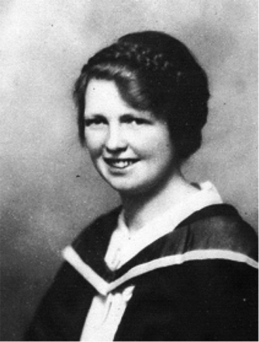
Fig. 7. Jean White (1877–1953; later Jean White-Haney) on graduation from the University of Melbourne (portrait from ...
Notes:
Fig. 7. Jean White (1877–1953; later Jean White-Haney) on graduation from the University of Melbourne (portrait from the National Library of Victoria; image nla.pic-an24631259.v, reproduced with permission).
Unless provided in the caption above, the following copyright applies to the content of this slide: © The Author [2008]. Published by Oxford University Press [on behalf of the Society for Experimental Biology]. All rights reserved. For Permissions, please e-mail: journals.permissions@oxfordjournals.org

Slide 8
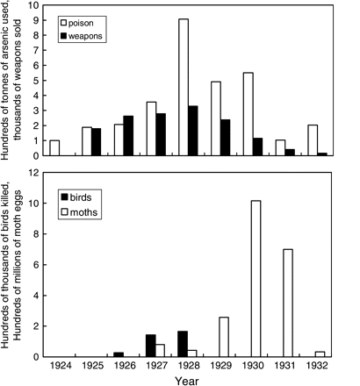
Fig. 8. Summary of the poison and biological CAMpaigns to control O. stricta in central eastern Australia, 1924–32 ...
Notes:
Fig. 8. Summary of the poison and biological CAMpaigns to control O. stricta in central eastern Australia, 1924–32 (redrawn from Osmond and Monro, 1981).
Unless provided in the caption above, the following copyright applies to the content of this slide: © The Author [2008]. Published by Oxford University Press [on behalf of the Society for Experimental Biology]. All rights reserved. For Permissions, please e-mail: journals.permissions@oxfordjournals.org

Slide 9
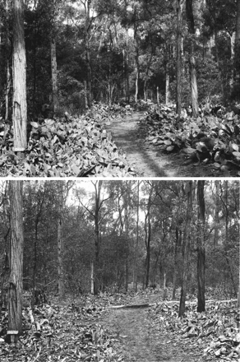
Fig. 9. Prickly pear in dry sclerophyll woodland, before and after the biological CAMpaign. Photos from original 8×10 ...
Notes:
Fig. 9. Prickly pear in dry sclerophyll woodland, before and after the biological CAMpaign. Photos from original 8×10 inch glass plates loaned to CB Osmond by WH Haselar and GJ Harvey, Queensland Department of Lands, 1980.
Unless provided in the caption above, the following copyright applies to the content of this slide: © The Author [2008]. Published by Oxford University Press [on behalf of the Society for Experimental Biology]. All rights reserved. For Permissions, please e-mail: journals.permissions@oxfordjournals.org

Slide 10
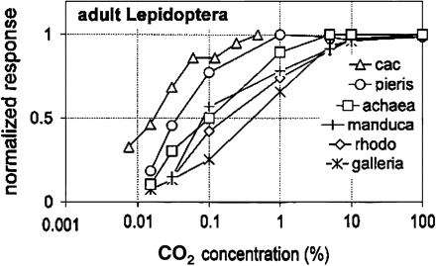
Fig. 10. Dose–response functions to atmospheric CO₂ in receptor systems of different moths and butterflies, ...
Notes:
Fig. 10. Dose–response functions to atmospheric CO2 in receptor systems of different moths and butterflies, based on electrophysiological data. The sensors of C. cactorum females are probably the most responsive of all so far examined. Note also that the least sensitive system is found in Galleria melonella, the wax moth which belongs to the same family as Cactoblastis but whose habitat is the enclosed environment of the beehive. cac, Cactoblastis cactorum (Pyralidae), redrawn from Stange et al. (1995); pieris, Pieris brassicae (Pieridae); achaea, Achaea lienardi (Noctuidae); manduca, Manduca sexta (Sphingidae); rhodo, Rhodogastria sp. (Arctiidae); galleria, Galleria melonella (Pyralidae), redrawn from Bogner et al. (1986) and Bogner (1990).
Unless provided in the caption above, the following copyright applies to the content of this slide: © The Author [2008]. Published by Oxford University Press [on behalf of the Society for Experimental Biology]. All rights reserved. For Permissions, please e-mail: journals.permissions@oxfordjournals.org

Slide 11
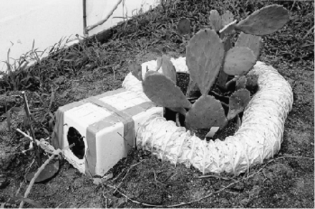
Fig. 11. System (mini-FACE ring in a controlled environment greenhouse) used to examine the effects of elevated ...
Notes:
Fig. 11. System (mini-FACE ring in a controlled environment greenhouse) used to examine the effects of elevated [CO2] on oviposition by C. cactorum on O. stricta (for properties of the CO2 plume, see Stange, 1997). Photo by G Stange.
Unless provided in the caption above, the following copyright applies to the content of this slide: © The Author [2008]. Published by Oxford University Press [on behalf of the Society for Experimental Biology]. All rights reserved. For Permissions, please e-mail: journals.permissions@oxfordjournals.org

