Slide 1
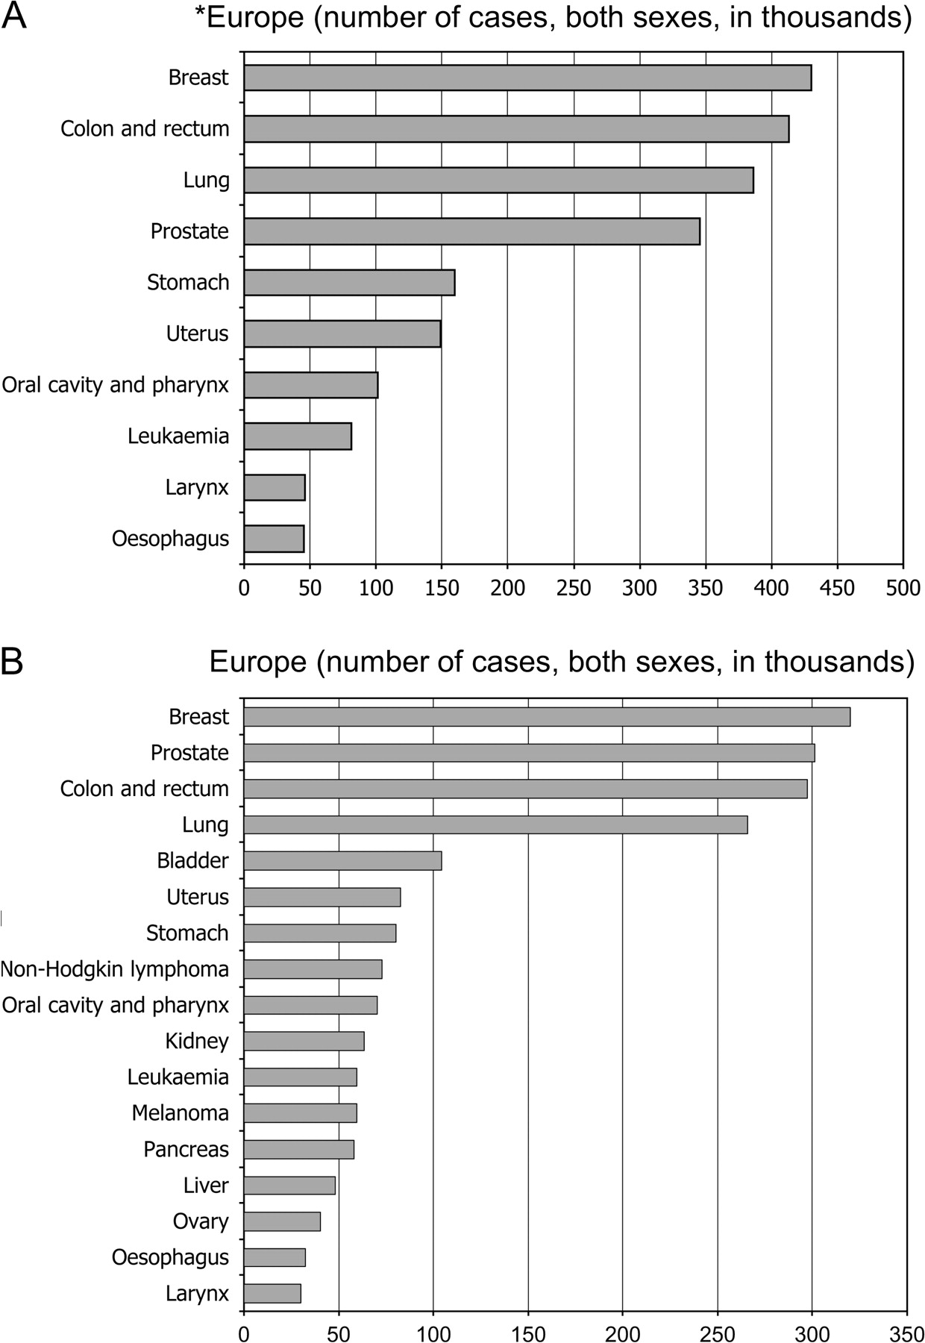
Figure 1. Estimated incidence of cancer in Europe and European Union, 2006. *No data for Europe for all the ...
Notes:
Figure 1. Estimated incidence of cancer in Europe and European Union, 2006. *No data for Europe for all the individual sites due to limitations of coding scheme employed.
Unless provided in the caption above, the following copyright applies to the content of this slide: © 2007 European Society for Medical Oncology

Slide 2
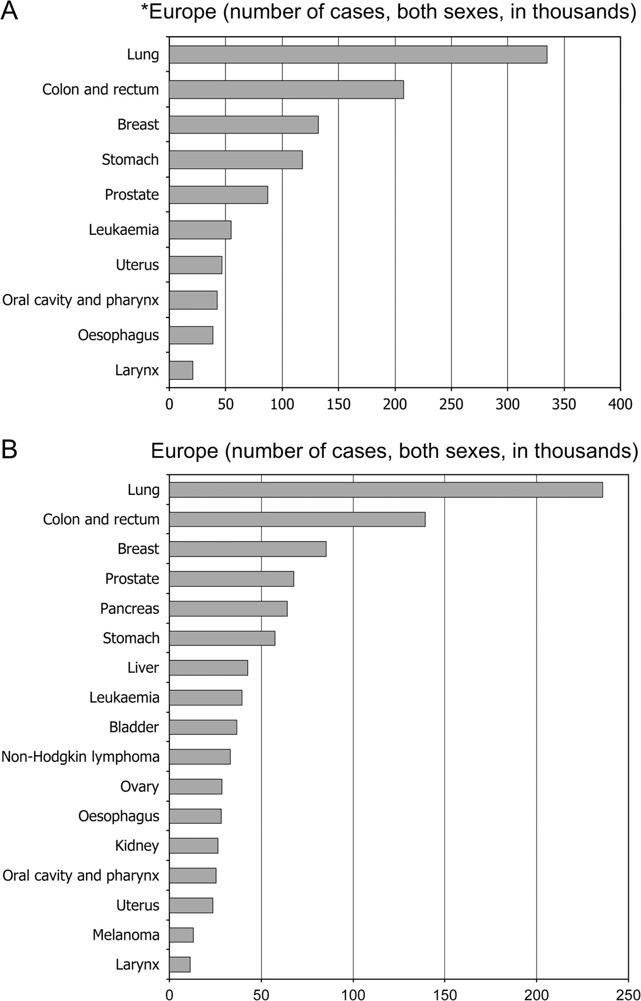
Figure 2. Estimated mortality from cancer in Europe and European Union, 2006. *No data for Europe for all ...
Notes:
Figure 2. Estimated mortality from cancer in Europe and European Union, 2006. *No data for Europe for all the individual sites due to limitations of coding scheme employed.
Unless provided in the caption above, the following copyright applies to the content of this slide: © 2007 European Society for Medical Oncology

Slide 3
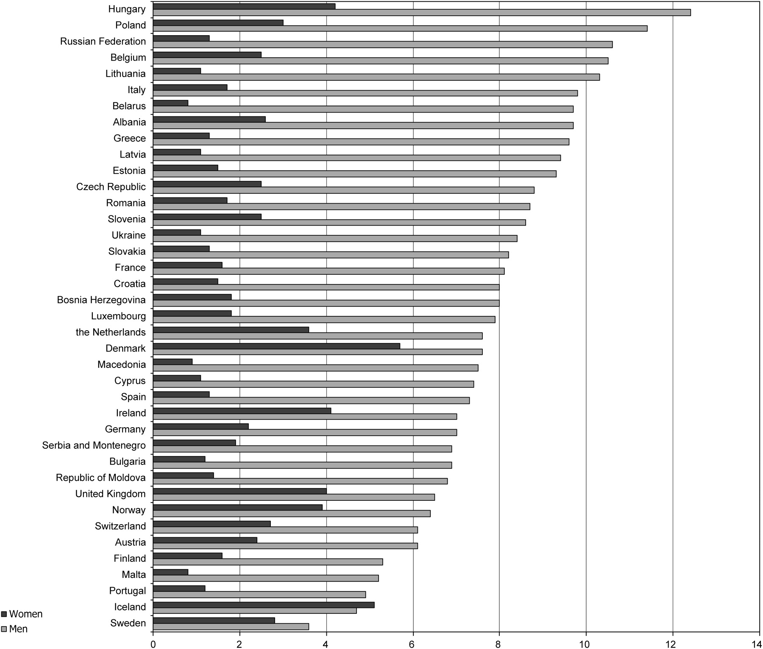
Figure 3. Cumulative lifetime (age 0–74 years) risk (percent) of lung cancer in men and women in Europe.
Notes:
Figure 3. Cumulative lifetime (age 0–74 years) risk (percent) of lung cancer in men and women in Europe.
Unless provided in the caption above, the following copyright applies to the content of this slide: © 2007 European Society for Medical Oncology

