Slide 1
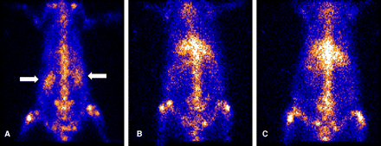
Fig. 1 Renal Ga-67 scintigraphy in rats in the AIN group (A) showing a striking uptake of the marker (white arrows) ...
Notes:
Fig. 1 Renal Ga-67 scintigraphy in rats in the AIN group (A) showing a striking uptake of the marker (white arrows) in frank contrast with the ATN (B) and NL (C) groups with no uptake (left kidney).
Unless provided in the caption above, the following copyright applies to the content of this slide: © Oxford University Press 2010

Slide 2
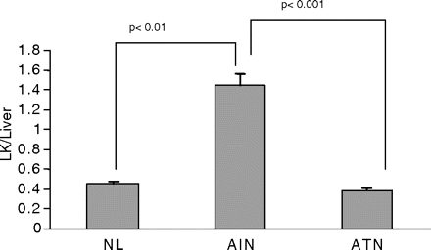
Fig. 2 Quantification of Ga-67 uptake in NL, AIN and ATN group rats (left kidney).
Notes:
Fig. 2 Quantification of Ga-67 uptake in NL, AIN and ATN group rats (left kidney).
Unless provided in the caption above, the following copyright applies to the content of this slide: © Oxford University Press 2010

Slide 3
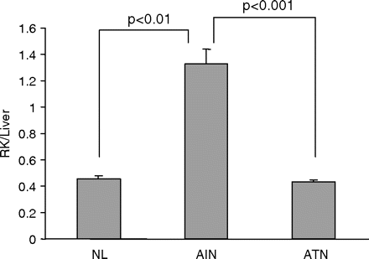
Fig. 3 Quantification of Ga-67 uptake in NL, AIN and ATN group rats (right kidney).
Notes:
Fig. 3 Quantification of Ga-67 uptake in NL, AIN and ATN group rats (right kidney).
Unless provided in the caption above, the following copyright applies to the content of this slide: © Oxford University Press 2010

Slide 4
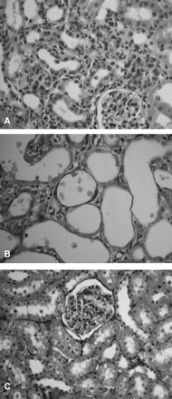
Fig. 4 (A) AIN group: renal histology showing intense mononuclear interstitial infiltrate (PAMS ×200); (B) ATN ...
Notes:
Fig. 4 (A) AIN group: renal histology showing intense mononuclear interstitial infiltrate (PAMS ×200); (B) ATN group: renal histology showing acute tubular injury, tubular dilation and thin epithelium (PAMS ×400). (C) Control rats with normal renal histology (HE ×200).
Unless provided in the caption above, the following copyright applies to the content of this slide: © Oxford University Press 2010

