Slide 1
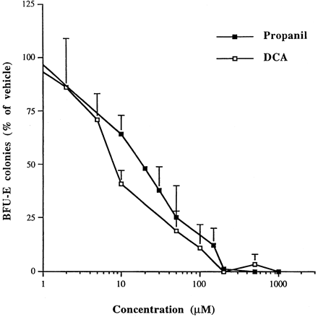
FIG. 1. Concentration-dependent inhibition of BFU-E colony formation resulting from in vitro exposure of murine bone ...
Notes:
FIG. 1. Concentration-dependent inhibition of BFU-E colony formation resulting from in vitro exposure of murine bone marrow cells to propanil and DCA. Data are expressed as percent vehicle colonies and represent the mean ± SE of three independent experiments performed in triplicate.
Unless provided in the caption above, the following copyright applies to the content of this slide: © 2002 Society of Toxicology

Slide 2
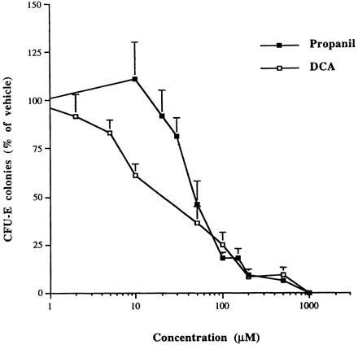
FIG. 2. Concentration-dependent inhibition of CFU-E colony formation resulting from in vitro exposure of murine bone ...
Notes:
FIG. 2. Concentration-dependent inhibition of CFU-E colony formation resulting from in vitro exposure of murine bone marrow cells to propanil and DCA. Data are expressed as percent vehicle colonies and represent the mean ± SE of three independent experiments performed in triplicate.
Unless provided in the caption above, the following copyright applies to the content of this slide: © 2002 Society of Toxicology

Slide 3
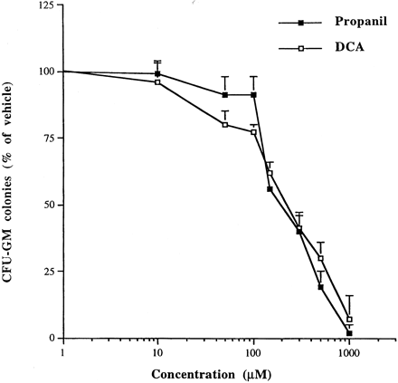
FIG. 3. Concentration-dependent inhibition of CFU-GM colony formation resulting from in vitro exposure of murine bone ...
Notes:
FIG. 3. Concentration-dependent inhibition of CFU-GM colony formation resulting from in vitro exposure of murine bone marrow cells to propanil and DCA. Data are expressed as percent vehicle colonies and represent the mean ± SE of three independent experiments performed in triplicate.
Unless provided in the caption above, the following copyright applies to the content of this slide: © 2002 Society of Toxicology

Slide 4
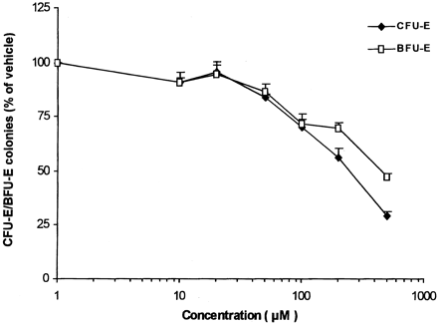
FIG. 4. Toxic effect of propanil on CFU-E and BFU-E colony formation from human cord blood progenitors. Data are ...
Notes:
FIG. 4. Toxic effect of propanil on CFU-E and BFU-E colony formation from human cord blood progenitors. Data are expressed as percent vehicle colonies and represent the mean ± SE. Each point represents the mean of at least three experiments.
Unless provided in the caption above, the following copyright applies to the content of this slide: © 2002 Society of Toxicology

Slide 5
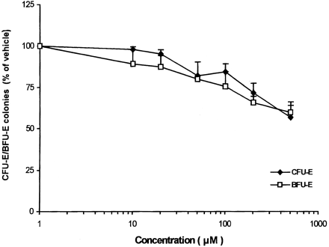
FIG. 5. Toxic effect of DCA on CFU-E and BFU-E colony formation from human cord blood progenitors. Data are expressed ...
Notes:
FIG. 5. Toxic effect of DCA on CFU-E and BFU-E colony formation from human cord blood progenitors. Data are expressed as percent vehicle colonies and represent the mean ± SE. Each point represents the mean of at least three experiments.
Unless provided in the caption above, the following copyright applies to the content of this slide: © 2002 Society of Toxicology

