Slide 1
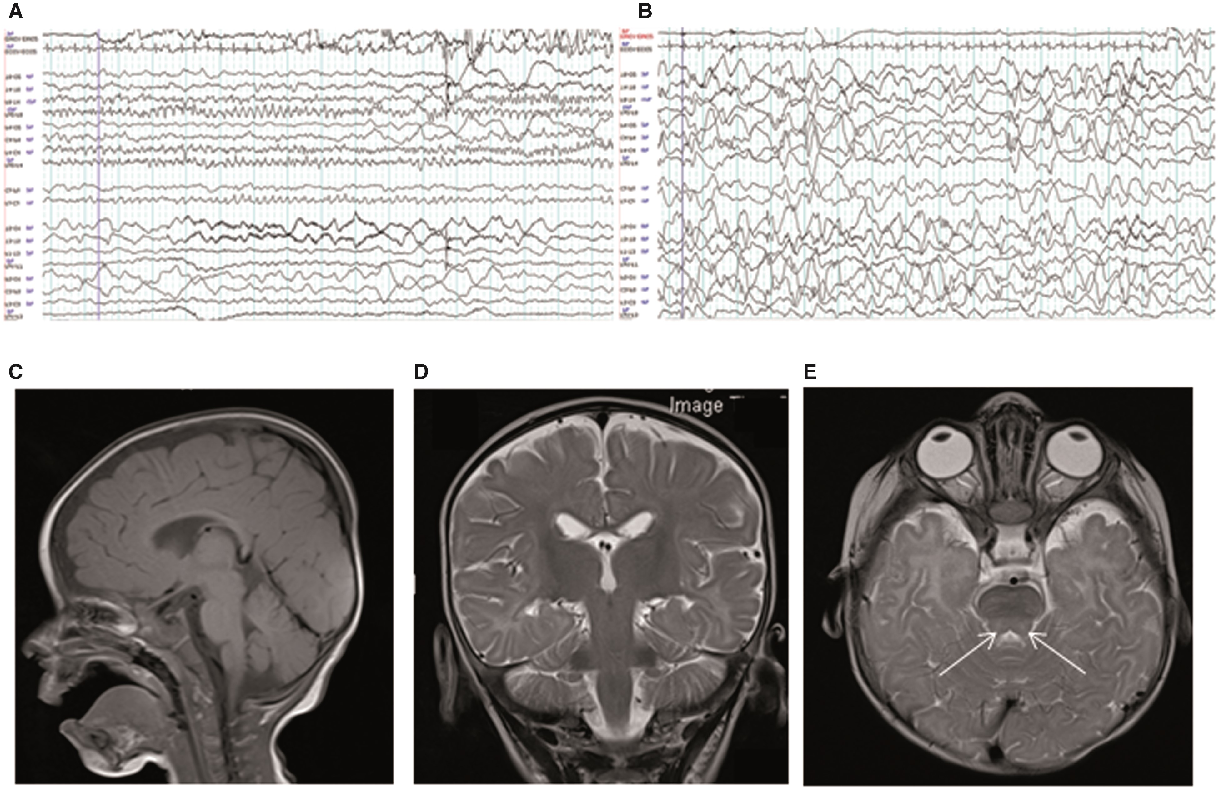
Figure 1. Clinical presentation of proband. Representative electroencephalograms. Longitudinal bipolar EEG montages ...
Notes:
Figure 1. Clinical presentation of proband. Representative electroencephalograms. Longitudinal bipolar EEG montages demonstrating (A) evolving focal seizure with build-up of rhythmic activity in the right frontal leads (7 months age); (B) modified hypsarrhythmia with high amplitude, poorly organized delta activity and multifocal, posterior dominant spikes at 9 months of age. MRI Brain Images. (C) Normal sagittal T1 midline at 5 months and (D) coronal T2 image at 7 months. (E) Axial T2 weighted images of the patient at 7 months demonstrating symmetric foci of T2 weighted hyperintensity (arrows) within the grey matter nuclei in the posterior pons adjacent to the fourth ventricle. Abbreviations: EEG, electroencephalogram; MRI, magnetic resonance imaging. CSF, cerebrospinal fluid.
Unless provided in the caption above, the following copyright applies to the content of this slide: © The Author 2016. Published by Oxford University Press. All rights reserved. For permissions, please e-mail: journals.permissions@oup.com

Slide 2
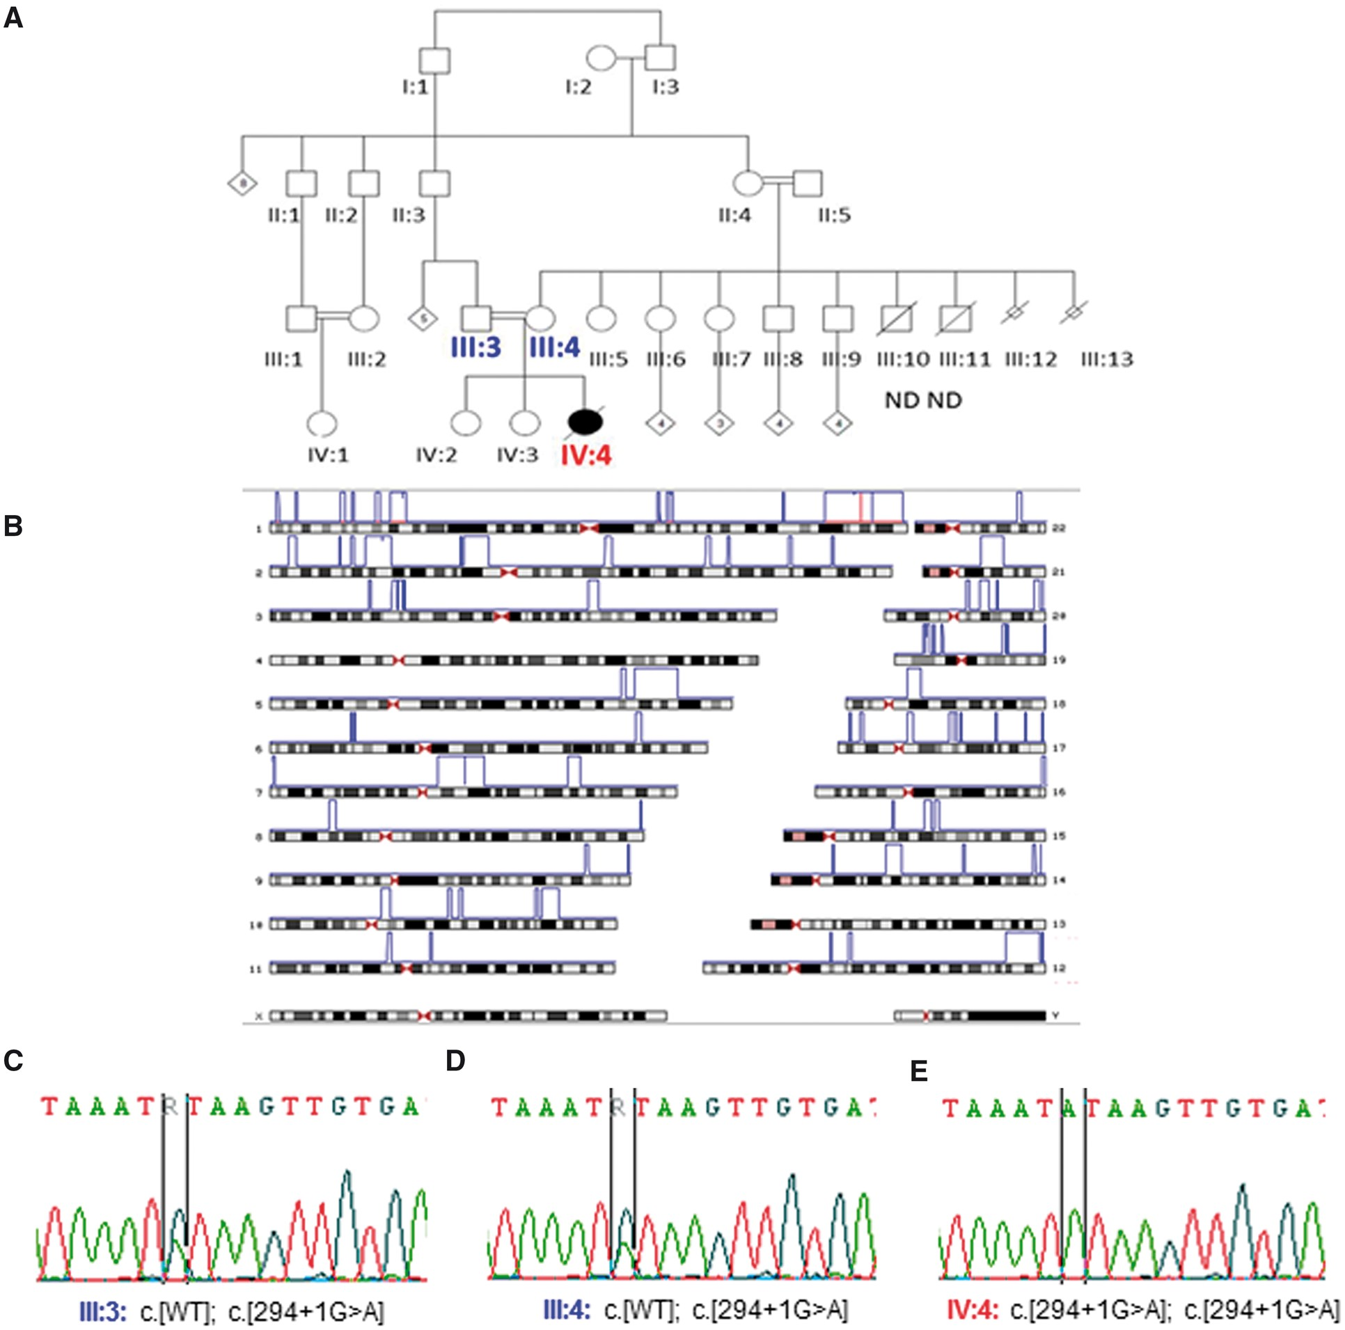
Figure 2. Pedigree, homozygosity mapping, and Sanger sequencing. (A) Pedigree for the proband’s family. The proband is ...
Notes:
Figure 2. Pedigree, homozygosity mapping, and Sanger sequencing. (A) Pedigree for the proband’s family. The proband is IV:4. (B) Homozygosity mapping for the proband. Parental homozygous regions are subtracted from the Proband (blue); candidate gene ARV1 shown in red on Chromosome 1. (C and D) Each parent (III:3 and III:4) is heterozygous for the splice variant. (E) The proband IV:4 is homozygous for splice site variant ARV1_NM_022786: c.294 + 1G > A. The unaffected siblings are either heterozygous or homozygous for reference allele- results not shown for confidentiality. Abbreviations: WT, wild type; ND, neonatal death.
Unless provided in the caption above, the following copyright applies to the content of this slide: © The Author 2016. Published by Oxford University Press. All rights reserved. For permissions, please e-mail: journals.permissions@oup.com

Slide 3
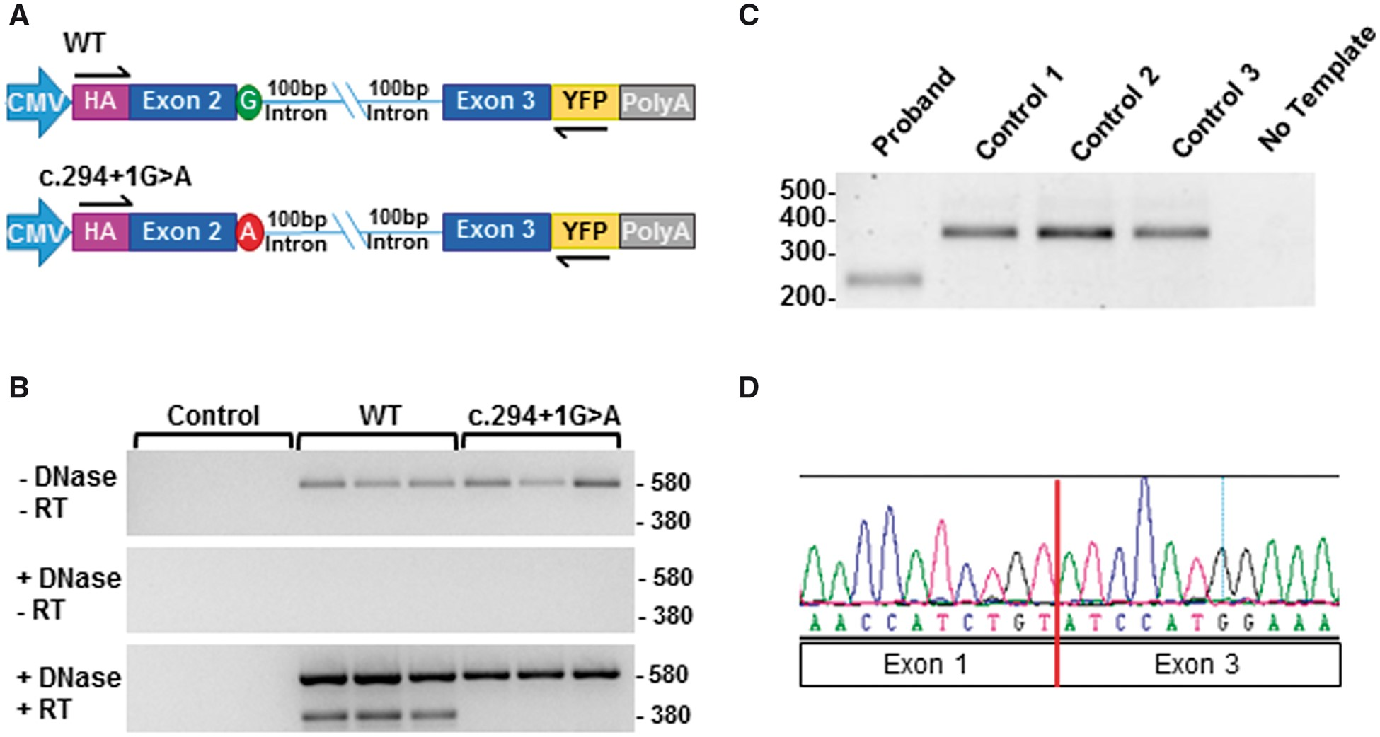
Figure 3. Impact of the ARV1 c.294 + 1G > A variant on splicing. (A) Schematic of minigene constructs used for splicing ...
Notes:
Figure 3. Impact of the ARV1 c.294 + 1G > A variant on splicing. (A) Schematic of minigene constructs used for splicing assay. The c.294 + 1G > A variant (red circle) occurs at the first intronic base after Exon 2. (B) Agarose gel image of minigene splicing assay. HEK293T cells were left untreated (Control) or transfected with WT or c.294 + 1G > A minigenes. The unspliced mRNA (or plasmid DNA) yields 580 bp and the spliced product is 380 bp. (C) Agarose gel image of RT-PCR products spanning from exon 1-4 in fibroblasts from the proband and three control samples. The WT transcript amplifies a predicted 322 bp band, while the proband sample produced a 202 bp fragment. (D) Chromatogram of the proband amplicon indicating skipping of Exon 2.
Unless provided in the caption above, the following copyright applies to the content of this slide: © The Author 2016. Published by Oxford University Press. All rights reserved. For permissions, please e-mail: journals.permissions@oup.com

Slide 4
Figure 4. Complementation assay for Gly189Arg and Lys59_Asn98Del variants in yeast. WT and arv1Δ Saccharomyces ...
Notes:
Figure 4. Complementation assay for Gly189Arg and Lys59_Asn98Del variants in yeast. WT and arv1Δ Saccharomyces cerevisiae strains were transformed with empty pRS426 (2μ, URA3), or pRS426 containing ScARV1, hARV1, hARV1-G189R, or hARV1-K56_N98Del. Strains were grown to stationary phase, then spotted onto standard Ura3 dropout media in a 1:2 dilution series from 0.1 OD600/mL. Plates were incubated at permissive (30 °C) or restrictive (37 °C) temperature for 72h.
Unless provided in the caption above, the following copyright applies to the content of this slide: © The Author 2016. Published by Oxford University Press. All rights reserved. For permissions, please e-mail: journals.permissions@oup.com

Slide 5
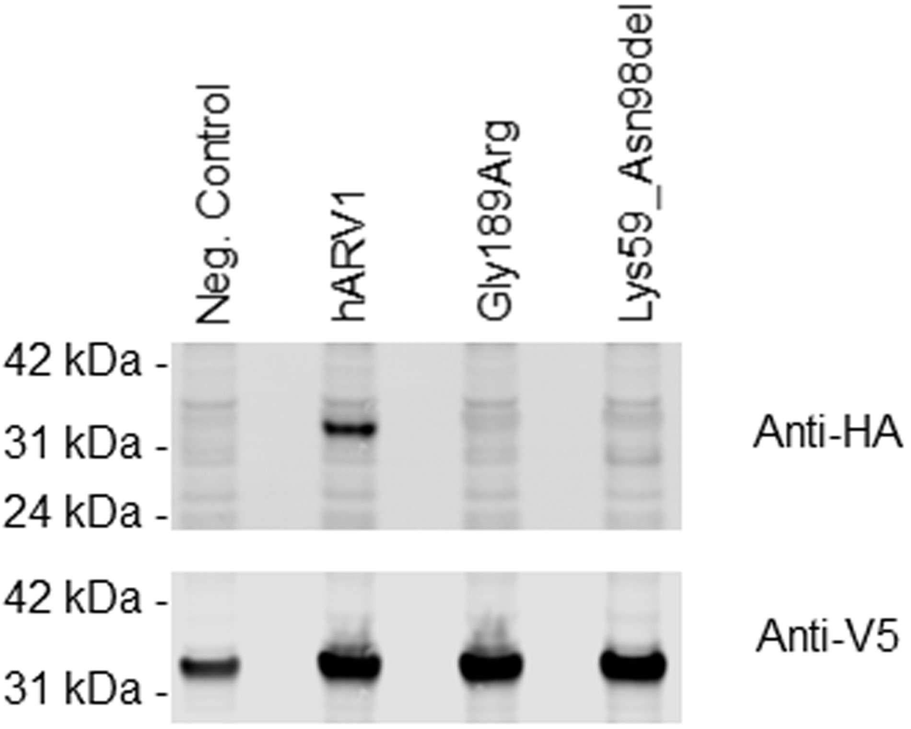
Figure 5. Protein expression of the Gly189Arg and Lys59_Asn98Del variants. Western blot of HEK293T cells transiently ...
Notes:
Figure 5. Protein expression of the Gly189Arg and Lys59_Asn98Del variants. Western blot of HEK293T cells transiently transfected with GFP (Neg. Control), WT, Gly189Arg, or Lys59_Asn98Del ARV1 constructs containing an N-terminal 3XFLAG-HA epitope tag, and detected with an anti-HA antibody (top). Cells were co-transfected with mKate2 (red fluorescent protein) which was detected with an anti-V5 antibody as a transfection and loading control (bottom). The expected sizes of epitope tagged ARV1 proteins are: WT and Gly189Arg: 36 kDa, and Lys59_Asn98Del: 31 kDa.
Unless provided in the caption above, the following copyright applies to the content of this slide: © The Author 2016. Published by Oxford University Press. All rights reserved. For permissions, please e-mail: journals.permissions@oup.com

Slide 6
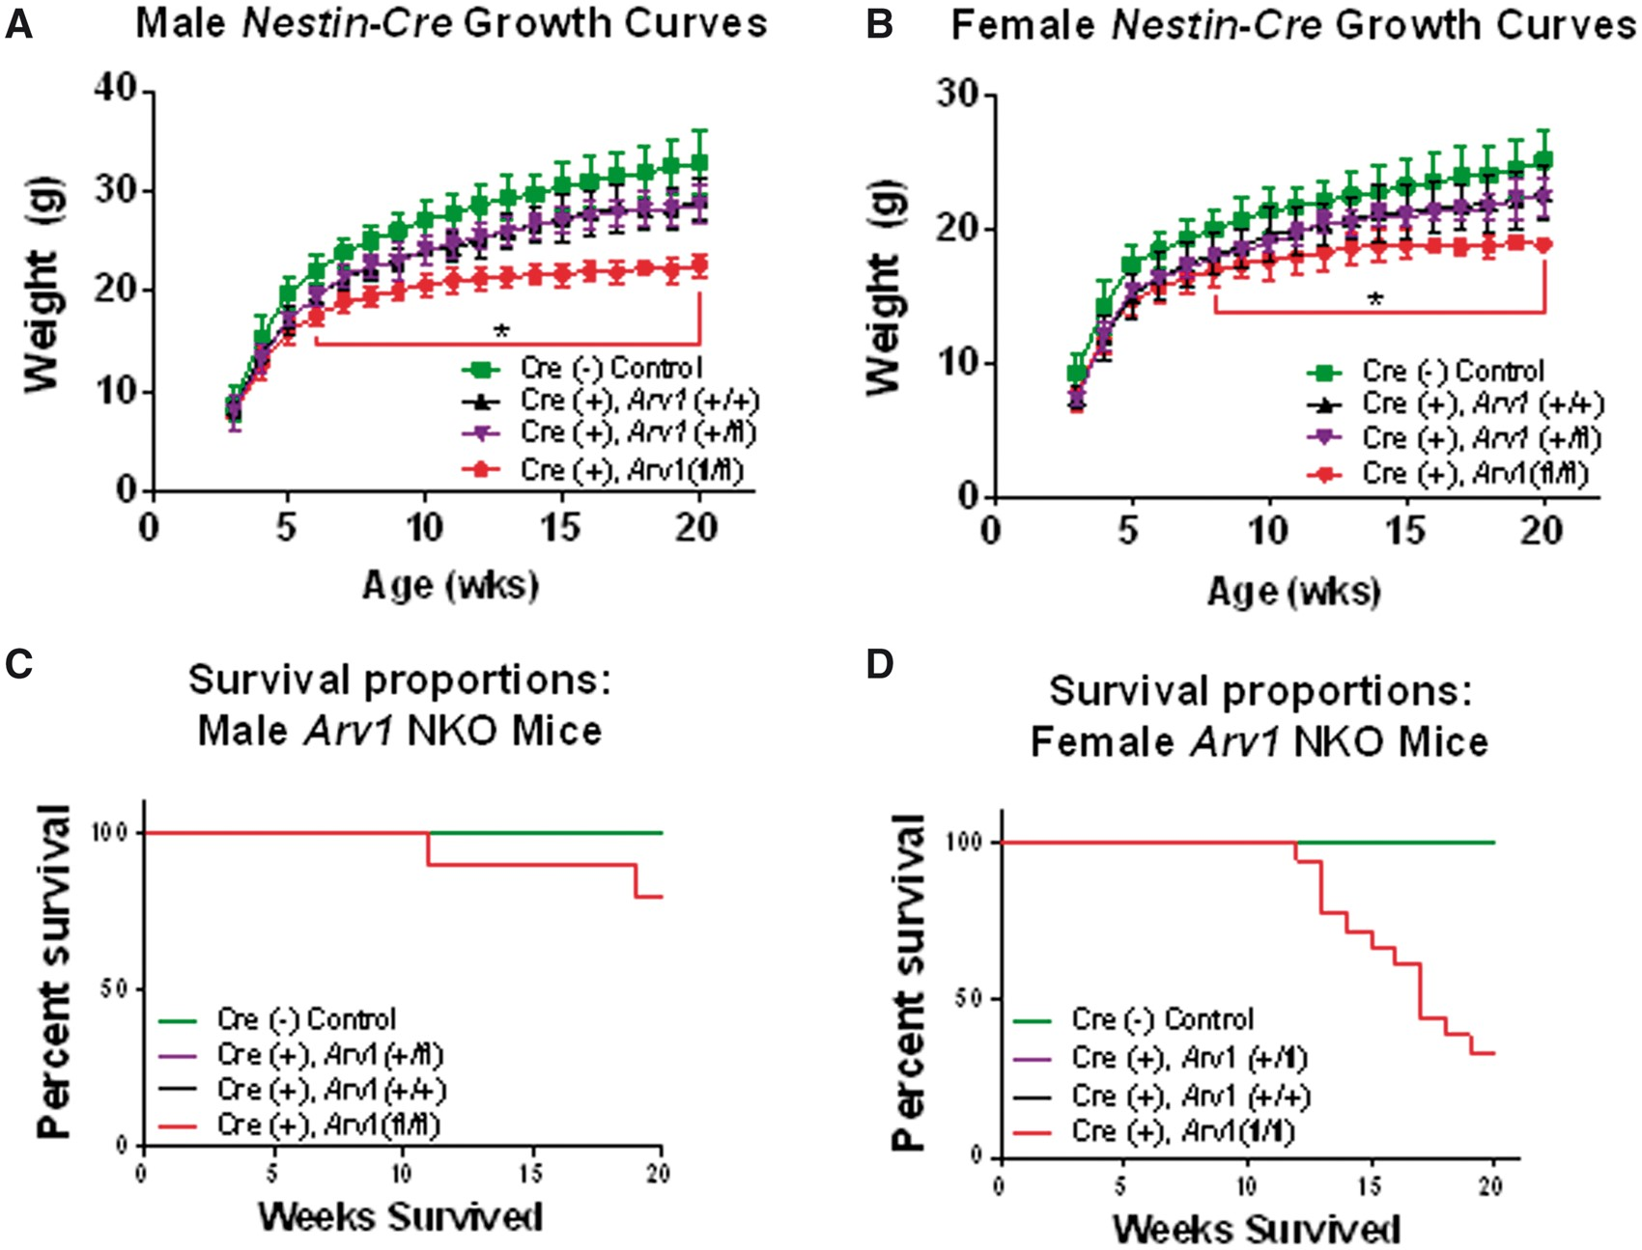
Figure 6. Growth and survival of Arv1 NKO mice. Mice were maintained on a standard chow diet and weighed weekly ...
Notes:
Figure 6. Growth and survival of Arv1 NKO mice. Mice were maintained on a standard chow diet and weighed weekly beginning at weaning (3 weeks) through 20 weeks of age. (A) Male growth curves: Cre− Control (n = 28–34); Cre+ Arv1+/+ (n = 6–12); Cre+ Arv1+/fl (n = 4–9); Cre+ Arv1fl/fl (n = 7–12). (B) Female growth curves: Cre− Control (n = 23–31); Cre+ Arv1+/+ (n = 8–9); Cre+ Arv1+/fl (n = 5–6); Cre+ Arv1fl/fl (n = 6–20). Survival was tracked from birth through 20 weeks of age. No spontaneous deaths were observed in the control genotypes for males or females. (C) Male survival curves. By 20 weeks of age, 20% of male Cre+ Arv1fl/fl mice spontaneously died: Cre- Control (n = 18); Cre+ Arv1+/+ (n = 6); Cre+ Arv1+/fl (n = 9); Cre+ Arv1fl/fl (n = 10); Mantel-Cox Log-rank test p = 0.073. (D) Female survival curves. By 20 weeks of age, 67% of Cre+ Arv1fl/fl female mice spontaneously die: Cre− Control (n = 17); Cre+ Arv1+/+ (n = 8); Cre+ Arv1+/fl (n = 5); Cre+ Arv1fl/fl (n = 18); Mantel-Cox Log-rank test P =0.0053. Data in panels A and B are mean ± SD.
Unless provided in the caption above, the following copyright applies to the content of this slide: © The Author 2016. Published by Oxford University Press. All rights reserved. For permissions, please e-mail: journals.permissions@oup.com

