Slide 1
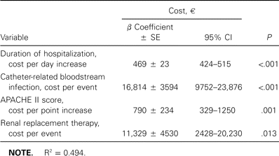
Table 5 Linear regression analysis adjusted for covariates to assess relationships with total hospital costs in ...
Notes:
Table 5 Linear regression analysis adjusted for covariates to assess relationships with total hospital costs in Euros.
Unless provided in the caption above, the following copyright applies to the content of this slide: © 2005 by the Infectious Diseases Society of America

Slide 2
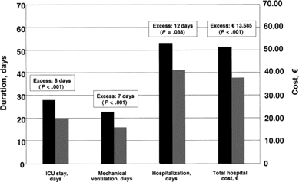
Figure 2 Economic determinants for critically ill patients with catheter-related bloodstream infection (n = 176) and ...
Notes:
Figure 2 Economic determinants for critically ill patients with catheter-related bloodstream infection (n = 176) and for matched control patients (n = 315). Black bars represent patients with catheter-related bloodstream infection, and gray bars represent matched control patients. Values are expressed as medians, and excesses are calculated by subtracting the median value for the control subjects from the median value for the patients with catheter-related bloodstream infection.
Unless provided in the caption above, the following copyright applies to the content of this slide: © 2005 by the Infectious Diseases Society of America

Slide 3
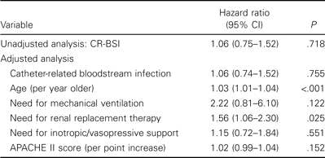
Table 4 Cox proportional-hazard regression analysis unadjusted and adjusted for covariates to assess the relationship ...
Notes:
Table 4 Cox proportional-hazard regression analysis unadjusted and adjusted for covariates to assess the relationship between catheter-related bloodstream infection (CR-BSI) and in-hospital mortality.
Unless provided in the caption above, the following copyright applies to the content of this slide: © 2005 by the Infectious Diseases Society of America

Slide 4
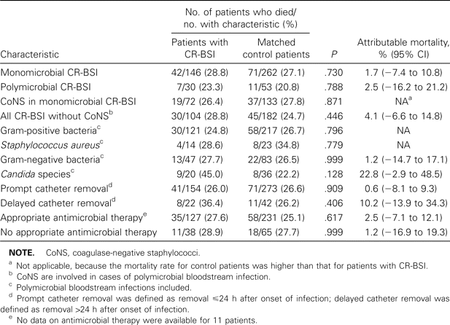
Table 3 In-hospital mortality rates for subgroups of critically ill patients with catheter-related bloodstream ...
Notes:
Table 3 In-hospital mortality rates for subgroups of critically ill patients with catheter-related bloodstream infection (CR-BSI) and matched control patients.
Unless provided in the caption above, the following copyright applies to the content of this slide: © 2005 by the Infectious Diseases Society of America

Slide 5
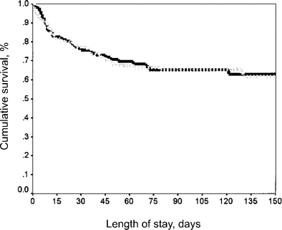
Figure 1 Survival curves for critically ill patients with catheter-related bloodstream infection and for matched ...
Notes:
Figure 1 Survival curves for critically ill patients with catheter-related bloodstream infection and for matched control patients. The black line represents patients with catheter-related bloodstream infection (n = 176), and the grey line represents matched control patients (n = 315; P = .812, by the log-rank test). Survival curves are drawn from the onset of the catheter-related bloodstream infection (for patients) or from the corresponding time in the intensive care unit (for matched control patients).
Unless provided in the caption above, the following copyright applies to the content of this slide: © 2005 by the Infectious Diseases Society of America

Slide 6
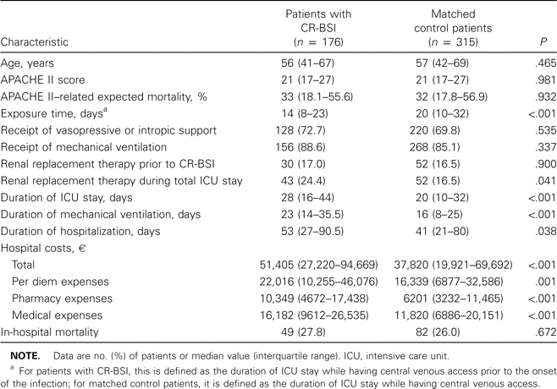
Table 2 Characteristics of critically ill patients with catheter-related bloodstream infection (CR-BSI) and matched ...
Notes:
Table 2 Characteristics of critically ill patients with catheter-related bloodstream infection (CR-BSI) and matched control patients.
Unless provided in the caption above, the following copyright applies to the content of this slide: © 2005 by the Infectious Diseases Society of America

Slide 7
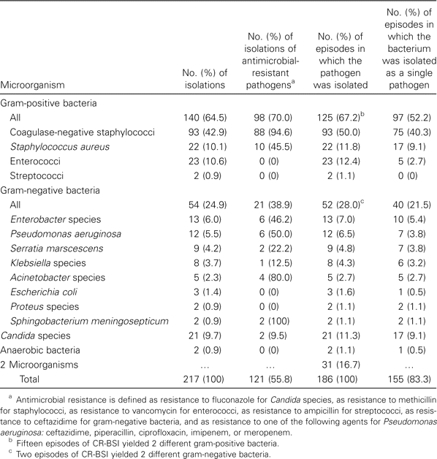
Table 1 Microorganisms involved in 186 episodes of nosocomial catheter-related bloodstream infection (CR-BSI).
Notes:
Table 1 Microorganisms involved in 186 episodes of nosocomial catheter-related bloodstream infection (CR-BSI).
Unless provided in the caption above, the following copyright applies to the content of this slide: © 2005 by the Infectious Diseases Society of America

