Slide 1
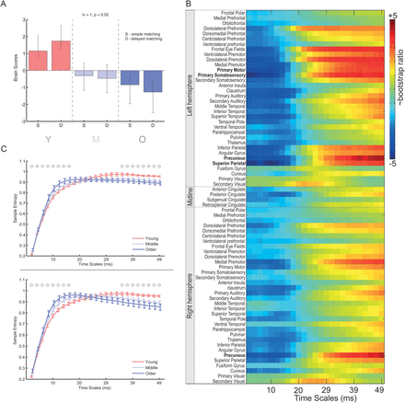
Figure 1. PLS result from the EEG data set for the comparison of age-related changes in MSE. (A) The bar graph depicts ...
Notes:
Figure 1. PLS result from the EEG data set for the comparison of age-related changes in MSE. (A) The bar graph depicts the data-driven contrast between age groups that was significantly expressed across the entire data set (source × timescales) as determined by permutation tests. (B) The statistical image plot represents the regional sources and timescale at which the contrast was most stable as determined by bootstrapping. Values represent the ratio of the parameter estimate for the source divided by the bootstrap-derived standard error (roughly z scores). Positive values indicate timescales and sources showing decreased MSE with age and negative values denote age-related increases. Text labels in bold font indicate regions where the bootstrap ratio is greater than 4.0. (C) Average MSE ( ±SE) curves for each group for the regional source in right precuneus for the simple (top) and delayed (bottom) matching tasks. Circle above the curves indicate the timepoints with reliable confidence intervals.
Unless provided in the caption above, the following copyright applies to the content of this slide: © The Authors 2013. Published by Oxford University Press.This is an Open Access article distributed under the terms of the Creative Commons Attribution License (http://creativecommons.org/licenses/by-nc/3.0/), which permits non-commercial use, distribution, and reproduction in any medium, provided the original work is properly cited. For commercial re-use, please contact journals.permissions@oup.com

Slide 2
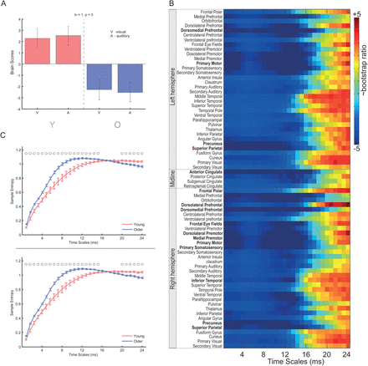
Figure 2. PLS result from the MEG data set for the comparison of age-related changes in MSE. (A) The bar graph depicts ...
Notes:
Figure 2. PLS result from the MEG data set for the comparison of age-related changes in MSE. (A) The bar graph depicts the data-driven contrast between age groups that was significantly expressed across the entire data set (source × timescales) as determined by permutation tests. (B) The statistical image plot represents the regional sources and timescale at which the contrast was most stable as determined by bootstrapping. Values represent the ratio of the parameter estimate for the source divided by the bootstrap-derived standard error (roughly z scores). Positive values indicate timescales and sources showing decreased MSE with age and negative values denote age-related increases. Text labels in bold font indicate regions where the bootstrap ratio is greater than 4.0. (C) Average MSE (±SE) curves for each group for the regional source in right dorsolateral prefrontal cortex for auditory (top) and visual (bottom). Circle above the curves indicate the timepoints with reliable confidence intervals.
Unless provided in the caption above, the following copyright applies to the content of this slide: © The Authors 2013. Published by Oxford University Press.This is an Open Access article distributed under the terms of the Creative Commons Attribution License (http://creativecommons.org/licenses/by-nc/3.0/), which permits non-commercial use, distribution, and reproduction in any medium, provided the original work is properly cited. For commercial re-use, please contact journals.permissions@oup.com

Slide 3
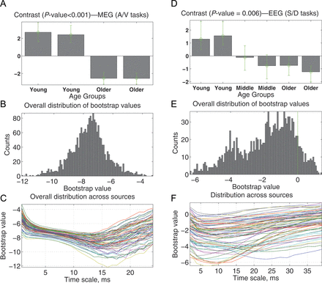
Figure 3. Age-related changes in local entropy: MEG (left) and EEG (right), from the PLS analysis. Panels (A and (D) ...
Notes:
Figure 3. Age-related changes in local entropy: MEG (left) and EEG (right), from the PLS analysis. Panels (A and (D) illustrate the data-driven contrasts. Expression of these trends is shown in (B) and (E) as the distributions of all the bootstrap ratio values for all regional sources. The same bootstrap ratio values are plotted in (C) and (F) as functions of timescales.
Unless provided in the caption above, the following copyright applies to the content of this slide: © The Authors 2013. Published by Oxford University Press.This is an Open Access article distributed under the terms of the Creative Commons Attribution License (http://creativecommons.org/licenses/by-nc/3.0/), which permits non-commercial use, distribution, and reproduction in any medium, provided the original work is properly cited. For commercial re-use, please contact journals.permissions@oup.com

Slide 4
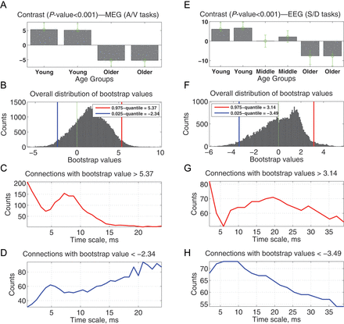
Figure 4. Age-related changes in distributed entropy: MEG (left) and EEG (right), from the PLS analysis. Panels (A) and ...
Notes:
Figure 4. Age-related changes in distributed entropy: MEG (left) and EEG (right), from the PLS analysis. Panels (A) and (E) illustrate the data-driven contrasts. Expression of these trends is shown in (B) and (G) as the distributions of all the bootstrap ratio values for the distributed entropy between each pair of regional sources. The strengths of the effects related to a decrease (C,G) and increase (D,H) in distributed entropy are plotted as the number of connections whose bootstrap ratio values belong to the corresponding 2.5% tails.
Unless provided in the caption above, the following copyright applies to the content of this slide: © The Authors 2013. Published by Oxford University Press.This is an Open Access article distributed under the terms of the Creative Commons Attribution License (http://creativecommons.org/licenses/by-nc/3.0/), which permits non-commercial use, distribution, and reproduction in any medium, provided the original work is properly cited. For commercial re-use, please contact journals.permissions@oup.com

Slide 5
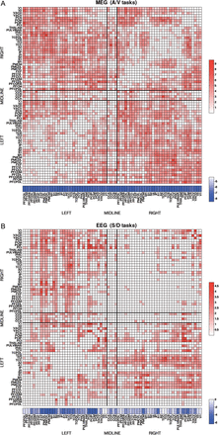
Figure 5. Matrix showing bootstrap ratios for pairwise age-related decreases in distributed entropy based on (A) MEG ...
Notes:
Figure 5. Matrix showing bootstrap ratios for pairwise age-related decreases in distributed entropy based on (A) MEG data; (B) EEG data. Plotted in the matrices, from the 7 ms timescale for MEG and 20 ms for EEG, are the connections associated with the bootstrap ratio values that are larger than one. The corresponding distribution of the bootstrap ratio values for local entropy across brain regions is shown below the matrix.
Unless provided in the caption above, the following copyright applies to the content of this slide: © The Authors 2013. Published by Oxford University Press.This is an Open Access article distributed under the terms of the Creative Commons Attribution License (http://creativecommons.org/licenses/by-nc/3.0/), which permits non-commercial use, distribution, and reproduction in any medium, provided the original work is properly cited. For commercial re-use, please contact journals.permissions@oup.com

Slide 6
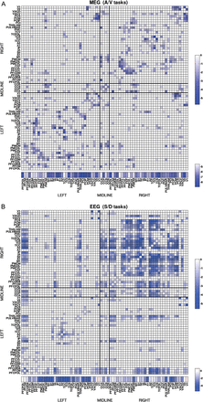
Figure 6. Matrix showing bootstrap ratios for pairwise age-related increases in distributed entropy based on (A) MEG ...
Notes:
Figure 6. Matrix showing bootstrap ratios for pairwise age-related increases in distributed entropy based on (A) MEG data; (B) EEG data. Plotted in the matrices, from the 27 ms timescale for MEG and 8 ms for EEG, are the connections associated with the bootstrap ratio values that are larger than one. The corresponding distribution of the bootstrap ratio values for local entropy across brain regions is shown below the matrix.
Unless provided in the caption above, the following copyright applies to the content of this slide: © The Authors 2013. Published by Oxford University Press.This is an Open Access article distributed under the terms of the Creative Commons Attribution License (http://creativecommons.org/licenses/by-nc/3.0/), which permits non-commercial use, distribution, and reproduction in any medium, provided the original work is properly cited. For commercial re-use, please contact journals.permissions@oup.com

