Slide 1
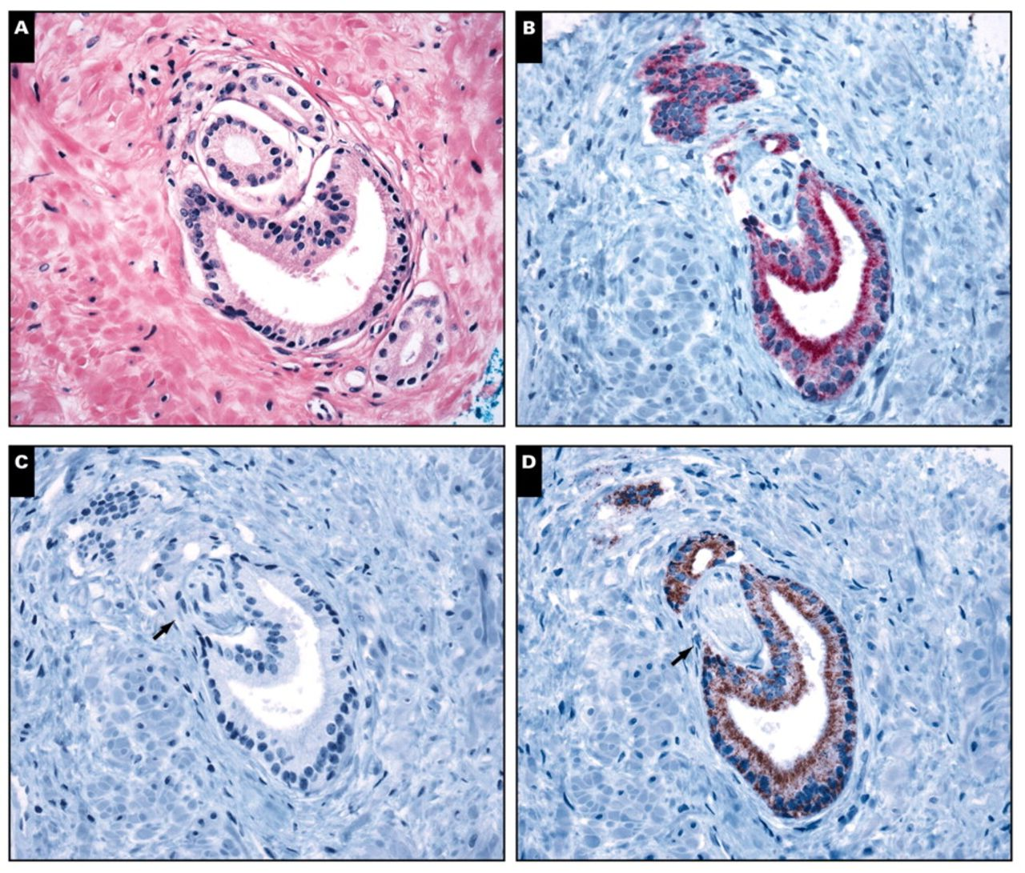
Image 1 A, Microfocus of prostatic adenocarcinoma (H&E, ×400). B, Cancer glands show strong cytoplasmic staining by ...
Notes:
Image 1 A, Microfocus of prostatic adenocarcinoma (H&E, ×400). B, Cancer glands show strong cytoplasmic staining by α-methylacyl coenzyme A racemase (AMACR; red) and are negative for cytokeratin (CK)5/6, which can be appreciated on the same slide stained by double immunohistochemical analysis for AMACR and CK5/6 (×400). C and D, Same microfocus represented on separately stained slides for CK5/6 and AMACR (C and D, ×400). Perineural invasion is apparent only on the immunohistochemically stained slides (B, C, and D, arrow).
Unless provided in the caption above, the following copyright applies to the content of this slide: © American Society for Clinical Pathology

Slide 2
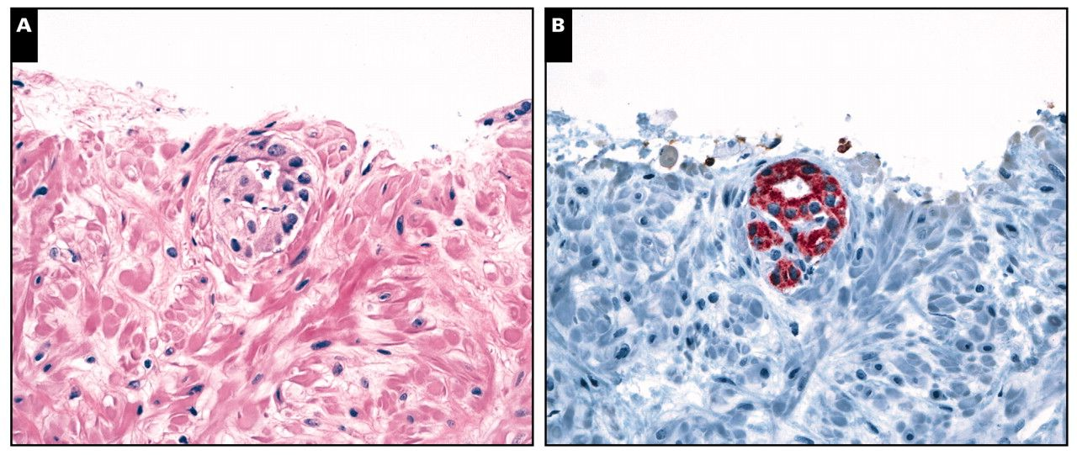
Image 3 A and B, Microfocus consisting of a single atypical and “suspicious” gland, which appears close to the edge ...
Notes:
Image 3 A and B, Microfocus consisting of a single atypical and “suspicious” gland, which appears close to the edge of the core (A, H&E, ×400). The gland shows strong cytoplasmic α-methylacyl coenzyme A racemase (AMACR) staining and is negative for cytokeratin (CK)5/6 (B, double immunohistochemical stain, AMACR-CK5/6, ×400). In the absence of additional glands on deeper levels, a diagnosis of adenocarcinoma cannot be established with certainty, despite a “malignant” immunoprofile (positive AMACR, negative CK5/6).
Unless provided in the caption above, the following copyright applies to the content of this slide: © American Society for Clinical Pathology

Slide 3
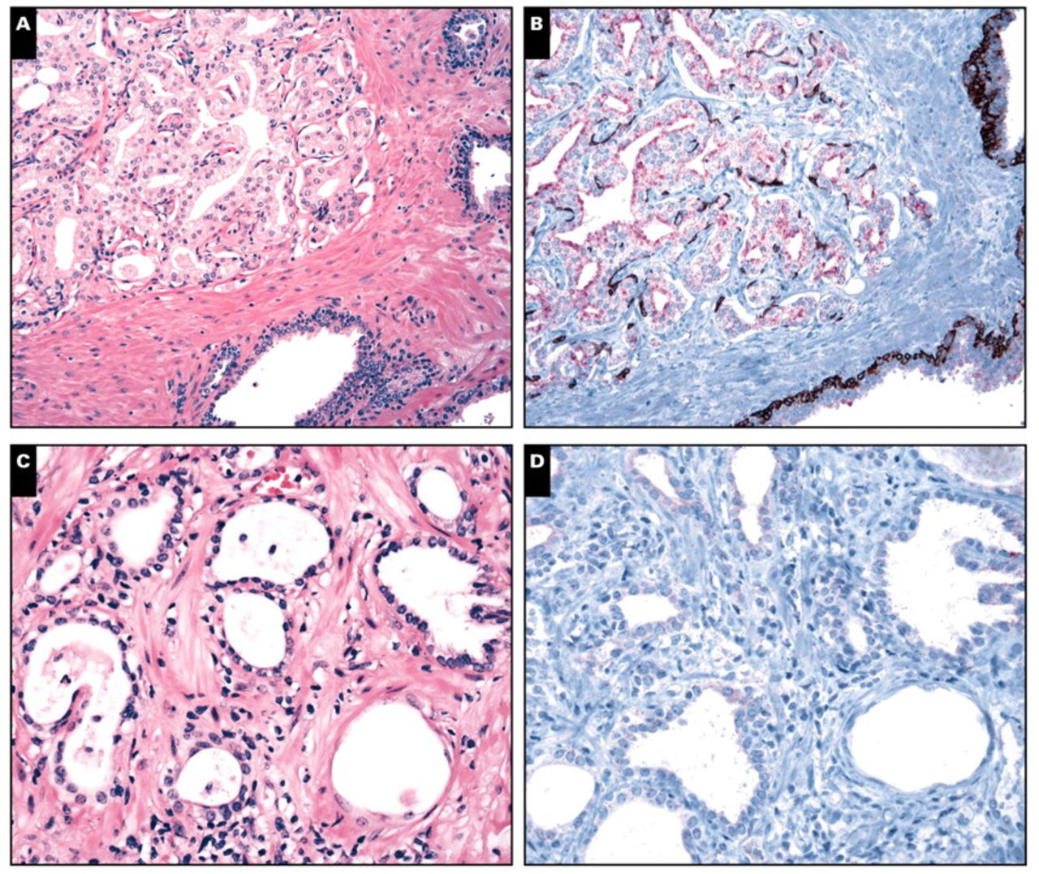
Image 4 A and B, Adenosis (or atypical adenomatous hyperplasia), a benign mimicker of prostate cancer (A, H&E, ×200). ...
Notes:
Image 4 A and B, Adenosis (or atypical adenomatous hyperplasia), a benign mimicker of prostate cancer (A, H&E, ×200). There is fragmented and focal basal cell staining for cytokeratin (CK)5/6, whereas α-methylacyl coenzyme A racemase (AMACR) shows subluminal staining that is weak to moderate (B, double immunohistochemical stain, AMACR-CK5/6, ×200). C and D, Partial atrophy, another benign mimicker of prostate cancer (C, H&E, ×400), shows complete lack of basal cells and is negative for CK5/6. AMACR is essentially negative in this focus of partial atrophy, and there is only focal and faint cytoplasmic positivity (D, double immunohistochemical stain, AMACR-CK5/6, ×400).
Unless provided in the caption above, the following copyright applies to the content of this slide: © American Society for Clinical Pathology

