Slide 1
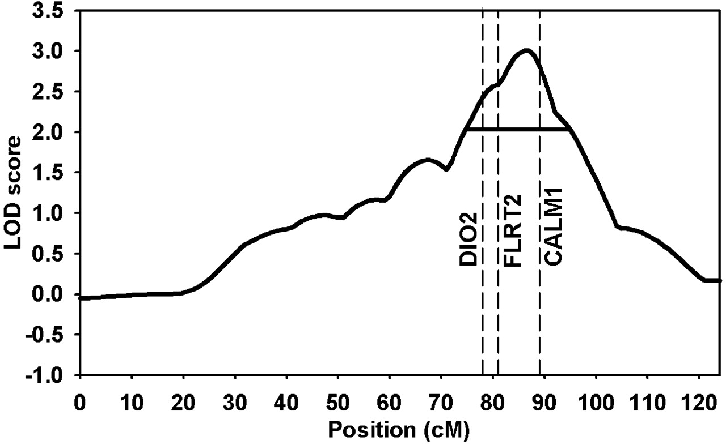
Figure 1. Suggestive evidence for linkage was observed on chromosome 14q32.11 using 179 Caucasian sibling pairs and ...
Notes:
Figure 1. Suggestive evidence for linkage was observed on chromosome 14q32.11 using 179 Caucasian sibling pairs and four trios from the GARP study. Horizontal line represents one LOD-drop interval [75–95 cM; mean informativity = 0.50 (range, 0.46–0.56)]. Three vertical lines represent the genes DIO2 (78 cM; informativity = 0.51), FLRT2 (82 cM; informativity = 0.54) and CALM1 (89 cM; informativity = 0.47).
Unless provided in the caption above, the following copyright applies to the content of this slide: © The Author 2008. Published by Oxford University Press. All rights reserved. For Permissions, please email: journals.permissions@oxfordjournals.org

