Slide 1
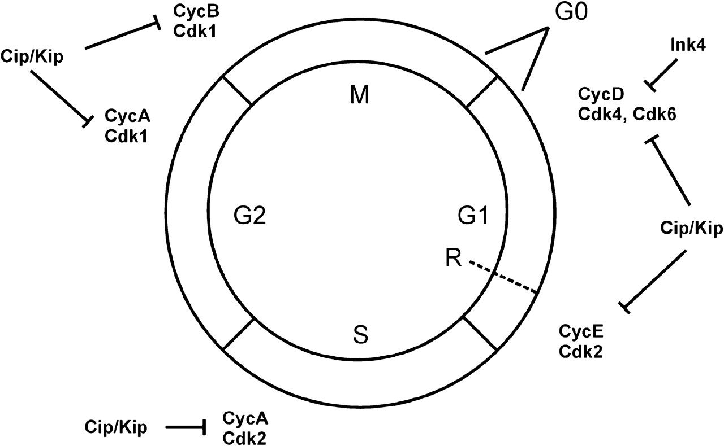
Figure 1. Schematic illustration of the involvement of cell cycle regulatory proteins in cell division. During the cell ...
Notes:
Figure 1. Schematic illustration of the involvement of cell cycle regulatory proteins in cell division. During the cell division cycle, expression and activity of Cdks and cyclins, the positive regulatory subunits of Cdks, are regulated in a phase-dependent manner. The activity of cyclin–Cdk complexes is negatively controlled by inhibitors of the Ink4 family (p15Ink4b, p16Ink4a, p18Ink4c, p19Ink4d) and of the Cip/Kip family (p21Waf1/Cip1, p27Kip1, p57Kip2). G0, stationary phase; G1, first gap phase; R, restriction point; S, DNA synthesis phase; G2, second gap phase; M, mitosis phase.
Unless provided in the caption above, the following copyright applies to the content of this slide: © The Author 2006. Published by Oxford University Press. All rights reserved. For permissions, please e-mail: journals.permissions@oxfordjournals.org

Slide 2
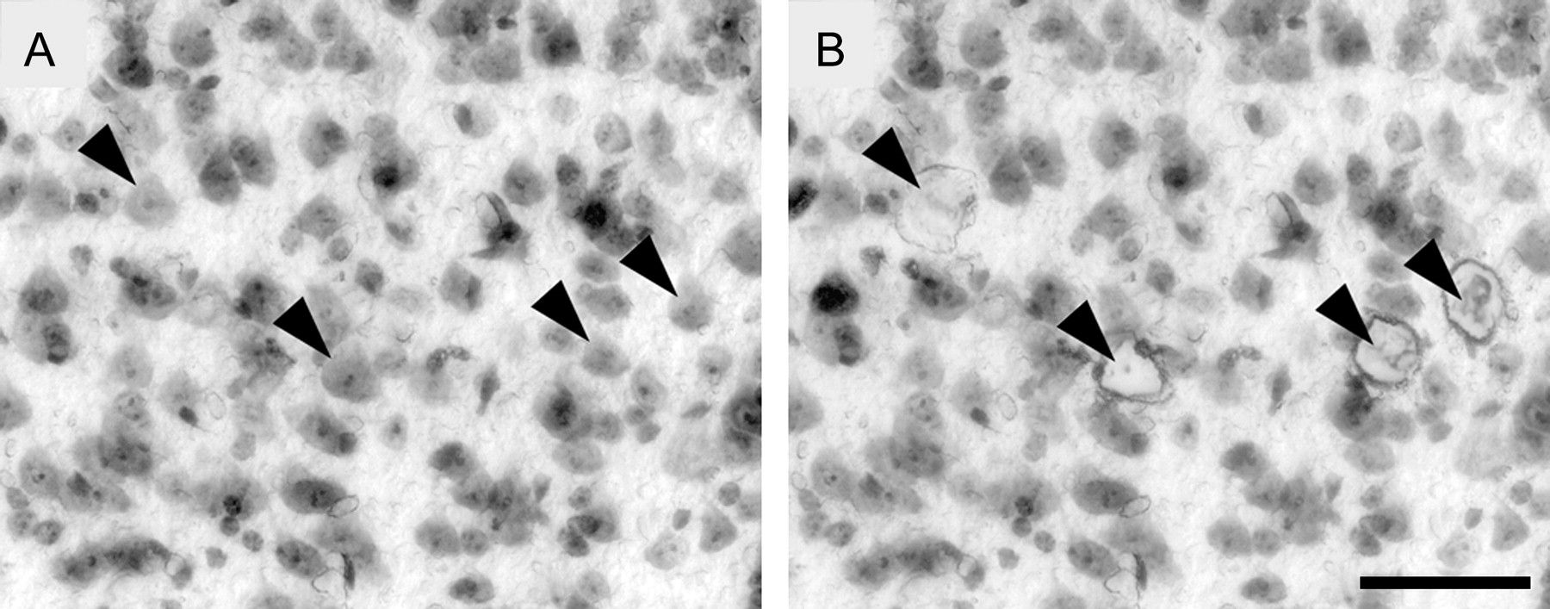
Figure 2. Photomicrographs of a coronal frozen Nissl-stained section before (A) and after (B) laser microdissection of ...
Notes:
Figure 2. Photomicrographs of a coronal frozen Nissl-stained section before (A) and after (B) laser microdissection of single layer V pyramidal neurons. Corresponding cell locations are indicated by arrow heads. Bar in (B) (also refers to A): 50 μm.
Unless provided in the caption above, the following copyright applies to the content of this slide: © The Author 2006. Published by Oxford University Press. All rights reserved. For permissions, please e-mail: journals.permissions@oxfordjournals.org

Slide 3
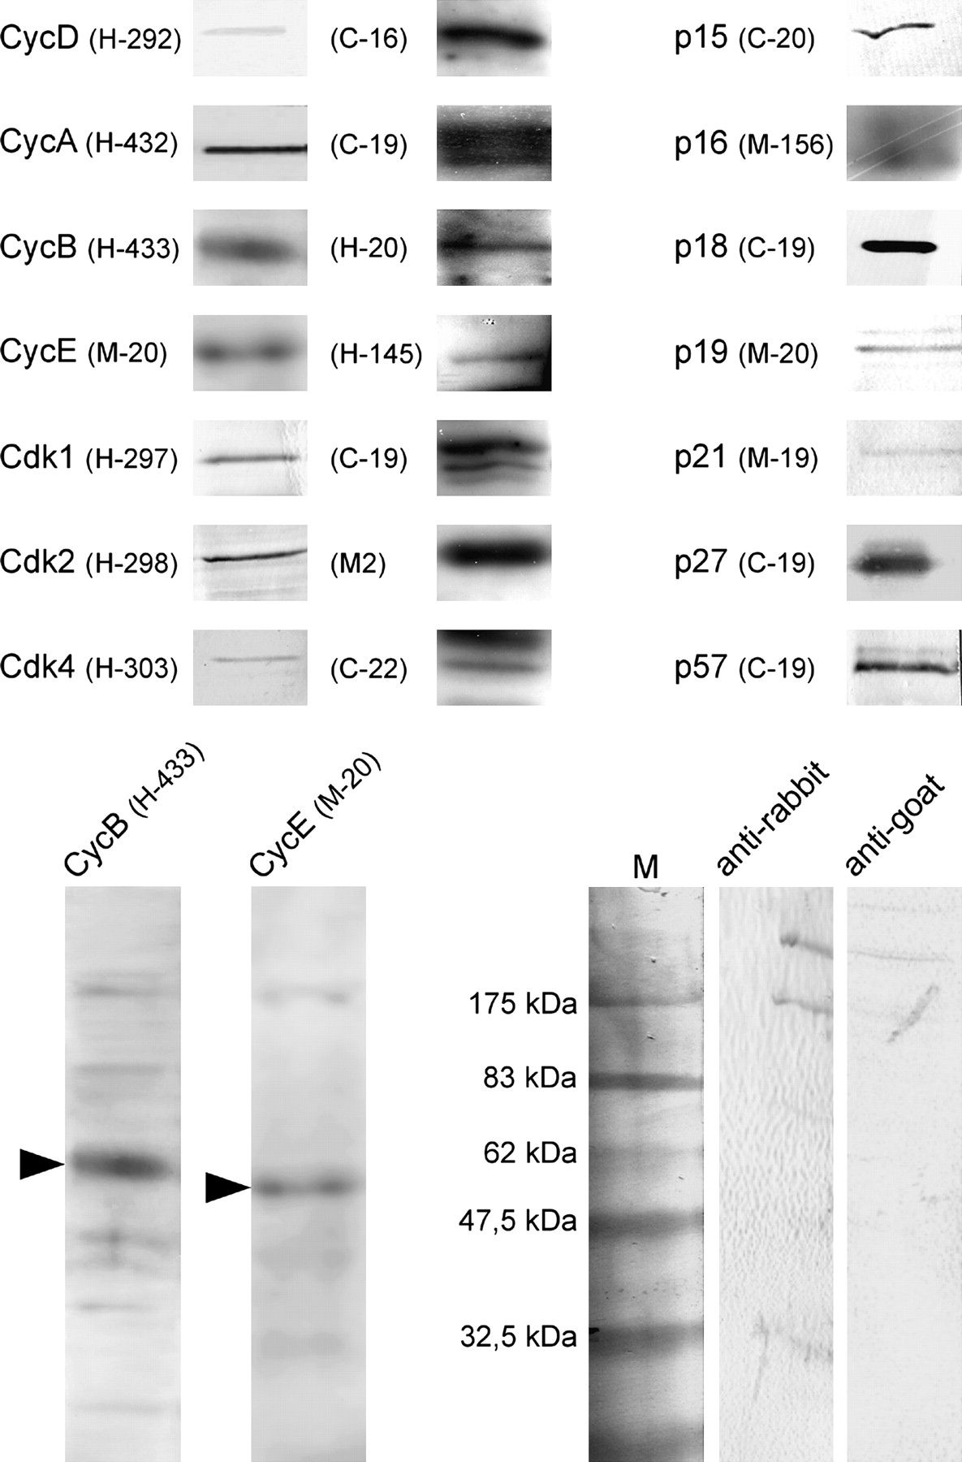
Figure 3. Detection of cell cycle–related proteins by western blot. Crude homogenate of neocortical tissue was ...
Notes:
Figure 3. Detection of cell cycle–related proteins by western blot. Crude homogenate of neocortical tissue was separated by 12% SDS-PAGE, transferred to polyvinylidene fluoride membrane, and probed with the primary antisera listed in Table 1. Noncropped western blots of cyclins B and E are provided to evaluate significance of dendritic staining. Control incubations in the absence of primary antisera show no labeling (at the right bottom).
Unless provided in the caption above, the following copyright applies to the content of this slide: © The Author 2006. Published by Oxford University Press. All rights reserved. For permissions, please e-mail: journals.permissions@oxfordjournals.org

Slide 4
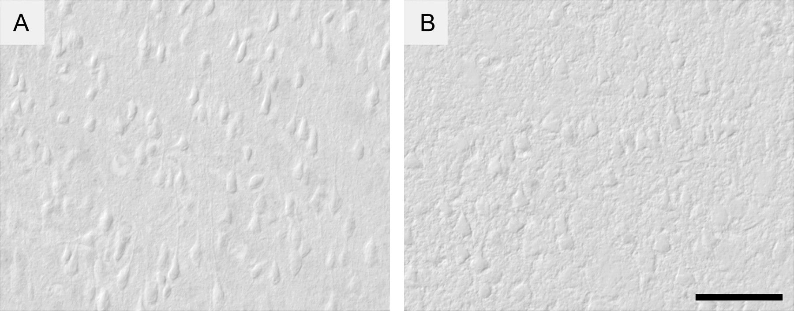
Figure 4. Control sections of adult brain incubated in the absence of primary antisera showed no immunostaining. (A) ...
Notes:
Figure 4. Control sections of adult brain incubated in the absence of primary antisera showed no immunostaining. (A) anti-rabbit antiserum, (B) anti-goat antiserum. Bar in (B) (also refers to A): 50 μm.
Unless provided in the caption above, the following copyright applies to the content of this slide: © The Author 2006. Published by Oxford University Press. All rights reserved. For permissions, please e-mail: journals.permissions@oxfordjournals.org

Slide 5
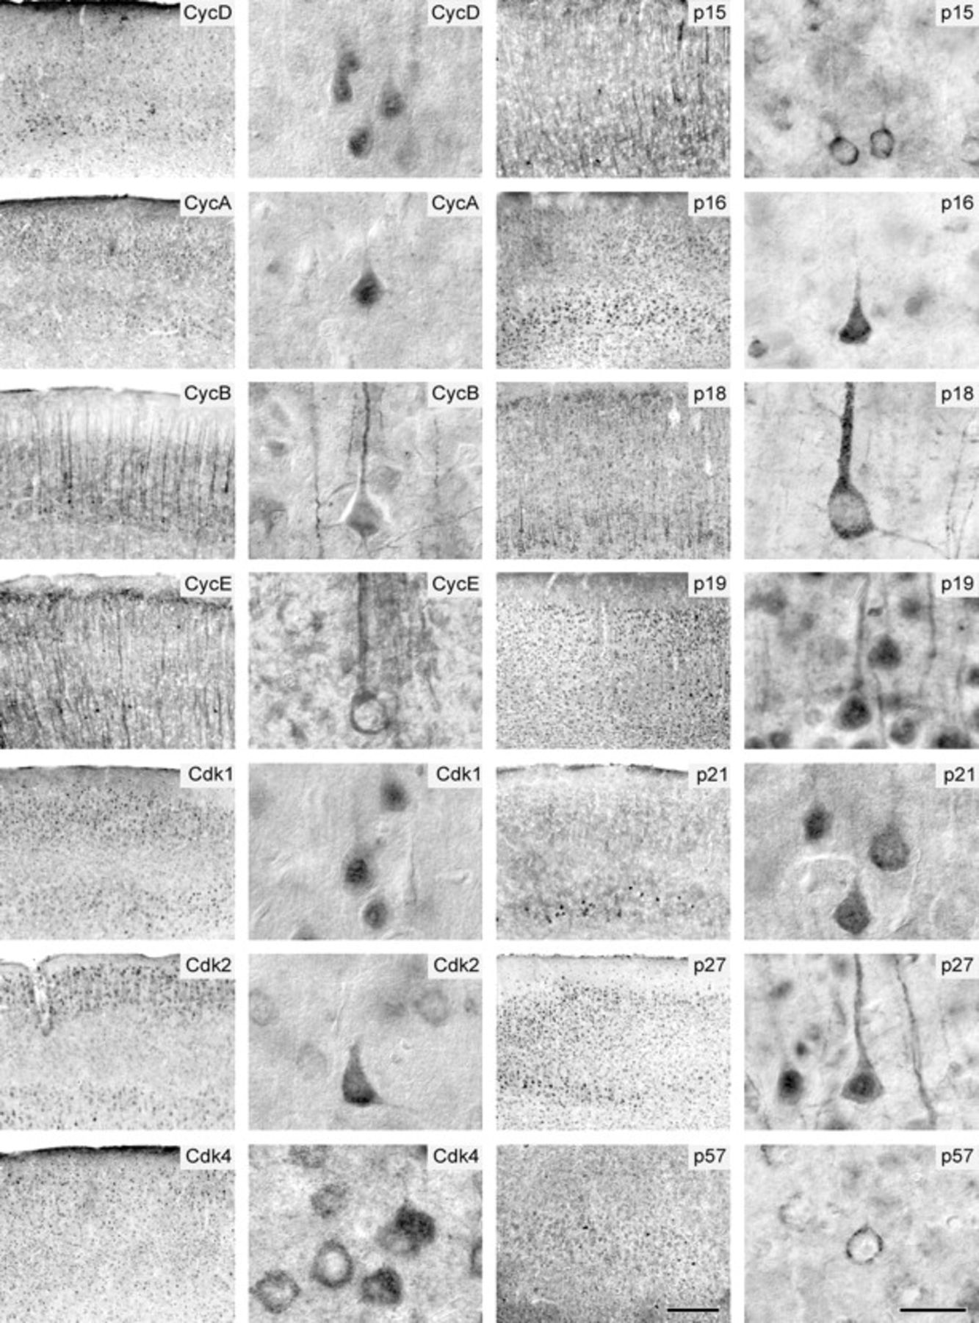
Figure 5. Immunohistochemical localization of cyclins, Cdks, and Cdkis in the somatosensory cortex of adult mouse brain ...
Notes:
Figure 5. Immunohistochemical localization of cyclins, Cdks, and Cdkis in the somatosensory cortex of adult mouse brain at 2 different magnifications thereby zooming in on layer V neurons. Bar at bottom of third column (also refers to first column): 200 μm. Bar at bottom of fourth column (also refers to second column): 25 μm.
Unless provided in the caption above, the following copyright applies to the content of this slide: © The Author 2006. Published by Oxford University Press. All rights reserved. For permissions, please e-mail: journals.permissions@oxfordjournals.org

Slide 6
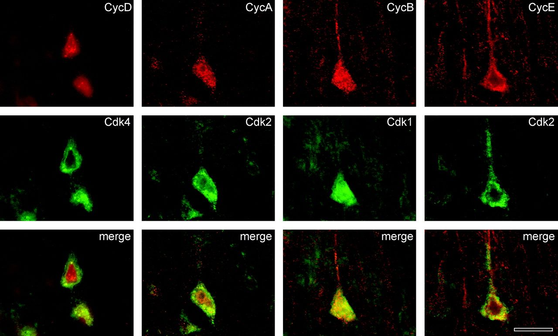
Figure 6. Double-fluorescence immunolabeling showing the cellular colocalization of cyclin D-Cdk4 (H-292, H-303), ...
Notes:
Figure 6. Double-fluorescence immunolabeling showing the cellular colocalization of cyclin D-Cdk4 (H-292, H-303), cyclin A-Cdk2 (H-432, H-298), cyclin B-Cdk1 (H-433, H-297), and cyclin E-Cdk2 (M-20, H-298). Corresponding images are arranged in columns. Bar at bottom of fourth column: 20 μm.
Unless provided in the caption above, the following copyright applies to the content of this slide: © The Author 2006. Published by Oxford University Press. All rights reserved. For permissions, please e-mail: journals.permissions@oxfordjournals.org

Slide 7
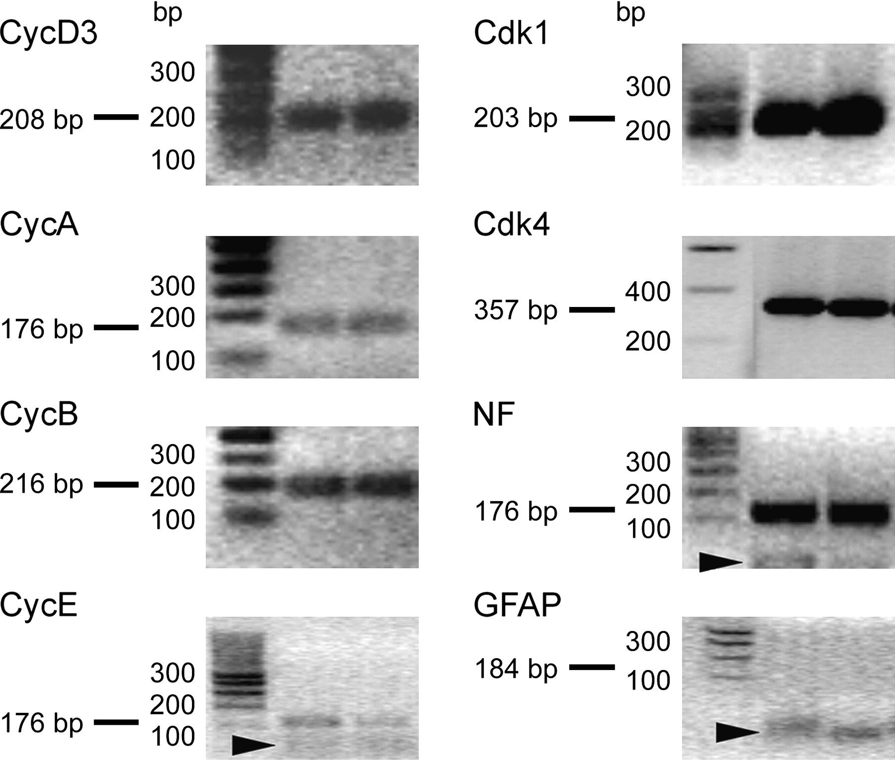
Figure 7. Visualization of PCR products in 2% agarose gel after staining with ethidium bromide verifies the correct ...
Notes:
Figure 7. Visualization of PCR products in 2% agarose gel after staining with ethidium bromide verifies the correct target sequence amplification. Simultaneous detection of neurofilament H (NF-H) message but not of gilal fibrillary acidic protein (GFAP) mRNA ensured that only neuronal cells were included in the analysis. Arrow heads point to unspecific primer dimers.
Unless provided in the caption above, the following copyright applies to the content of this slide: © The Author 2006. Published by Oxford University Press. All rights reserved. For permissions, please e-mail: journals.permissions@oxfordjournals.org

Slide 8
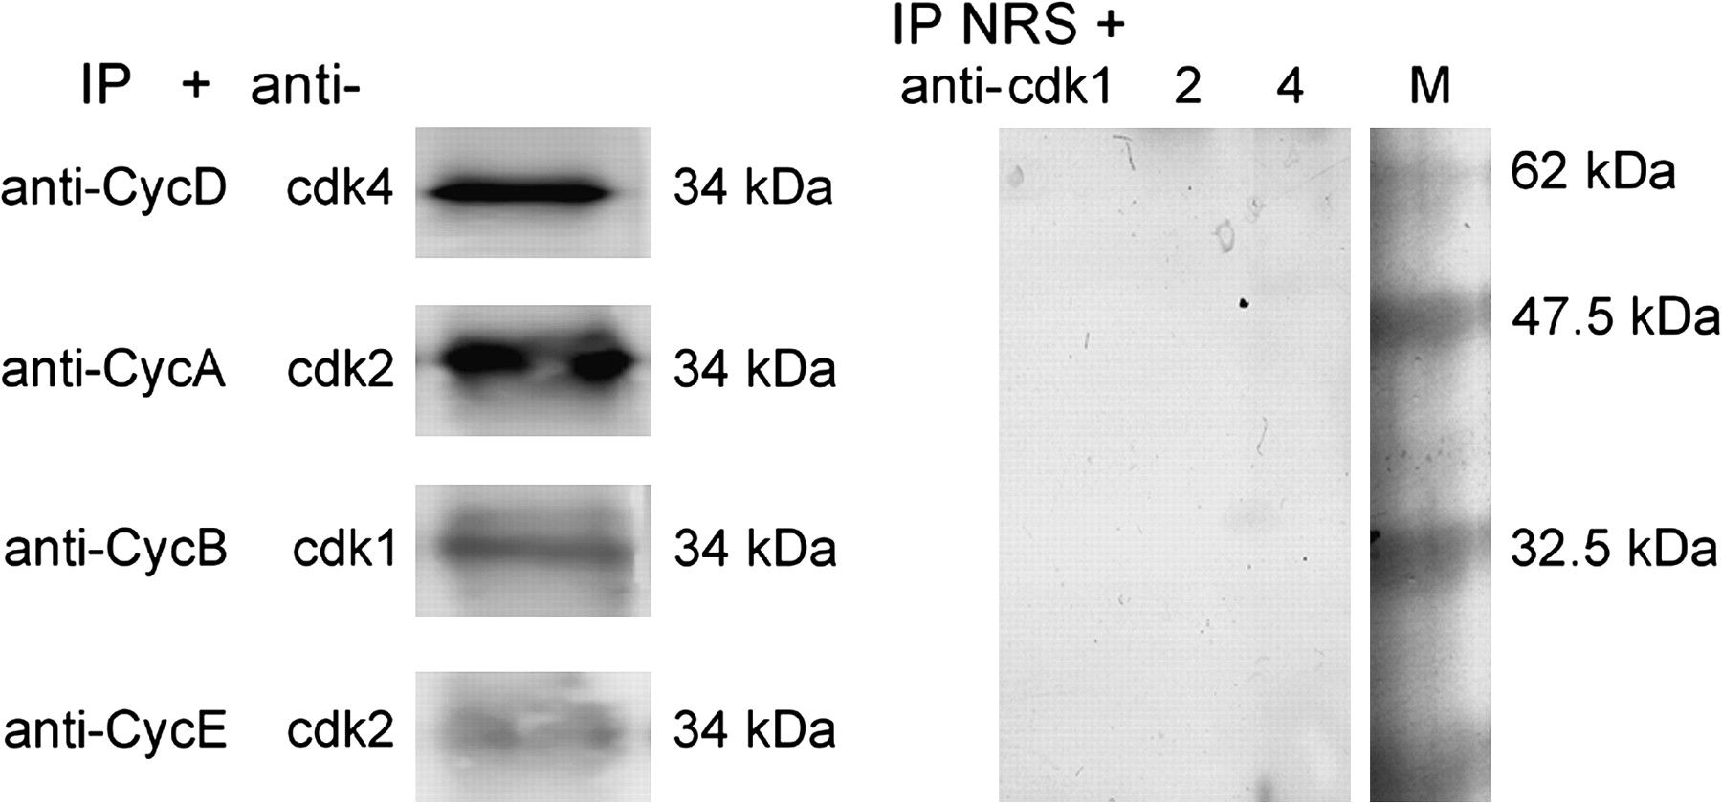
Figure 8. Physical interactions between Cdks and cyclins. Extracted proteins from the neocortex were subjected to ...
Notes:
Figure 8. Physical interactions between Cdks and cyclins. Extracted proteins from the neocortex were subjected to immunoprecipitation with antisera to either Cyclin D3, Cylin A, Cyclin B, or Cyclin E or with NRS (control, on the right). Precipitates were probed for the presence of Cdks1, 2, and 4 by western blot analysis. The mobility of molecular mass markers (M) is indicated (in kDa).
Unless provided in the caption above, the following copyright applies to the content of this slide: © The Author 2006. Published by Oxford University Press. All rights reserved. For permissions, please e-mail: journals.permissions@oxfordjournals.org

Slide 9
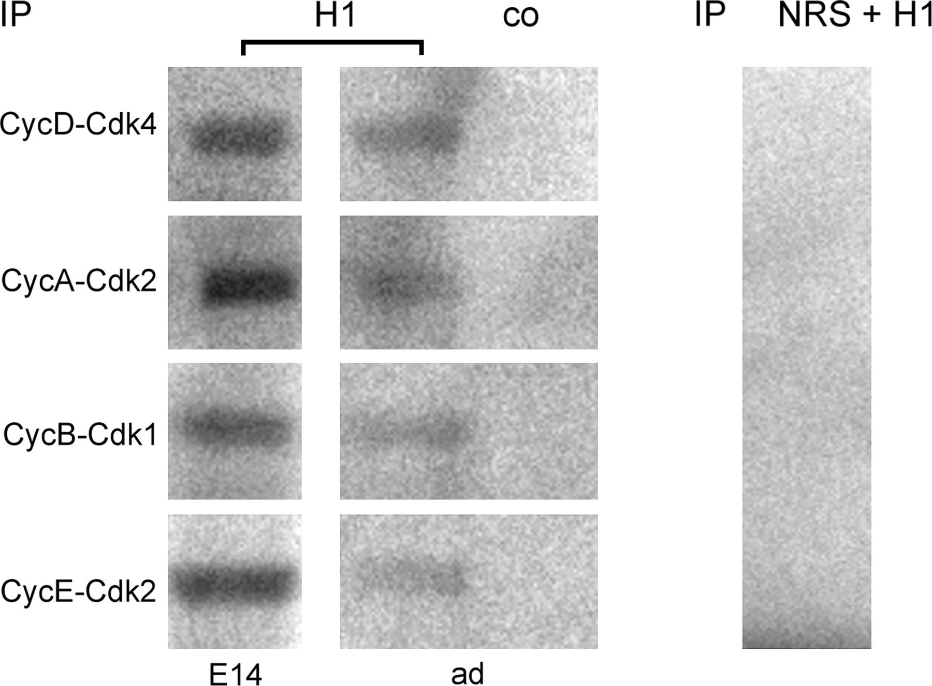
Figure 9. Immunoprecipitation-linked in vitro kinase assays to characterize the functional relevance of cyclin–Cdk ...
Notes:
Figure 9. Immunoprecipitation-linked in vitro kinase assays to characterize the functional relevance of cyclin–Cdk complexes. IPs (please refer to Fig. 8) obtained from embryonic (E14) and adult (ad) lysates were assayed for kinase activity towards histone H1. Data demonstrate the functional association of cyclins with Cdks and suggest a persistent Cdk activity in the adult neocortex. Control incubations were performed in the absence of histone (co) or with IPs obtained with NRS (right).
Unless provided in the caption above, the following copyright applies to the content of this slide: © The Author 2006. Published by Oxford University Press. All rights reserved. For permissions, please e-mail: journals.permissions@oxfordjournals.org

