Slide 1
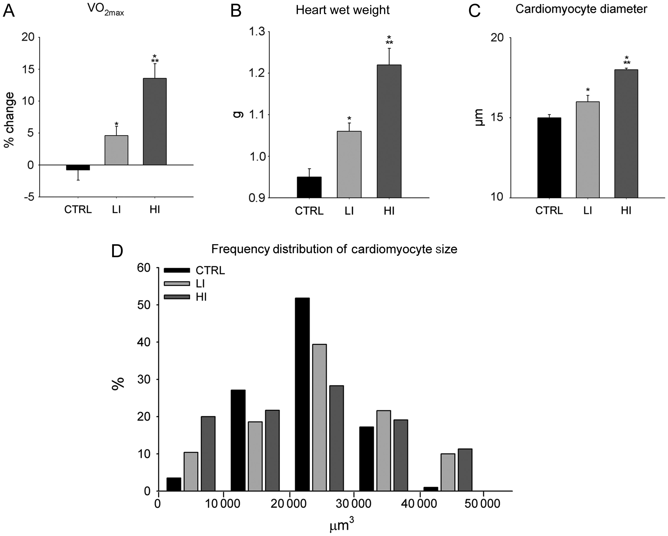
Figure 1 Treadmill exercise training improved VO_{2 max}, myocardial mass and induced cardiomyocyte ...
Notes:
Figure 1 Treadmill exercise training improved VO2 max, myocardial mass and induced cardiomyocyte hypertrophy. (A–C) VO2 max (A), heart weight (B), and left ventricle cardiomyocyte diameter (C) following 4 weeks of low intensity and high intensity exercise training, compared with sedentary CTRL animals (data are mean ± SEM, *P < 0.05 vs. CTRL, **P < 0.05 vs. LI; n = 6/group). (D) The distribution plot of the ventricular cardiomyocyte volume (µm3) in exercise-trained and CTRL rats at 2 weeks (n = 6/group).
Unless provided in the caption above, the following copyright applies to the content of this slide: © The Author 2012. Published by Oxford University Press on behalf of European Society of Cardiology.This is an Open Access article distributed under the terms of the Creative Commons Attribution License (http://creativecommons.org/licenses/by-nc/3.0/), which permits non-commercial reuse, distribution, and reproduction in any medium, provided that the original authorship is properly and fully attributed; the Journal, Learned Society and Oxford University Press are attributed as the original place of publication with correct citation details given; if an article is subsequently reproduced or disseminated not in its entirety but only in part or as a derivative work this must be clearly indicated. For commercial re-use, please contact journals.permissions@oup.com.

Slide 2
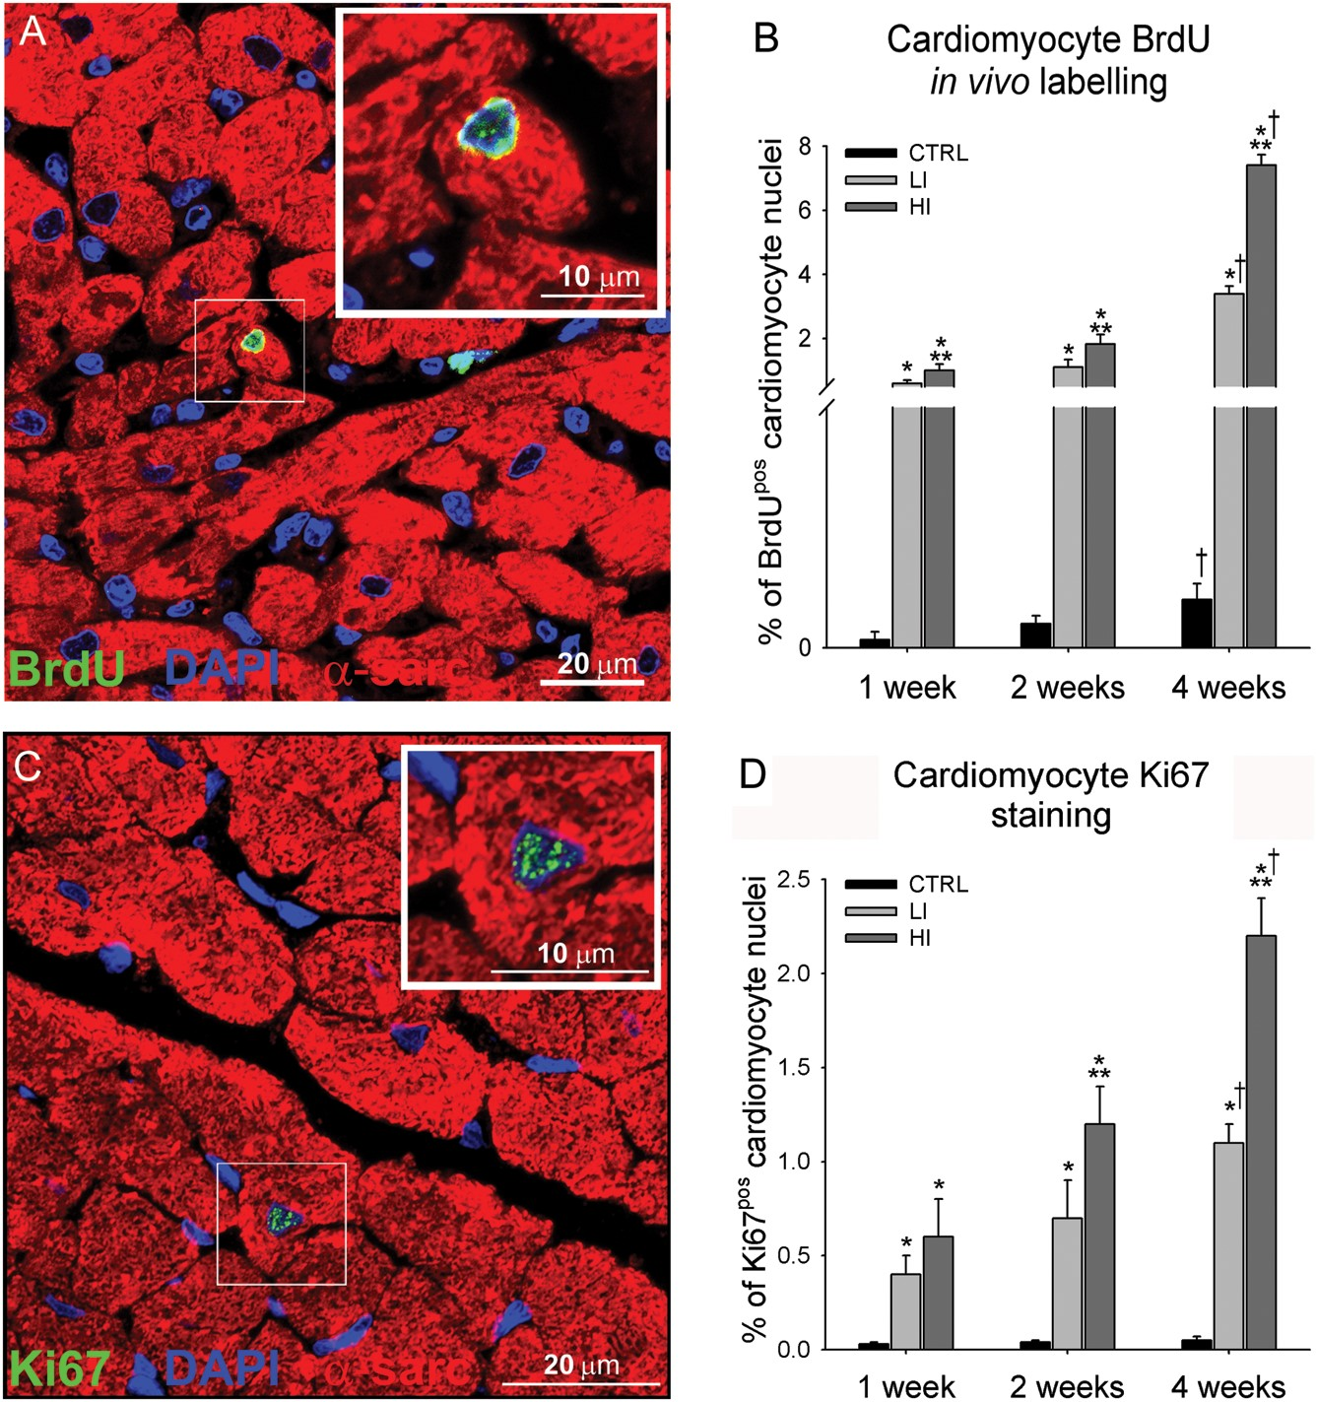
Figure 2 Intensity-controlled treadmill exercise induced cardiac myogenesis (A) Representative image of a small newly ...
Notes:
Figure 2 Intensity-controlled treadmill exercise induced cardiac myogenesis (A) Representative image of a small newly formed BrdUpos (green) cardiomyocyte (α-sarcomeric actin; red) in the LV of a high intensity exercising animal. (Inset is ×2 zoom of boxed area). Nuclei detected by DAPI in blue. (B) The % number of BrdUpos cardiomyocytes formed was dependent on the exercise duration and intensity. (C) Representative image of a small newly formed Ki67pos (green) cardiomyocyte in the left ventricle of a high intensity exercising animal. (D) The % number of Ki67pos cardiomyocytes was dependent on the exercise duration and intensity (data are mean ± SEM, *P < 0.05 vs. CTRL, **P < 0.05 vs. LI, †P < 0.05 vs. 1 and 2 weeks; n = 6 for All).
Unless provided in the caption above, the following copyright applies to the content of this slide: © The Author 2012. Published by Oxford University Press on behalf of European Society of Cardiology.This is an Open Access article distributed under the terms of the Creative Commons Attribution License (http://creativecommons.org/licenses/by-nc/3.0/), which permits non-commercial reuse, distribution, and reproduction in any medium, provided that the original authorship is properly and fully attributed; the Journal, Learned Society and Oxford University Press are attributed as the original place of publication with correct citation details given; if an article is subsequently reproduced or disseminated not in its entirety but only in part or as a derivative work this must be clearly indicated. For commercial re-use, please contact journals.permissions@oup.com.

Slide 3
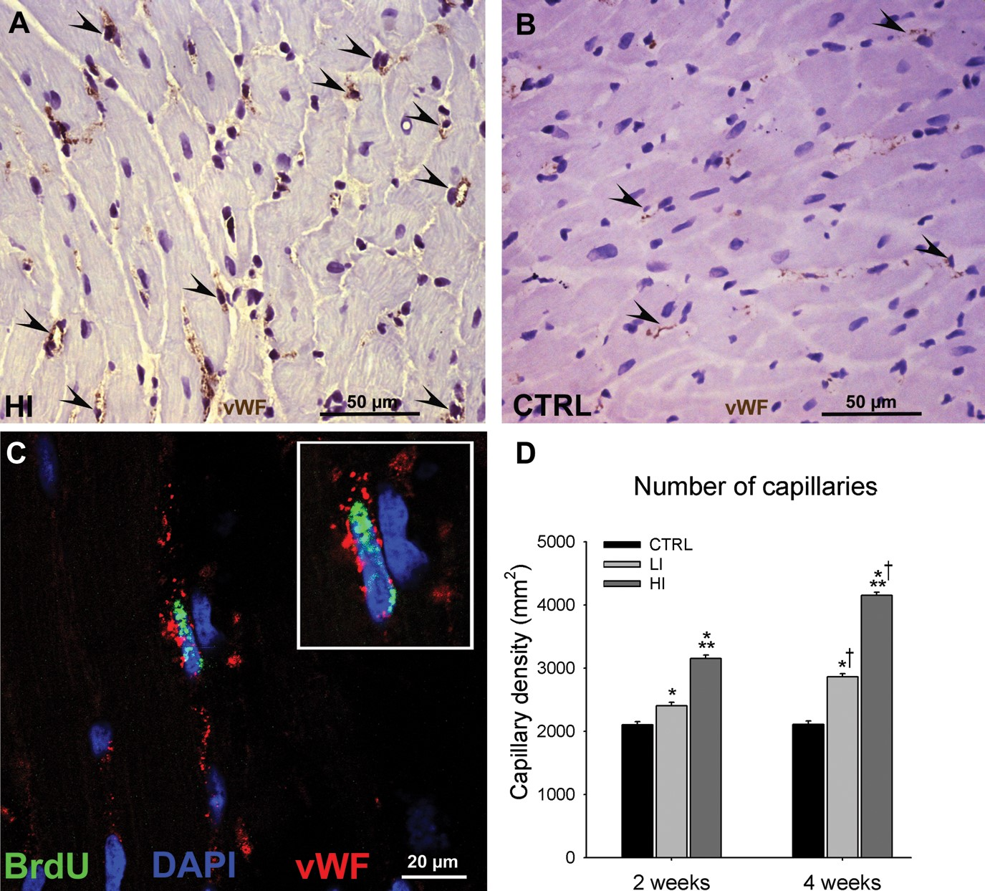
Figure 3 Intensity-controlled treadmill exercise induced angiogenesis. (A and B), Representative images of vWF (brown) ...
Notes:
Figure 3 Intensity-controlled treadmill exercise induced angiogenesis. (A and B), Representative images of vWF (brown) capillaries (arrowheads) identified in the left ventricle of a high intensity exercised (A) and CTRL (B) animal. (C) Representative image of a BrdUpos (green) capillary (vWF; red) from the left ventricle of a high intensity exercised animal (Inset is ×2 zoom). (D) The capillary density in the left ventricle of exercising animals was dependent on the exercise intensity and duration (data are mean ± SEM, *P < 0.05 vs. CTRL, **P < 0.05 vs. LI, †P < 0.05 vs. 2 weeks; n = 6 for all).
Unless provided in the caption above, the following copyright applies to the content of this slide: © The Author 2012. Published by Oxford University Press on behalf of European Society of Cardiology.This is an Open Access article distributed under the terms of the Creative Commons Attribution License (http://creativecommons.org/licenses/by-nc/3.0/), which permits non-commercial reuse, distribution, and reproduction in any medium, provided that the original authorship is properly and fully attributed; the Journal, Learned Society and Oxford University Press are attributed as the original place of publication with correct citation details given; if an article is subsequently reproduced or disseminated not in its entirety but only in part or as a derivative work this must be clearly indicated. For commercial re-use, please contact journals.permissions@oup.com.

Slide 4
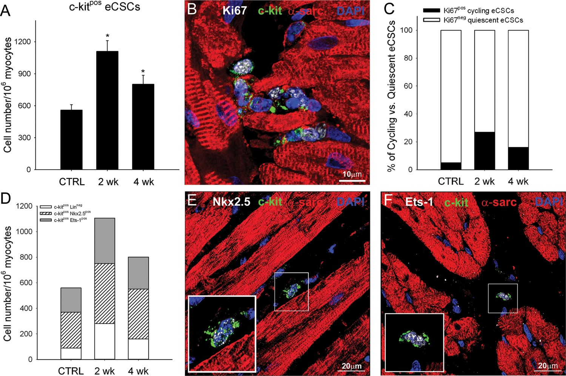
Figure 4 Activation and ensuing differentiation of c-kit^{pos} endogenous cardiac stem-progenitor cells in ...
Notes:
Figure 4 Activation and ensuing differentiation of c-kitpos endogenous cardiac stem-progenitor cells in hearts of exercising animals. (A) c-kitpos endogenous cardiac stem-progenitor cell number in the left ventricle of CTRL and following 2 or 4 weeks of high intensity exercise training. (B) Representative image showing c-kitpos (green), Ki67pos (white) endogenous cardiac stem-progenitor cells from the left ventricle (α-sarcomeric actin; red) of a 2-week HI exercised animal. Nuclei detected by DAPI in blue. (C and D) % number of c-kitposKi67pos (cycling) and c-kitposKi67neg (quiescent) cells (C) and number of uncommitted c-kitposLinneg, c-kitposNkx2.5pos, or c-kitposEts-1pos progenitor cell (D) in the left ventricle of CTRL animals and following 2 or 4 weeks of HI exercise training. (data are mean ± SEM, *P < 0.05 vs. CTRL; n = 6 for all). (E and F) c-kitpos (green) endogenous cardiac stem-progenitor cells express the transcription factors Nkx2.5 (white dots; E) or Ets-1 (white dots; F) indicating their commitment to the cardiomyocyte and endothelial lineage, respectively (inset is ×2 zoom of boxed area).
Unless provided in the caption above, the following copyright applies to the content of this slide: © The Author 2012. Published by Oxford University Press on behalf of European Society of Cardiology.This is an Open Access article distributed under the terms of the Creative Commons Attribution License (http://creativecommons.org/licenses/by-nc/3.0/), which permits non-commercial reuse, distribution, and reproduction in any medium, provided that the original authorship is properly and fully attributed; the Journal, Learned Society and Oxford University Press are attributed as the original place of publication with correct citation details given; if an article is subsequently reproduced or disseminated not in its entirety but only in part or as a derivative work this must be clearly indicated. For commercial re-use, please contact journals.permissions@oup.com.

Slide 5
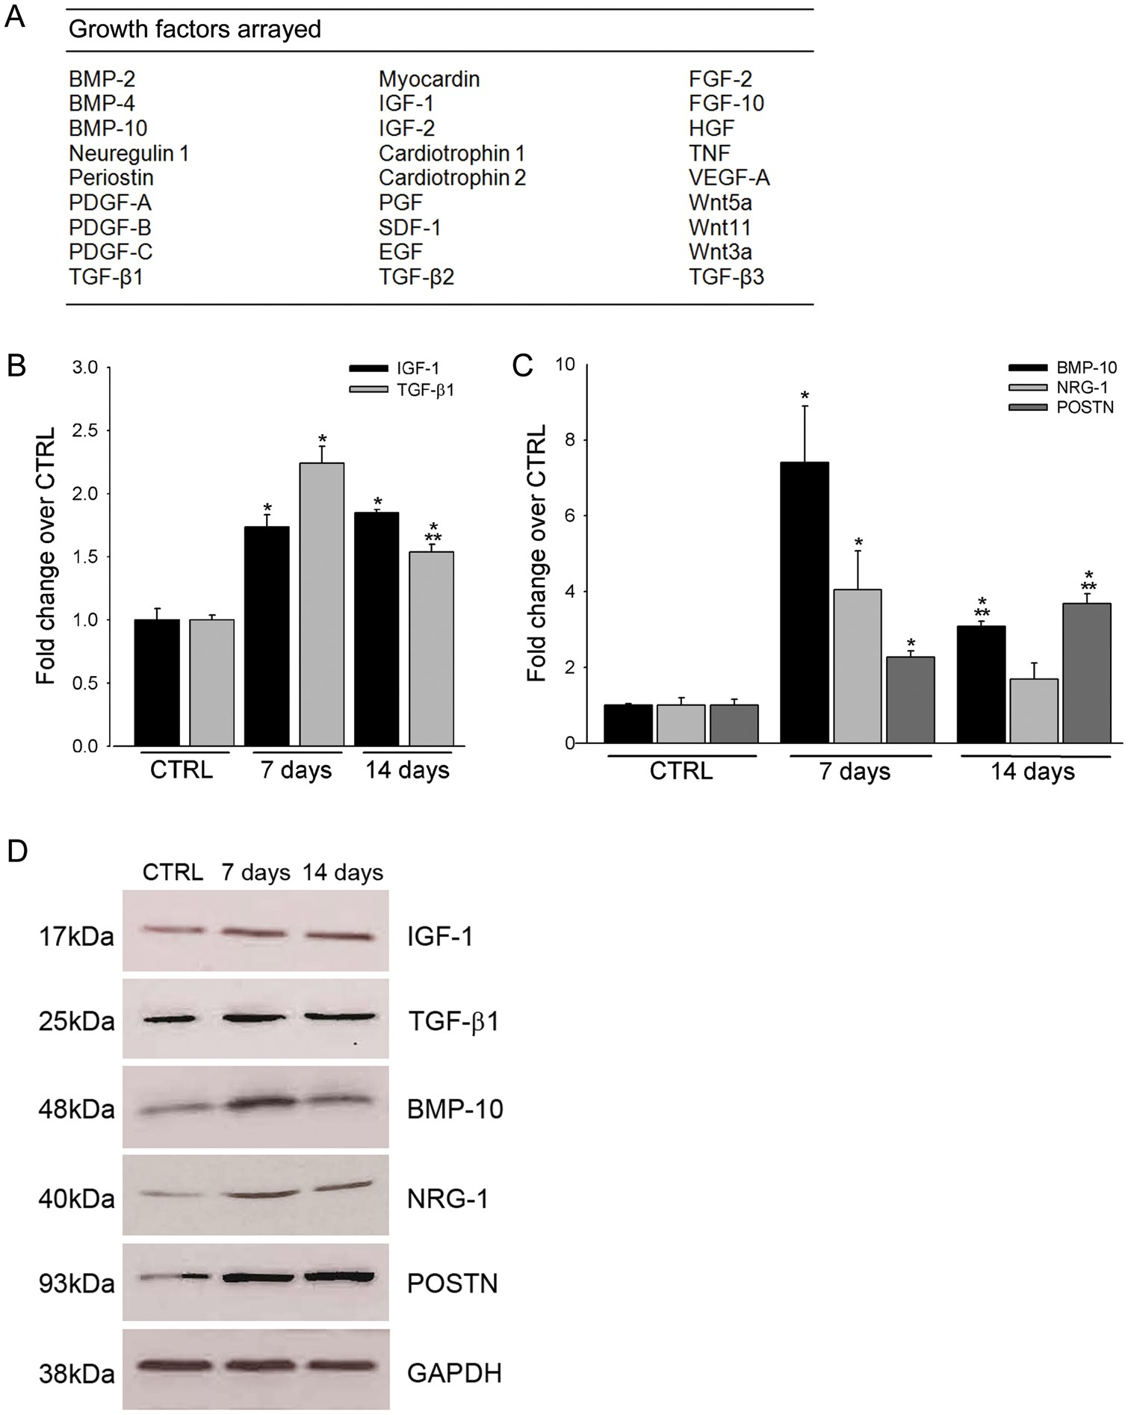
Figure 5 Exercise-induced changes in myocardial growth factor expression. (A) The array of 26 growth factors that were ...
Notes:
Figure 5 Exercise-induced changes in myocardial growth factor expression. (A) The array of 26 growth factors that were analysed for transcript expression in cardiomyocytes following 4 weeks of high intensity exercise training. (B–C) qRT–PCR array analysis revealed up-regulation of insulin-like growth factor-1, transforming growth factor-β1 (B) bone morphogenetic protein-10, NRG-1, and POSTN (C) in cardiomyocytes isolated from high intensity animals after 7 and 14 days, compared with CTRL. (D) Western blot analysis confirmed up-regulation of insulin-like growth factor-1, transforming growth factor-β1, bone morphogenetic protein-10, NRG-1, and POSTN at the protein level (data are mean ± SEM, *P < 0.05 vs. CTRL, **P < 0.05 vs. 7 days; n = 3 for all).
Unless provided in the caption above, the following copyright applies to the content of this slide: © The Author 2012. Published by Oxford University Press on behalf of European Society of Cardiology.This is an Open Access article distributed under the terms of the Creative Commons Attribution License (http://creativecommons.org/licenses/by-nc/3.0/), which permits non-commercial reuse, distribution, and reproduction in any medium, provided that the original authorship is properly and fully attributed; the Journal, Learned Society and Oxford University Press are attributed as the original place of publication with correct citation details given; if an article is subsequently reproduced or disseminated not in its entirety but only in part or as a derivative work this must be clearly indicated. For commercial re-use, please contact journals.permissions@oup.com.

Slide 6
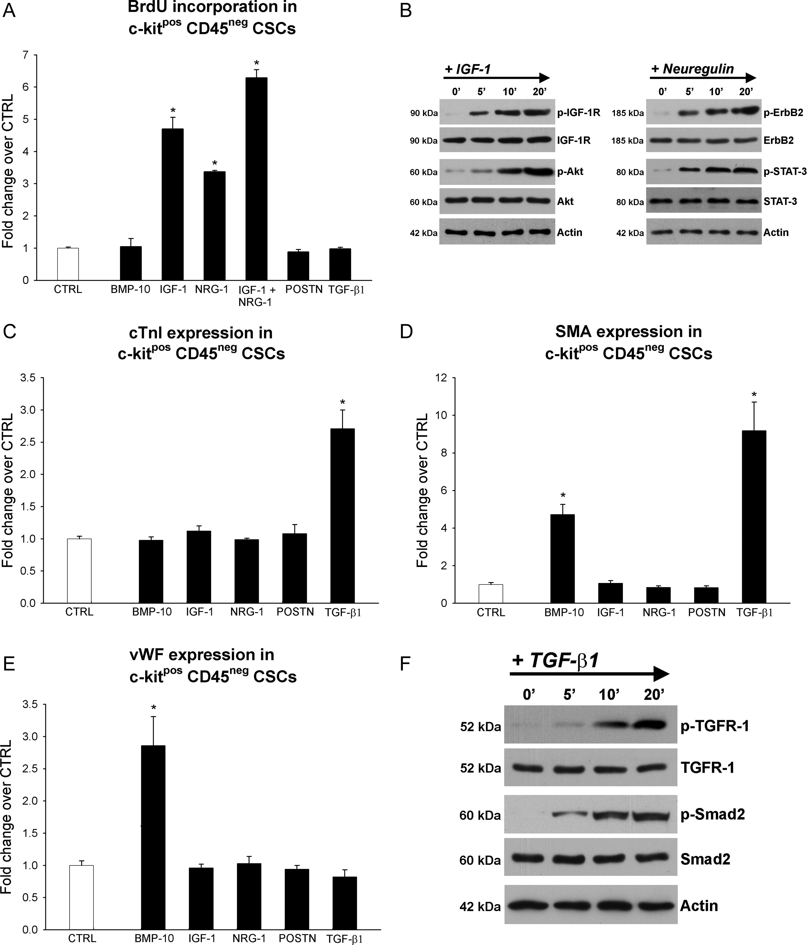
Figure 6 Exercise-induced cardiac growth factors govern c-kit^{pos} endogenous cardiac stem-progenitor cell ...
Notes:
Figure 6 Exercise-induced cardiac growth factors govern c-kitpos endogenous cardiac stem-progenitor cell growth and differentiation in vitro. (A–F) Histogram plots and western blots showing the effect of bone morphogenetic protein-10 (10 ng/mL), insulin-like growth factor-1 (100 ng/mL), NRG-1 (100 ng/mL), POSTN (500 ng/mL), or transforming growth factor-β1 (5 ng/mL) supplementation on endogenous cardiac stem-progenitor cell proliferation, and cardiomyocyte, smooth muscle, and endothelial differentiation. Differences are expressed as the fold change over un-supplemented CTRL cells (data are mean ± SEM, *P < 0.05 vs. CTRL; n = 3 for all).
Unless provided in the caption above, the following copyright applies to the content of this slide: © The Author 2012. Published by Oxford University Press on behalf of European Society of Cardiology.This is an Open Access article distributed under the terms of the Creative Commons Attribution License (http://creativecommons.org/licenses/by-nc/3.0/), which permits non-commercial reuse, distribution, and reproduction in any medium, provided that the original authorship is properly and fully attributed; the Journal, Learned Society and Oxford University Press are attributed as the original place of publication with correct citation details given; if an article is subsequently reproduced or disseminated not in its entirety but only in part or as a derivative work this must be clearly indicated. For commercial re-use, please contact journals.permissions@oup.com.

