Slide 1
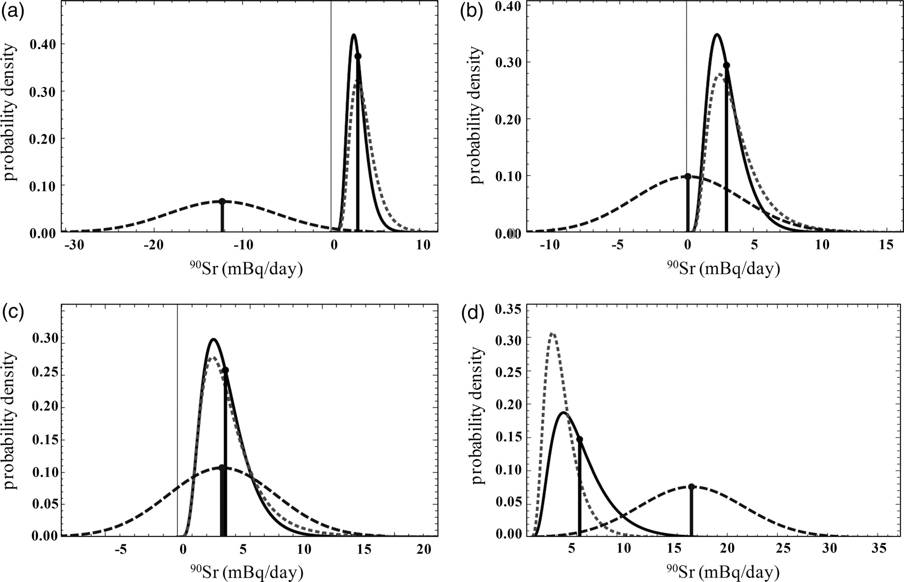
Figure 1. Graphs of likelihood PDFs (dashes), ‘everybody else’ prior PDFs (dots) and posterior PDFs (solid lines) for ...
Notes:
Figure 1. Graphs of likelihood PDFs (dashes), ‘everybody else’ prior PDFs (dots) and posterior PDFs (solid lines) for four selected individuals with 90Sr measurements. Dots on top of vertical lines indicate arithmetic means of PDFs. (a) A person with a large negative likelihood; (b) a person whose likelihood is centred very near zero; (c) a person whose likelihood is approximately the population mean and (d) a person with a large positive likelihood.
Unless provided in the caption above, the following copyright applies to the content of this slide: © The Author 2011. Published by Oxford University Press. All rights reserved. For Permissions, please email: journals.permissions@oup.com

Slide 2
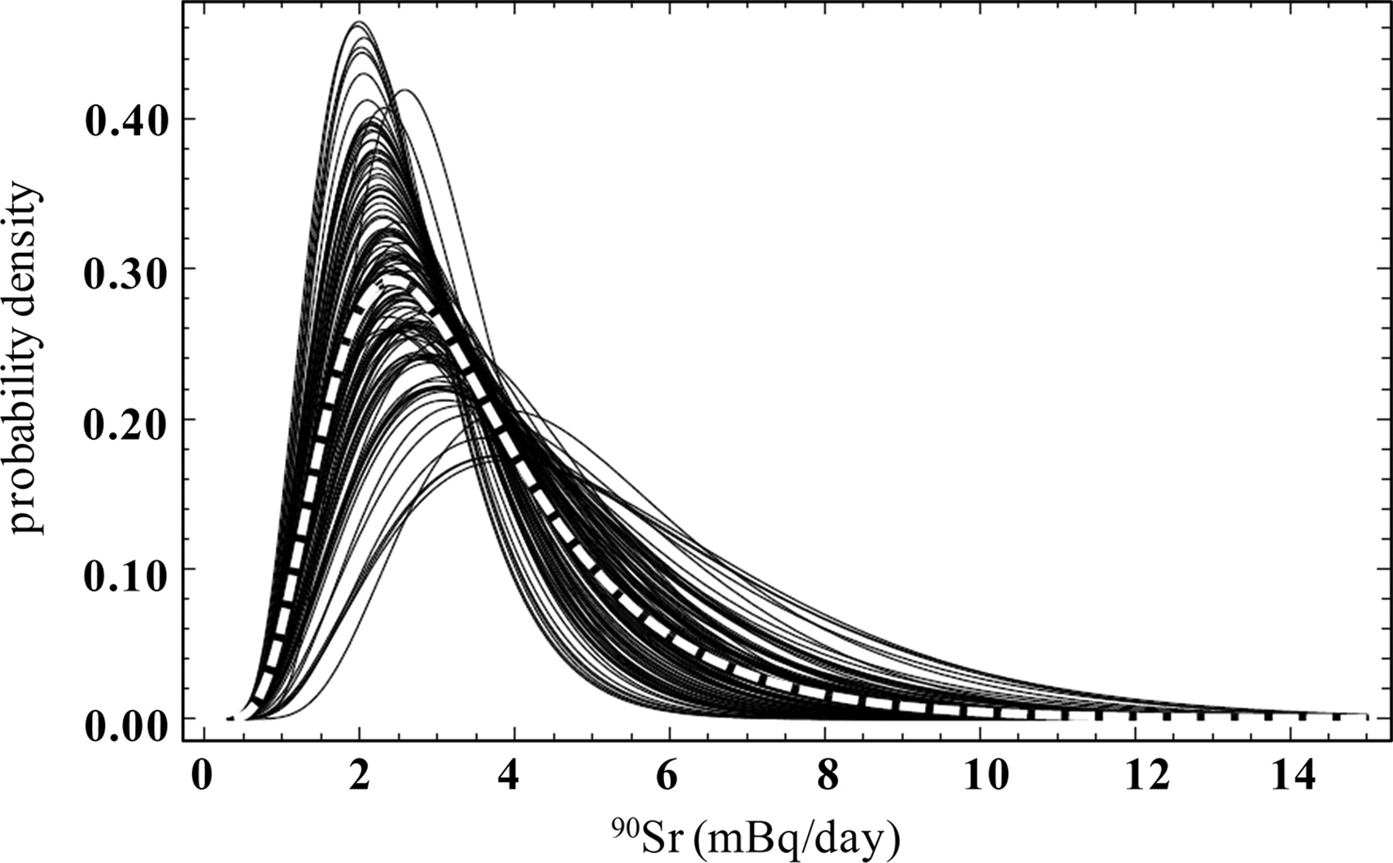
Figure 2. All 128 posterior PDFs for the ⁹⁰Sr urinalysis data (solid lines), with the normalised sum of all ...
Notes:
Figure 2. All 128 posterior PDFs for the 90Sr urinalysis data (solid lines), with the normalised sum of all 128 PDFs (white dashes).
Unless provided in the caption above, the following copyright applies to the content of this slide: © The Author 2011. Published by Oxford University Press. All rights reserved. For Permissions, please email: journals.permissions@oup.com

Slide 3
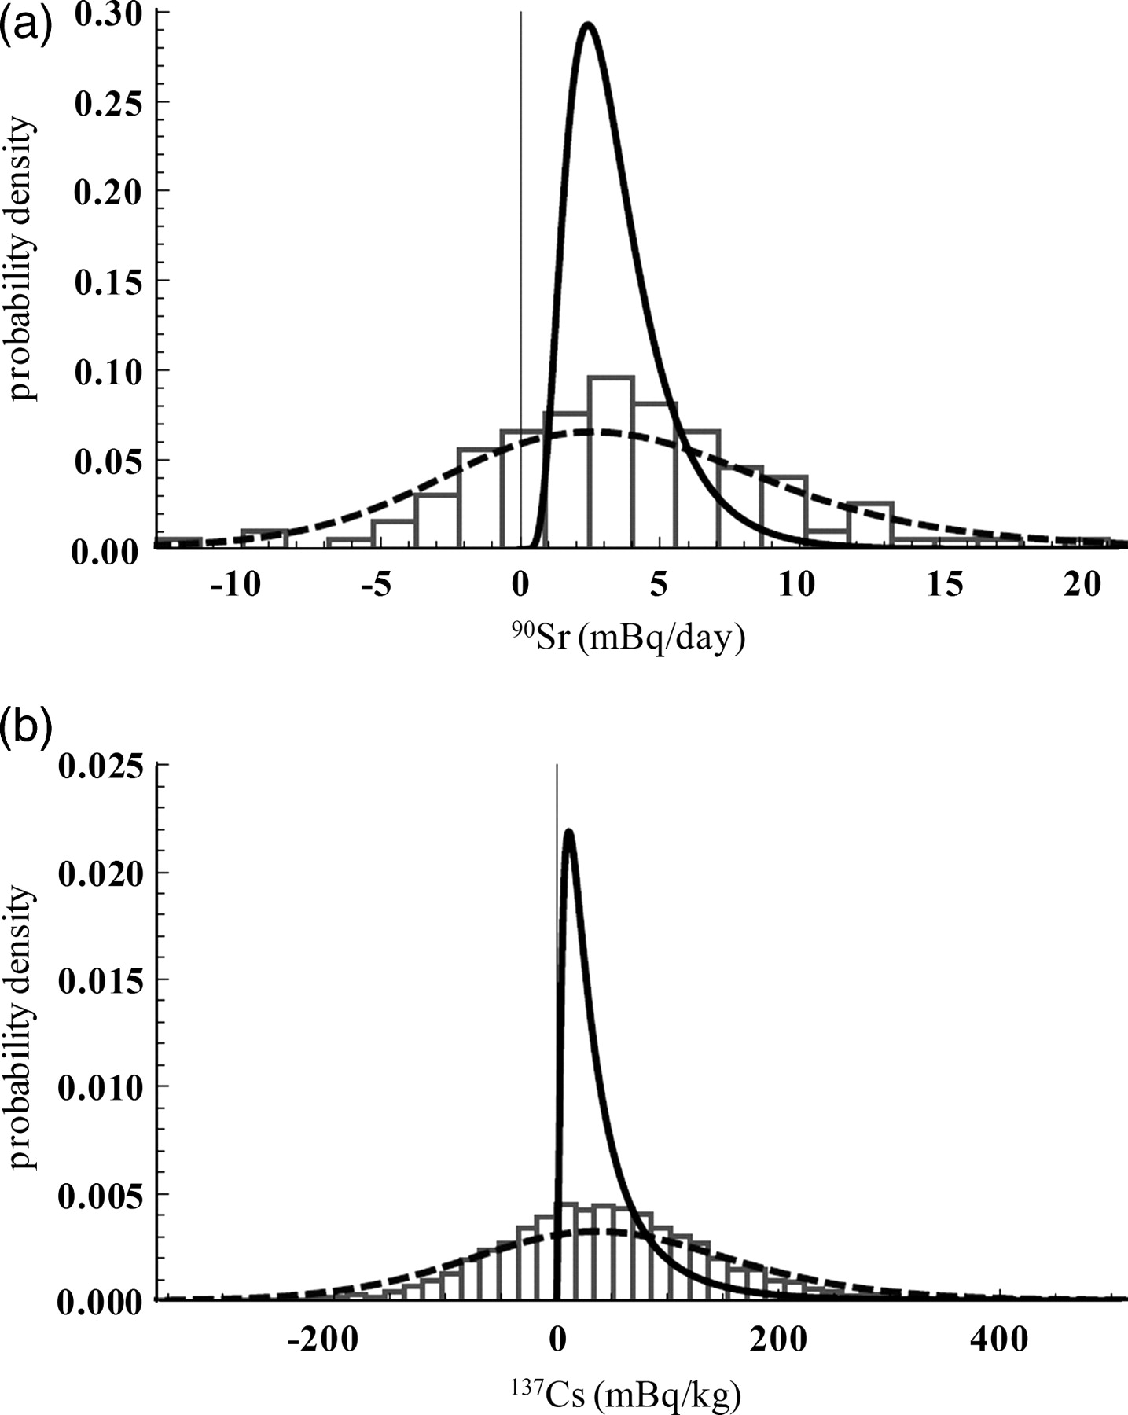
Figure 3. Normalised histograms of measurements (bars), and normalised sums of likelihood (dashed lines) and posterior ...
Notes:
Figure 3. Normalised histograms of measurements (bars), and normalised sums of likelihood (dashed lines) and posterior (solid lines) PDFs for (a) 90Sr and (b) 137Cs.
Unless provided in the caption above, the following copyright applies to the content of this slide: © The Author 2011. Published by Oxford University Press. All rights reserved. For Permissions, please email: journals.permissions@oup.com

Slide 4
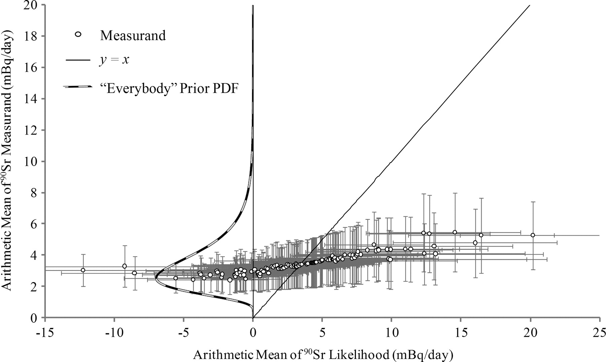
Figure 4. Means of posterior PDFs of measurands plotted as a function of measurement value (mean of likelihood) for the ...
Notes:
Figure 4. Means of posterior PDFs of measurands plotted as a function of measurement value (mean of likelihood) for the 128 90Sr measurements. Uncertainty bars are 1 standard deviation. If measurand means equalled measurement results, they would fall on the solid line. The ‘everybody’ prior PDF is plotted up the vertical axis (black and white dashes; not to scale) to show how these highly uncertain data cluster around the prior.
Unless provided in the caption above, the following copyright applies to the content of this slide: © The Author 2011. Published by Oxford University Press. All rights reserved. For Permissions, please email: journals.permissions@oup.com

Slide 5
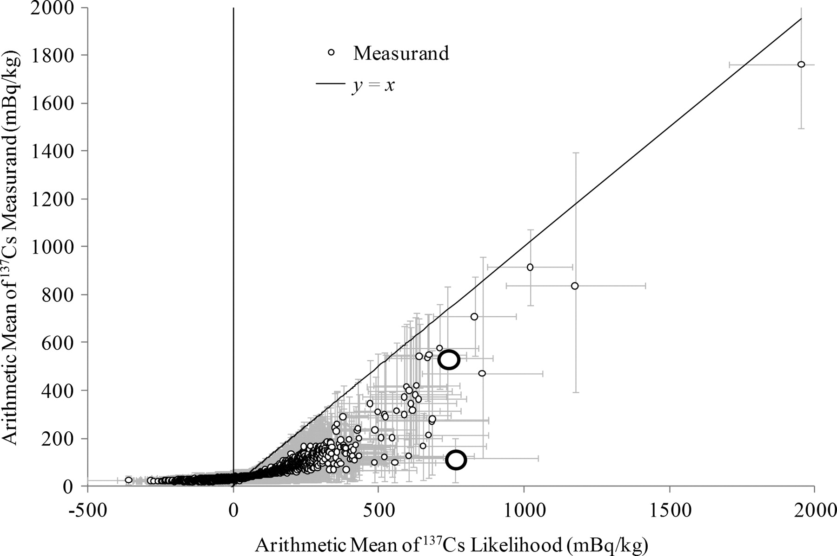
Figure 5. Means of posterior PDFs of measurands plotted as a function of measurement value (mean of likelihood) for the ...
Notes:
Figure 5. Means of posterior PDFs of measurands plotted as a function of measurement value (mean of likelihood) for the 5337 137Cs measurements. Uncertainty bars are 1 standard deviation. If measurand means equalled measurement results, they would fall on the solid line. Analysis of the two data points represented by large circles is provided below.
Unless provided in the caption above, the following copyright applies to the content of this slide: © The Author 2011. Published by Oxford University Press. All rights reserved. For Permissions, please email: journals.permissions@oup.com

Slide 6
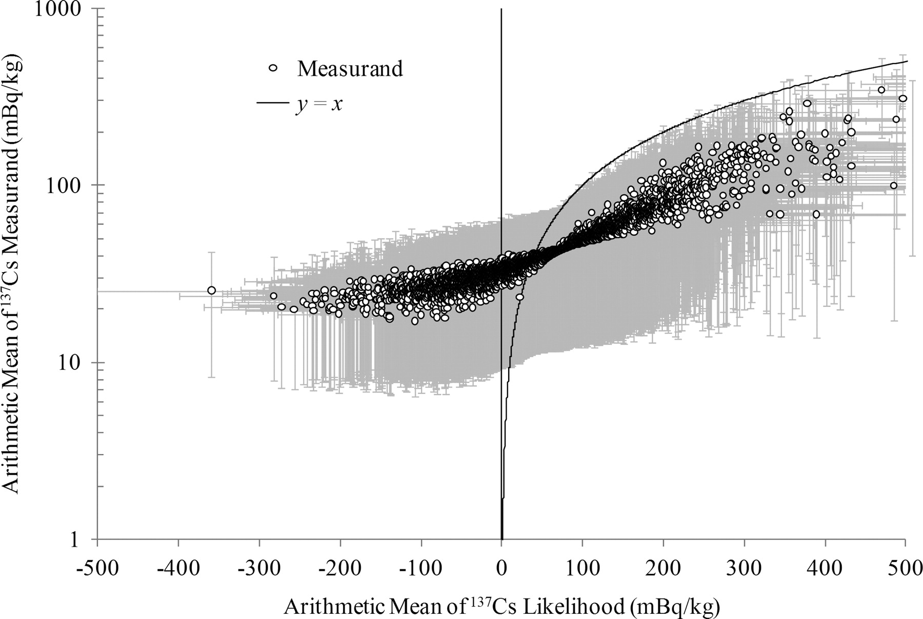
Figure 6. Means of posterior PDFs of measurands plotted on a logarithmic scale as a function of measurement value (mean ...
Notes:
Figure 6. Means of posterior PDFs of measurands plotted on a logarithmic scale as a function of measurement value (mean of likelihood) for the 137Cs measurements less than 500 mBq kg−1. Uncertainty bars are 1 standard deviation. If measurand means equalled measurement results, they would fall on the solid line.
Unless provided in the caption above, the following copyright applies to the content of this slide: © The Author 2011. Published by Oxford University Press. All rights reserved. For Permissions, please email: journals.permissions@oup.com

Slide 7
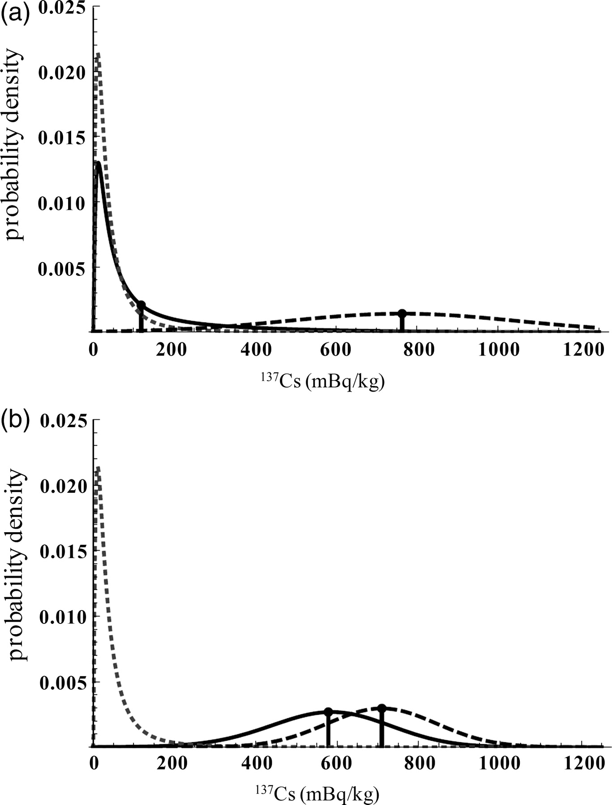
Figure 7. Comparison of posterior PDFs (solid lines) for two individuals with very similar measurement results (dot on ...
Notes:
Figure 7. Comparison of posterior PDFs (solid lines) for two individuals with very similar measurement results (dot on top of vertical line on dashed curves) but quite different uncertainties, so that the likelihood PDFs (dashed lines) differ. Individual (a) is the lower large circle in Figure 5, while individual (b) is the upper large circle. The prior PDFs (dotted lines) are almost identical. Individual (a) has a CV of 0.37, while individual (b) has a CV of 0.19. The result is that individual (a)’s posterior PDF resembles the prior, while individual (b)’s posterior PDF more closely resembles his likelihood.
Unless provided in the caption above, the following copyright applies to the content of this slide: © The Author 2011. Published by Oxford University Press. All rights reserved. For Permissions, please email: journals.permissions@oup.com

Slide 8
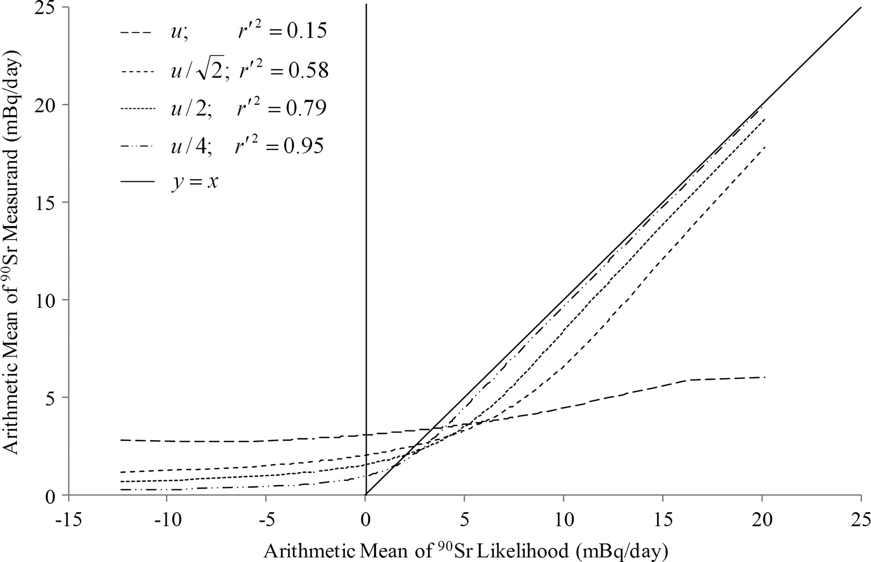
Figure 8. Analysis of ⁹⁰Sr measurement data with individual uncertainties replaced by the square root of the ...
Notes:
Figure 8. Analysis of 90Sr measurement data with individual uncertainties replaced by the square root of the mean square measurement uncertainty. The four curves are the unaltered average uncertainty (dashes), average uncertainties divided by (short dashes), average uncertainties divided by two (dots) and average uncertainties divided by four (dash-dot-dot).
Unless provided in the caption above, the following copyright applies to the content of this slide: © The Author 2011. Published by Oxford University Press. All rights reserved. For Permissions, please email: journals.permissions@oup.com

Slide 9
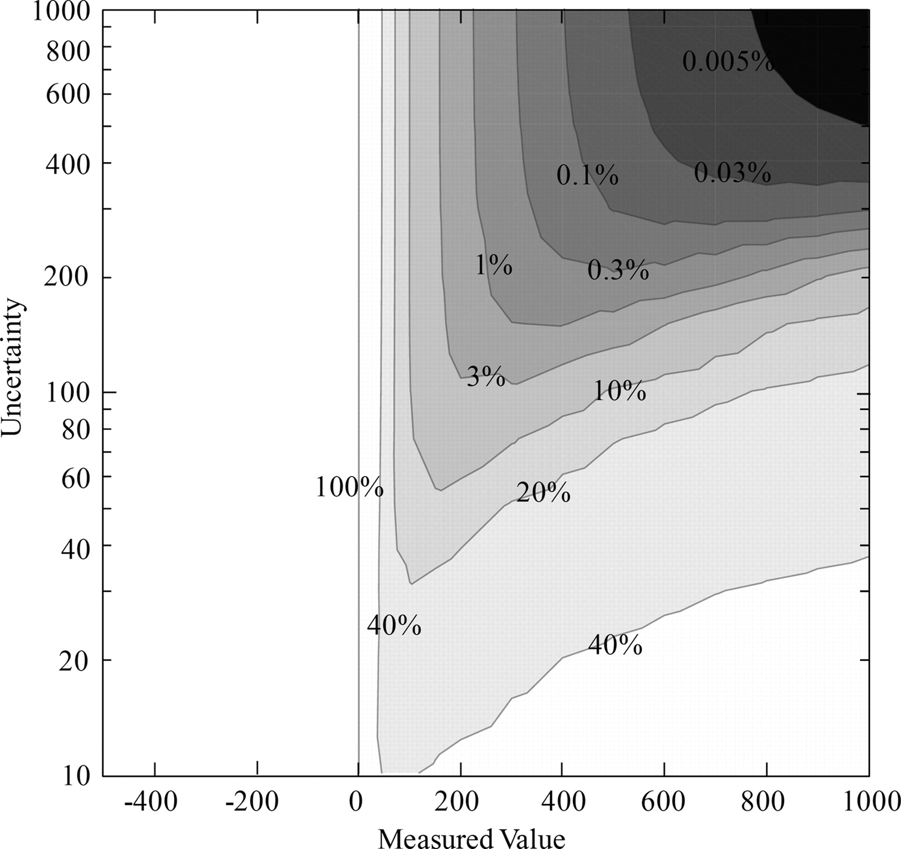
Figure 9. Results of a thought experiment showing the probability that the mean of the measurand is greater than or ...
Notes:
Figure 9. Results of a thought experiment showing the probability that the mean of the measurand is greater than or equal to the measurement as a function of measurement and uncertainty for a prior with an arithmetic mean of 50 and a standard deviation of 100.
Unless provided in the caption above, the following copyright applies to the content of this slide: © The Author 2011. Published by Oxford University Press. All rights reserved. For Permissions, please email: journals.permissions@oup.com

Slide 10
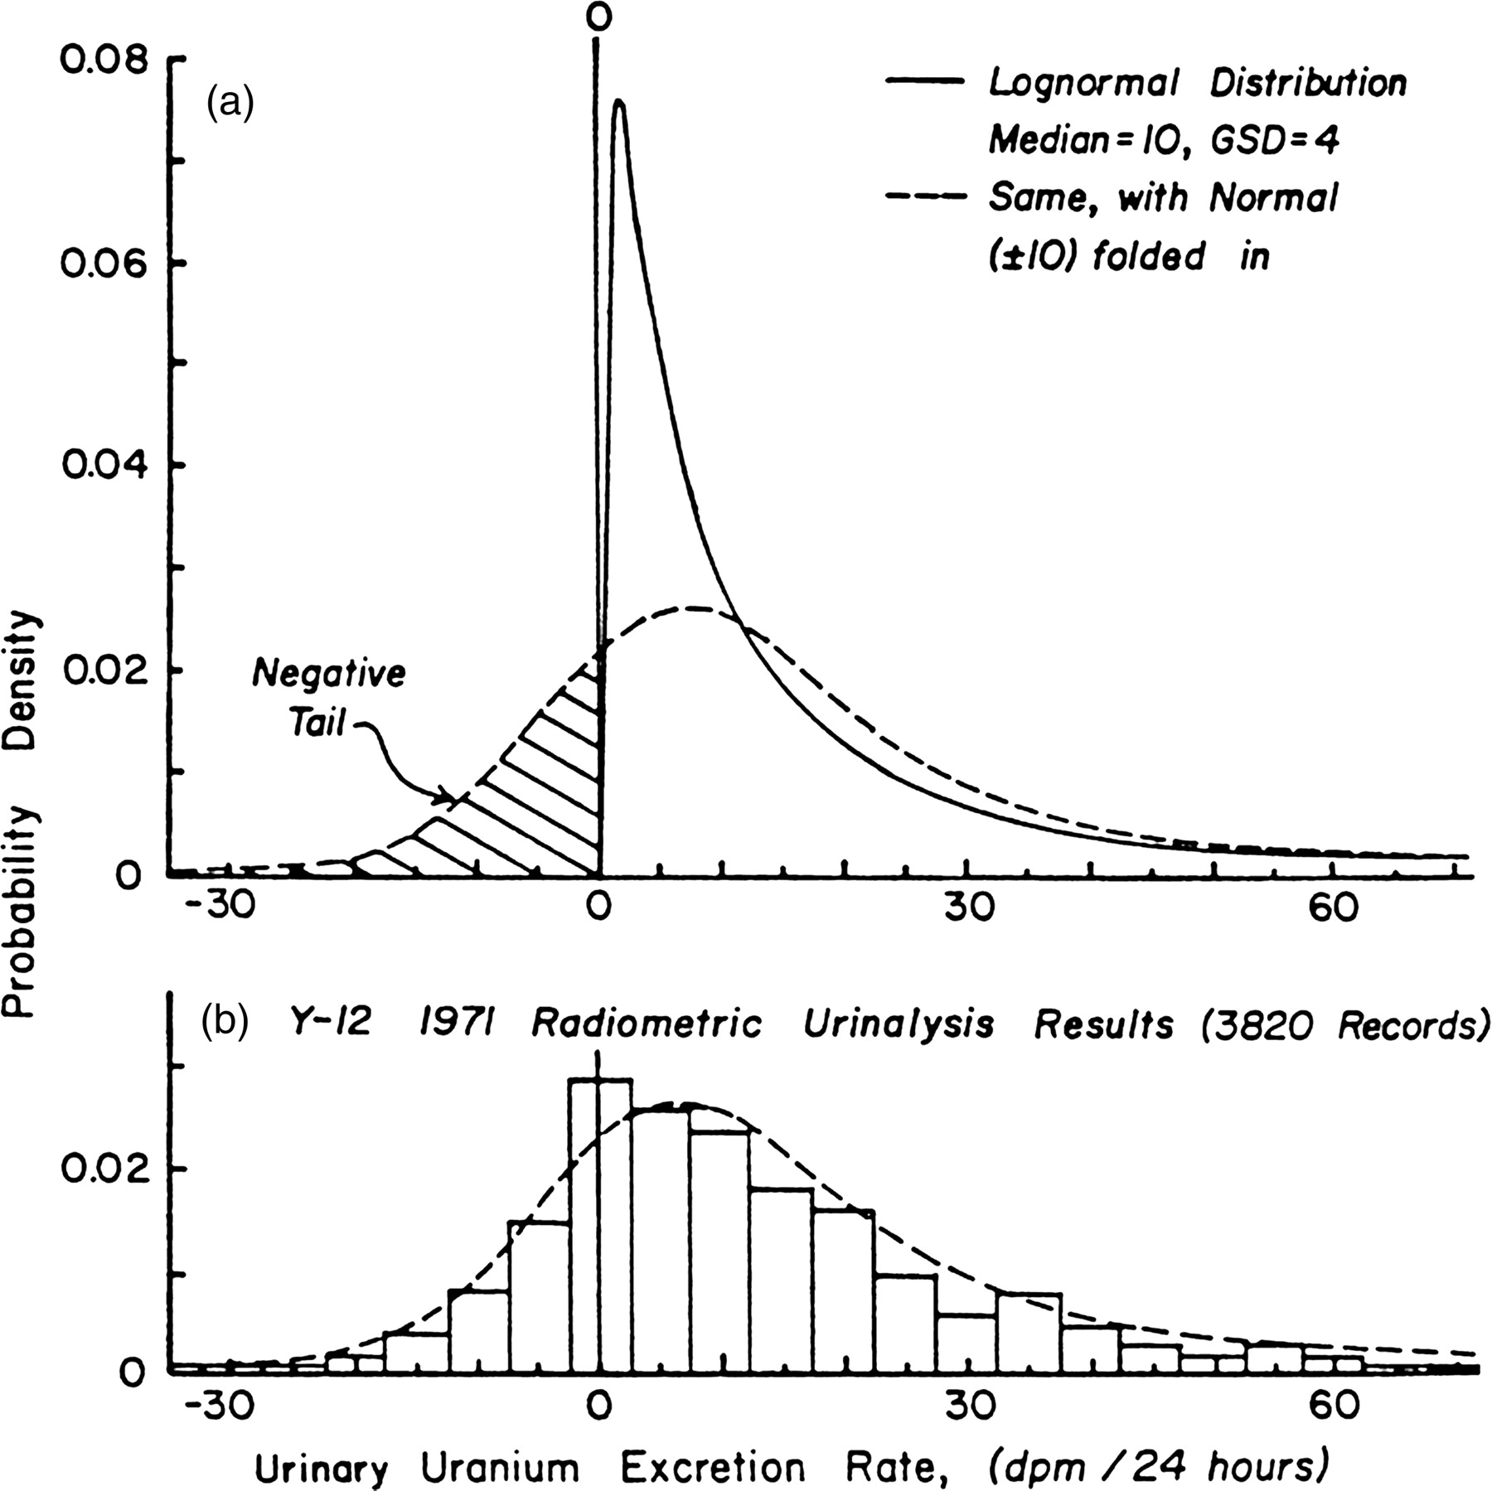
Figure 10. (a) Lognormal PDF ‘of true values’ with and without convolution with a normal distribution. (b) Comparison ...
Notes:
Figure 10. (a) Lognormal PDF ‘of true values’ with and without convolution with a normal distribution. (b) Comparison with radiometric uranium urinalysis results from the Y-12 plant for the year 1971(4).
Unless provided in the caption above, the following copyright applies to the content of this slide: © The Author 2011. Published by Oxford University Press. All rights reserved. For Permissions, please email: journals.permissions@oup.com

